Slide 1
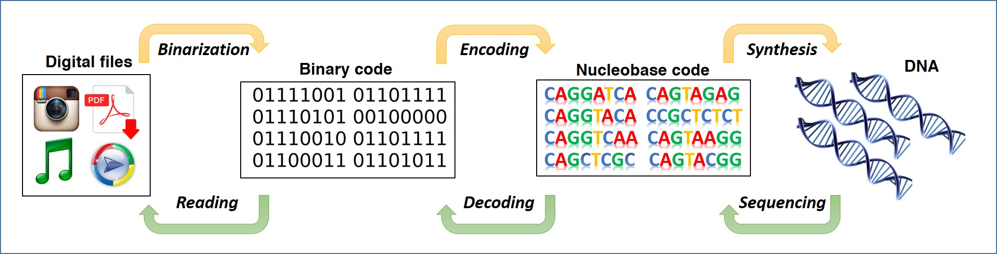

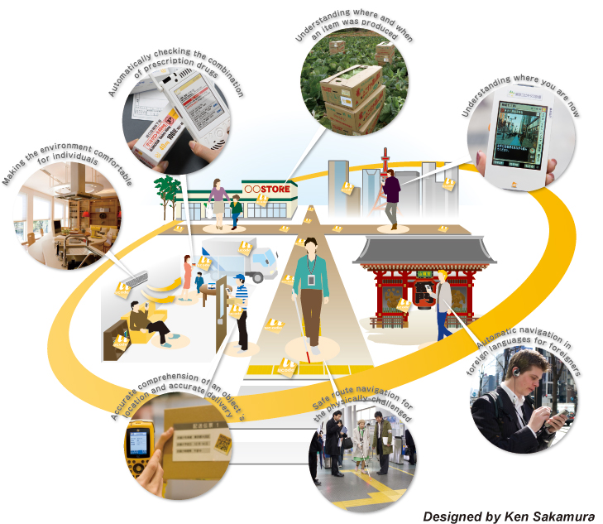





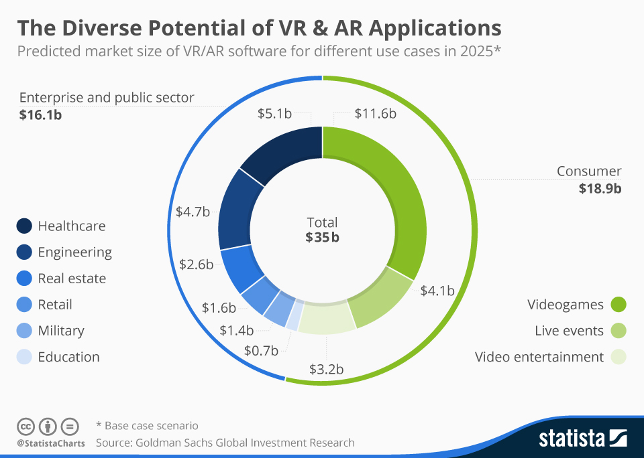
Every[Ware]
Alexander Aksentyev
National Research Nuclear University “MEPhI”
<10⁻¹⁰ W/GB
Power Use
100+ years
Data Retention
1 kg
=
WWW
~10¹⁹ bits/cm³
Data Density
<100 µs/bit
Read/Write Speed
45%
Entertain-
ment
60%
Gaming
23%
Education
17%
Healthcare
13%
Travel
10%
Aerospace/
Defense
9%
Property/
Construction
Machine learning is a must
to make sense of all this data
4 billion
Connected People
50 trillion
GBs of Data
25+ billion
Embedded Systems

