Slide 1
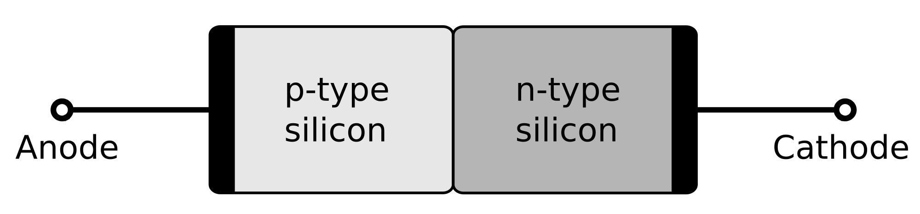
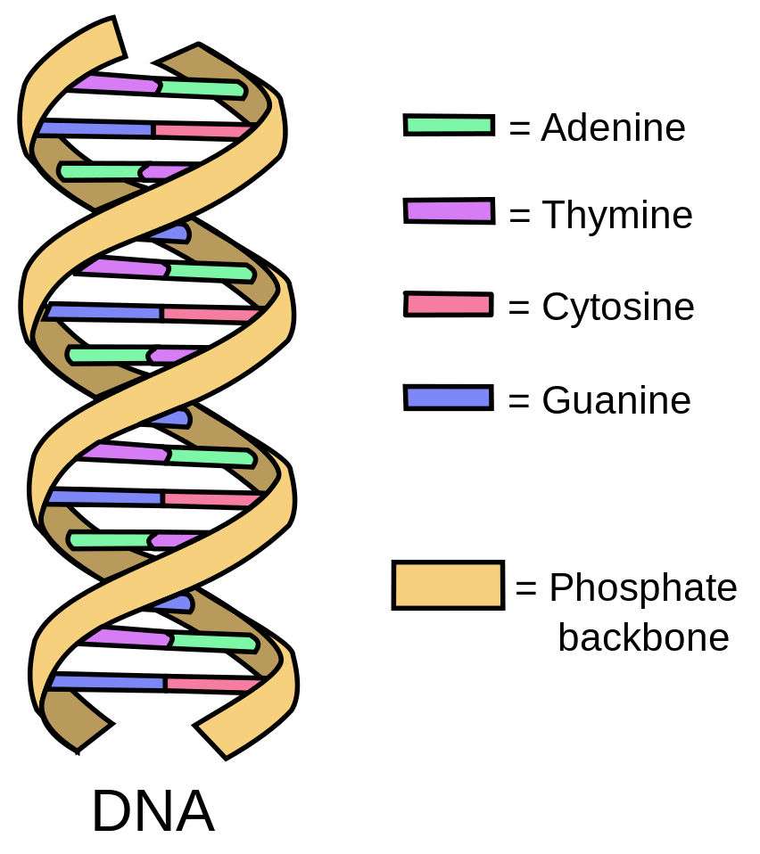
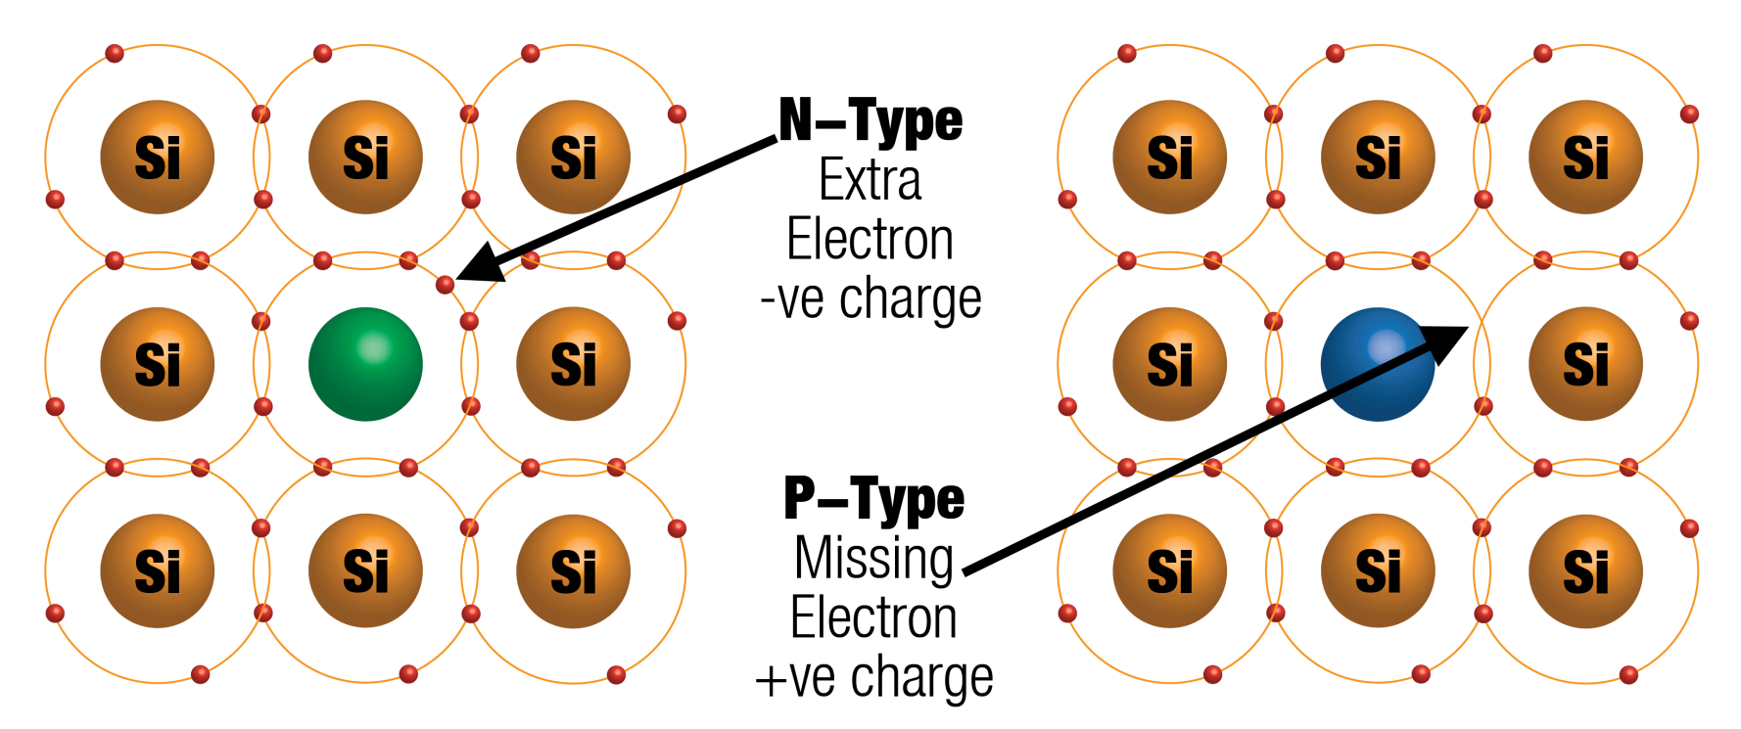
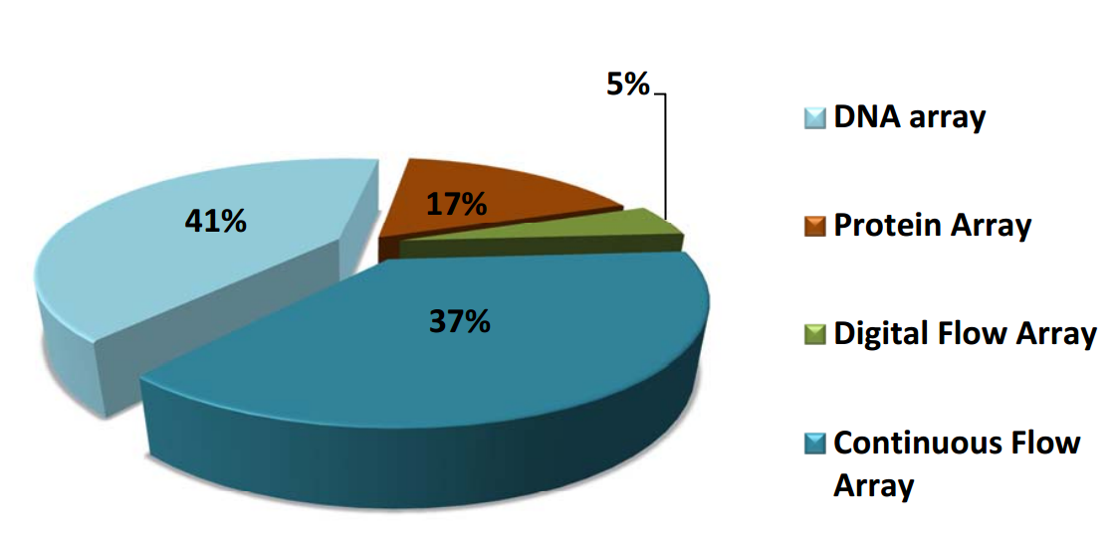
Molecular computing
Alexander Aksentyev
National Research Nuclear University “MEPhI”
Ever since the advent of the integrated circuit in the 1960s, computing has been synonymous with chips of solid silicon. But some researchers have been taking an alternative approach: building liquid computers using DNA and its cousin RNA, the naturally occurring nucleic-acid molecules that encode genetic information inside cells. Rather than encoding ones and zeroes into high and low voltages that switch transistors on and off, the idea is to use high and low concentrations of these molecules to propagate signals through a kind of computational soup.
Silicon-based computers…
… use the semiconductor property of Silicon to encode information in binary (0,1) code.
DNA-based computers…
… encode information in quaternary (A,T,C,G) code. Use biochemical reactions for computation.
1 billion times more operations per Joule power than a silicon-based computer.
5 grams of DNA can fit the Internet 1000 times over
Each DNA strand is a microprocessor
AND, OR, NOT operations are performed by cutting, linking, pasting, amplifying, or repairing DNA
A silicon computer chip…
… is made from a silicon crystal by introducing impurities (doping).
N-type doping: the silicon crystal is imbued with Phosphorous or Arsenic to add extra electrons.
P-type doping: Boron or Gallium is the dopant. Each have only three electrons, hence when mixed into the silicon lattice they produce holes.
A biochip …
… is a miniaturized laboratory that can perform 100,000 simultaneous biochemical reactions. Biochips are fabricates in two ways:
In Microarrays, a 2D array of DNA or proteins is arranged on a solid substrate.
In Microfluidics, the behavior of biological fluids is precisely controlled by micro pumps and micro valves.
Pros and Cons
Millions of operations simultaneously
Generate a complete set of potential solutions
Could be made small enough to operate inside cells and control their activity
Efficiently handle massive amounts of working memory
Biochemical reactions take anywhere from minutes to days to complete
Generation of solution sets may require impractical amounts of memory

