Slide 1
Walking on a Cloud
Alexander Al Basosi
IBM Cloud Developer Advocate
alexander.al.basosi@ae.ibm.com

Slide 2
Introduction to cloud-based programming with IBM Cloud.

Slide 3
There was an estimate of 3.5 billion internet users worldwide in 2016. This means about 45 percent of the global population accessed the internet that year.

Slide 4
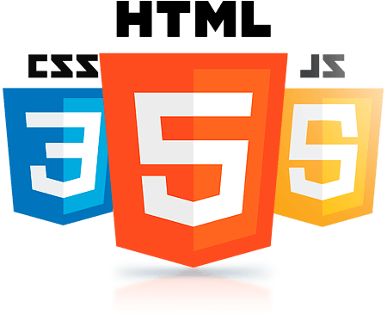

Slide 5
HTML
Markup language to give content structure and meaning.

Slide 6
CSS
Presentation language to give content style and appearance.

Slide 7
JS
Programming language to give functionality within web browsers.

Slide 8

Introducing IBM Cloud
A platform for the world’s ideas
Bringing together infrastructure and platform services, IBM Cloud is the home of 170+ unique services, including offerings like IBM Watson and Weather.com, and millions of running applications, containers, servers, and more.
Used by over a million developers making over a billion API calls a day and starting over a 100,000 apps a month. Welcoming over 2,000 new users everyday to the largest Cloud Foundry deployment.

Slide 9
Sign up for IBM Cloud ibm.biz/WalkingOnACloud

Slide 10
Clone this Repository: https://github.com/AlexAlBasosi/WalkingOnACloud

Slide 11


Thank you
ibm.biz/AlexAlBasosi
twitter.com/AlexAlBasosi
github.com/AlexAlBasosi
developer.ibm.com/code

