Slide 1


A Journey of a Female Coder

Slide 2
Tonight
6:00-6:30
Check in + Networking
6:30-6:45
Intros from WWCode Portland, Code Fellows, and Cloudability
6;45-8:00
Panel: “A Journey of a Female Coder”
8:00-9:00
Networking

Slide 3
Panelists
Jordana Gustafson - Campus Director, Code Fellows Portland
Danielle Heberling - Currently taking Code 401, been taking classes since 201
Yvonne Haynes - Code Fellows graduate
Whitney Harvey - Code Fellows graduate
Panel Moderator:
Sabina Andersson - Product Manager, Elemental,
Lead, Women Who Code Portland

Slide 4
Code Fellows is an in-person code school offering job-ready web and mobile development training in Seattle, WA and Portland, OR.
For aspiring developers, Code Fellows offers Code 101 workshops and Code 201 courses that train students in the fundamentals of software development. Code 301 focuses on creating and launching an interactive web app in HTML, CSS, and JavaScript, plus the technologies, tools, and frameworks used by developers around the world.
Developers who are ready to launch a new career or learn a new programming language can level up their skills in Code 401, where they receive world-class training from industry professionals in an immersive environment. Students also receive job-search training through practice interviews, resume help, networking, mentorship, and more.

Slide 5
Women Who Code is a global non-profit
dedicated to inspiring women
to excel in technology careers.
Join us on Meetup.com:
www.meetup.com/Women-Who-Code-Portland
Twitter: @wwcodeportland
#wwcode

Slide 6



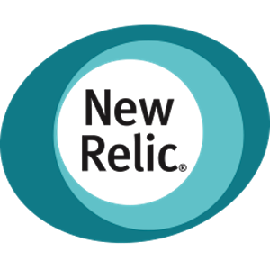
Upcoming Events
AUG. 16th
SEPT. 7th
SEPT. 13th
OCT. 3rd
NOV. 11-13
DEC.
24-Hour
IoT Hackathon
Women+Tech
Holiday Party

