Slide 1
UniCredit Consumer Financing presentation for Statistical Tools for Finance Lecture
Bucharest, Faculty of Mathematics and Computer Science,
University of Bucharest, May 2018

Slide 2




ABOUT US: UniCredit Consumer Financing
Part of UniCredit Group, UniCredit Consumer Financing (UCFin) started its activity in Romania in 2008.
UCFin is specialized in finance of private individuals.
Products offered and selling channels:
UniCredit Bank
Branch network
Partner stores (ex. Altex, Media Galaxy, Dedeman etc.)
Auto dealers (Ex. Ford)
Personal Loans (including Refinancing) without mortgage
2x Mastercard Credit cards : UniCreditCard Principal and Premium
Loans in stores (dedicated for goods acquisitions)
1 x credit card Mastercard: UniCreditCard Partener
Auto Loans with fix and variable interest

Slide 3
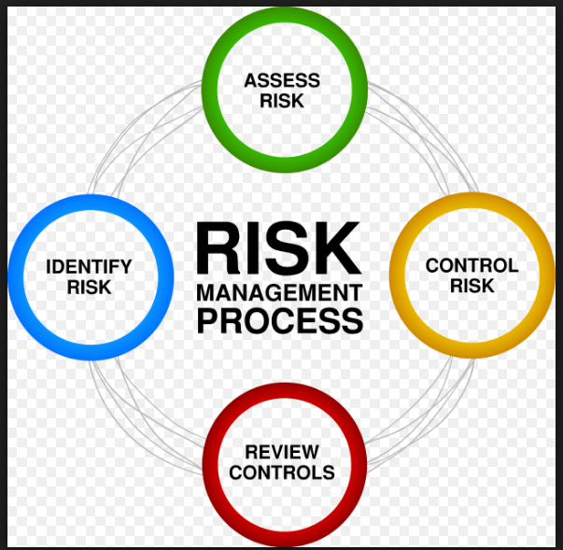
Risk Management & Decision Systems
Mitigate losses and risks due to retail revolving and non-revolving loans through monitoring, reporting and improving modelling / policy rules /parameters for loan decision
Periodic monitoring (daily, monthly, quarterly, half-yearly and yearly) of applications and customers’ loans (applications) taken through branch or point of service;
Improving performance within the company strategy
Automatize reporting, analyze patterns and optimize risk polices using SAS, Groovy, R system, Microsoft Office package
Historical data analysis, profile analysis, comparisons, monitoring trends, so as to determine criteria for improving decision making models parameters;
Improve and manage policy rules in Decision System;
Improve portfolio quality and recovery rates
Extract, update and model data in SAS Risk Data Mart.

Slide 4

We are looking for
RISK ANALYST
Numeracy skills [ knowledge, understanding, interpreting of numbers and figures];
Strategic thinking skills [ ability to learn, flexibility, prioritization];
Attention to details [ time management, active listening, organization];
Technical skills – basic statistics and programming – SAS, R system, SQL, Java or Groovy to deal with large datasets
Please contact us : roucfinhr@unicredit.ro

Slide 5
Thank You
Viorel Dediu
Head of Credit Risk Management Function
viorel.dediu@unicredit.ro

