Slide 1
Collabolicious
Alex Ameri
Serhiy Lykhachov
Gabriel Csapo
Collaboration with you in mind

Slide 2
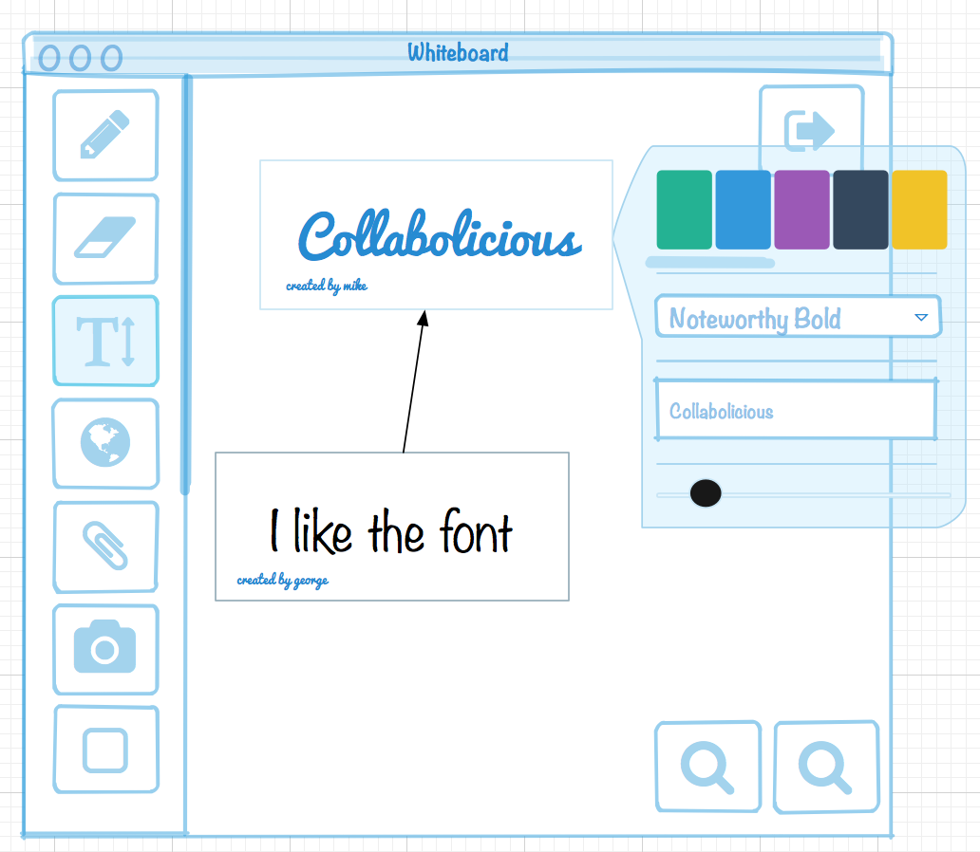

What is it?
A collaborative environment where users interact on a virtual whiteboard, over an encrypted internet connection in real – time.

Slide 3
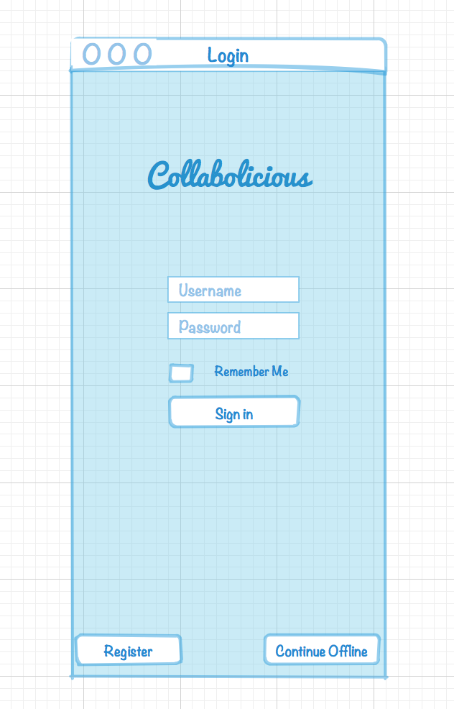
What makes it different
Collabolicous takes the idea of a physical whiteboard, to the digital realm allowing users to interact on a virtual space.

Slide 4
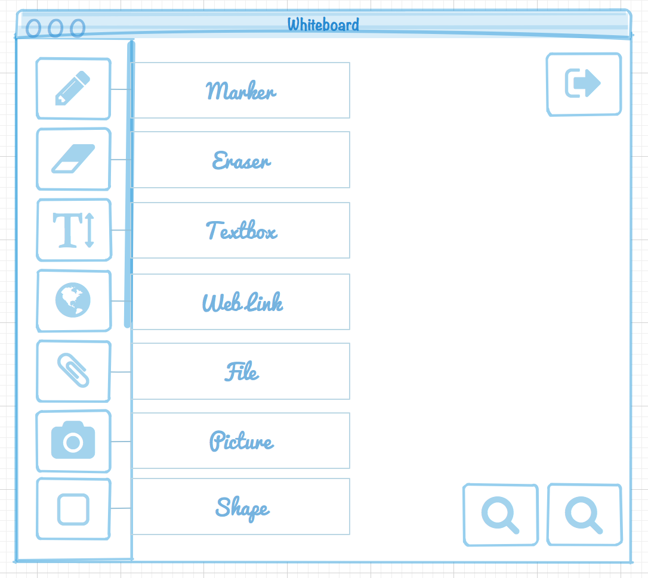
What can users do?
Using the tools available users can collaborate or work alone to make documents

Slide 5
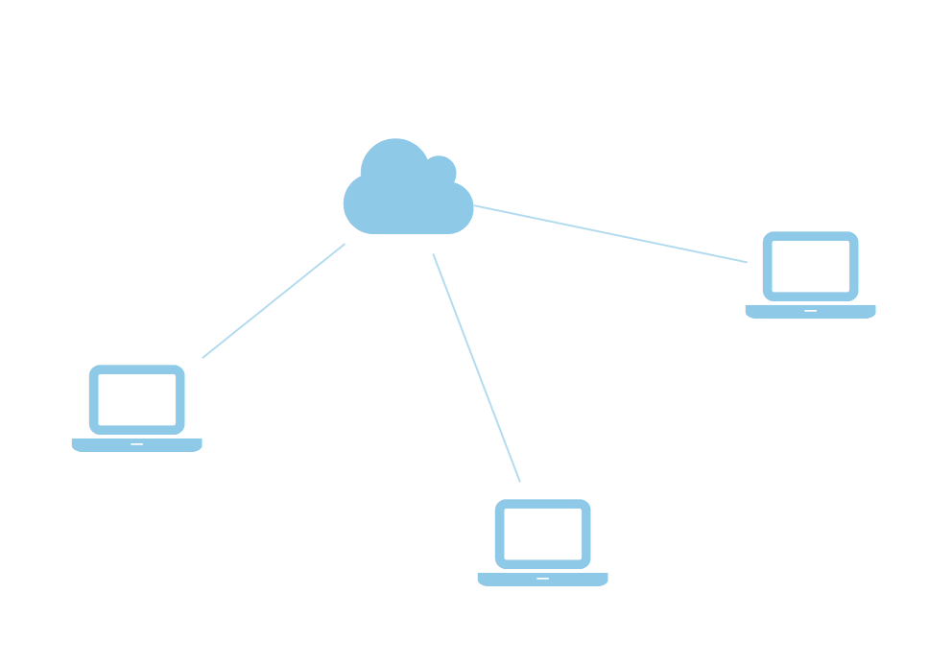
How does it work?
Users log on to a secure connection connected them right to the server. This secure connection only relays messages when edits are made and transposed across the network.

Slide 6
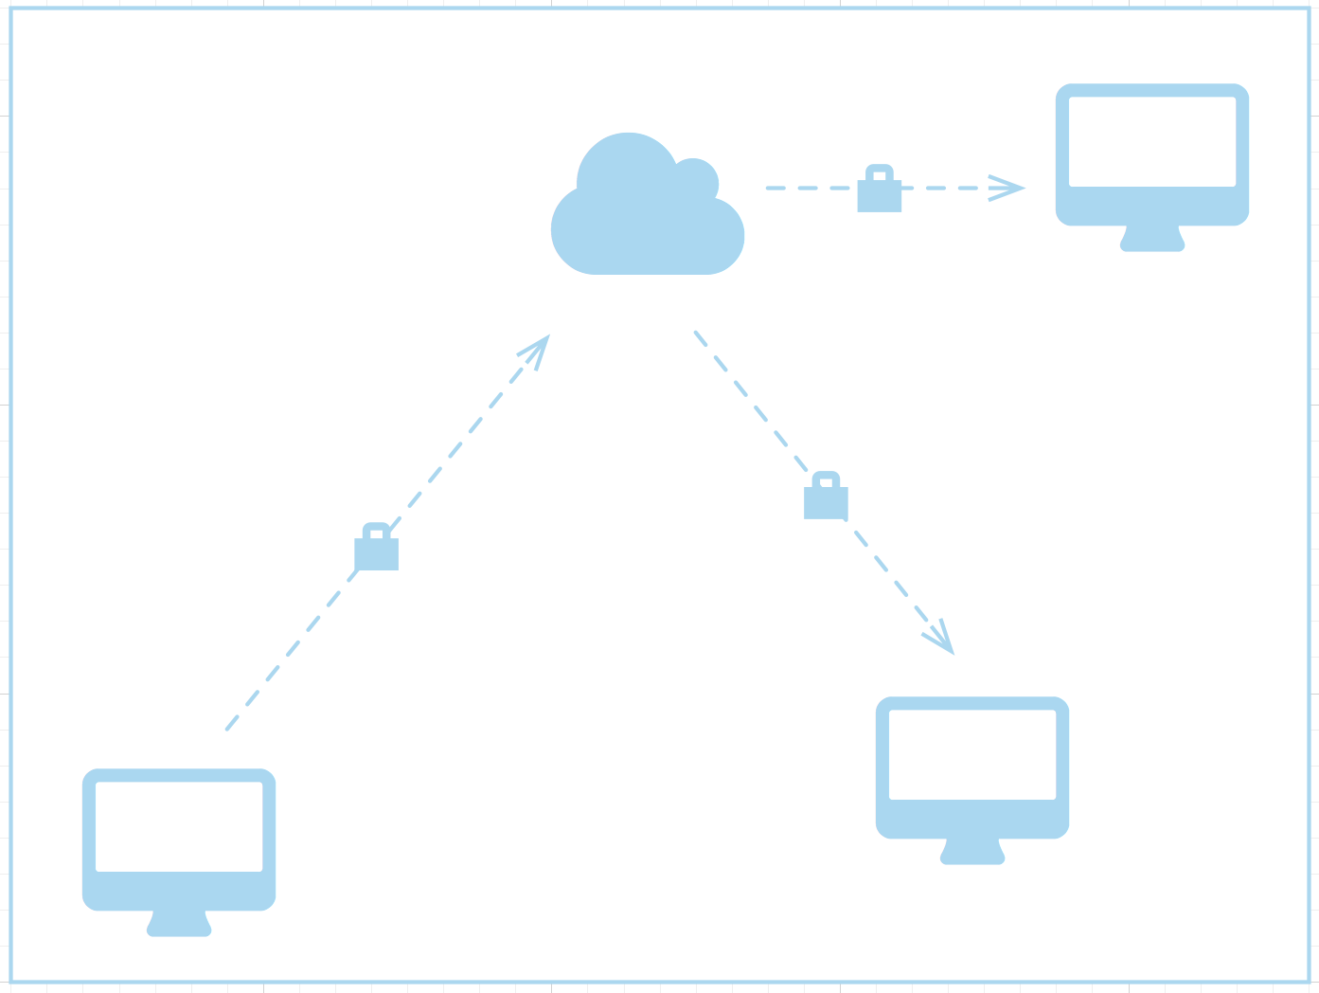
Encryption
Uses a hybrid of asymmetric and symmetric key encryption to ensure traffic is safe and secure when on our network.

Slide 7
Use Cases

Slide 8
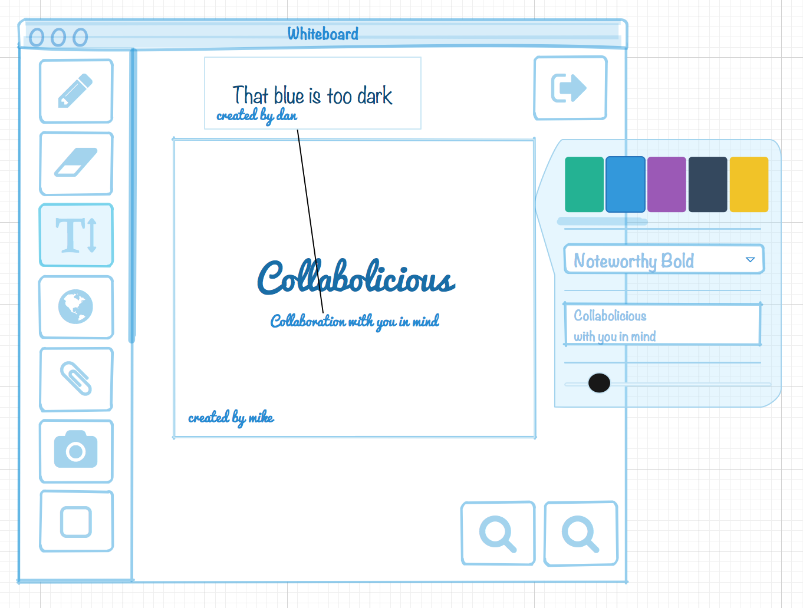
Who would use it?
This application is most useful for users working on a team that needs to share and communicate their ideas clearly

Slide 9
Business Problems
Often times Business people need to fax or email files to colleagues which creates a inconvenient source of data sharing.

Slide 10
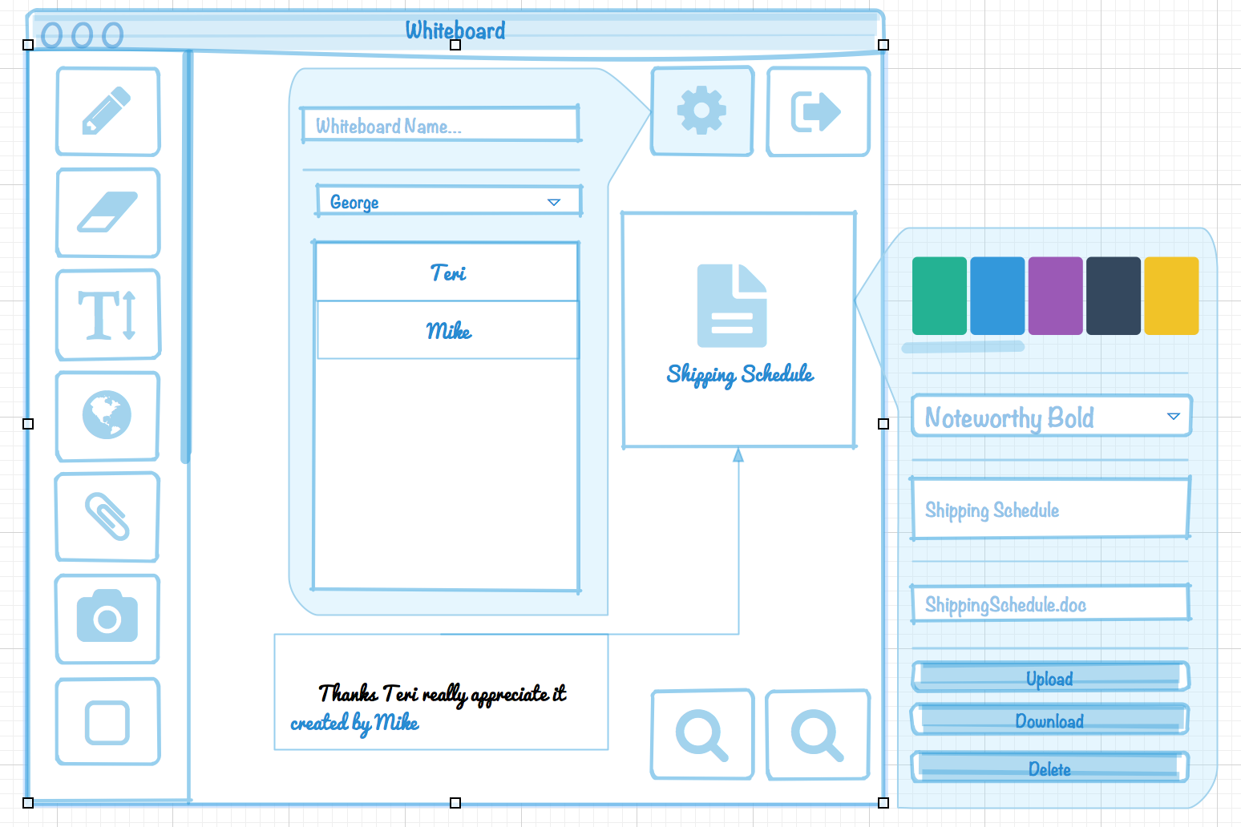
Solution

Slide 11
School Problems
Having a schedule that doesn’t mesh is something that happens in school. Having a collaborative environment that allows students to work together on their studies and fits their schedule is hard.

Slide 12
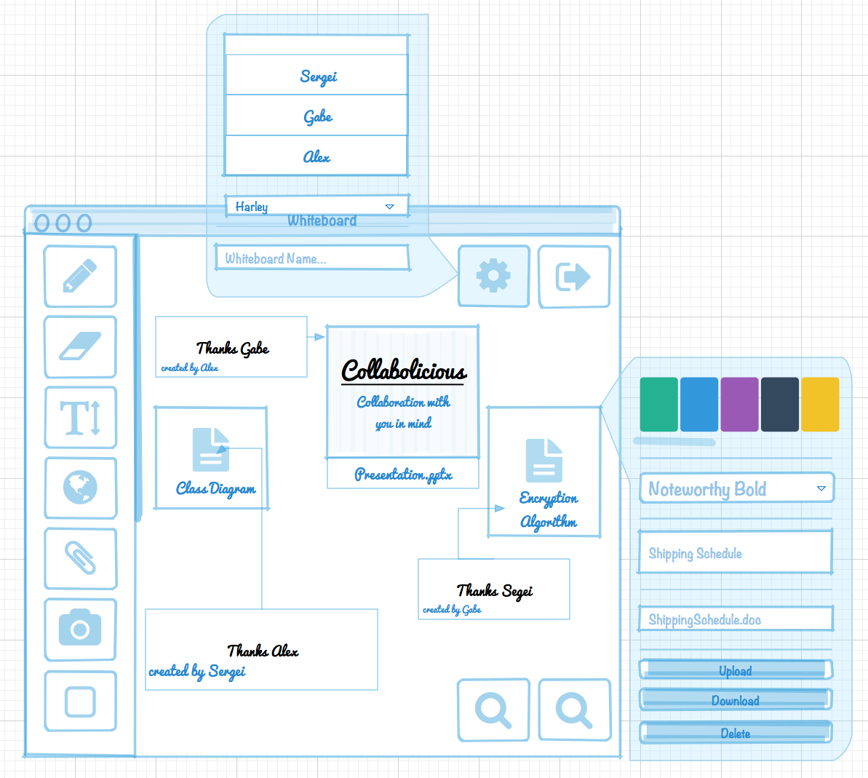
School Problems

Slide 13
What does it look like in action?

