Slide 1
Collabolicious
Alex Ameri
Serhiy Lykhachov
Gabriel Csapo
Collaboration with you in mind

Slide 2
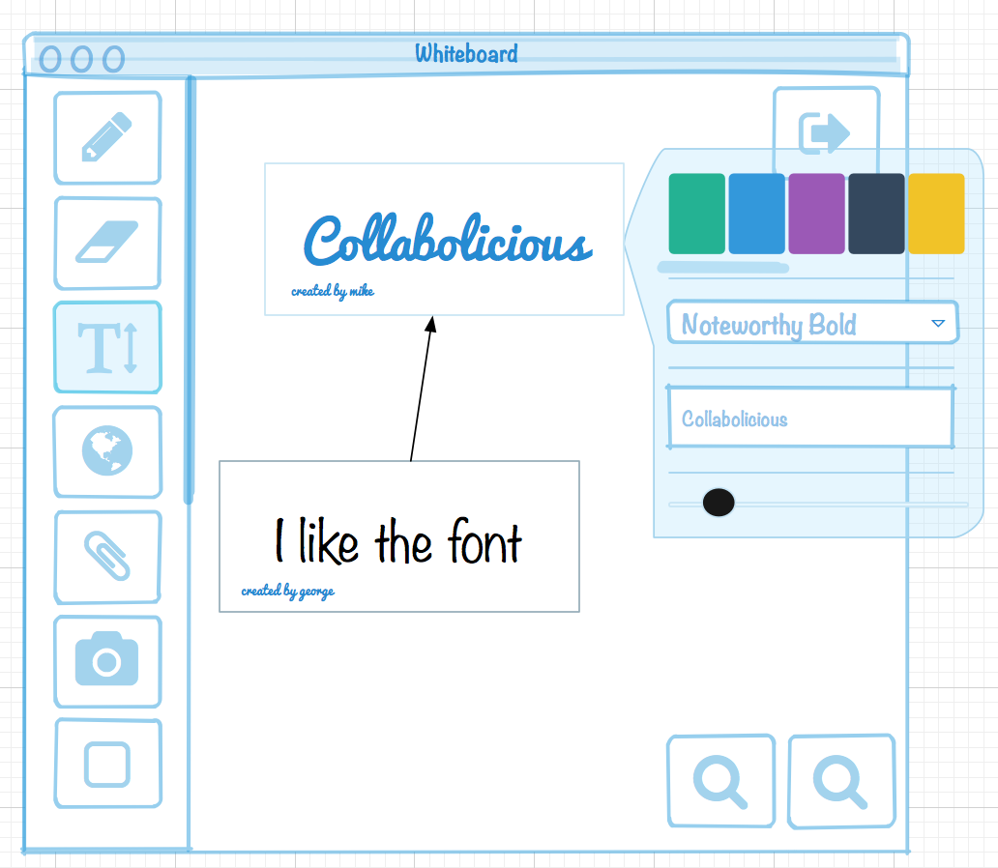
What is it?
A collaborative environment where users interact on a shared space. this helps users collaborate by drawing on shared “whiteboards” over a secure, encrypted internet connection in real – time.

Slide 3
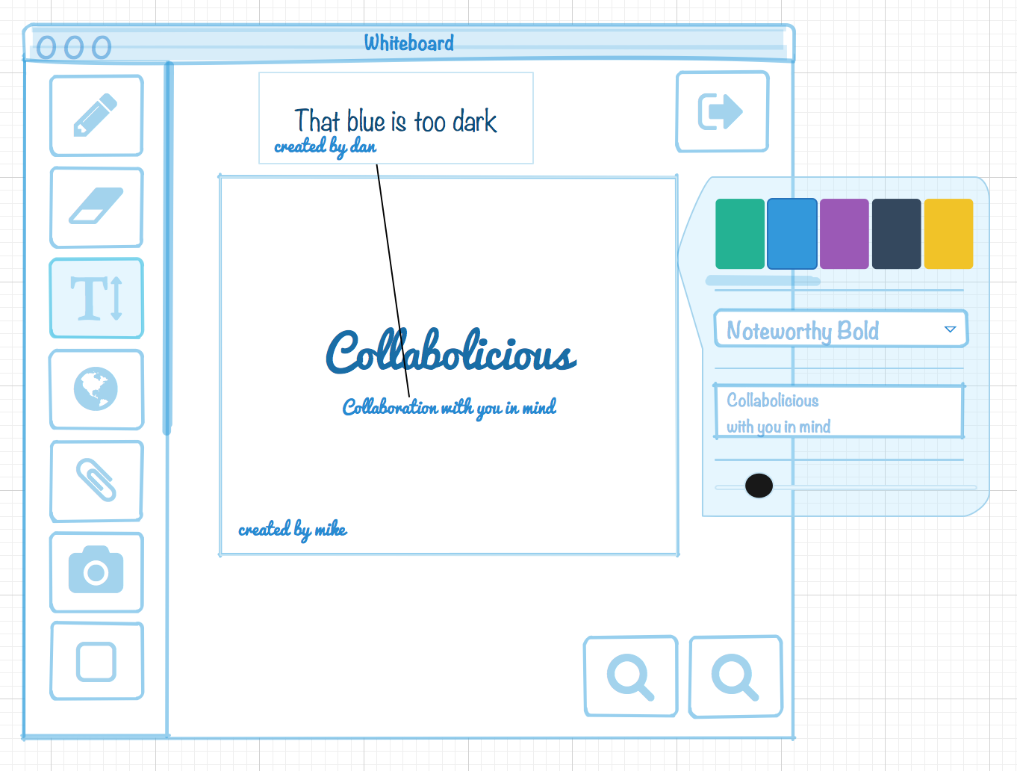
Who would use it?
This application is most useful for users working on a team that needs to share and communicate its ideas clearly

Slide 4
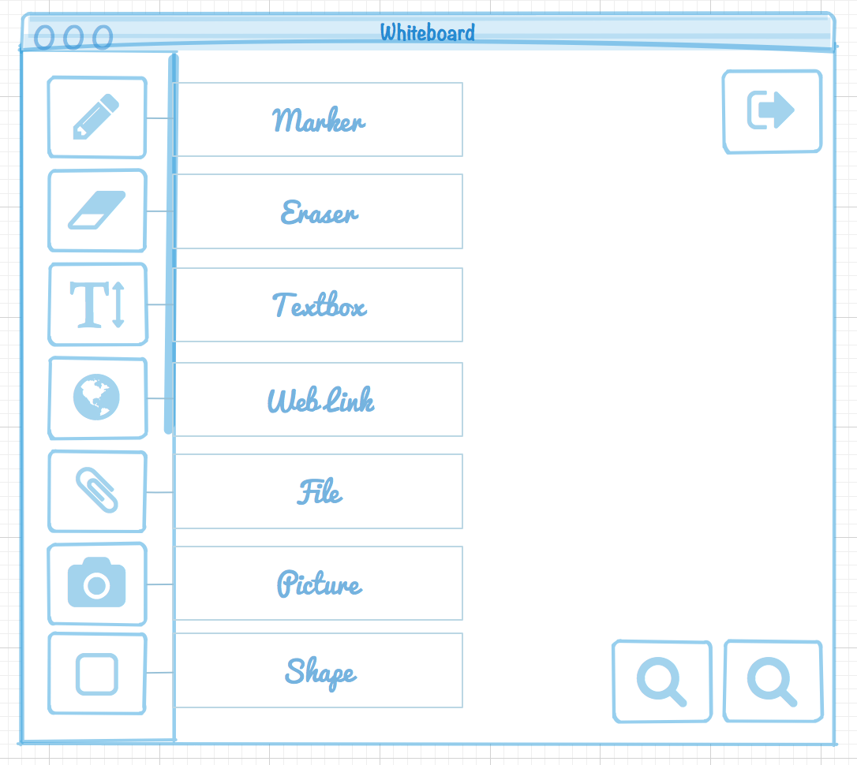
What can users do?
Using the tools available users can collaborate or work alone to make documents

Slide 5
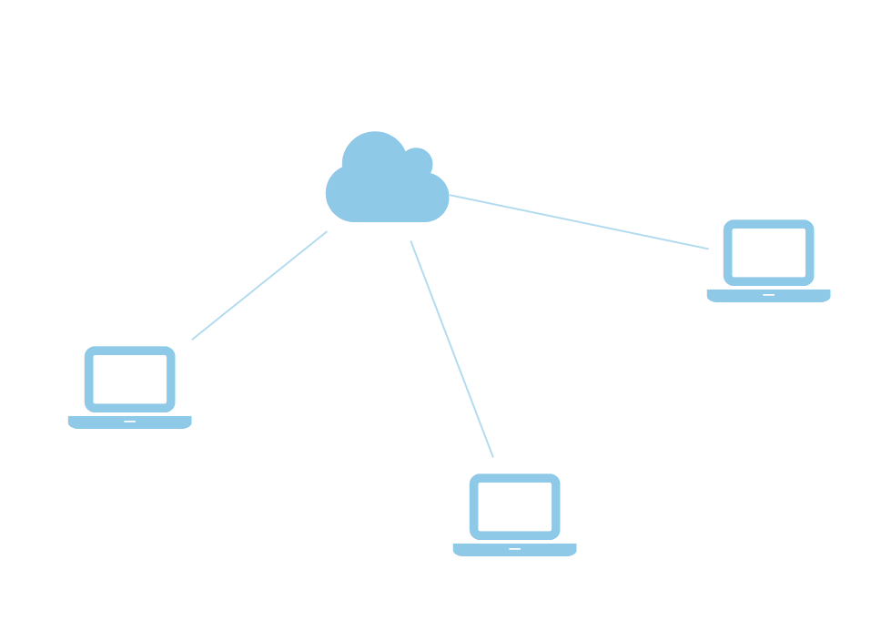
How does it work?
Users log on to a secure connection connected them right to the server. This secure connection only relays messages when edits are made and transposed across the network.

Slide 6
Use Cases

Slide 7
Business Problems
Creating shipping plans quick and easy with the help of others, uploading files and commenting on them after, allows users to communicate needs and thoughts in real time.

Slide 8
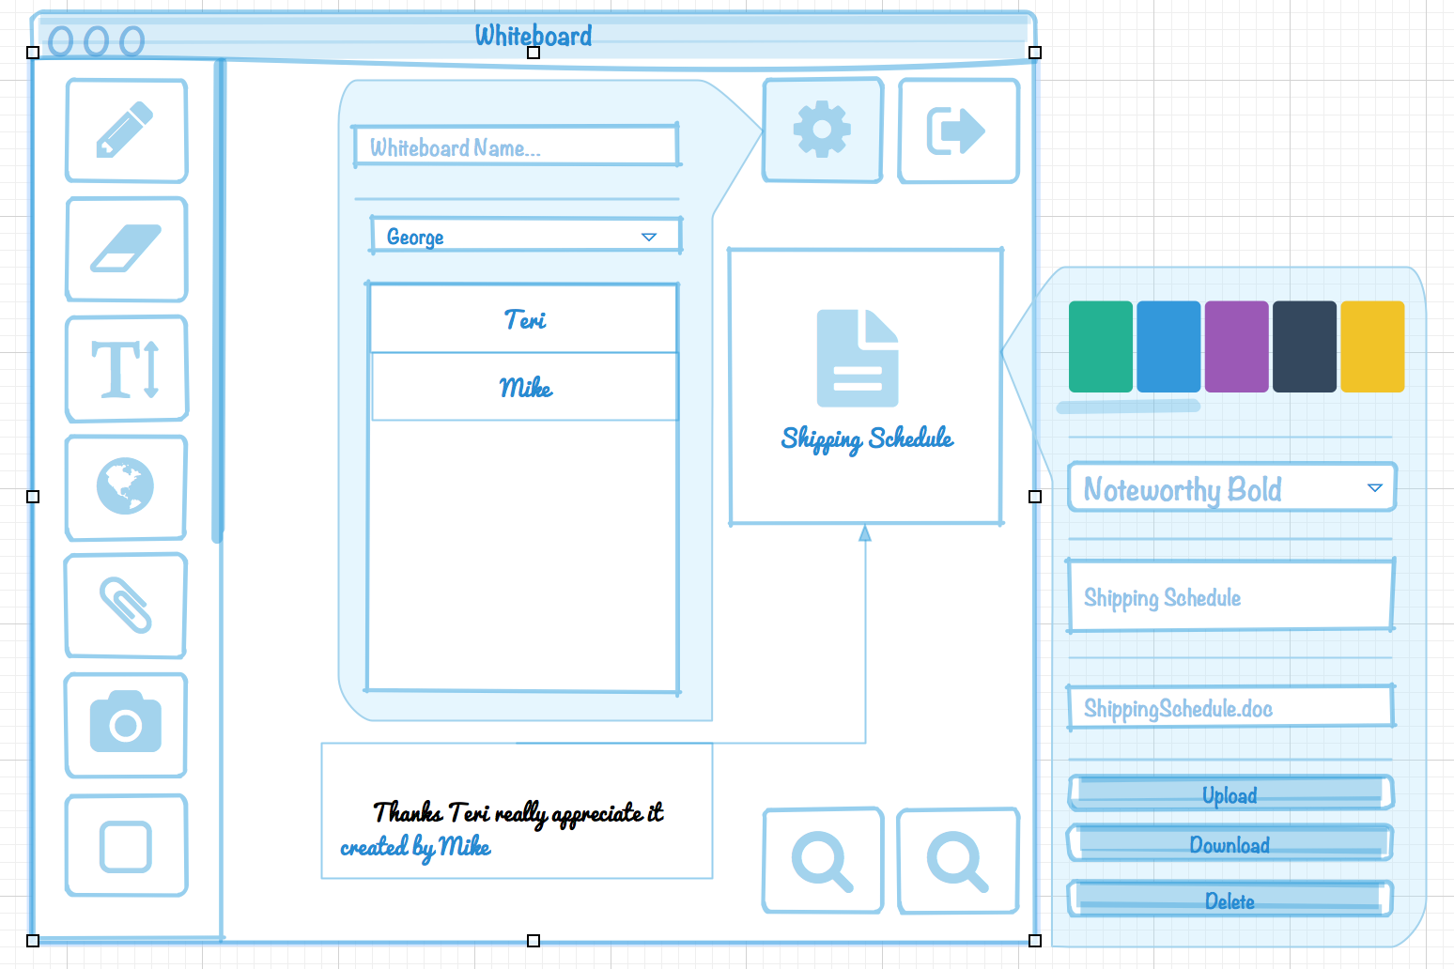
Solution

Slide 9
School Problems
Having a schedule that doesn’t mesh is something that happens in school. Having a conducive study and programming environment.

Slide 10
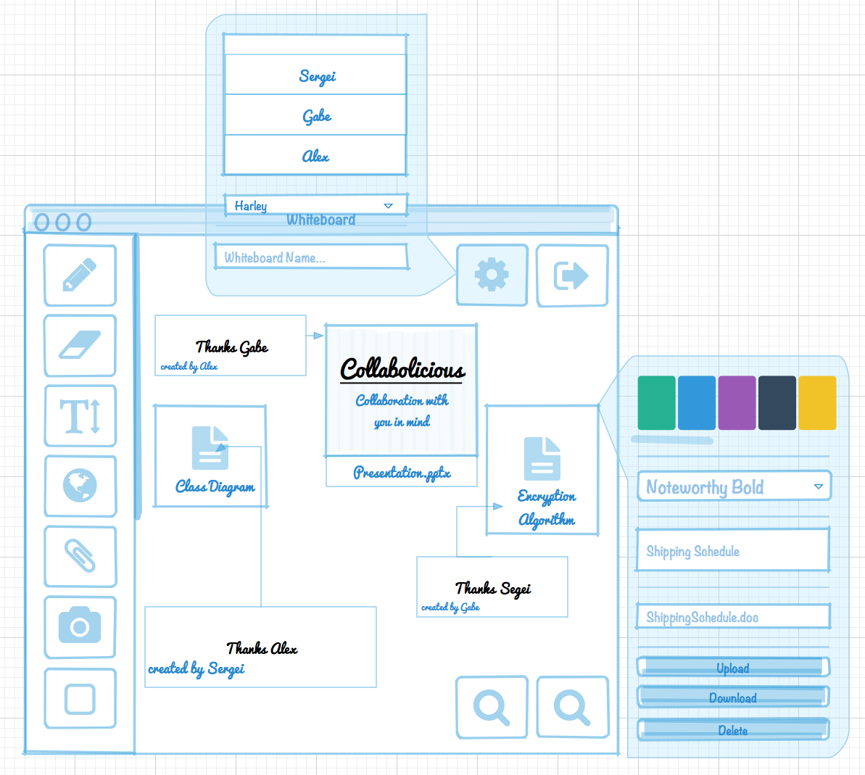
School Problems

Slide 11
What does it look like in action?

