Slide 1
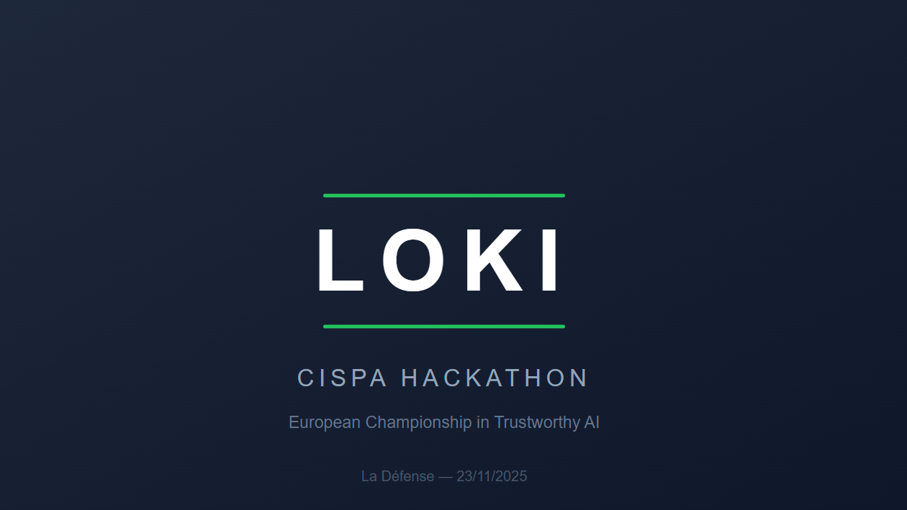

Slide 2
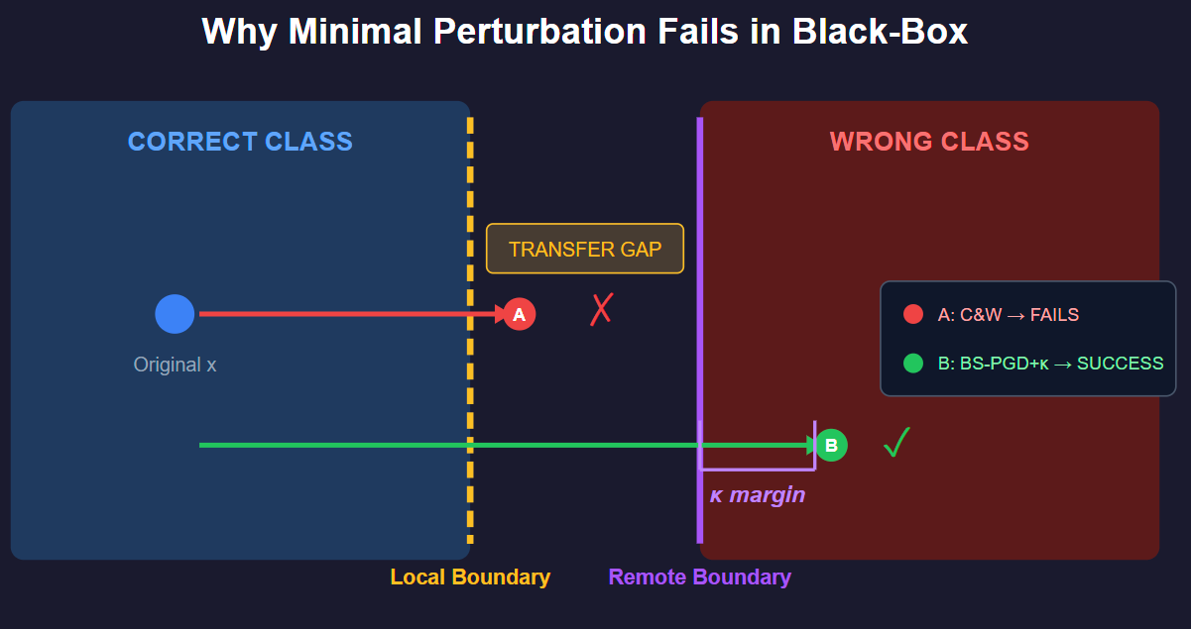
Task 1: Adversarial Images
The Strategy: Optimized Transferability
Objective: Minimize L_2 norm under the constraint of Black-Box Transferability.
Method: Binary Search PGD (BS-PGD) with adaptive parameters.
Why not C&W? Carlini-Wagner optimizes for the local decision boundary. In a black-box setting, this leads to false positives

Slide 3
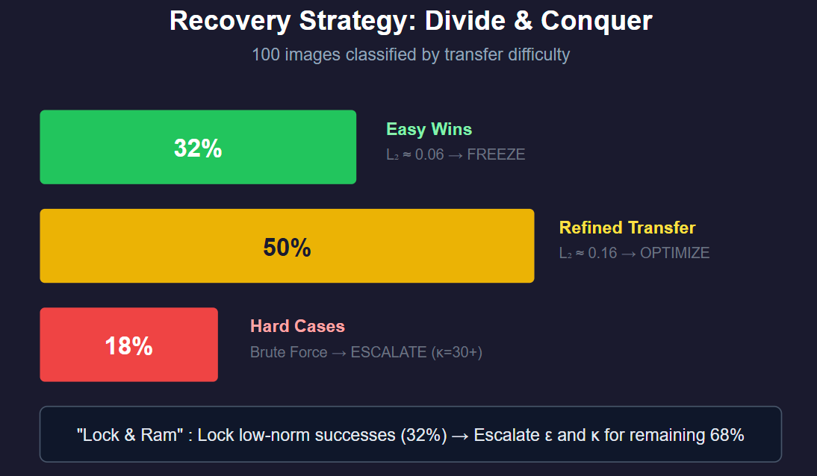
Task 1: Adversarial Images
The Strategy: Optimized Transferability
The Challenge: Automation failure during the night loop. Result: Overfitting to local surrogates
Root Cause: Surrogate Mismatch. We used upsampled ImageNet models.
→ The target was likely a CIFAR-10/MNIST-native architecture.
The Recovery: "Lock & Ram" Strategy.
Locked the low-norm successes.
Escalated parameters for the remaining failures (increased epsilon)
Optimization: Performed a manual binary search on epsilon for each image

Slide 4
Task 2
First Idea:
Better Idea:
ConvNext + Image classification
Using the specificity of each Model
Outlier
SD
VAR
RAR
TAMMING

Slide 5
Task 2
Using the specificity of each Model
VAR
VQ-VAE : Encoder -> Codebook -> Decoder
TAMMING
Each TEST Image : The distance between the test image and the decode (encode(image)) → close to 0

Slide 6
Task 2
Fine-tuning ConvNext + Generated Data
SD
Categorize
RAR
Heavy Safety Nets
Outlier
Categorize
Maximize the score = outliers have to be right

Slide 7
Task 3 : Watermark Detection
Extreme Data Scarcity: Only 320 training images.
Tree-Rings: Add watermarks in the Fourier Spectrum .
BitMark: Add watermarks by reorganizing imperfections.
Stable Signature: Add watermarks by producing a specific hidden fingerprint in its pixels.

Slide 8
Solution
1 - FFT → Tree-Rings → transform the image as a signal → high frequency filters to know what Tree-Rings modified
2 - CNN → Image - Blurred image = Detailed image and then amplifies what is left to detect the modifications
Generate images but it did not work

