Slide 1
FOR INSTRUCTOR PURPOSES ONLY
LEARNING OBJECTIVES
Gain an overview of the JavaScript landscape and its placement in the web ecosystem.
Practice programmatic thinking by writing pseudo-code.
Write expressions that both assign and evaluate variables.
Explain the difference between jQuery and vanilla JS.
Register and trigger event handlers for jQuery events.

Slide 2
FOR INSTRUCTOR PURPOSES ONLY
INSTRUCTOR TIPS
There’s a lot to fit into this class! Don’t worry about diving too deep—this should be an introductory lesson.
Keep track of time, so you can get through all the content.
Be aware of differing skill levels and try to differentiate as needed.

Slide 3
FOR INSTRUCTOR PURPOSES ONLY
MATERIALS
Laptop
Google Chrome
Sublime Text or Atom

Slide 4
FOR INSTRUCTOR PURPOSES ONLY
PRE-WORK
DASH Project 1
Install either Sublime Text 3 or Atom on to computer (choose one before telling students which one to install).
Write learning objectives on board.
Have a way to distribute starter code for code challenges at the beginning of class.
Make sure wifi network and password (GA Guest, yellowpencil) is written on board, since students will need to be online to use codepen.io.

Slide 5
JAVASCRIPT 101
Insert Instructor Name
Title, Company

Slide 6
JAVASCRIPT 101
GREETINGS + THE GA EXEPERIENCE

Slide 7
Learning objectives
JAVASCRIPT 101
Gain an overview of the JavaScript landscape and its placement in the web ecosystem.
Practice programmatic thinking by writing pseudo-code.
Write expressions that both assign and evaluate variables.
Explain the difference between jQuery and vanilla JS.
Register and trigger event handlers for jQuery events.
Notes:
Read learning objectives to the class, or ask a member of the class to read them out loud.
>Instructor Note: Ask each student to share their first name and answer the following question: "What brought you here tonight?.”
>Instructor Note: **You can distribute the starter code here to your class.**
***

Slide 8
JAVASCRIPT 101
WEB PRODUCTION WORKFLOW

Slide 9


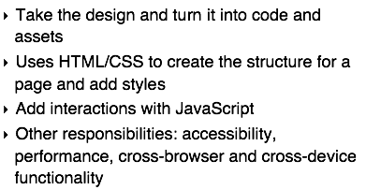

Web Production workflow

Slide 10
What does Front End even mean?
“A mix of programming and layout that powers the visuals and interactions of the web.”

Slide 11
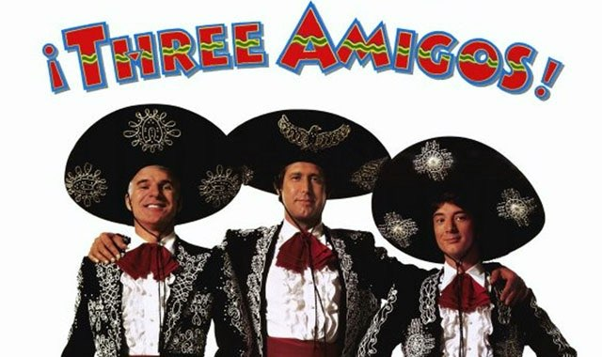
front end is made up of…
HTML
CSS
JavaScript
Notes:
The 3 Amigos of Web Programming
Does anyone know what each language helps us achieve when coding a website?

Slide 12
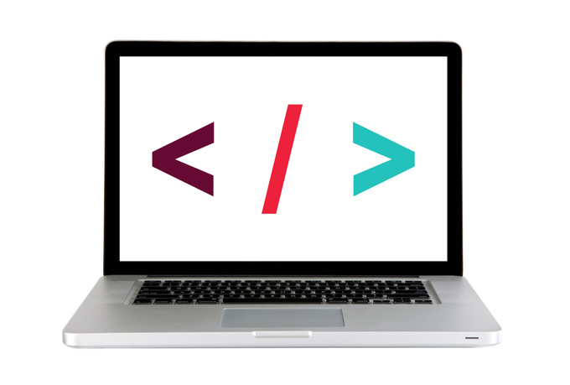
Let's take a look
https://lyft.com/

Slide 13
In Summary
The Front End is what the user sees.
It powers the visuals and interactions of the web.
It is meant to be pretty, but doesn't always happen that way.
Made up of HTML, CSS and Javascript.
Notes:
What kind of web sites might only require front-end web development?
Example: A restaurant website that only has pictures, text to communicate their hours and menus.

Slide 14
JAVASCRIPT 101
WHAT IS JAVASCRIPT?

Slide 15
JAVASCRIPT is responsible for…
content behavior
interactions
animations

Slide 16
WITH JAVASCRIPT YOU CAN…
1
2
3
4
Access
Content
Modify
Content
Program
Rules
React to
Events
MANIPULATE THE DOM;
Notes:
Review the DOM here for students who don’t know what it is.

Slide 17

PRActice reading JavaScript
DIRECTIONS
Let’s visit this codepen together
Turn to someone next to you and as a team try to figure out on a high level what is happening
With your partner try to make it so that the slow button changes the bulb to yellow
With your partner try to make it so that the go button works
This exercise is simply to help introduce you to what JavaScript looks like, do not get caught up in all the details just yet
EXERCISE

Slide 18
JAVASCRIPT 101
INTRO TO PSEUDO CODE

Slide 19

The importance of planning

Slide 20
pseudo code is…
A way to 'plan out' your program before coding it.
A detailed yet readable description of what a computer program must do.
Expressed in plain english.

Slide 21
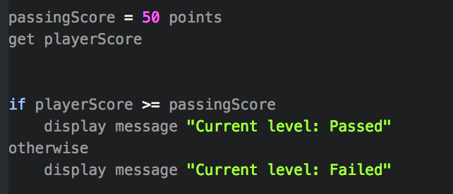
Pseudo Code — Example
A program that lets a player know whether he or she has passed the current level.
Notes:
White board and walk students through writing a program for that controls a thermostat. Highlight variables, conditionals, and loops.

Slide 22
Pseudo Code — thermostat
DIRECTIONS
Write pseudo code for an application that would monitor the room temperature and adjust it so the room remains at a certain temperature.
EXERCISE
Notes:
>Instructor Note: Walk through the problem and have a couple students share what they come up with. At this point students might not have the best idea of how to name variables in the pseudocode, but that's okay! Focus on the logic here.

Slide 23
JAVASCRIPT 101
VARIABLES + DATA TYPES

Slide 24
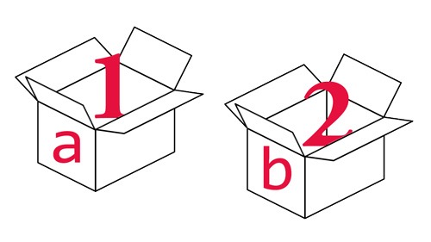
what are Variables?
We can tell our program to remember (store) values for us to use later on.
The 'container' we use to store the value is called a variable.
A variable has a name and a value.
The value can change.
var age = 29;;

Slide 25
Variables
Reassigning a variable means you are changing the value you set initially
How is this done?:
var age = 29;
age = 30;;
Notes:
**Check**: "If we keep going with the analogy of a 'container' or 'box', why does it work this way, where you do not have to repeat the word var?"

Slide 26
USING THE CONSOLE
DIRECTIONS
We'll be using the console to practice creating variables. It's where JavaScript is interpreted and run. You can use it to practice writing JavaScript!
Open up Google Chrome
Right click and go to "inspect"
Select "console"
Follow along!
EXERCISE
Notes:
IN THE CONSOLE TYPE:
```
console.log("Hello!");
var name = "Susan";
name;
```
```
var age = 18;
age;
```
To predict the types of data you're dealing with you can use ```typeof```.
```
typeof 3.45;
```
```
typeof true;
```

Slide 27
what can be stored in variables?
Data types:
Strings
numbers
booleans
"Today is Monday"
10
22.75
true
false
Letters and other characters enclosed in quotes
Positive numbers
Negative numbers
Decimals
Can have one of two values:
True
False
Notes:
Strings - single/double quotes: will explain later
Booleans - like a light switch

Slide 28
arithmetic operators
Operator:
Example:
Result:
Addition
+
2 + 4
6
Subtraction
-
8 - 1
7
Name:
Multiplication
*
2 * 3
6
division
/
4 / 2
2
Notes:
> Instructor Note: Discuss arithmetic operators and assignment operators from slides 25-26 with students.
Demo in console
```
2 + 4
=> 6
8 - 1
=> 7
4 / 2
=> 2
2 * 3
=> 6
```

Slide 29
assignment operators
initial value:
Operator:
Example:
result:
assign value
to variable
var num = 8
=
num = 6
6
add value
to variable
var num = 8
+=
num += 6
14
subtract value
from variable
var num = 8
-=
num -= 6
2
Notes:
```
var num = 8;
=> 8
num += 6
=> 14
num -= 6
=> 2
```

Slide 30
GUIDED/INDEPENDENT PRACTICE: Variables
DIRECTIONS
Open up the project called “Variables” in Sublime Text. I will walk you through how to do this
Go to the file called main.js
We will do Part 1 together
You will do Part 2 on your own
EXERCISE

Slide 31
JAVASCRIPT 101
JAVASCRIPT IN ACTION

Slide 32
methods and properties of strings
MAKE STRING LOWERCASE:
LENGTH OF A STRING (PROPERTY):
var str = "Hello World";
var res = str.toLowerCase();
// the result of res will be:
// hello world
var str = "Hello World";
var n = str.length;
// the result of n will be 11
MAKE STRING UPPERCASE:
var str = "Hello World";
var res = str.toUpperCase();
// the result of res will be:
// HELLO WORLD
**Find a whole list of methods and properties for strings here

Slide 33
string Concatenation
To take two strings and stick them together, use the + operator.
This is called string concatenation.
var book = "Happy";
var summary = "Best book ever.";
var review = book + ": " + summary;
// Result will be: Happy: Best book ever.

Slide 34
JAVASCRIPT 101
JQUERY:
A JS LIBRARY

Slide 35

WHAT IS jquery?
jQuery is an open-source project that was released in 2006, and it's currently the most widely used JavaScript library on the web.
jQuery is a JavaScript file you include in your pages.
Makes it faster and easier to write cross-browser JavaScript.
Allows us to find elements using CSS-style selectors and then do something to them using jQuery methods.
Notes:
“Cross browser” - works the same in all* browsers

Slide 36
jquery vs. javascript
js:
document.getElementById('heading').innerHTML = "Your Name";
jquery:
$('#heading').html('Your Name');
Notes:
Explain the syntax and difference from JS

Slide 37
jquery vs. javascript
jQuery allows us to use the CSS-style selectors that we know and love!
js:
jquery:
document.getElementsByTagName('body')[0]
$('body')
document.getElementById('about')
$('#about')
Notes:
The dollar sign specifies that you are using jQuery, what goes inside the parentheses and quotes is what you are selecting. As you can see, you can use your CSS-style selectors!

Slide 38
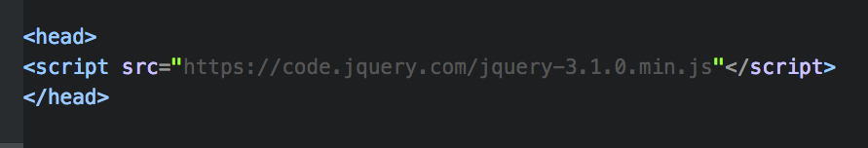
Loading jQuery
jQuery is a javascript file, but before you start using jQuery, you'll need to include it in our html page. Here are two ways to get jQuery.
1. Download the compressed version [online](https://jquery.com/download/).
2. Alternatively, you can link to the jQuery file in the <script> tag in your HTML like so:
Notes:
“Cross browser” - works the same in all* browsers

Slide 39
JAVASCRIPT 101
HOW DOES jQUERY WORK?

Slide 40
using jquery to manipulate the dom
1
2
Select an element/elements
Work with those elements

Slide 41
jquery — selecting elements
Selector
$('li')
.addClass('selected');
jQuery Function
jQuery Function:
Lets us find one or more elements in the page
Creates a jQuery object which holds references to those elements

Slide 42
jquery objects — finding elements: some examples
You can use your CSS-style selectors!!!
css:
jquery:
class
.className
$('.className')
id
#idName
$('#idName')
Selector:
multiple
selectors
h1, h2, h3
$('h1, h2, h3')
DescendAnt
li a
$('li a')
& tons more!!!

Slide 43
using jquery to manipulate the dom
1
2
Select an element/elements
Work with those elements

Slide 44
jquery — working with those elements
Parameter(s)
$('li')
.addClass('selected');
Method

Slide 45

jquery methods — working with those elements
After we've selected elements, we can use jQuery methods to:
create
event
listeners
get/set
content
add effects/animation
Refer to the jQuery docs for list

Slide 46
jquery methods — Getting/setting content
Get/change content of elements, attributes, text nodes
Some methods available to us:
What goes in the parentheses?
The html, styles, classes you want to add/change
.html( )
.attr( )
.css( )
.addClass( )
.removeClass( )
.toggleClass( )
Examples of adding/changing content:
$('h1').html('Content to insert goes here');
$('img').attr('src', 'images/bike.png');
$('#box1').css('color', 'red');
$('p').addClass('success');
$('p').removeClass('my-class-here');

Slide 47

jquery Codealong part 1
key objective
Utilize jQuery to access and manipulate DOM elements.
EXERCISE
Type of exercise
Individual/Partner
As a class
Exercise is in starter_code > jquery_code_along
Follow the instructions under part 1 in main.js

Slide 48
jquery methods — working with those elements
After we've selected elements, we can use jQuery methods to:
add effects/animation
create
event
listeners
get/set
content
Refer to the jQuery docs for list

Slide 49
jquery methods — effects/animation
Add effects and animation to parts of the page
Some methods available to us:
What goes in the parenthesis?
An animation speed
.show( )
.hide( )
.fadeIn( )
.fadeOut( )
.slideUp( )
.slideDown( )
.slideToggle( )
Examples:
$('h1').fadeOut(200);
$('#box1').slideDown('slow');
$('h1').fadeIn();

Slide 50
jquery methods — working with those elements
After we've selected elements, we can use jQuery methods to:
add effects/animation
create
event
listeners
get/set
content
Refer to the jQuery docs for list

Slide 51
jquery methods — events!
The .on() method is used to handle all events.
Syntax:
$('selector').on('event', code_that_should_run);
Example:
$('li').on('click', function() {
// your code here
});

Slide 52
jquery methods — events!
Some events that .on() deals with:
UI: focus, blur, change
Keyboard: keydown, keyup
Mouse: click, mouseup, mousedown, mouseover
Form: submit
Browser: resize, scroll
$('li').on('eventGoesHere', function() {
// your code here
});

Slide 53
jQUERY CODEALONG Part 2
key objective
Utilize jQuery to access and manipulate DOM elements.
EXERCISE
Type of exercise
Individual/Partner
As a class
Exercise is in starter_code > jquery_code_along
Follow the instructions under Part 2 in main.js

Slide 54
IF
CONDITIONALS

Slide 55
conditional logic
If something is true, do one thing. If it is not, do something else. This type of logic or statement is a condition.
In JavaScript (and coding in general) you'll need to make comparisons all the time:
Is a user logged in?
Has the user chosen three or more colors?
Is the password correct?
Does a user have enough money in their bank account?
etc.
Notes:
Explain: Why would you need to convert data types?

Slide 56
javascript — comparison operators
>=
===
Greater than or equal to
Equal to
<=
!==
Less than or equal to
Not equal to
>
Greater than
<
Less than

Slide 57
assignment vs. comparison — don't get them confused!
=
===
assignment
comparison
==
var number = 7;
or
if (number === 8) {
// Do something
}
Notes:
10 === 10 //true
10 === 5 //false
"hi" === "hi" //true

Slide 58
if statements
if (age > 65) {
$('h1').html("Senior Discount Applied");
}

Slide 59
if statements
if (age > 65) {
$('h1').html("Senior Discount Applied");
} else {
$('h1').html("Sorry, you do not qualify for a discount.");
}

Slide 60
javascript — if/else if/else
if (answer === 38) {
// Do something if first condition is true
} else if (answer === 30) {
// Do something second condition is true
} else {
// Do something if all above conditions are false
}

Slide 61
if statements
if (age > 65) {
$('h1').html("Senior Discount Applied");
} else if (age < 18) {
$('h1').html("Student Discount Applied");
} else {
$('h1').html("Sorry, you don't qualify for a discount");
}

Slide 62
javascript — logical operators
&&
and
||
or
!
not

Slide 63
multiple conditions
if (name == "GA" && password == "YellowPencil"){
//Allow access to internet
}

Slide 64
JAVASCRIPT 101
wrap-up

Slide 65

So, who needs to know about this stuff?

Slide 66


WRAP UP
Business Managers
Product Managers
Designers
Marketers
Programmers
Notes:
Everyone! Even if you’re not the one doing the coding, being able to communicate effectively with developers and understand what’s going on behind the scenes of a product is a very important and highly valued skill in today’s job market.

Slide 67



HOW TO LEARN THIS AT GA?
JAVASCRIPT 101
PART-TIME:
JS/FEWD
ONLINE:
HCD
FULL-TIME:
WDI / WDIR

Slide 68
reference pages:
JAVASCRIPT 101
Mozilla Developer Network
W3Schools
CSS Tricks
Web Field Manual
Free IT Books
JSDB.io
Site Point
Codrops

Slide 69
STAYING CURRENT
JAVASCRIPT 101
Smashing Magazine
Sidebar.io
Codrops
Medium
A List Apart
Web Designer Weekly
Creative Bloq
CSS Tricks
Codepen.io

Slide 70
SITE INSPIRATION
JAVASCRIPT 101
Awwwards
Site Inspire
Mediaqueri.es
One Page Love
Little Big Details
The Best Designs
CSS Design Awards
Web Design File
Behance
Dribbble
Responsive Patterns
Notes:
]

Slide 71
A COUPLE OF LAST THINGS
JAVASCRIPT 101
You are going to get lots of errors…
Google first, ask questions later (but don't be afraid to ask)
Stack Overflow is great for this stuff!
Get immersed! Coding is hard if you don't get really involved.

Slide 72
AFTER CLASS YOU CAN…
DIRECTIONS
Go to dash.ga.co
The last two projects cover what we went over tonight
EXERCISE

Slide 73
JAVASCRIPT 101
Q & A

Slide 74
THANKS!
NAME
Body Level One
Body Level Two
Body Level Three
Body Level Four
Body Level Five
Body Level One
Body Level Two
Body Level Three
Body Level Four
Body Level Five
Optional Information:
Email?
Website?
Twitter?

