Slide 1
Script your phishing mailbox processing with powershell & O365
Alex Bliskavka
BSidesOK 2020

Slide 2
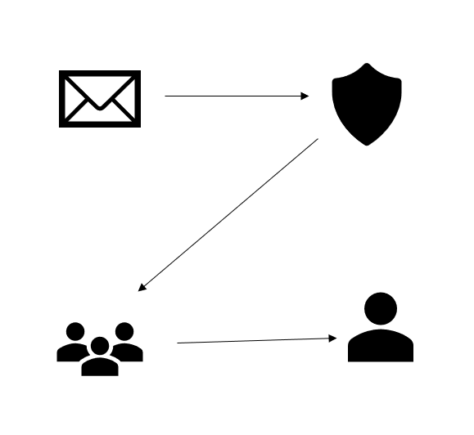
Phishing Mailbox?
Some poor soul has to review them….let’s work on helping that person out today.

Slide 3
Stats – Last 30 days – 2281 total

Slide 4
Resources:
Powershellgallery.com
https://docs.microsoft.com/en-us/powershell/scripting/learn/more-powershell-learning?view=powershell-7

Slide 5
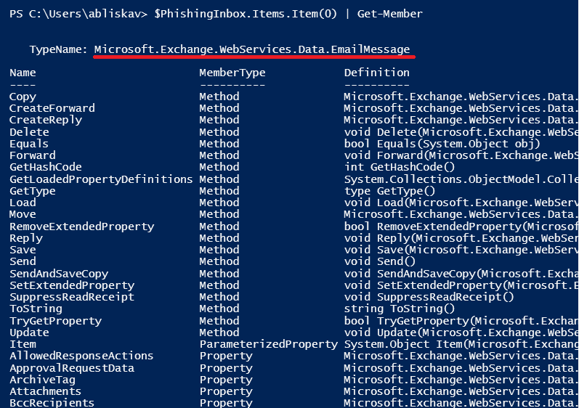
Get-member

Slide 6
Powershell + Outlook Client
$Outlook = New-Object -ComObject Outlook.Application
$Namespace = $Outlook.GetNameSpace("MAPI")
$PhishingMB = $namespace.Folders | Where-Object Folderpath -eq "\\Phishing"
$PhishingInbox = $PhishingMB.Folders | Where-Object Name -eq "Inbox"
$EmailArray = $PhishingInbox.Items
$InboxEmail = $PhishingInbox.Items.GetFirst()
$InboxEmail.Sender.Name
$InboxEmail.Subject
$InboxEmail.Body.Substring(0,300)

Slide 7
Exchange Web Services Client
https://www.microsoft.com/en-us/download/details.aspx?id=42951
Download and install client
$dllpath = "C:\Program Files\Microsoft\Exchange\Web Services\2.2\Microsoft.Exchange.WebServices.dll"
[void][Reflection.Assembly]::LoadFile($dllpath)
$service = new-object Microsoft.Exchange.WebServices.Data.ExchangeService
$service.Url = new-object Uri("https://outlook.office365.com/EWS/Exchange.asmx");
Get-Credential | Export-Clixml "c:\tools\Cred.xml"
$preCredential = Import-Clixml -Path "C:\tools\Cred.xml"
$cred = New-Object System.Management.Automation.PSCredential -ArgumentList $preCredential.username, $preCredential.Password
$Service.Credentials = New-Object Microsoft.Exchange.WebServices.Data.WebCredentials($cred)

Slide 8
Some possible actions
Search object class from Get-Member…. Check out the documentation….so many options

Slide 9
Practical suggestions
Scan mailbox for spam/phish duplicates & move
Send auto-replies to users based on folder
Regex headers for common legitimate providers
Regex for links, do some initial analysis

Slide 10
Exercise/Demo 1
https://github.com/AlexB123456/PhishingScripts/blob/master/EmailCount.ps1

Slide 11
Exercise/Demo 2
https://github.com/AlexB123456/PhishingScripts/blob/master/EmailMessage.ps1

Slide 12
Exercise/Demo 3
https://github.com/AlexB123456/PhishingScripts/blob/master/FilterSpamBsides.ps1

