Slide 1
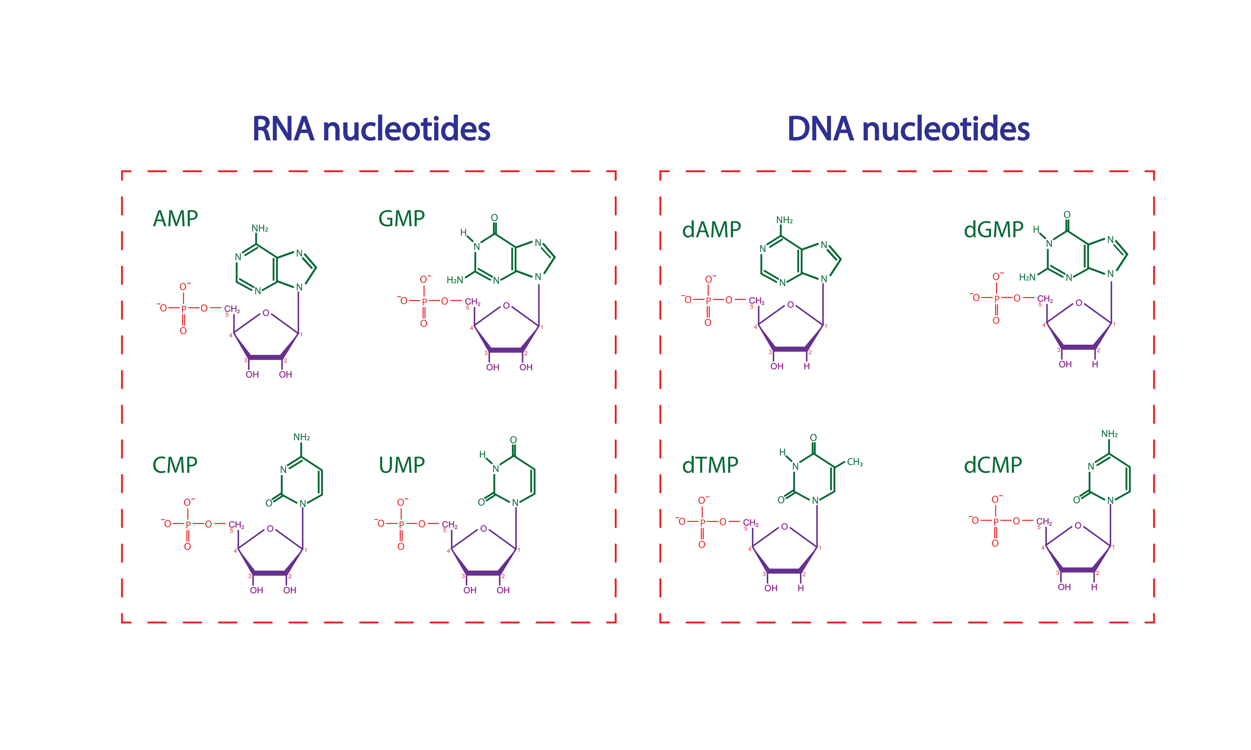


Adenine (A) Guanine (G)
Thymine (T) Cytosine (C)
Adenine (A) Guanine (G)
Uracil (U) Cytosine (C)

