Slide 1





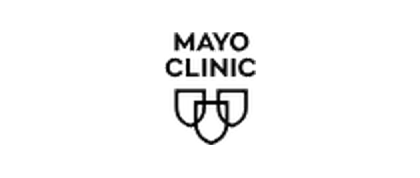



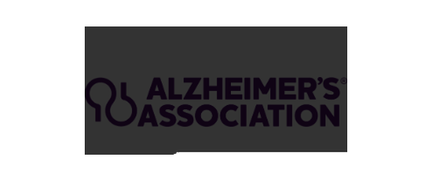


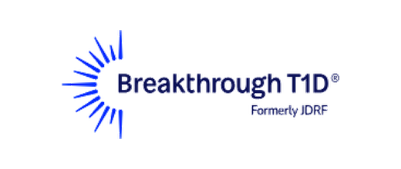







AHA comparator brand matrix
Logos
All
US
Global
Human side
Institutional
Rebuilt with 20 brands. Logos are normalized first, then placed on a matrix that asks how useful the brand feels as a guide and how human the experience feels.
Logo normalization check
Every mark sits on the same card and uses the same container. The differences you still see are intentional brand-shape differences, not random source-file scale drift.
US set
International set
American Cancer Society
American Red Cross
British Heart Foundation
Heart and Stroke Foundation of Canada
St. Jude Children's Research Hospital
Mayo Clinic
National Heart Foundation of Australia
Heart Foundation NZ
Cleveland Clinic
Alzheimer's Association
Irish Heart Foundation
Deutsche Herzstiftung
Breakthrough T1D
American Diabetes Association
Heart Research UK
Heart Research Australia
American Lung Association
Susan G. Komen
Singapore Heart Foundation
Heart and Stroke Foundation South Africa

Slide 2
AHA comparator brand matrix
Logos
All
US
Global
Human side
Institutional
Rebuilt with 20 brands. Logos are normalized first, then placed on a matrix that asks how useful the brand feels as a guide and how human the experience feels.
Higher guide utility
AHA opportunity: high guide value with a more people-made feel
Lower guide utility
More institutional / system-led
More human / inviting
This is directional scoring from first-fold brand signals, not audited market research.

Slide 3
AHA comparator brand matrix
Logos
All
US
Global
Human side
Institutional
Rebuilt with 20 brands. Logos are normalized first, then placed on a matrix that asks how useful the brand feels as a guide and how human the experience feels.
Higher guide utility
AHA opportunity: high guide value with a more people-made feel
Lower guide utility
More institutional / system-led
More human / inviting
This is directional scoring from first-fold brand signals, not audited market research.

Slide 4
AHA comparator brand matrix
Logos
All
US
Global
Human side
Institutional
Rebuilt with 20 brands. Logos are normalized first, then placed on a matrix that asks how useful the brand feels as a guide and how human the experience feels.
Higher guide utility
AHA opportunity: high guide value with a more people-made feel
Lower guide utility
More institutional / system-led
More human / inviting
This is directional scoring from first-fold brand signals, not audited market research.

Slide 5
AHA comparator brand matrix
Logos
All
US
Global
Human side
Institutional
Rebuilt with 20 brands. Logos are normalized first, then placed on a matrix that asks how useful the brand feels as a guide and how human the experience feels.
Higher guide utility
AHA opportunity: high guide value with a more people-made feel
Lower guide utility
More institutional / system-led
More human / inviting
This is directional scoring from first-fold brand signals, not audited market research.

Slide 6
AHA comparator brand matrix
Logos
All
US
Global
Human side
Institutional
Rebuilt with 20 brands. Logos are normalized first, then placed on a matrix that asks how useful the brand feels as a guide and how human the experience feels.
Higher guide utility
AHA opportunity: high guide value with a more people-made feel
Lower guide utility
More institutional / system-led
More human / inviting
This is directional scoring from first-fold brand signals, not audited market research.

