Slide 1

Welcome to the
Montreal

Slide 2

Welcome!

Slide 3
Welcome Let’s get acquainted

Slide 4
Agenda
09h00-9h15 Intro
09h15-9h30 Deploy LogAnalytics
09h30-9h50 Deploy Environment
09h50-10h35 App Insights 1
10h35-11h20 Log Analytics + Pause
11h20-11h50 Security Center
11h50-12h30 LUNCH
12h30-13h00 App Service troubleshooting & tools
13h00-13h30 App Insights 2
13h30-14h20 Azure Monitor + Logic App
14h20-15h00 Azure Policy

Slide 5
Goal
Today is focused on practical skills (20% theory, 80% hands on).
All day long, you’ll learn about what is Life after initial deployment. All about governance & best practices following speakers instructions.

Slide 6
Intro

Slide 7
Goal
Getting to know Azure and the Portal

Slide 8
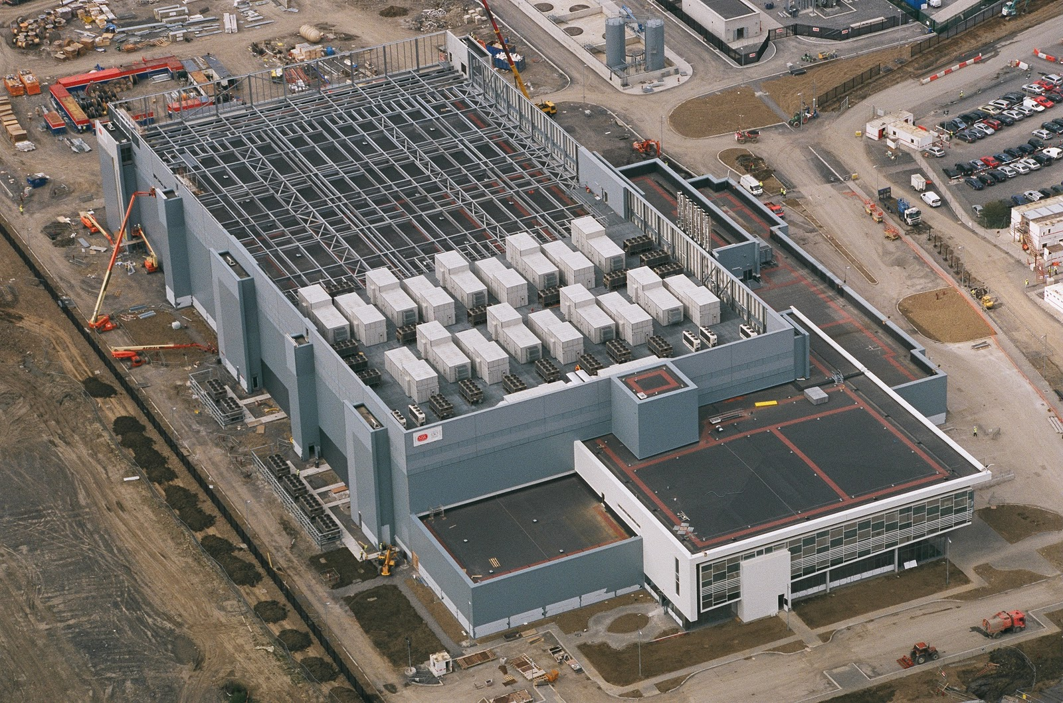

Slide 9
http://portal.azure.com

Slide 10
References:
Get started with Azure
Microsoft Azure Blog
Azure Updates
Cloud Platform roadmap
Azure Code Samples
Azure Quickstart Templates
AzureCAT Guidance
Cloud Design Patterns

