Slide 1
Step 9 ARM Governance

Slide 2
Goal
Learn how to apply Governance to your subscrition.

Slide 3
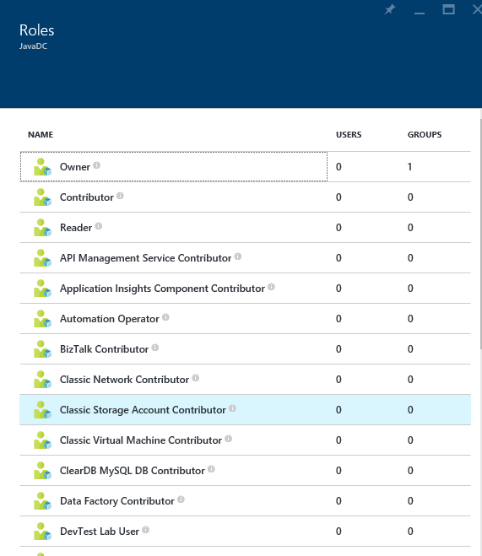
Role Based Access Control (RBAC)
Allows secure access with granular permissions
Assignable to users, groups, or service principals
Built-in roles make it easy to get started
NOTE – RBAC in ARM applies to resources exposed via ARM. Software inside of VMs which may have it’s own security mechanisms and should be considered during design.
Notes:
ARM provides role-based access control, integrating with the Azure Active Directory directory associated with your subscription. This allows you to limit access to resource groups or resources to specific users or groups. There are built-in roles, such as “Virtual Machine Contributor” that lets you manage virtual machines, but not the access to them, and not the virtual networks or storage they are connected to.
It’s important to note RBAC in ARM applies to resources exposed via ARM. Software inside of VMs which may have it’s own security mechanisms and should be considered during design.

Slide 4
Role Based Access Control (RBAC)
Notes:
Access is inherited in the RBAC model. Contributors, owners, and readers assigned at the subscription level have access to the resource groups and resources within that subscription. This can be useful when monitoring all resources deployed to a subscription.
A user assigned as a contributor, owner, or reader of a resource group has access to that resource group and everything contained within it. This can be useful when monitoring a group of resources that comprise an application.
Users and roles can be assigned at the resource level. You might assign a reader for a specific resource so they can see, but not modify, a resource. This can be useful when monitoring a specific resource.

Slide 5
Role Based Access Control (RBAC)
Can get the effective permissions per Subscription, Resource Group or resource
Can get effective permissions per user
Using portal, PS or Azure CLI
68 built-in roles *
All RBAC assignments are tracked in Azure Activity Log
Notes:
* October 2017

Slide 6
Custom RBAC
Custom roles if the built-in roles are not appropriate
Can be created by PS, CLI or REST API
Can create up to 2000 custom roles per tenant
Can assign operations or exclude operations
Excluded operations are not denying the action.
Assignable scope control to which level or specific subscription/resource group the role can be applied

Slide 7
Custom RBAC
Get-AzureRmProviderOperation shows the operations of Azure Resource Providers
Get-AzureRmRoleDefinition shows the builtin or custom roles definitions
Export a built-in role and then customize it.
New-AzureRmRoleDefinition –InputFile <file>

Slide 8
Mapping teams to RBAC - examples
Teams | Built-in Role | Custom Role
Storage Administrator | Storage Account Contributor
Network Operator |  | Network Contributor - permissions
Network Engineer | Network Contributor
Platform Operator |  | Virtual Machine Contributor - permission
Platform Engineer | Virtual Machine Contributor
Security Engineer |  | Security Admin + Security Manager

Slide 9
Resource Tags
Name-value pairs assigned to resources or resource groups
Subscription-wide
Each resource can have up to 15 tags
Name <=512 | Value <=256
No inheritance
Not for Classic (ASM resources)
x15
Notes:
Tags can be applied to resource groups or individual resources, and these tags appear within your usage and billing statement. This enables you to track consumption against individual IO codes, projects, or other taxonomies. You can apply up to 15 tags per resource and resource group. Tags may be placed on a resource at the time of creation or added to an existing resource.

Slide 10
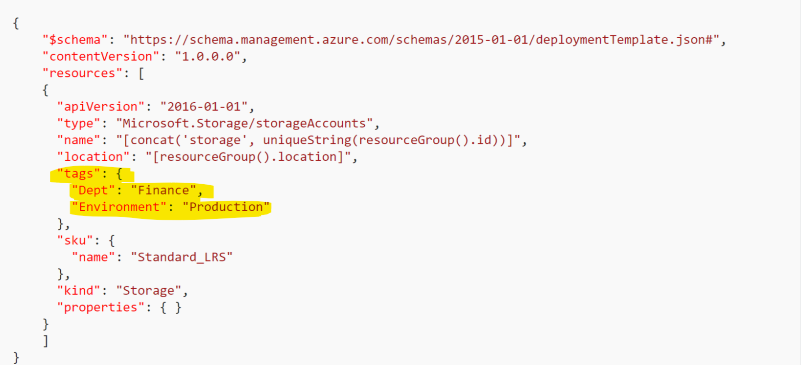
Resource Tags
Tags can by applied in ARM templates, PowerShell, Azure CLI but NOT in the creation wizard in the portal

Slide 11
Tagging Tips
Tag by environment, e.g. dev/test/prod
Tag by role, e.g. web/cache/db
Tag by department, e.g. finance/retail/legal
Tag by responsible party, e.g. Bob
From EA portal, you can get billing excel sheets with the
x15

Slide 12

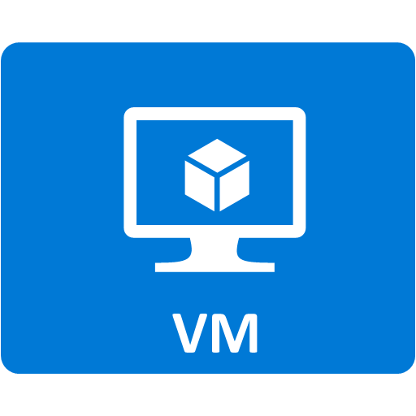
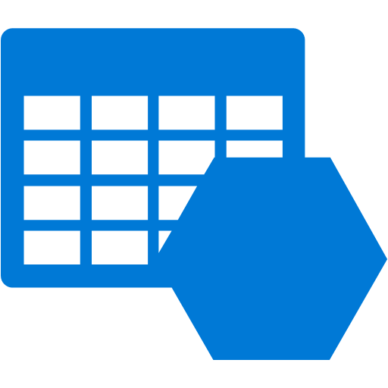


Demo Architecture
Resource Group
IO Code
Virtual Machine Contributor
Availability Set
Machine Type
Machine Type
VM0
VM1
Storage
Virtual Network
Network interface
Network interface
Load balancer
Notes:
The previous demonstration showed how to use a template to provision resources to a resource group. This demonstration will show how to apply tags and role-based access control. We will apply a custom tag, “IO Code”, to the resource group, apply a custom tag “Machine Type” to the virtual machines, and assign the group role “Virtual Machine Contributor” to the resource group.

Slide 13
Azure Policies
Establish conventions
Policy definition
parameters
display name
description
policy rule
logical evaluation
Effect
Policy assignment
Subscription
Resource Group

Slide 14
Azure Policies: Scenarios
Chargeback: Require departmental tags
Geo Compliance: Ensure resource locations
Service Catalogue: Select your service catalog
Convention: Enforce naming & tags
Combine ARM Policies with Activity Log Alerts to cover all requirements

Slide 15
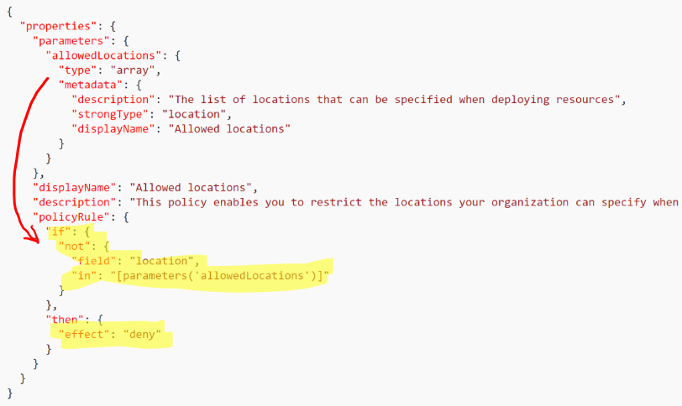
Azure Resource Manager Polices-examples

Slide 16
Resources
Design for subscription boundaries
Billing and Usage APIs
Azure Resource Manager provides RBAC, tagging, organization, and deployment
Samples - https://github.com/Azure/azure-quickstart-templates
Documentation - http://azure.microsoft.com/en-us/documentation/articles/resource-group-overview/

