Slide 1
Step 5
Azure Security Center
Notes:
Introduction slide to Azure Security Center

Slide 2
Goal
Better Secure a Virtual Machine (VM)
Applying Endpoint Protection against Malware.
Enabling Just In Time Access to the VM.
Ensuring the VM is protected by an NSG.
Notes:
Goal Slide.
Essentially we want to better secure a virtual machine which we created with the modules at the start. Since we have created the VM’s they are sitting unprotected in the cloud.
We will apply a few steps to aid in the protection of this artifact:
We will apply Endpoint Protection to aid with Malware which may infiltrate itself onto the box.
We will enable JIT Access to determine when and how the VM shall be accessed via RDP.
We will utilize an NSG to lower the footprint of our VM in order to aid us in securing it against intrusions and malicious activity.

Slide 3
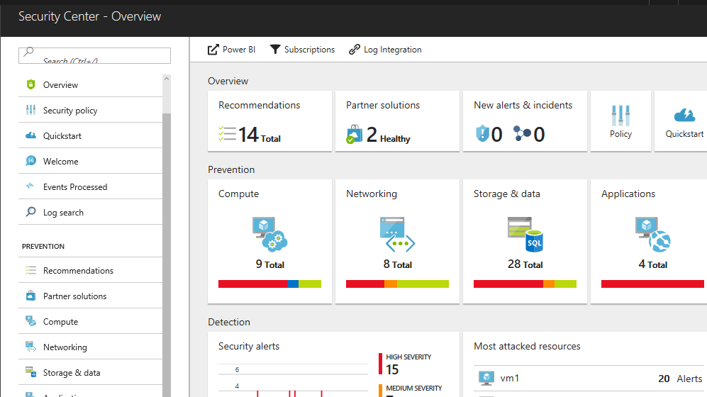
ASC - Monitors the security state of cloud resources
Built-in Azure, no setup required
Automatically discover and monitor security of Azure resources
Gain insights for hybrid resources
Easily onboard resources running in other clouds and on-premises
Notes:
ASC is an integral part of the Azure Portal experience. It comes procured and ready to analyze. From this analysis one can action and remediate issues that arise. Azure Security Center will discover newly added artifacts and resources and recommend actions. ASC will also alert and bring forth incidents that occur against the resources.

Slide 4


Malware is rampant and rapidly evolving
Always evolving
Malware is constantly changing - you can no longer rely on antimalware software to detect and remove malicious code from running on your machines
Hard to block
Application controls can be very effective at blocking malware and unwanted applications, but management of whitelists can be labor-intensive and error prone
BUILT ON CLOUD LOG ANALYTICS PLATFORM
Notes:
Malware is a preponderant part of the security landscape where we see many cases of mass encryptions for ransom as of late. The threats are always evolving and the landscape is ever changing.

Slide 5
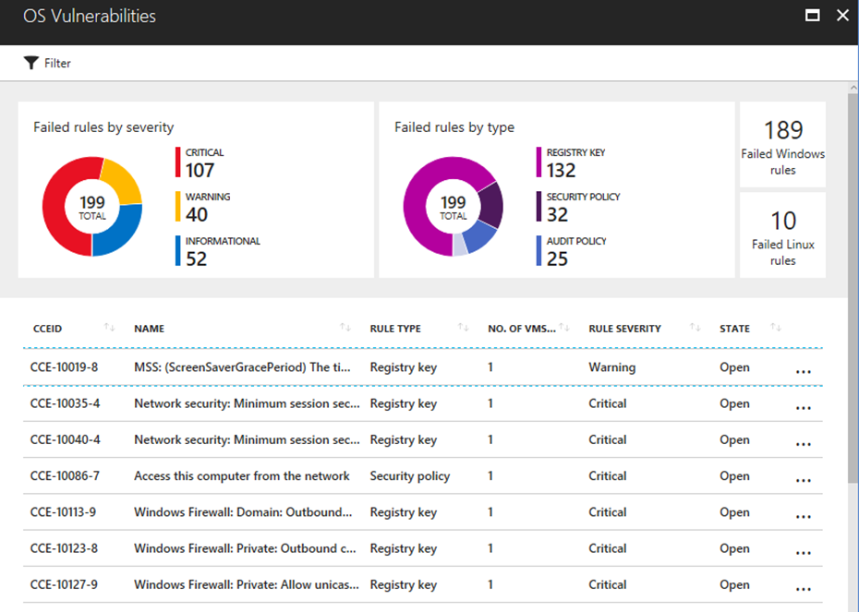
Ensure secure VM configurations
Harden Virtual Machines
System update status
Antimalware protection
OS and web server config
Fix vulnerabilities quickly
Prioritized, actionable security recommendations
Notes:
One of the goals is to ensure that our VM has a secure configuration. One of the steps is to provide anti-malware protection for the endpoint. This will install the necessary software on our VM. Other steps are available but for this area we will only apply the Endpoint protection.

Slide 6
Brute force attacks commonly target open management ports
RDP
SSH
100,00 attacks/month
On average Azure VMs are the subject to 100,000 brute force attacks targeting management ports, most commonly RDP and SSH ports
Easy access
Access to VMs requires only local admin credentials, which are easier targets for brute attacks than more carefully managed domain accounts
Always open
While access to management ports is only required sporadically, these ports are often left open for convenience or by accident
Notes:
When creating a VM in Azure, the scanning commences as they say. This means that malicious actors are scanning all available IP ranges for open ports and the RDP Brute Forces begin. Even if we have only had the VM created for a few hours some attacks have usually commenced.

Slide 7
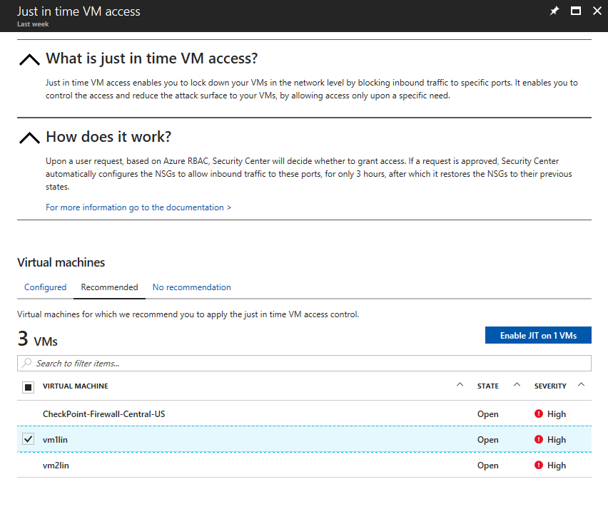
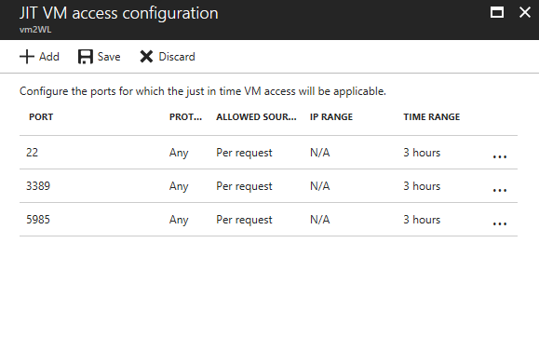
Limit exposure to brute force attacks
Lock down management ports on virtual machines
Enable just-in-time access to virtual machines
Access automatically granted for limited time
Notes:
In order to mititgate the brute forcing we will only allow the machine to be available for certain periods, via certain ports and we can also monitor the login data.

Slide 8
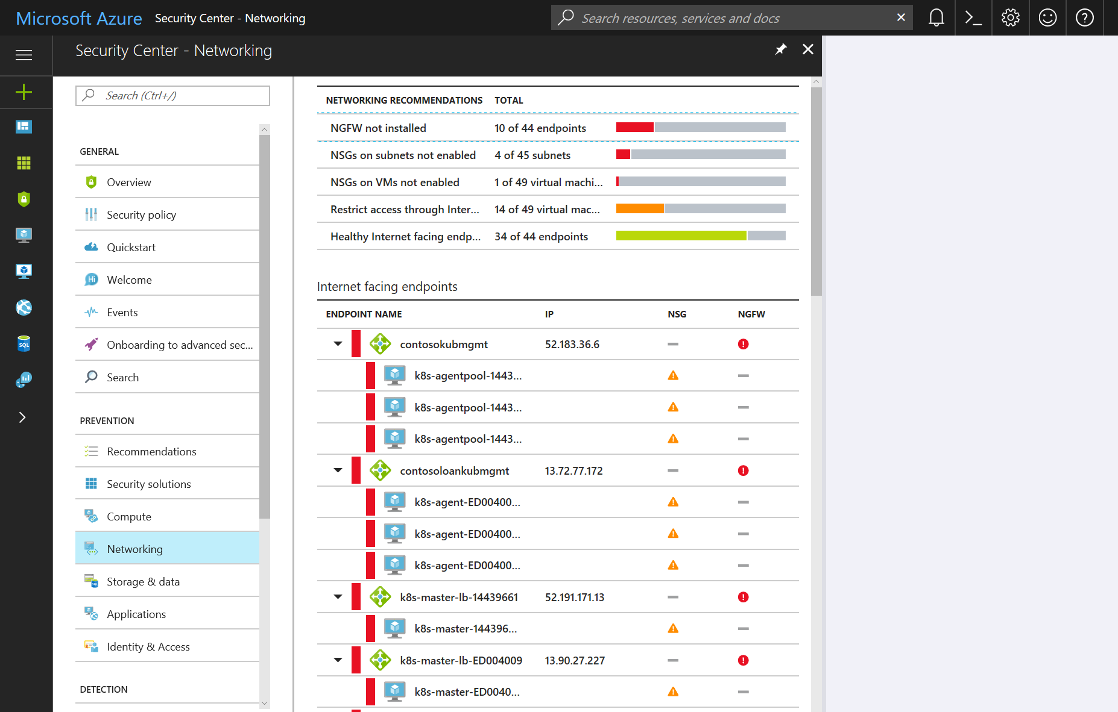
Control network traffic
Use Network Security Groups
Apply NSG rules for inbound and outbound traffic
Add Built-In and Partner Firewalls
Protect web applications with web application firewalls
Deploy Next Generation firewalls
Notes:
We will also apply an NSG around the artifacts to ensure that it has less of a footprint. This is good for malicious actors trying to fingerprint the server. Also good to limit outbound traffic so that data is not extracted with command and conquer techniques.

Slide 9
References:
What is Azure Security Center?
Enable Network Security Groups in Azure Security Center
Manage virtual machine access using just in time
Manage endpoint protection issues with Azure Security Center

