Slide 1
Step 3 Application Insights
Part 1

Slide 2
Goal
Learn how to use Application Insight to find performance problem in a running application.

Slide 3
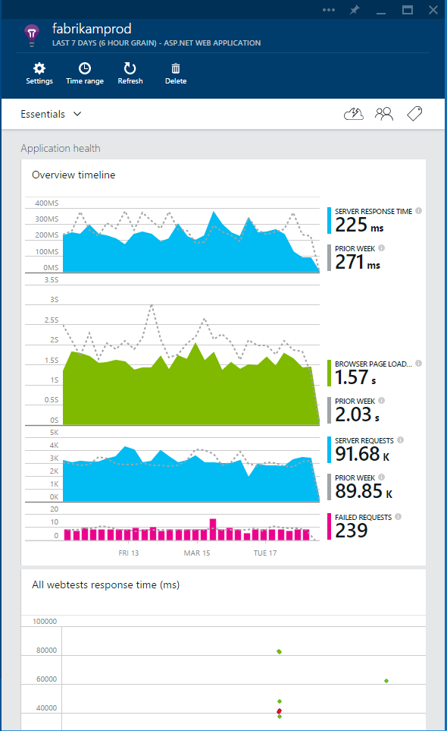
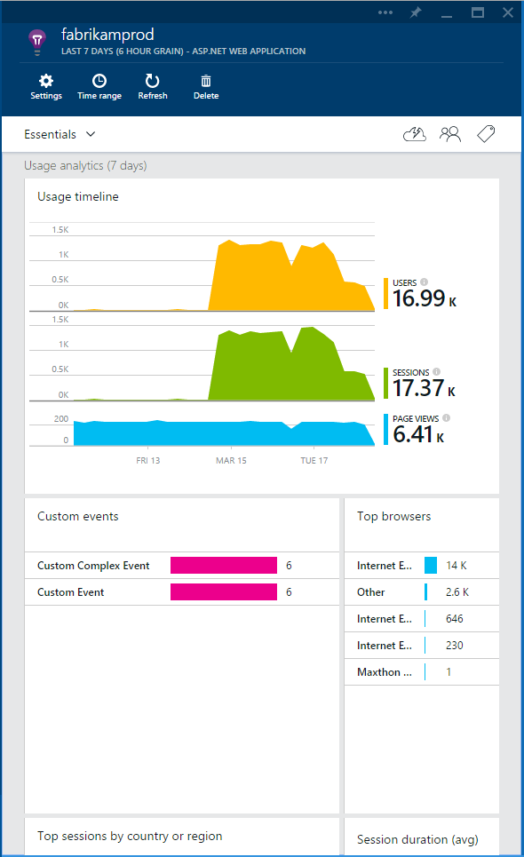
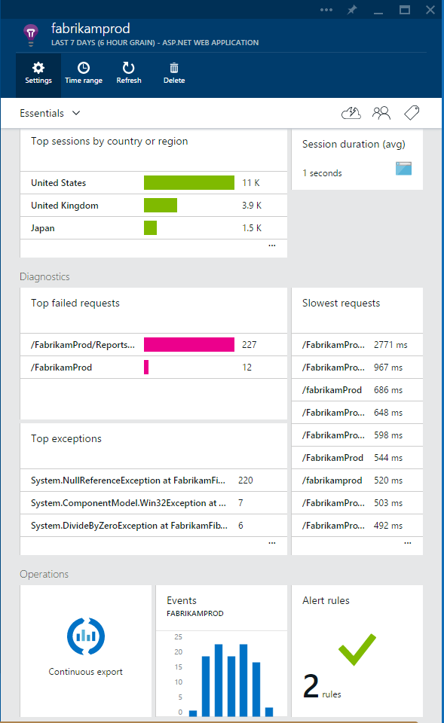
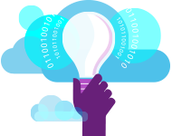

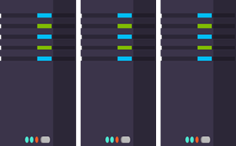
What is Application Insights?
3
Get a 360° view of the application including availability, performance and usage patterns
1
Telemetry is collected at each tier: mobile applications, server applications and browser
2
Telemetry arrives in the Application Insights service in the cloud where it is processed & stored

Slide 4


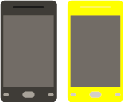

Sources of Telemetry
1
Outside-in monitoring
URL pings and web tests from 16 global points of presence
2
Observed user behavior
How is the application being used?
3
Developer traces and events
app
Whatever the developer would like to send to Application Insights
4
Observed application behavior
platform
No coding required – service dependencies, queries, response time, exceptions, logs, etc.
infrastructure
Infrastructure performance
5
System performance counters

Slide 5
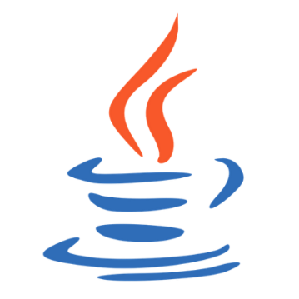
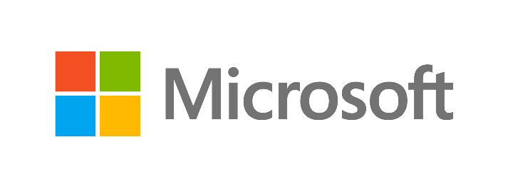



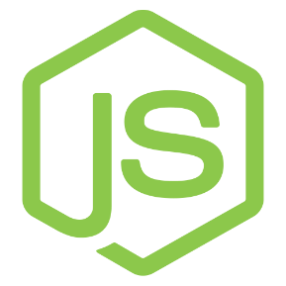



Key capabilities
In Any cloud or On-premise
Multiple platforms: .NET, Java/J2EE, iOS, Android, Windows, Node.JS, PHP, Ruby, Python
Logging framework:
Log4Net
nLog
System.Diagnostics
Log4J
Logback
Open source SDK: https://github.com/Microsoft/ApplicationInsights-Home

Slide 6
Let’s code

Slide 7
References:
How to configure remote debugging for Web Apps & Visual Studio 2017

