Slide 1

Chapter 6
Queueing systems
Learning objectives :
Little's law
Impact of the randomness on performances of queueing systems
Product-form solutions
Textbook :
C. Cassandras and S. Lafortune, Introduction to Discrete Event Systems, Springer, 2007
S.M. Ross, Stochastic Process, John Wiley & Sons

Slide 2
Plan
Introduction
Classification of queueing systems
Little's law
Single stage queuing systems
Queuing networks

Slide 3
Introduction

Slide 4
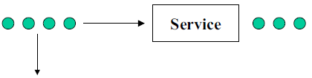
Definition of a queueing system
Departure of served customers
Customer arrivals
Departure of impatient customers
A queueing system can be described as follows:
"customers arrive for a given service, wait if the service cannot start immediately and leave after being served"
The term "customer" can be men, products, machines, ...

Slide 5
History of queueing theory
The theory of queueing systems was developed to provide models for forecasting behaviors of systems subject to random demand.
The first problems addressed concerned congestion of telephone traffic (Erlang, "the theory of probabilities and telephone conversations ", 1909)
Erlang observed that a telephone system can be modeled by Poisson customer arrivals and exponentially distributed service times
Molina, Pollaczek, Kolmogorov, Khintchine, Palm, Crommelin followed the track

Slide 6
Interests of queueing systems
Queueing theory found numerous applications in:
– Trafic control (communication networks, air traffic, …)
– Planing (manufacturing systems, computer programmes, …)
– Facility dimensioning (factories, ...)

Slide 7
Classification of queueing systems

Slide 8
Characteristics of simple queueing systems
Queueing systems can be characterized with several criteria:
Customer arrival processes
Service time
Service discipline
Service capacity
Number of service stages

Slide 9
Notation of Kendall
The following is a standard notation system of queueing systems
T/X/C/K/P/Z with
– T: probability distribution of inter-arrival times
– X: probability distribution of service times
– C: Number of servers
– K: Queue capacity
– P: Size of the population
– Z: service discipline

Slide 10

Customer arrival process
T/X/C/K/P/Z
T can take the following values:
– M : markovian (i.e. exponential)
– G : general distribution
– D : deterministic
– Ek : Erlang distribution
– …
• If the arrivals are grouped in lots, we use the notation T[X] where X is the random variable indicating the number of customers at each arrival epoch
– P{X=k} = P{k customers arrive at the same time}
• Some arriving customers can leave if the queue is too long

Slide 11

Service times
T/X/C/K/P/Z
X can take the following values:
– M : markovian (i.e. exponential)
– G : general distribution
– D : deterministic
– Ek : Erlang distribution
– …
k exponential servers with parameter μ
Erlang distribution E_{k} with parameter μ

Slide 12
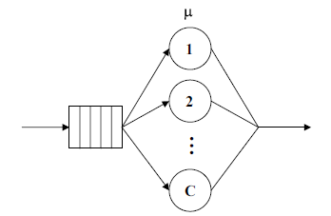
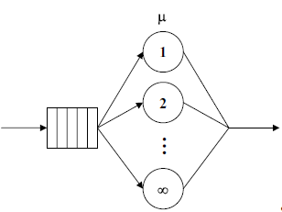
Number of servers
T/X/C/K/P/Z
In simple queueing systems, servers are identical

Slide 13
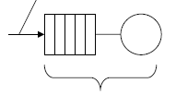
Queue capacity
T/X/C/K/P/Z
Loss of customers if the queue is full
Capacity K

Slide 14
Size of the population
T/X/C/K/P/Z
The size of the population can be either finite or infinite
For a finite population, the customer arrival rate is a function of the number of customers in the system: λ(n).

Slide 15
Service discipline
T/X/C/K/P/Z
Z can take the following values:
FCFS or FIFO : First Come First Served
LCFS or LIFO : Last Come First Served
RANDOM : service in random order
HL (Hold On Line) : when an important customer arrives, it takes the head of the queue
PR ( Preemption) : when an important customer arrives, it is served immediately and the customer under service returns to the queue
PS (Processor Sharing) : All customers are served simultaneously with service rate inversely proportional to the number of customers
GD (General Discipline)

Slide 16

The concept of customer classes
A queueing system can serve several classes of customers characterized by:
different arrival processes
different service times
different costs
service priority according to their class (preemption or no for example)

Slide 17
Simplified notation
We will use the simplified notation T/X/C when we consider a queue where:
The capacity is infinite
The size of the population is infinite
The service discipline is FIFO
• Hence T/X/C = T/X/C/∞/∞/FIFO

Slide 18
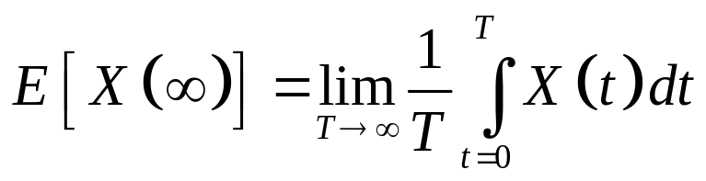
Ergodicity
A system is said ergodic if
its stationary performances
equal
the time average of any realisation of the system, observed over a sufficiently long period
A regenerative system, i.e. a system with a given state s₀ that is visited infinitely often, is ergodic.
Finite, irreducible and aperiodic CMTC are ergodic.
Only ergodic systems will be considered in this course

Slide 19
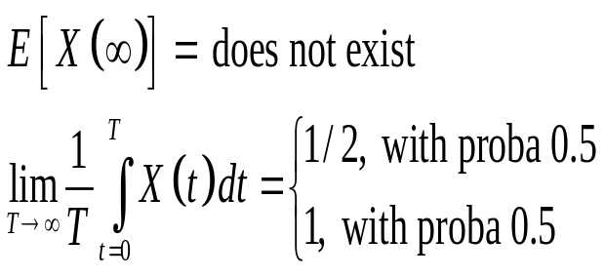
Ergodicity
A non ergodic system : X(t) = reward of the state at time t
1
2
3
unit reward 1
1
1
1
1
4
5
unit reward 2

Slide 20
Little's law

Slide 21
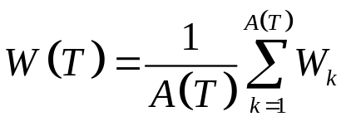
Some transient performances
TH_{e}(T)
TH_{s}(T)
L(T)
W(T)
A(T) : number of customers arrived from 0 to T
D(T) : number of departures between 0 to T
TH_{e}(T) = A(T)/T : average arrival rate between 0 to T
TH_{s}(T) = D(T)/T : average departure rate between 0 to T
L(T) : average number of customers between 0 to T
W_{k}: sojourn time of k-th customer in the system
average sojourn time between 0 to T

Slide 22
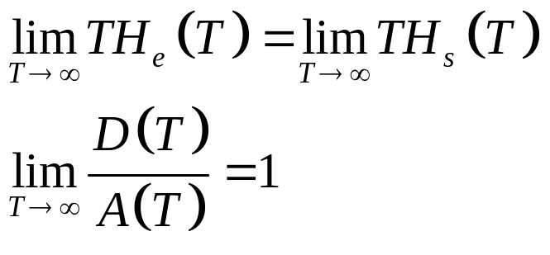
Stability of the queueing system
TH_{e}(T)
TH_{s}(T)
Queueing system
Definition : A queueing system is said stable if the number of customers in the system remains finite.
Implication of the stability:

Slide 23
Little's law
For a stable and ergodic queueing system,
L = TH×W
where
L : average number of customers in the system
W : average response time
TH : average throughput rate
Queueing system
TH
TH
L
W

Slide 24
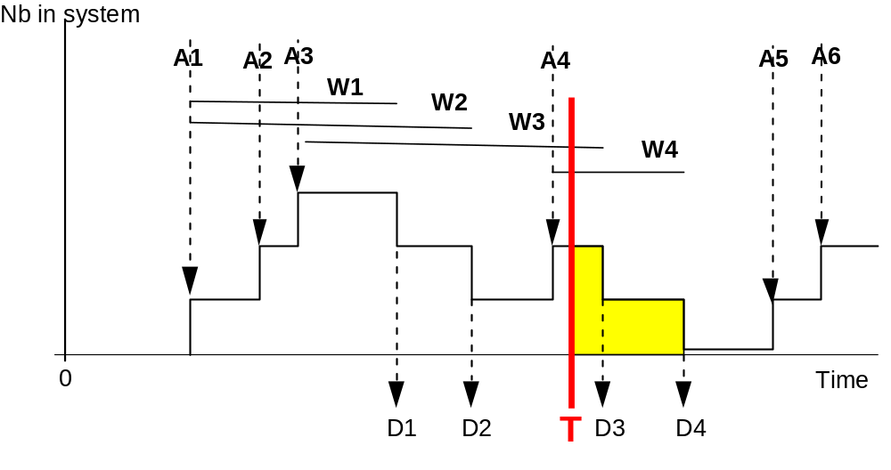
Proof
e(T)

Slide 25
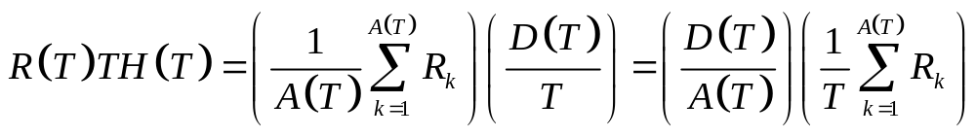
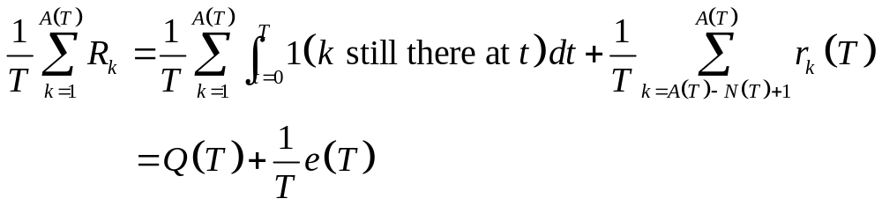
Proof
where N(T) is the number of customers at time T, e(T) total remaining system time of customers present at time T.
Letting T go to infinity, the stability implies the proof.

Slide 26
Single stage queueing systems

Slide 27
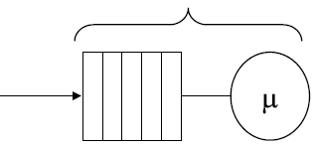
M/M/1 queue
N(t) : number of customers in the system
λ
Poisson arrivals
Exponentially distributed service tim

Slide 28
Stability condition of M/M/1 queue
The M/M/1 queue is stable iff
λ < μ
or equivalently
ρ < 1
where
ρ = λ/μ is called the traffic ratio or traffic intensity.
The number of customers in the system is unlimited and hence there is no steady state when the system is not stable.

Slide 29
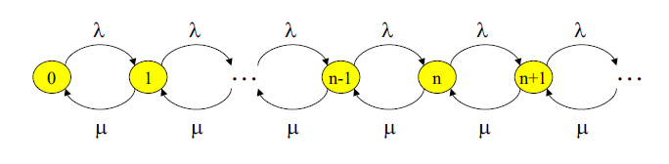
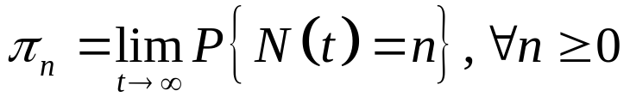
Markov chain of the M/M/1 queue
When the system is stable, stationary probability distribution exists as the CTMC is irreducible.
Let

Slide 30
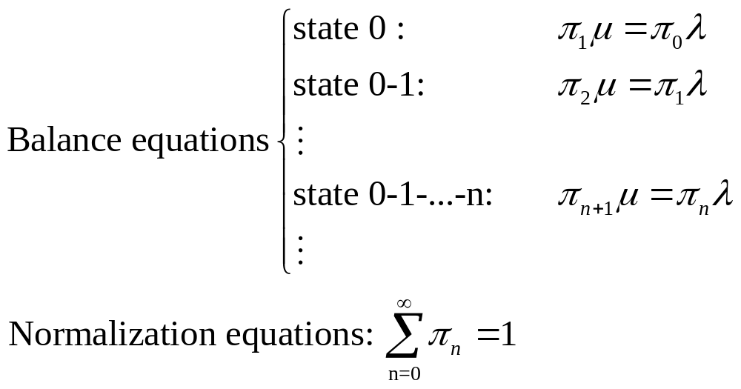
Steady state distribution of M/M/1 queue
With ρ = λ/μ,
π₀ = 1 − π
π_{n} = ρ^{n} π₀

Slide 31
Performance measures of M/M/1 queue
(online proof and figures)
Ls = Number of customers in the queue = ρ/(1−ρ) = λ/(μ−λ)
Ws = Sojourn time in the system = 1/(1−ρ)μ = 1/(μ−λ)
Lq = queue length = λ²/(μ−λ)μ = Ls − ρ
Wq = average waiting time in the queue = λ/(μ−λ)μ = Ws − 1/μ
ΤΗ = departure rate = λ
Server utilization ratio = ρ
Server idle ratio = P₀ = 1 - ρ
P{n > k} = Probability of more than k customers = ρ^{k+1}

Slide 32
M/M/C queue
Exponentially distributed service tim
λ
Poisson arrivals
N(t) : number of customers in the system
N(t) is a birth and death process with
  The birth rate λ.
  The deadth rate is not constant and is equal to N(t)μ if N(t) ≤ C and Cμ if N(t) > C.
Stability condition : λ< cμ.

Slide 33
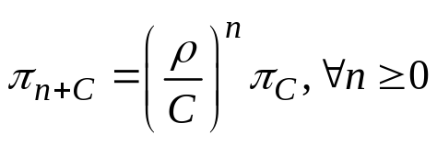
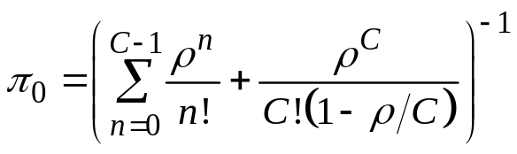
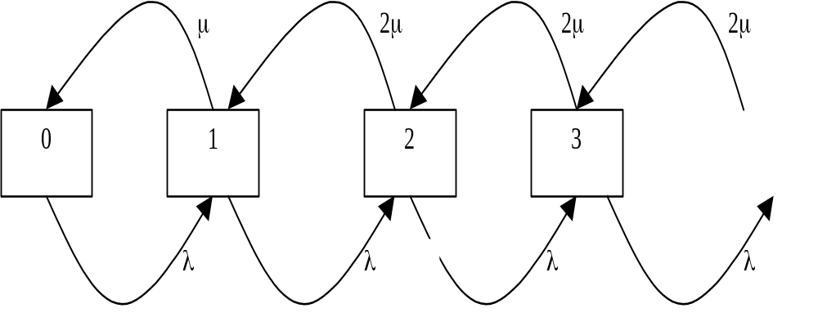
Steady state distribution of M/M/C queue
Distribution :
= λ/μ
π_{n} = ρ^{n}/n! π₀, ∀ 0 < n ≤ C
Markov chain of M/M/2 queue

Slide 34
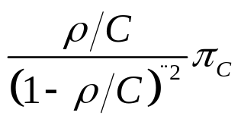
Performance mesures of M/M/C queue
Ls = Number of customers in the system
= Lq + ρ
Ws = Sojourn time in the system
= Wq + 1/μ
Lq = Average queue length
=
Wq = Average waiting time
= Lq / λ
= Average number of busy server, π = ρ
U = Waiting probability
= π_{C} + π_{C+1} + ...
= π_{C}/(1-ρ/C)

Slide 35
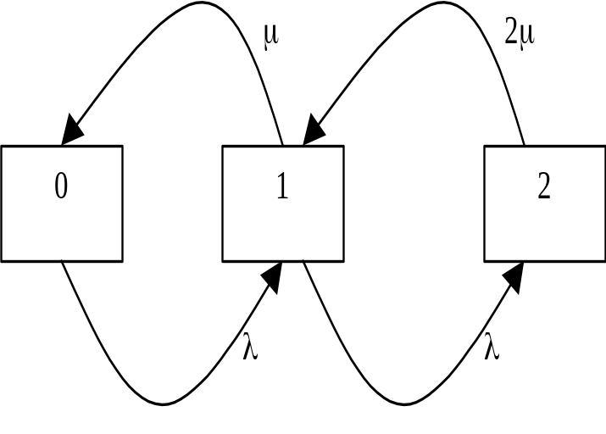
M/M/C with impatient customers
Similar to M/M/C queue except the loss of customers which arrive when all servers are busy.
Markov chain of M/M/2 queue with impatient customers

Slide 36
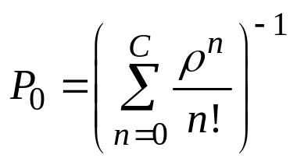
M/M/C with impatient customers
Steady state distribution :
ρ = λ/μ
P_{n} = ρ^{n}/n! P₀, ∀ 0 < n ≤ C
Pourcentage of lost customers = P_{C}
Server utilization ratio = (1 – P_{C}) λ/Cμ
Insensitivity of Erlang Loss system M/GI/C without queue
(see Gross & Harris or S. Ross, proof by reserved system) :
P_{n} depends on the distribution of service time T only through its mean, i.e. with μ = E[T]

Slide 37
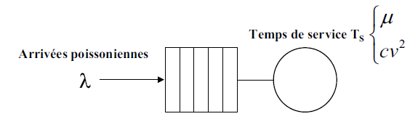
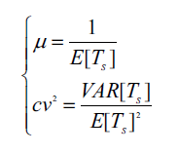
M/G/1 queue
Service time T_{s}
Poisson arrival

Slide 38
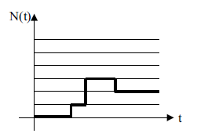
M/G/1 queue
As the service time is generally distributed, the departure of a customer depar depends on the time it has been served.
The stochastic process N(t) is not a Markov chain.

Slide 39
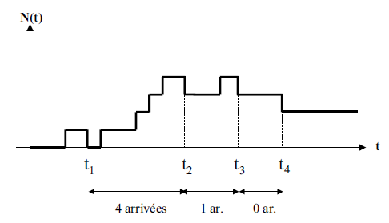
M/G/1 queue: an embeded Markov chain
Consider the stochastic process {X_{k}}_{k≥1} , the number of customers after the departure of the k-th customer at t_{k}
4 arrivals
{X_{k}}_{k≥1} is a CTMC and X_{k+1} = (X_{k} -1)⁺ + number of customers arrived during the service of the (k+1)-th customer.
Distribution of {X_{k}} is also the steady state distribution.

Slide 40
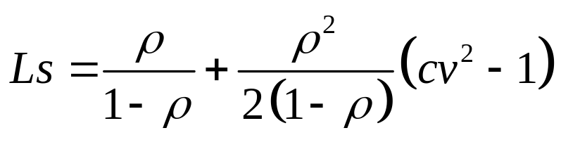
M/G/1 queue: Pollaczek-Khinchin formula
Pollaczek-Khinchin formula or PK formula
From the PK formula, other performance measures such as Ws, Lq, Wq can be easily derived.
From PK formula, we observe that randomness always hurt the performances of a system. The larger the randomness (i.e. larger cv²), the longer the queue length is.

Slide 41


G/G/1 queue
Inter-arrival times A_{n} between customer n and n+1 :
E[A_{n}] = 1/λ
Service time T_{n} of customer n :
E[T_{n}] = 1/μ
Waiting time W_{n} in the queue of customer n (Lindley equation)
W_{n+1} = max{0, W_{n} + T_{n} - A_{n}}

Slide 42
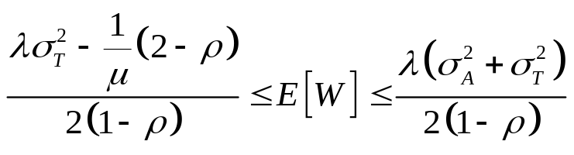
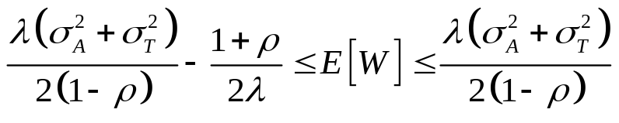
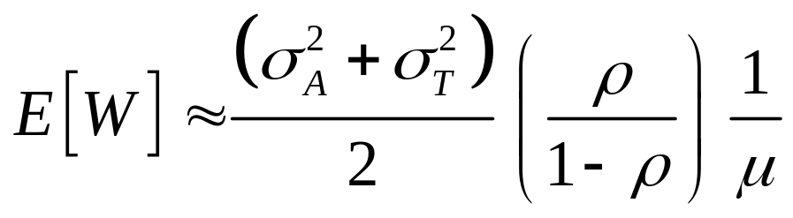
G/G/1 queue
Bounds of Waiting time
If E[A - t | A > t] < 1/λ, then
Waiting time approximation (Kingman's equation or VUT equation)
tightless check with Lq
Varability
Utilization
Time

Slide 43
Queueing networks

Slide 44
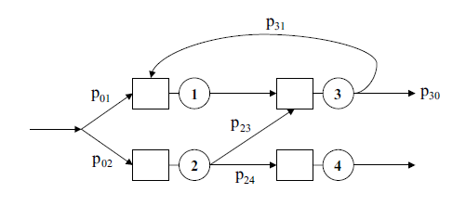
Definition of queueing networks
A queueing network is a system composed of several interconnected stations, each with a queue.
Customers, upon the completion of their service at a station, moves to antoher station for additional service or leave the system according some routing rules (deterministic or probabilitic).

Slide 45
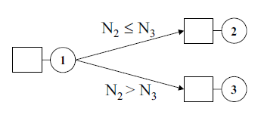
Example of deterministic routing
Shortest queue rule

Slide 46
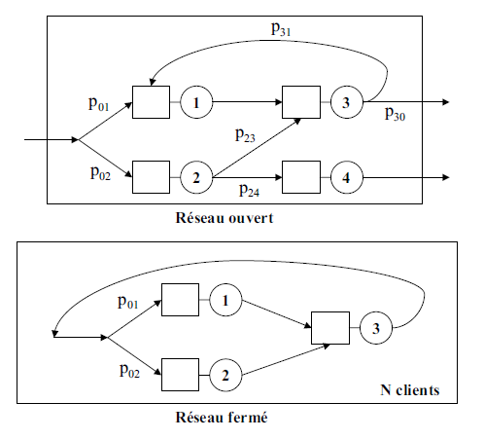
Open network or closed network
Open network
N customers
Closed network

Slide 47
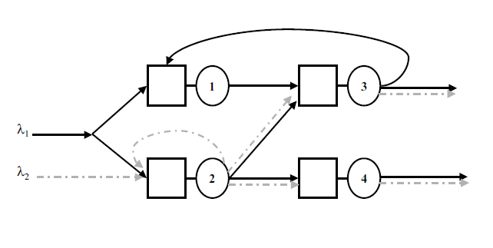
Multi-class network

Slide 48
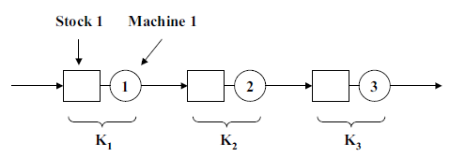
A production line
Raw parts
Finished parts

Slide 49
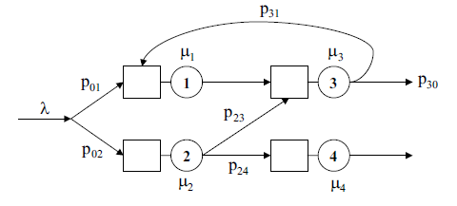
Open Jackson Network
An open Jackson network (1957) is characterized by:
One single class of customers
A Poisson arrival process at rate λ (equivalent to independent external Poisson arrival at each station)
One server at each station
Exponentially distributed service time with rate μ_{i} at station i
Unlimited capacity at each queue
FIFO service discipline at all queues
Probabilistic routing

Slide 50
Open Jackson Network
routing
p_{ij} (i ≠0 and j≠ 0) : probability of moving to station j after service at station i
p_{0i} : probability of an arriving customer joining station i
p_{i0} : probability of a customer leaving the system after service at station i

Slide 51
Open Jackson Network
stability condition
Let λ_{i} be the customer arrival rate at station i, for i = 1, ..., M where M is the number of stations.
The system is stable if all stations are stable, i.e.
λ_{i} < μ_{i}, ∀i = 1, ..., M
Consider also e_{i} the average number of visits to station i for each arriving customer:
e_{i} = λ_{i}/λ

Slide 52
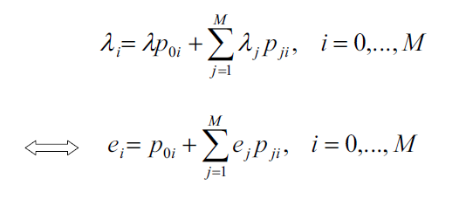
Open Jackson Network
arrival rate at each station
These arrival rates can be determine by the following system of flow balance equations which has a unique solution.
Example: ???

Slide 53
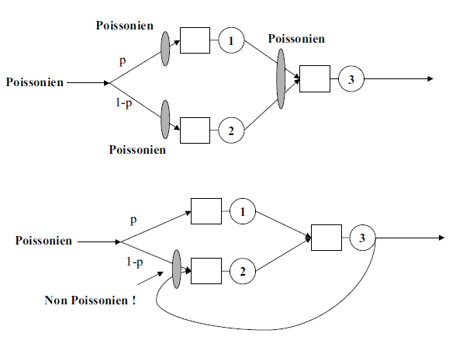
Open Jackson Network
Are arrivals to stations Poisson?
as the departure process of M/M/1 queue is Poisson.
Feedback keeps memory.

Slide 54
Open Jackson Network
State of the queueing network
Let n(t) = (n₁(t), n₂(t), …, n_{M}(t)), where n_{i}(t) is the number of customers at station i at time t
The vector n(i) describes entirely the state of the Jackson network
{n(t)}_{t≥0} is a CTMC
Let π(n) be the stationary probability of being in state n
Notation: e_{i} = (0, …, 0, 1, 0, …, 0)
i-th position

Slide 55
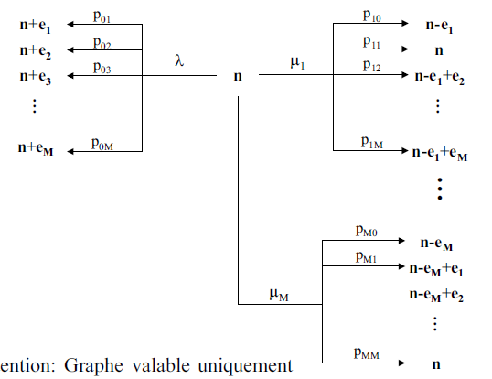
Open Jackson Network
Underlying Markov Chain
Attention: Some transitions are not possible when n_{i} = 0, for some i

Slide 56
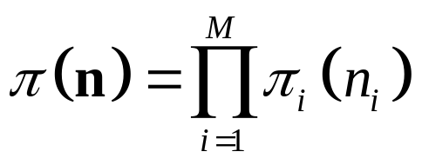
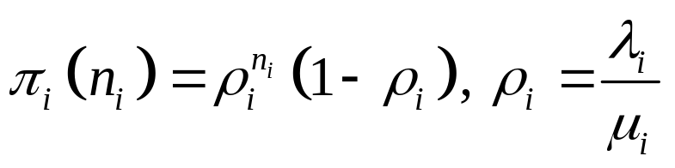
Open Jackson Network
Stationary distribution - Product form solution
Theorem: The stationary distribution of a Jackson queueing network has the following product form :
where π_{i}(n_{i}) is the stationary distribution of a M/M/1 queue with arrival rate λ_{i} and service rate μ_{i}, i.e.

Slide 57
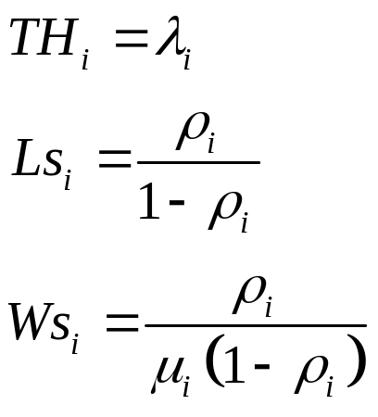
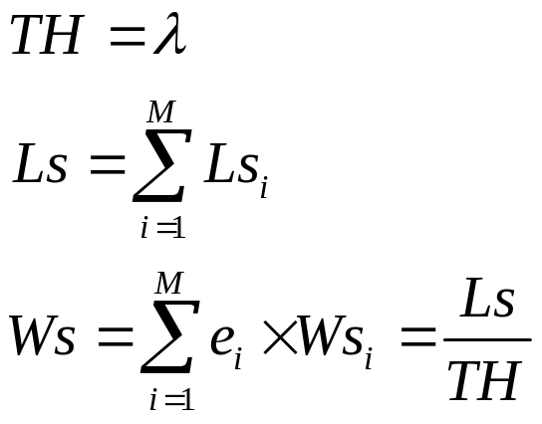
Open Jackson Network
Performance measures
Performance measures of each M/M/1 queue
Performance measures of the queueing network

Slide 58
Open Jackson Network
Extension to multi-server stations
Assume that each station i has C_{i} servers
The stability condition is
λ_{i} < C_{i}μ_{i}, ∀i = 1, …, M
The stationary probability distribution still has the product form:
where π_{i}(n_{i}) is the stationary distribution of a M/M/C_{i} queue with arrival rate λ_{i} and service rate μ_{i}.

Slide 59
Open Jackson Network
Proof of the product form solution
Reversed Markov chain of a Markov chain is obtained by looking back in time.
Transition rates μ*_{ij} are defined such that
π_{i}μ*_{ij} = π_{j}μ_{ji}
where μ_{ij} and π_{i} are transition rates and stationary distribution of the original CTMC.
From the balance eq, Σ_{j} μ*_{ij} = Σ_{j} μ_{ij} (same state sojourn time)
Theorem of reversed CTMC: For an irreducible CTMC, if we can find a collection of numbers μ*_{ij} and a collection of numbers x_{i} ≥ 0 summing to unity such that
x_{i}μ*_{ij} = x_{j}μ_{ji} and Σ_{j} μ*_{ij} = Σ_{j} μ_{ij}
then μ*_{ij} are the transition rates of the reversed chain and x_{i} are the steady state probabilities for both chains. (Home work)

Slide 60
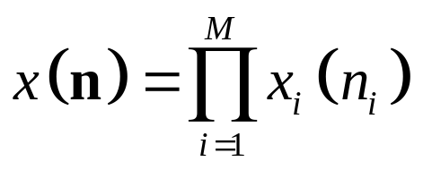
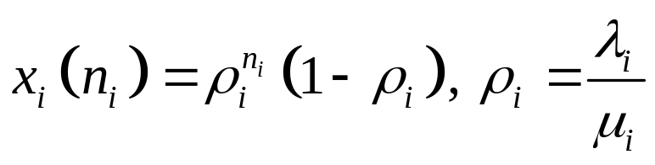
Open Jackson Network
Proof of the product form solution
Guessed Reversed Markov chain of the Jackson network :
a Jackson network with
(1) arrival rate at station i including 0 : λ*_{i} = λ_{i}
(2) prob. of joining station j after service at i : λ*_{i}p*_{ij} = λ_{j}p_{ji} or p*_{ij} = λ_{j}p_{ji}/λ_{i}
(3) service rate at station i : μ*_{i} = μ_{i}
Guessed Probability distribution to prove :

Slide 61
Open Jackson Network
Proof of the product form solution
Checking conditions of the reversed CTMC theorem
1/ Same sojourn time at the same state at any state n
Trivial as λ*₀ = λ₀ and μ*_{i} = μ_{i} ;
2/ x_{n}μ*_{n,n'} = x_{n'}μ_{n',n} for all couple of states n, n'.
Case n = (n₁, ..., n_{i}, …, n_{M}) and n' = (n₁, ..., n_{i}+1, …, n_{M})
μ*_{n,n'} = λ*₀p*_{0i} = λ_{i}p_{i0}; μ_{n',n} = μ_{i}p_{i0}
Case n = (n₁, ..., n_{i}, …, , n_{j}, ..., n_{M}) and n' = (n₁, ..., n_{i}+1, …, , n_{j}-1, ..., n_{M})
μ*_{n,n'} = μ*_{j}p*_{ji} = μ_{j}λ_{i}p_{ij}/λ_{j}; μ_{n',n} = μ_{i}p_{ij}
Case n = (n₁, ..., n_{i}, …, n_{M}) and n' = (n₁, ..., n_{i}-1, …, n_{M})
μ*_{n,n'} = μ*_{i}p*_{i0} = μ_{i}λp_{0i}/λ_{i}; μ_{n',n} = λp_{0i}
Hence, x(n) is the distribution of the Jackson network.

Slide 62
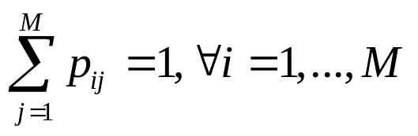
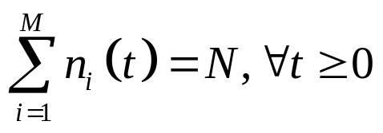
Closed Queuing Network
Definition
Similar to Jackson network but
with a finite population of N customers
without extern arrivals.
As a result,
λ = 0

Slide 63
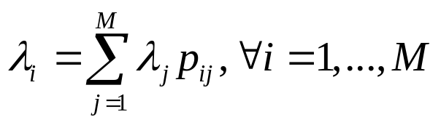
Closed Queuing Network
Arrival rates
The arrival rates λi satisfy the following flow balance equations
Unfortunately, the above system of flow balance equations has one free variable.

Slide 64
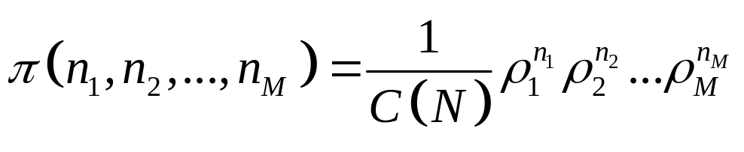
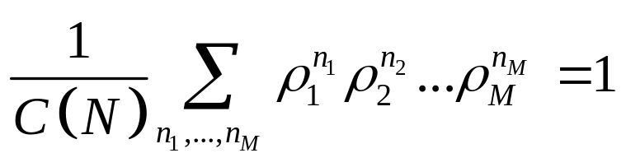
Closed Queuing Network
Product form solution
Product form solution of Gordon and Newell (1967)
where
ρ_{i} = λ_{i}/μ_{i} with λ_{i} obtained from the solution of the flow balance equations with a free constant chosen arbitrarily
C(N) is a normalizing constant such that the sum of probability equals 1, i.e.
Direct computation of C(N) is very tedious when the state space is large.

Slide 65
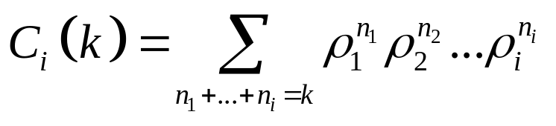
Closed Queuing Network
Computation of the normalization constant C(N)
Buzen's algorithm (1973) uses relations (home work)
C_{i}(k) = C_{i-1}(k) + ρ_{i}C_{i}(k-1), ∀i=2, ..., M, k = 2, ..., N
where
with initial conditions
C₁(k) = (ρ₁)^{k}, C_{i}(1) = 1
from which C(N) is obtained as
C(N) = C_{M}(N)

Slide 66


Closed Queuing Network
Computation of the normalization constant C(N)
It can be shown that the utilization of station i is given by
The marginal distribution can be determined as follows (home work):

Slide 67



Closed Queuing Network
Mean Value Analysis (MVA)
Suppose we are only interested in throughput TH_{i} and mean number of customers at station i L_{i} (i.e. Ls_{i})and mean system time W_{i} (i.e. Ws_{i})
The MVA method of Reiser and Lavenberg (1980) bypasses te computation of C(N).
It relies on the following simple relations :
where
is the average system time experienced by a customer arriving at i
is the average queue length seen by a customer arriving at i
λ_{i} is any solution of the flow balance equation
a_{N} is the missing factor.

Slide 68

Closed Queuing Network
Mean Value Analysis (MVA)
It can be shown that is the same as the average queue length at i in a network with (N-1) customers.
Let L_{i}(N), TH_{i}(N), W_{i}(N) be the queue length, the throughput and the system time of a network with N customers.
The following system can be iteratively solved to obtain the results:
where equation (4) is from Little's law for station i.
At each iteration N = 1, 2, ..., (1) is used to determine W_{i}(N), combination of (3) & (4) determines a_{N} and TH_{i}(N), (4) gives L_{i}(N).

Slide 69
Closed Queuing Network
Example
p
μ₂
μ₁
1-p
μ₃
p = 0.5, μ₁ = 4, μ₂ = 1, μ₃ = 2
N= 2, 3, 4

