Slide 1
Database Keys
Maneel Reddy
Alex Bradshaw
Nischal Mishra
Yu-Hsin Wang

Slide 2
Helping a friend in creating an ecommerce website database….
Our friend Cody wants to create a website where he can sell his saxophones and needs your help in creating a database infrastructure. In return, he promises 10% of equity. He tells us the following:-
Customer information is important. I hope to monetize it ASAP.
I currently sell around 6 types of saxophones which are supplied by multiple suppliers. There are no discounts & my payments are handled by Stripe.
All my deliveries are fulfilled by USPS directly from the supplier.
I want to keep track of cart data for the purpose of analytics. An intern from USF will deploy state-of-the-art ML models to recommend customer churn as part of his practicum.
While predicting customer churn seems more interesting, we know that is impossible without having a proper database infrastructure. Armed with our knowledge of databases, we have a task in hand. The following thoughts come to our head….
Suppliers
Session
Customers
Product
Transactions

Slide 3
Brainstorming tables….
Keeping in mind Suppliers,Product,Session & Cart data,Customers & Transactional data, we create the following tables with some basic rudimentary datatypes:-
Product
id | int
name | varchar
desc | text
price | decimal
created_at | timestamp
modified_at | timestamp
Shopping Session
id | int
user_id | int
total_time | decimal
created_at | timestamp
modified_at | timestamp
Cart Item
Session_id | int
product_id | int
quantity | decimal
created_at | timestamp
modified_at | timestamp
User
id | int
username | varchar
password | text
first_name | varchar
last_name | varchar
address | varchar
telephone | int
created_at | timestamp
modified_at | timestamp
Orders
id | int
user_id | text
transaction_date | timestamp
Order Items
order_id | int
product_id | text
quantity | int

Slide 4
Establishing monogamy, polygamy & polyandry between tables….
Now, we need to identify relationships between all these tables:-
Product
id | int
name | varchar
desc | text
price | decimal
created_at | timestamp
modified_at | timestamp
Shopping Session
id | int
user_id | int
total_time | decimal
created_at | timestamp
modified_at | timestamp
One-One
One-Many
Many-Many
User | Orders
id | user_id
X
Cart Item
Session_id | int
product_id | int
quantity | decimal
created_at | timestamp
modified_at | timestamp
User
id | int
username | varchar
password | text
first_name | varchar
last_name | varchar
address | varchar
telephone | int
created_at | timestamp
modified_at | timestamp
User | Shopping Session
id | user_id
X
Orders | Order Items
id | order_id
X
Orders
id | int
user_id | text
transaction_date | timestamp
Supplier | Product
id | id
X
Supplier
id | int
name | varchar
address | varchar
product_id | varchar
created_at | timestamp
Shopping session | Cart item
id | session_id
X
Order Items
order_id | int
product_id | text
quantity | int
User | User
id | username
X

Slide 5
Lock and Key….
Now that we have defined our relationships between keys. We need to define our primary, unique, foreign & composite keys to enforce data integrity :-
Product | Product
PK | id | int
 | name | varchar
 | desc | text
 | price | decimal
 | created_at | timestamp
 | modified_at | timestamp
Shopping Session | Shopping Session
PK | id | int
FK | user_id | int
 | total_time | decimal
 | created_at | timestamp
 | modified_at | timestamp
Cart Item | Cart Item
FK | Session_id | int
FK | product_id | int
 | quantity | decimal
 | order_status | boolean
 | created_at | timestamp
 | modified_at | timestamp
Primary Key:
Ensures every data point is unique
Does not allow NULL values
Foreign Key:
Refers a primary key of another table
Enforces referential integrity
Links tables and ensures that no data point can come outside the primary key of the referred table.
Composite Key:
A combination of two or more columns which enforce uniqueness
Each column by itself does not enforce uniqueness.
Unique Key:
Enforces every data point is unique
Can accept NULL values
Is not the primary key
User | User
PK | id | int
UK | username | varchar
 | password | text
 | first_name | varchar
 | last_name | varchar
 | address | varchar
 | telephone | int
 | created_at | timestamp
 | modified_at | timestamp
Orders | Orders
PK | id | int
FK | user_id | text
 | transaction_time | timestamp
Order Items | Order Items
FK | order_id | int
FK | product_id | text
 | quantity | int
Suppliers | User
CK | id | int
UK | name | varchar
 | address | varchar
CK/FK | product_id | varchar
 | created_at | timestamp

Slide 6
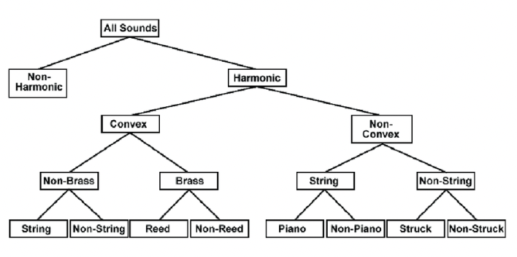
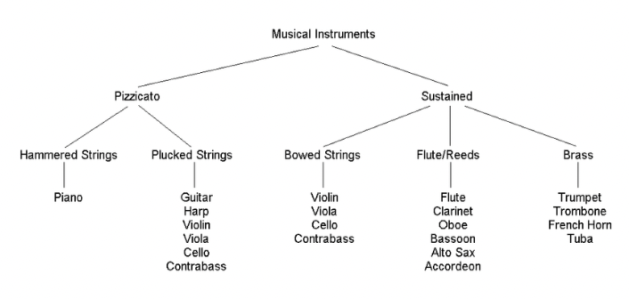
In business, complexity both drives innovation and hinders it ….
Congratulations!!! Our initial database model is a success. Fast forward 5 months, there are several orders and Cody wishes to expand beyond his 6 saxophones. He decides to sell all forms of musical instruments to guitars & drums etc. Meanwhile, our intern says he can predict customer churn better if he has features of the musical instruments. Such as size, string tension etc. Now, thinking it is an easy task, you decide to revise your database model to add a product features table as below:-
Product | Product
PK | id | int
 | name | varchar
 | desc | text
 | price | decimal
 | created_at | timestamp
 | modified_at | timestamp
Product Features | User
FK | product_id | int
 | size | varchar
 | color | text
 | frequency | int
 | type | varchar
 | material | varchar
Cody has a look and says the following:-
“What about drums & pianos? I don’t think color matters a lot. I also wish to sell music accessories like hardware & shells soon. Also, there might be a hierarchy within features. Do you think their features can be incorporated well in this model?”
He shows us the following:-

Slide 7
Drawbacks of keys….
“A friend of mine is a guitar player, but you have to leave the door open for him. He can never find the right key to come in.”
Looking at it, we think of the following.
Music Features | User
FK | product_id | int
 | Pizzicato | boolean
 | Plucked Cat | boolean
 | Sustained Cat | varchar
 | Sustained Cat2 | varchar
Product | Product
PK | id | int
 | name | varchar
 | desc | text
 | price | decimal
 | created_at | timestamp
 | modified_at | timestamp
Sound Features | User
FK | product_id | int
 | Harmonic | Boolean
 | Convex | Boolean
 | Brass | Boolean
 | String | Boolean
 | Piano | Boolean
 | Struck | Boolean
Is this a good solution. While inserting the data, we also notice several NULL values in the columns. Keys are important and enforce integrity in data. However, they can cause the following problems:-
Inserting into a database becomes time intensive(especially for foreign keys) as each time data is inserted, the system has to cross check against another table.
Changing business scenarios mean that keys have to be updated on a regular basis. It is time intensive to create new keys as a combination of multiple attributes.
There are storage implications as well(too technical).
Can increase querying time due to several joins required.

Slide 8
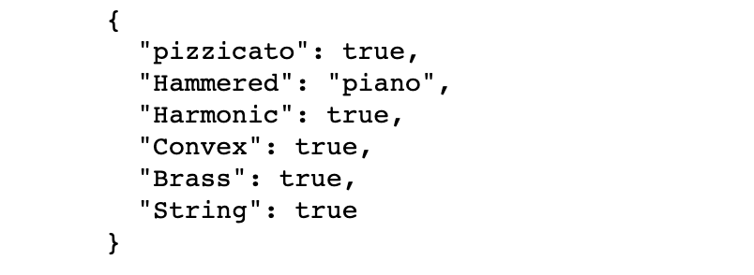
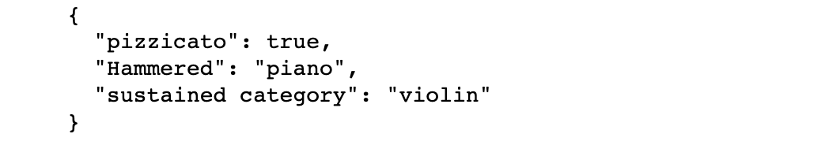
Plausible solutions….
Keys are still important. They enforce data integrity and are still widely used. For e.g. the foreign and primary keys need to be used in the order details, order and supplier tables. A plausible solution to the features problem is using a key value database as follows:-
Product | Product
PK | id | int
 | name | varchar
 | desc | text
 | price | decimal
 | Features_json | json
Most real-life database models use a combination of both key-value & RDMS solutions. E.g. Shopify ER diagram.

