Slide 1
Node.js Chat-Server Group D
Alexander Brückner 742830,
Franziska Drobnik 742079

Slide 2
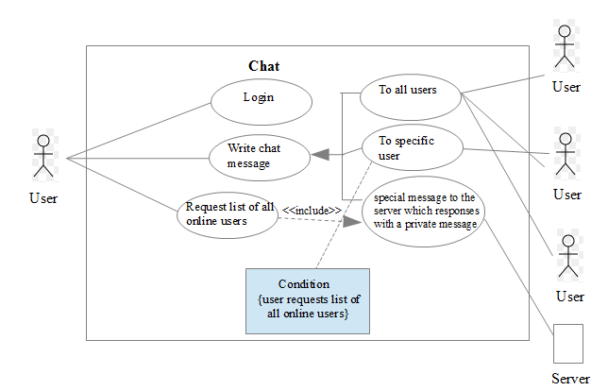
Use Case Diagram

Slide 3
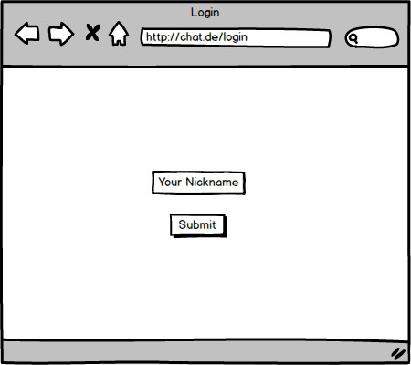
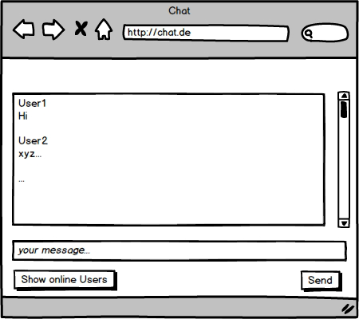
Design Mockups

Slide 4
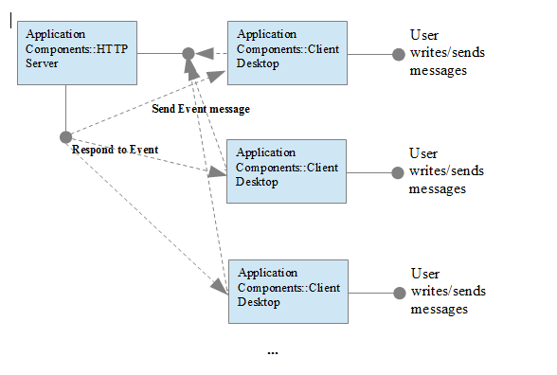
Component Diagram

Slide 5
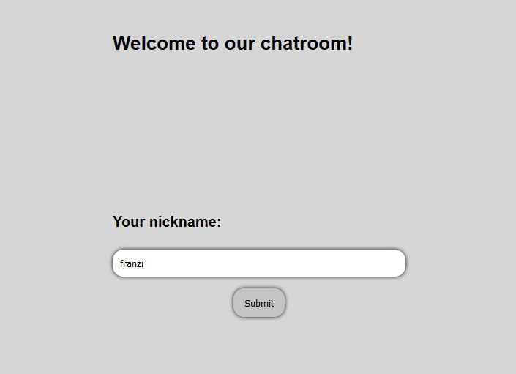
Our Node.js Chat-Server

Slide 6
Our Node.js Chat-Server
HTML
• chat.html
contains the html description for the chatroom area and the chat message events
for the server if the users are typing messages.
• index.html
contains the html description for the login area of the chatroom.
Javascripts
• enternickname.js
stores the nicknames of the users.
• index.js
contains the setup of the application, initializes the instance of socket.io and listens
to the connection for incoming sockets. Furthermore the chat message events of
the chat.html are printed out here.

