Slide 1
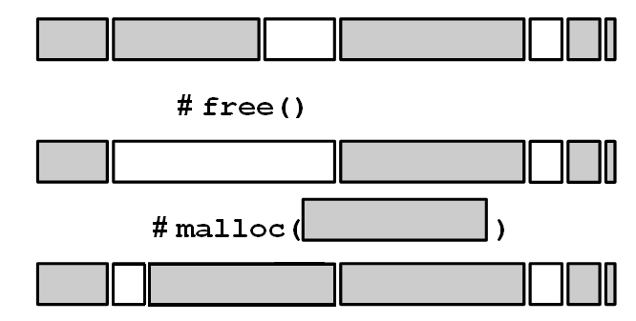
Unix System : Malloc
Kind of Basic Dynamic Allocation

Slide 2
Plan
I Subject
II Team
III Breakdown of Tasks
IV Al Khwarizmi

Slide 3

Subject
We have to rewrite the 3 library functions which are:
▶ Malloc
▶ Free
▶ Realloc
Using only brk/sbrk and our mind.

Slide 4


A-Team
Malloc No Name
Arthur Coruble
Alexandre Brun

Slide 5

BreakDown
We used the Trello tool , emails and meetings to organize and distribute the following tasks:
- Structure Creation
- Free Blocks
- Malloc
- Free
- Realloc

Slide 6
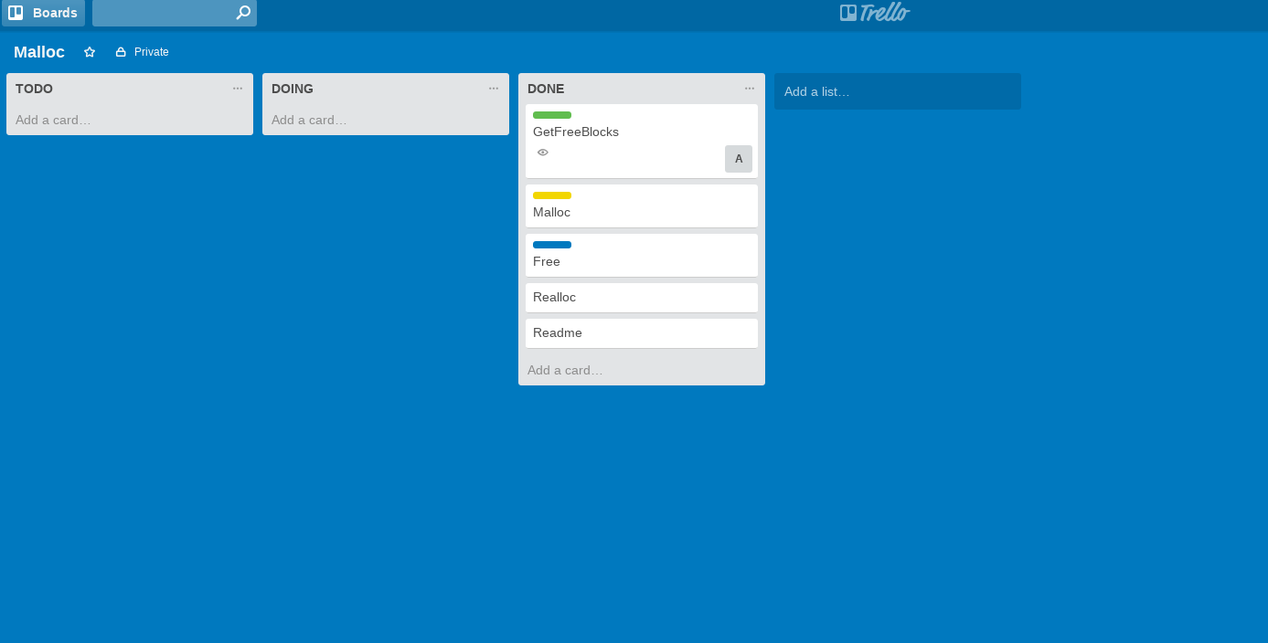

Slide 7
                Al Khwarizmi
Different algorithms :
- First fit algorithm (used in our project)
-Best fit algorithm
-Next fit algorithm
-Buddy algorithm

Slide 8
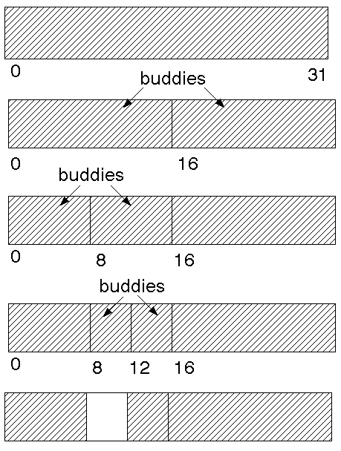
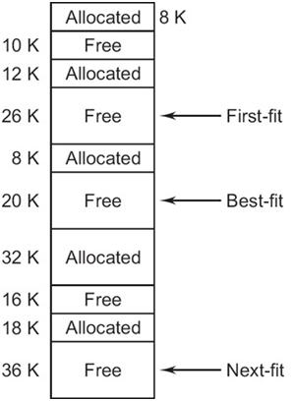
Algorithm illustrations

