Slide 1

Web Client Performance, Availability and Usage Monitoring with Microsoft Application Insights
Alex Bulankou | Development manager at Microsoft Application Insights | Linkedin: Alex Bulankou | Twitter: @bulankou
Demo: https://github.com/AlexBulankou/stocksrv, https://github.com/AlexBulankou/ai-talk0
Notes:
Hello, my name is Alex Bulankou and I am a development manager at Microsoft Application Insights. I’ve been with Microsoft for 10 years and I was a front end UX developer for most of that time, working on Visual Studio, Office 365, Bing. As part of Application Insights my team works on building SDKs, ingestion service that handles all incoming telemetry and triage and diagnostics experience in Azure portal.
Today I am here to talk about Application Insigths, and how it can be used for to monitor performance, availability and usage of your web applications.

Slide 2

Setting the context: AppInsights for browser applications
AppInsighs is mostly focusing on server-side apps running on Azure platform: ASP.NET classic, ASP.NET Core, Node.JS
However it has a solid offering for monitoring client-side applications running the browser
Including device apps running in WebView
Out of scope: native device applications
What kind of monitoring
In Scope: health and performance, availability, root-cause analysis, basic usage
Out of scope: advanced usage, conversion, funnels, A/B testing
Notes:
First let’s set the context – what do I mean when I say client-side monitoring for web applications. The main focus of AppInsights is on the server apps, but today I would like to speak about the features AppInsights provides for JavaScript apps running in a browser. These are websites, where you control only the HTML and JavaScript layer and communicate to various services via AJAX calls. More frequently you control both frontend and backend, and this is where you can see true power of Application Insights – it is in the client to server correlation experience that I will talk about in this presentation.
Out of scope, as Application Insights is NOT targeting is native device appplications, for example written with iOS and Android.
Secondly, let me set the context of kind of monitoring I mean. Application Insights is APM and Analytics solution and the focus is on health and performance with some basic usage capability. It doesn’t provide advanced usage functionality, with features, such as conversion, funnels or A/B testing. Our recommendation for the customers who would like to have these features is to run Google analytics or Mixpanel alongside Application Insights
Demo:
Specify the ikey on the server side, rebuild
Open main_page0.html and show the basic structure. It is a simple application consisting of two pages.
Go to Azure portal and create a resource and name it aitalk0_n, pin it to dashboard
Click on “Getting started”, open “Client Side Telemetry” and copy the snippet
Mention use of master pages
Details page:
For this step I shouldn’t forget to add disableCorrelationHeaders: false
Start running both pages with refresh interval of 1 second

Slide 3
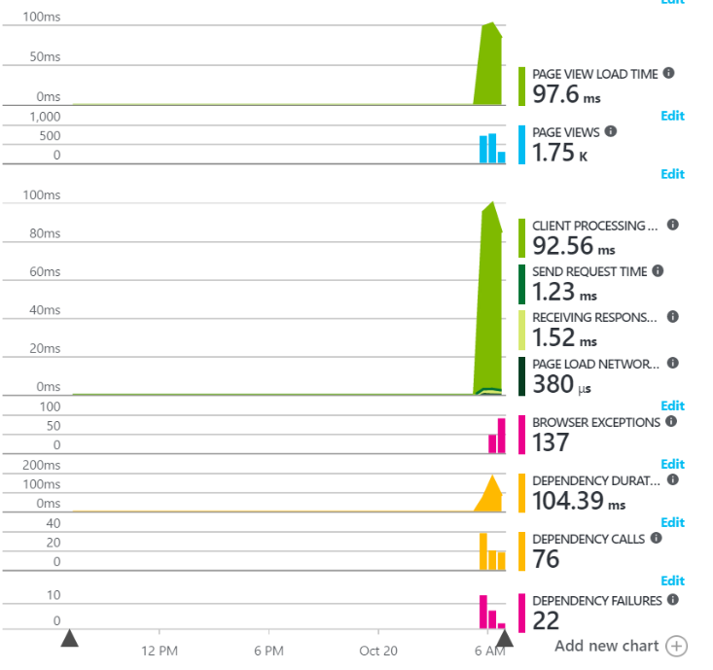
What you get with AppInsighs by default
Time till page ready (can be customized)
Count of page views
Browser timings
Browser exceptions
AJAX AVG duration
AJAX count
AJAX failures
Notes:
This is the view that you get out of the box by just inserting the JS SDK snippet, after you give it couple of minutes for telemetry to be ingested and processed by our backend. Out of the box you get:…

Slide 4
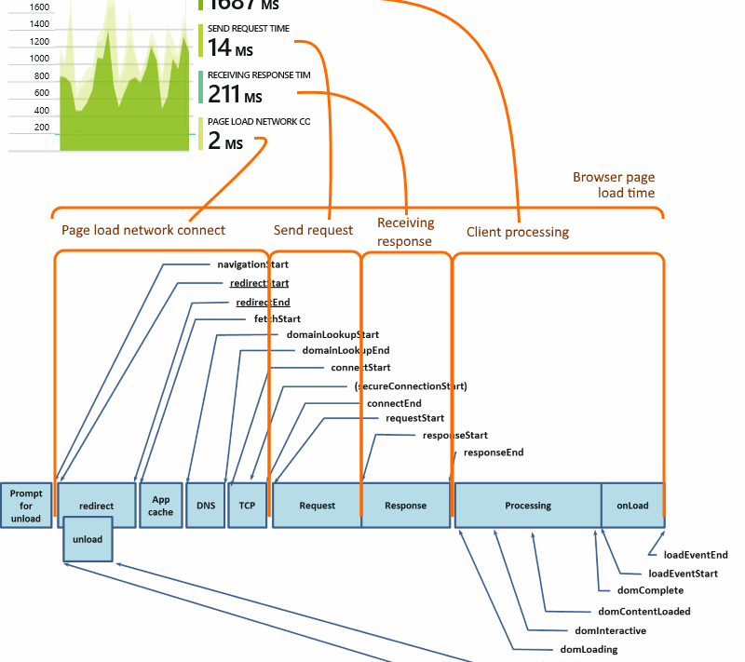
Browser performance monitoring
If you measure nothing else, measure Page Load Time
Amazon.com calculated than one second page load degradation would cost them $1.6 billion annually
Application Insights collects aggregates page performance metrics automatically
browserTimings
| summarize percentile(totalDuration, 95) by bin(timestamp, 5m)
| render timechart
Notes:
Page Load Time is the most popular industry standard
Demo:
By this time AppInsights page is showing data
Script error that introduced on purpose
Browser performance timings
browserTimings
| summarize percentile(totalDuration, 95) by bin(timestamp, 5m)
| render timechart

Slide 5
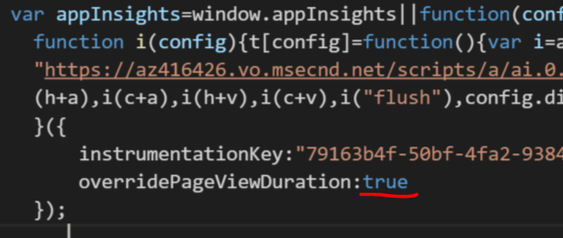
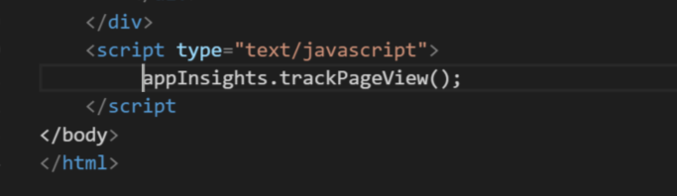
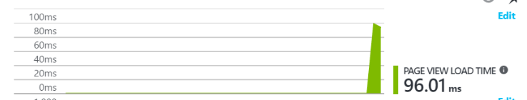
Customizing page load completion marker
Set overrridePageViewDuration in the snippet
Set trackPageView() in the custom location
pageViews
| summarize percentile(duration, 95) by bin(timestamp, 5m)
| render timechart
Notes:
Often it doesn’t reflect true state of readiness of the page, that’s why we also support customizing the marker
Demo:
Move trackPageView() down to the point in code where you would like to have the marker placed
pageViews
| summarize percentile(duration, 95) by bin(timestamp, 5m)
| render timechart

Slide 6
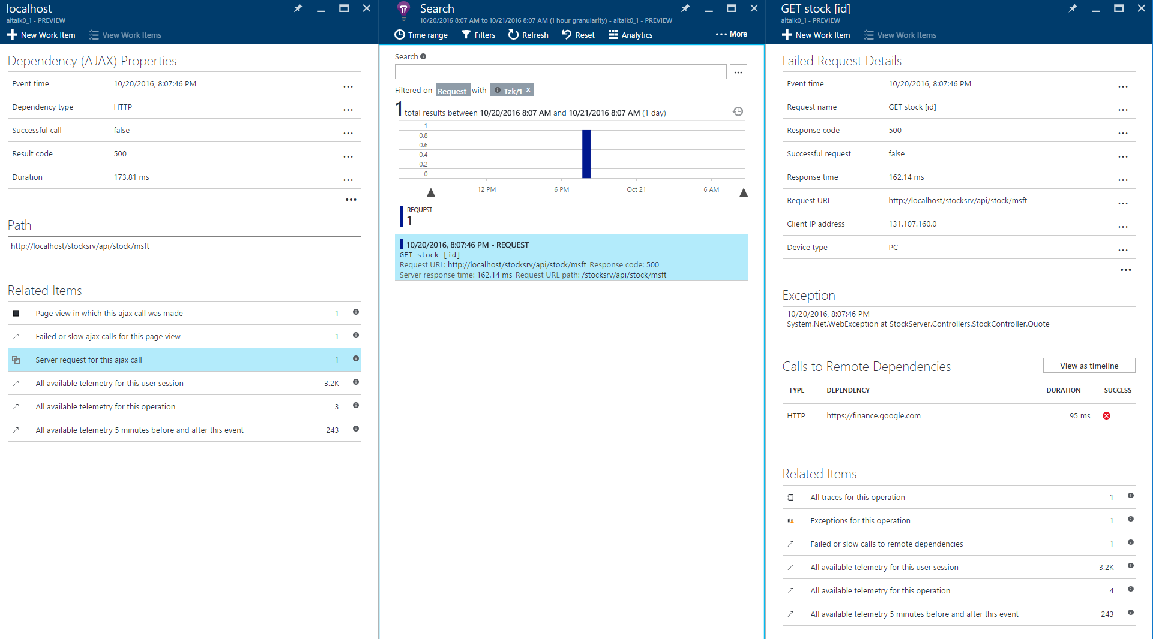
AJAX health root-cause analysis
With both server and client instrumented with AppInsights, you can track transactions across client->server layers
Failed AJAX
Failed server request
Failed dependency
Why?
Why?
Notes:
For this step I shouldn’t forget to add disableCorrelationHeaders: false
I would like to show you have you can diagnose the root cause of an AJAX failure.
Start by clicking a sample failing AJAX, see “server request for this AJAX call”

Slide 7
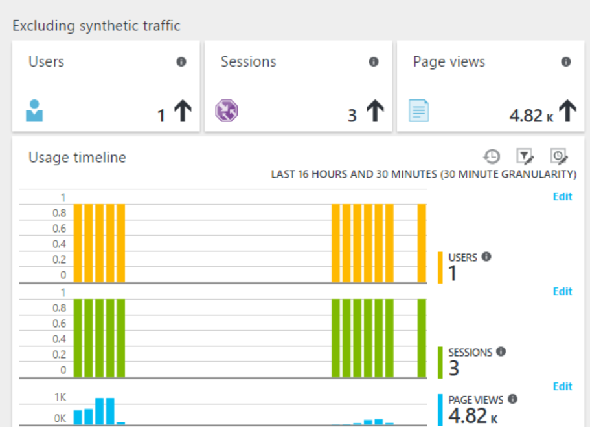
Usage Telemetry
Tracked using a cookie
Propagates from client to server, so we can track users and sessions across client-server boundaries
Used for sampling consistency
Notes:
What we do for our own services is we track the % of successful sessions

Slide 8
Adding custom telemetry
trackEvent - Log a user action or other occurrence.
trackEvent(name: string, properties?: {[string]:string}, measurements?: {[string]:number})
trackMetric - Log a positive numeric value that is not associated with a specific event. Typically used to send regular reports of performance indicators
trackMetric(name: string, average: number, sampleCount?: number, min?: number, max?: number, properties?: {[string]:string})
trackTrace - Log a diagnostic event such as entering or leaving a method In the portal, you can search on message content and display individual trackTrace events
trackTrace(message: string, properties?: {[string]:string}, measurements?: {[string]:number})
Example: button click, form step completion
Example: duration from page load till first action, page visit duration
Example: track all headers from AJAX response

Slide 9
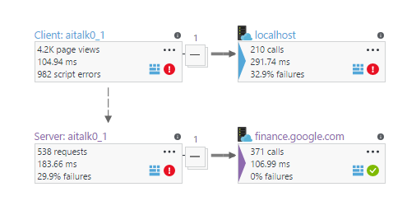
Application Map
Shows the topology of your application at a glance

Slide 10
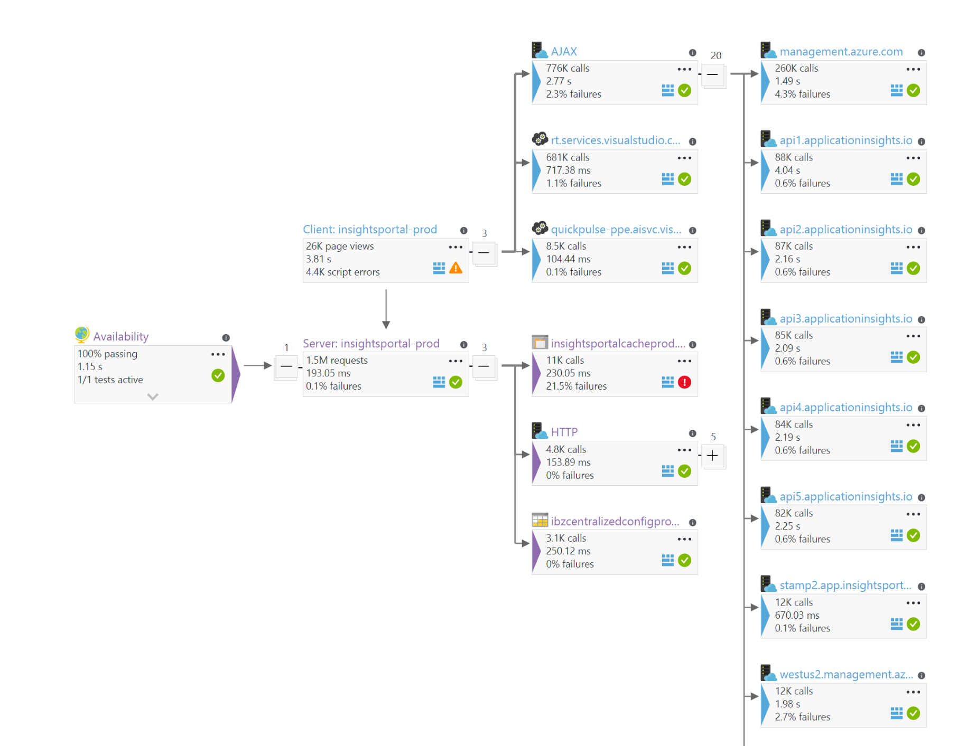
Real life application map
Notes:
Application map for out service that serves our extension in Azure portal

Slide 11

Application Insights on GitHub
Https://github.com/Microsoft/ApplicationInsights-home
Android
Asp.Net Core
C++ Universal apps
DotNet Core
DotNet Logging Adaptors
DotNet Server
Go
iOS
JavaScript
Java
Node.js
OSX
PHP
Python
Ruby
StatsD
WordPress
Xamarin

Slide 12








Tools and frameworks for web client monitoring: comparative advantages
Usage & page views tracking | Page view tracking, browser breakdown impact analysis | Adwords integration, conversion reporting | Retroactive funnel & retention analysis, mobile A/B testing | Visit duration, click tracking | User action monitoring | Page view tracking, browser breakdown impact analysis
Injection | Manual, assisted, automatic (prototype) | Manual | Manual | Automatic (via NR APM agent) Manual (snippet injection) | Browser extensions (IE, FF), manual snippet injection | Automatic (Java, ASP.NET, SharePoint), manual, assisted (ASP.NET, using attributes)
End-user perf, script errors, AJAX & correlation | Navigation perf, Perf by page load, by geo, AJAX, client-server correlation | Basic slow loading page reporting by geo & by page |  | Navigation perf, AJAX, client-server correlation. New: Auto-route change tracking for SPAs | Script errors, page loads | Navigation perf, AJAX monitoring Angular SPA support
Advanced diagnostics with browser instrumentation |  |  |  |  | JS function call instrumentation, network speed, rendering profile

Slide 13
Q & A

Slide 14
Application Insights JavaScript: deep dive
Initialization snippet loads
Set track* methods to write to in-memory queue
Sending pipeline
Auto-collection
features
appInsights
.track*
Sampling
Unhandled script errors
Log client perf information
Init unhandled script errors
Start loading full script
Enrichment with common properties
initializers
AJAX requests
In-memory queue
Full script loaded
Initialize sending pipeline
memory
Session storage
Sender buffer
Resource timing
Init resource timing
Init AJAX monitor
Process and delete in-memory queue
Send to Breeze

Slide 15
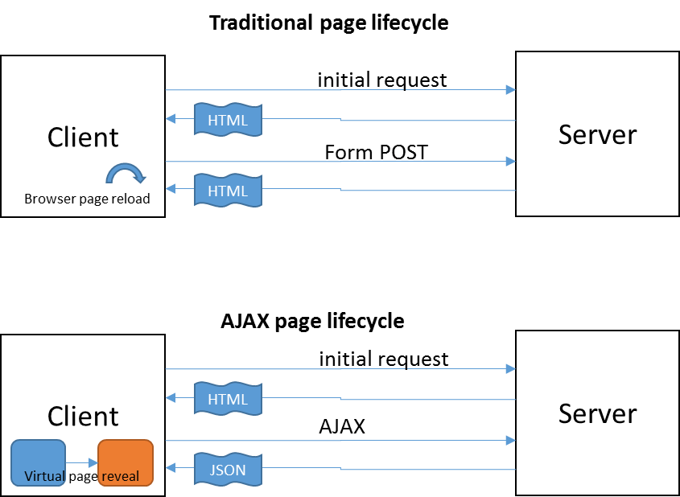
SPA application specifics
Initial page load is followed by virtual page transition
Log page views for each virtual page transition
Initialize new operation to keep associated telemetry grouped by operation

Slide 16
Summary
Setting the context on the presentation:
What kind of applications will be covered in this presentation (traditional and SPA websites hosted onprem or in the cloud), and which ones won’t be covered (device applications). Focus on health, not on usage
Monitoring web applications
Browser performance
Customized page load performance
AJAX health root cause analysis
Adding custom telemetry
Application Map
Tools and frameworks
Q & A
Extra
SPA application specifics
Application Insights JavaScript SDK: how it works
Application Insights: client-side sampling, server-side sampling & throttling

Slide 17
Traditional page lifecycle
Client
initial request
Server
HTML
Form POST
Browser page reload
HTML
AJAX page lifecycle
Client
initial request
Server
HTML
AJAX
Virtual page reveal
JSON

