Slide 1
CAI 4520 · AGENTIC AI · FINAL PROJECT
Agentic Golf Caddy
A bounded multi-agent system for trustworthy on-course club recommendations
7 agents. Deterministic core. 100% grounded outputs.
Alex Cannon
Group 28 · Solo presenter · April 29, 2026
1 / 11

Slide 2



MOTIVATION
Why an agentic caddy?
Every shot is a small puzzle. Picking a club means juggling distance, wind, elevation, the lie, hazards, pin position, and your own tendencies — and you have about a minute to decide. Today’s tools make you choose. Rangefinders give you a number with no reasoning. AI caddies sound smart but make up yardages and don’t know what’s actually in your bag.
Hallucination
LLMs invent yardages and miss the gaps between your clubs.
Ambiguity
Real golfers say things like “a little breezy, ball sitting down.”
Safety
Bad lies and hazards need rules, not vibes.
Agentic Golf Caddy · Group 28 · Alex Cannon · CAI 4520
2 / 11

Slide 3
RELATED WORK
What already exists — and where it falls short
Category
Examples
Strength
Limitation we attack
GPS rangefinders
Arccos, Shot Scope, Garmin Approach
Accurate distances and shot tracking
Just a number — no reasoning, can’t take plain-English input
AI / LLM caddies
ChatGPT, Caddie.ai, Pin-High AI
Conversational, explains its thinking
Makes up yardages and doesn’t know what’s in your bag
Multi-agent frameworks
AutoGen, MetaGPT, ReAct, Plan-and-Execute
Generic templates for agents working together
No domain math, no fact-checking, no safety rules
The gap. No one combines real golf math with an LLM kept on a tight leash, then double-checked — for the same shot.
Agentic Golf Caddy · Group 28 · Alex Cannon · CAI 4520
3 / 11

Slide 4



CHALLENGES
Five challenges this project had to solve
Stop hallucination
Smart follow-ups
Safety rules
Make it yours
Prove it works
Make the LLM pick only from clubs that are actually in your bag.
Only ask a question when the answer would actually change the club.
Block long carries from bunkers or deep rough where the shot isn’t realistic.
Every golfer is different — learn your distances and tendencies.
No public benchmark exists, so I built my own tests and logged real runs.
Design principle. Do the math the same way every time. Let the LLM only pick from a short list of clubs — and then double-check what it says.
Agentic Golf Caddy · Group 28 · Alex Cannon · CAI 4520
4 / 11

Slide 5



SOLUTION
A 7-agent pipeline with a deterministic core
0
0.5
1
2
3
4
5
Input
Interpreter
Clarification
Context
Decision
Adaptive
Strategy
Coach
Verifier
understands what you said
asks only if needed
pulls weather + course
calculates the shot
picks from short list
explains the choice
fact-checks the answer
LLM step (bounded)
Logic / guardrail
Deterministic math
Real-data API
Math core
LLM on a leash
Always verified
Distance and club selection are calculated the same way every time — no model in the loop.
The LLM only picks from a short list of 3–5 clubs that the math has already vetted.
Every explanation gets fact-checked against the real decision — and rewritten safely if it drifts.
Agentic Golf Caddy · Group 28 · Alex Cannon · CAI 4520
5 / 11

Slide 6
AGENT ROLES
What each agent actually does
Agent
Type
Inputs → outputs
Why it matters
Input Interpreter
LLM
Plain-English shot description → structured shot data
Golfers can just talk — no forms to fill out.
Clarification
Logic
Shot data + your bag → one follow-up question if needed
Only asks when two clubs are within 20 yards of each other.
Context
API
Shot data → shot data + live conditions
Pulls live weather, elevation, and course geometry from public APIs.
Decision
Math
Shot + your profile → adjusted distance + club shortlist
Wind, elevation, lie, temperature, altitude — all calculated, not guessed.
Adaptive Strategy
LLM
Short list of clubs → final pick + risk flags
LLM only re-ranks the shortlist using lie, hazards, and history.
Coach
LLM
Final decision → friendly explanation
Plain-English summary, what was adjusted, and a backup club.
Verifier
Logic
Explanation → either approved or rewritten
If the LLM drifts, swap in a safe template — every output is grounded.
Why this layering? Every agent has one job and a strict input/output contract. The math agents set the rules of what’s correct; the LLM agents only get to play inside those rules.
Agentic Golf Caddy · Group 28 · Alex Cannon · CAI 4520
6 / 11

Slide 7


MY ROLE & CONTRIBUTION
What I built (solo group)
Solo group — full ownership of design, code, evaluation, and writeup.
The 7-agent pipeline
The math engine
Real-world data
Designed and built every agent, the orchestrator that runs them, and the data contracts between them.
Calculates how far the shot really plays after wind, elevation, lie, temperature, and altitude — plus safety rules for tough lies.
Live weather, elevation, and course geometry pulled from free public APIs — no paid services.
Player profiles
Testing + evaluation
The app itself
Imports your real shot data from TrackMan, Foresight, or Golf Pad, then learns your tendencies as you play.
Built my own benchmark scenarios and a logger that captures every real run for analysis later.
Streamlit UI with both structured and free-text input, course/pin pickers, a feedback loop, and a clean README.
Tech stack. Python 3.10 · Pydantic data contracts · OpenAI gpt-4o-mini for the 3 LLM agents · Streamlit UI · Open-Meteo · USGS · OSM Overpass · pytest · ~3K LOC
Agentic Golf Caddy · Group 28 · Alex Cannon · CAI 4520
7 / 11

Slide 8
DEMO
End-to-end shot, in the app
● ● ● localhost:8501 / Agentic Golf Caddy
What happened under the hood
Describe your shot
0
Input Interpreter
“145 out, into the wind ~12, ball sitting down a little, back pin, just middle of the green.”
Pulled 5 details from the sentence — nothing was unclear.
0.5
Clarification
Confident enough — no follow-up question needed.
Parsed shot intent
Context
1
distance 145 yd · wind 12 mph headwind · lie rough
pin back · target center green
Live weather: 12 mph headwind, 71°F, flat ground.
2
Decision
Shot plays like 162 yards — shortlist: 8-iron, 9-iron, 7-iron.
Use your 8-iron.
Plays-like 162 yd · confidence high · backup 9-iron
3
Adaptive Strategy
Kept the 8-iron; flagged that long-side miss leaves a tough chip.
4
Coach
Wrote the plain-English explanation.
Adaptive caddie note [ risk_flags: long_side_penalty ] Ball is sitting down — long side leaves a tough chip. Center green is the smart play; 8-iron lets you take the wind out of the equation.
5
Verifier
Fact-checked — every number matches the real decision.
Agentic Golf Caddy · Group 28 · Alex Cannon · CAI 4520
8 / 11

Slide 9
EVALUATION
Real-run logging across 1,021 pipeline executions
1,021
100%
9.2%
17%
real shots run through the system
explanations passed fact-check
needed a follow-up question
came in as plain-English shots
structured + free-text inputs
verifier never had to rewrite
only when it would change the club
parsed by the Input Interpreter
Findings
✓ Across all 927 completed runs, the verifier never had to rewrite the LLM’s explanation. ✓ The safety rule kicked in 4 times to block unrealistic carries from bunkers or deep rough. ✓ The system only asked a follow-up question 9% of the time — only when it really mattered. ✓ I built 17 test scenarios covering math, club re-ranking, and follow-up question logic.
Agentic Golf Caddy · Group 28 · Alex Cannon · CAI 4520
9 / 11

Slide 10
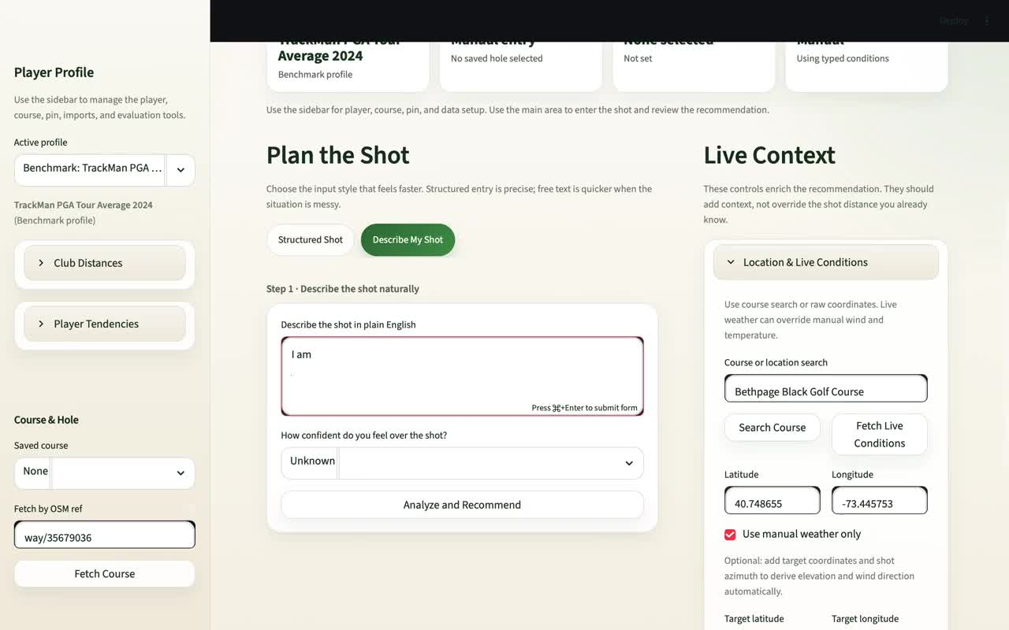
LIVE DEMO
The app running, end-to-end
What you’re about to see: TrackMan PGA Tour profile loaded → free-text shot pasted in → 5 fields parsed → adjusted distance + club shortlist → final pick + plain-English explanation. Click the video to play.
Agentic Golf Caddy · Group 28 · Alex Cannon · CAI 4520
10 / 11

Slide 11
THANK YOU · QUESTIONS WELCOME
When the answer has to be right, small specialized agents beat one big LLM.
Limitations
Future work
It’s a caddy that helps you decide — not a full swing simulator.
The math is tuned for typical player profiles, so very unusual swings will be less accurate.
The LLM only re-ranks the shortlist, so it can only be as good as the math-based ranking it starts from.
It can’t account for the actual swing — once the ball leaves the club, you’re on your own.
Identify the lie automatically from a quick phone photo of the ball.
Personalize the club rankings for each golfer using their own shot feedback over time.
Plug into Arccos or Shot Scope so it learns from every real shot, not just logged ones.
A voice interface so it works hands-free while you’re actually on the course.
Alex Cannon · Group 28 · CAI 4520, April 2026 · GitHub: github.com/alex-cannon/agentic-golf-caddy
11 / 11

