Slide 1


D2 : Final Presentation
A 3

Slide 2
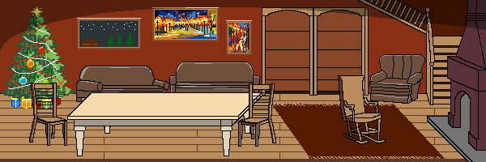
Description
(1)
STYLE: 2D Platforming & Puzzle Game
AUDIENCE: Family / Children (ages 7+)
THEME: Christmas
ROLES:
Team Lead & Puzzle Developer: Ben
Art Director: Leo
Game Engine & Platform Developer: Val & Alex
Level Designer: Gary

Slide 3
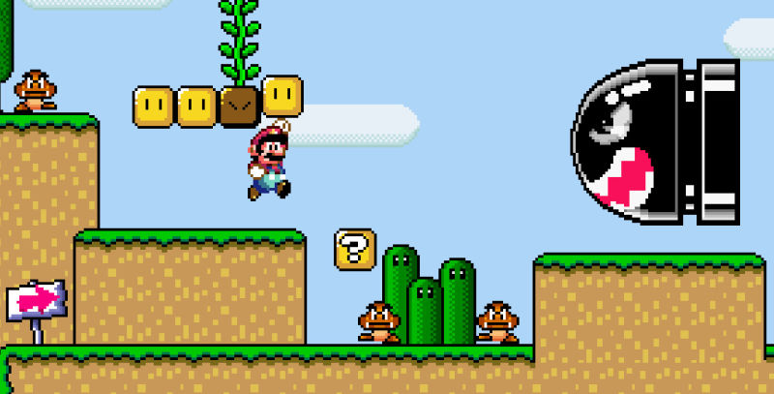
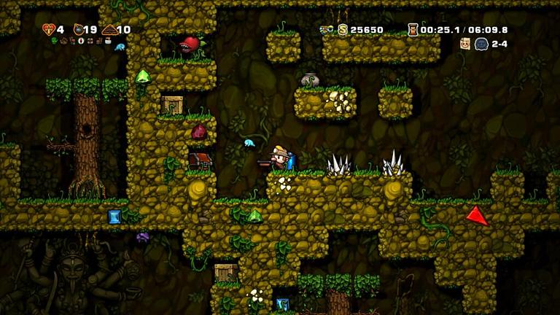
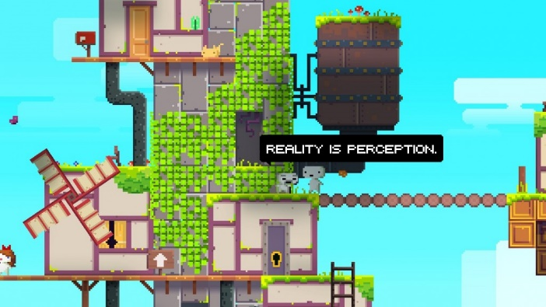
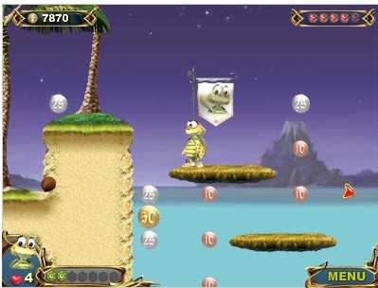
Planning and Ideas
(1)

Slide 4
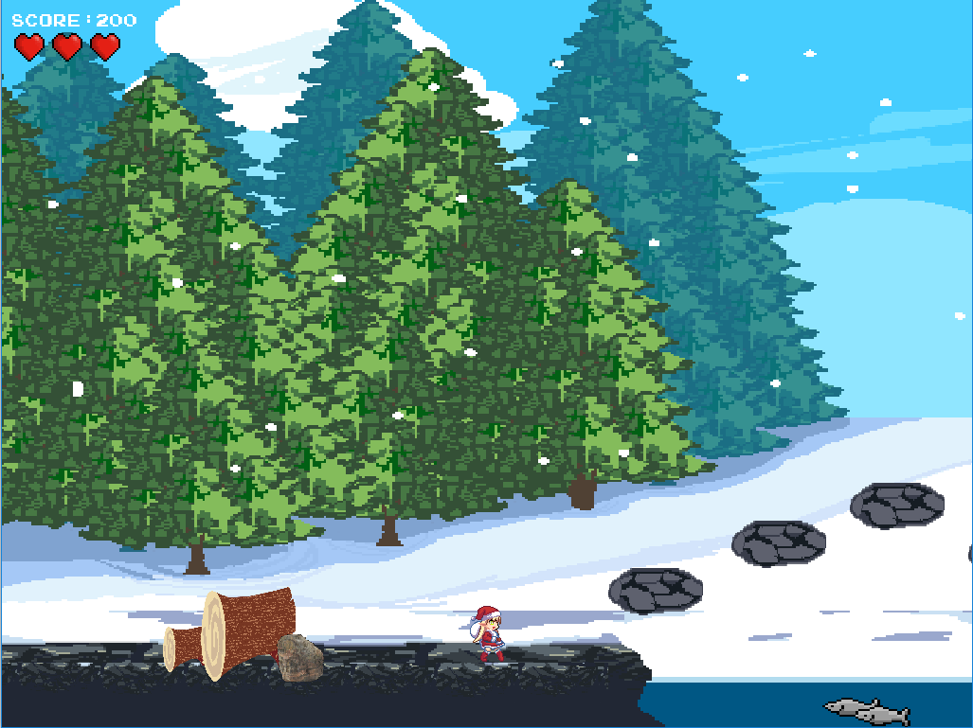
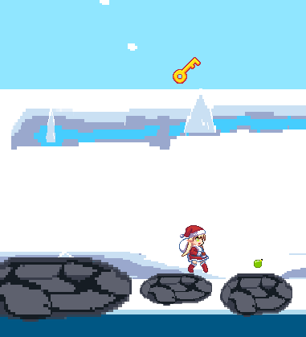
Gameplay
(2)
AIM: Beat all 4 levels to help bring Christmas to a less fortunate family.
LEVEL COMPOSITION: Each level contains the following components.
PLATFORM: A side-scrolling platforming section with challenges such as damaging obstacles and bottomless pits which reset the players progress.
PUZZLE: A different puzzle for each of the 4 levels, themed around a particular Christmas element: ‘Fir Christmas Tree’ , ‘Roast Turkey’ , ‘Decorations’ and ‘Presents’.
PROGRESS: After each level, the player is returned to the menu, where their collectables and newest Christmas element is displayed in the background.

Slide 5
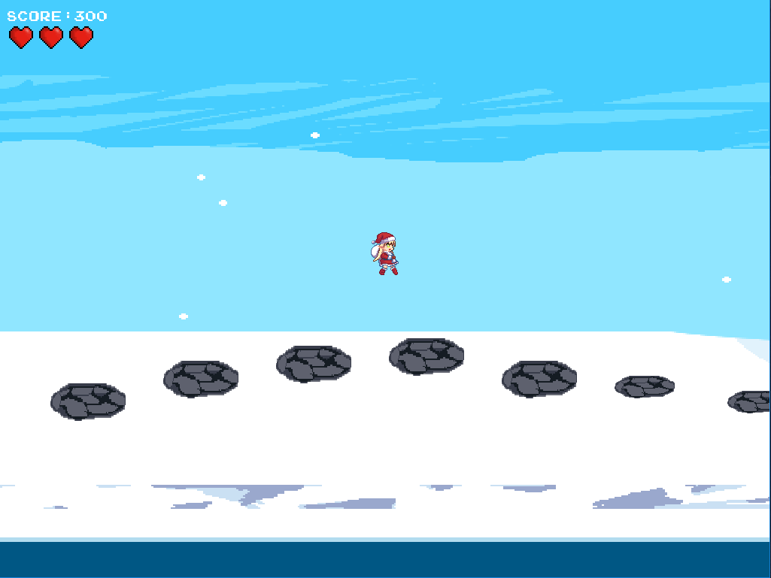


Game Rules
(2)
CONTROLS:
Menu Navigation: WSAD/Up-Down-Left-Right + Enter
Player Movement: WSAD/Up-Down-Left-Right
Puzzle Navigation: WSAD/Up-Down-Left-Right + Num-Keys
GAME DIRECTION:
The game must be played through in chronological order beginning with platform level 1 (forest), leading to a puzzle. This sequence is to be repeated for the following 3 levels.
Levels & puzzles can be replayed in order to find all the collectables.
LEVEL PROGRESSION:
In order to complete each level, the player must find the scroll, situated towards the end of the level.
However, by default the scroll is locked, and to unlock it, the player must collect the key to remove the padlock from the scroll.
Once the scroll is unlocked and found, the puzzle can be initiated, and the player can progress with the next stage of the game.

Slide 6
What Makes a Good Game?
(2)
Long term Goal: to decorate the Christmas Room
Subgoals: to complete each level, collecting items
Game starts easily, and complexity/difficulty gradually increases
Game uses standard controls and concepts. Basic guidance is given.
Levels are fairly short; losing a life restarts the level; losing 3 lives goes back to the menu
Each level has few clear rewards, which are not too difficult nor too easy to achieve
Game has interesting graphics; each level is similar and yet unique
Once completed, players can choose to redo any platform or puzzle to collect additional items

Slide 7
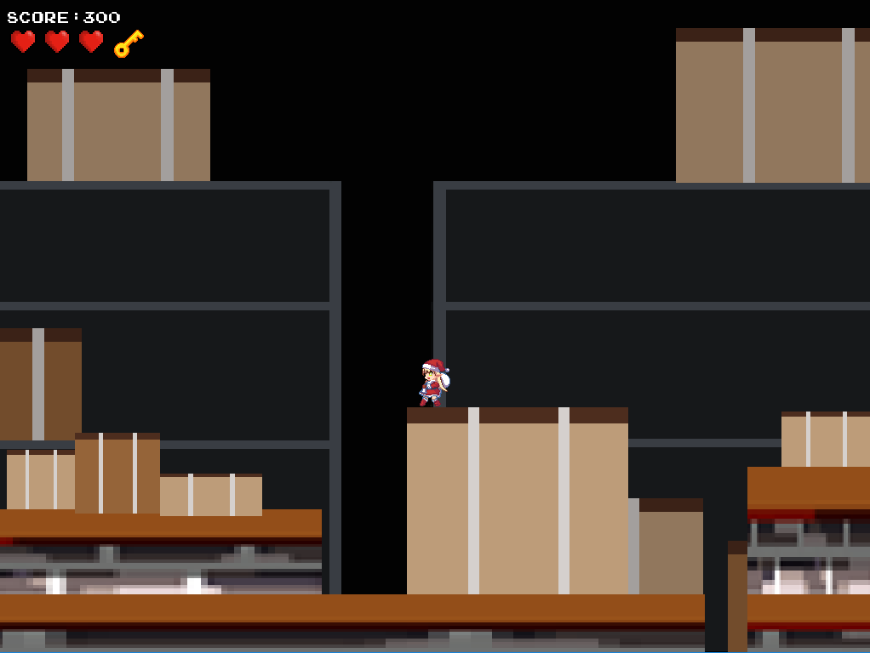
Implementation
(3)
Design Spec.
Artwork
Placeholders
Gameplay
Puzzles
Platforming
Base Tile Set
Sprites
Character Movement
Backgrounds & Platforms
Specification for each puzzle
Collision
Platform & Collectables Layout
Puzzle Tiles
Puzzle Interaction
Success Conditions
Failure and Success conditions

Slide 8
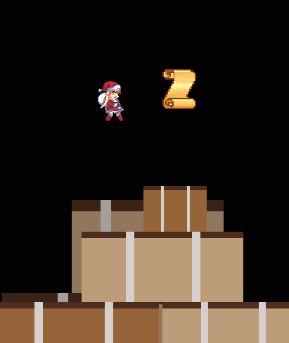
Challenges
(3)
HOW DO WE SIDESCROLL WITHOUT A CAMERA?
Give all objects in the level movement along the X axis. Keep the player centralised and move everything in accordance with the player.
HOW DO WE ENCOURAGE REPLAYABILITY?
Create persistent collectables across all levels as an additional optional measure of tracking progress. Collectables are stored and displayed in the main menu.
HOW DO WE TRANSLATE REAL LIFE PUZZLES TO NON-MOUSE DRIVEN INTERFACE?
Create a player controlled focal point. (maze, tile).
Limit scalability to bindable keys on the keyboard (traffic).

Slide 9
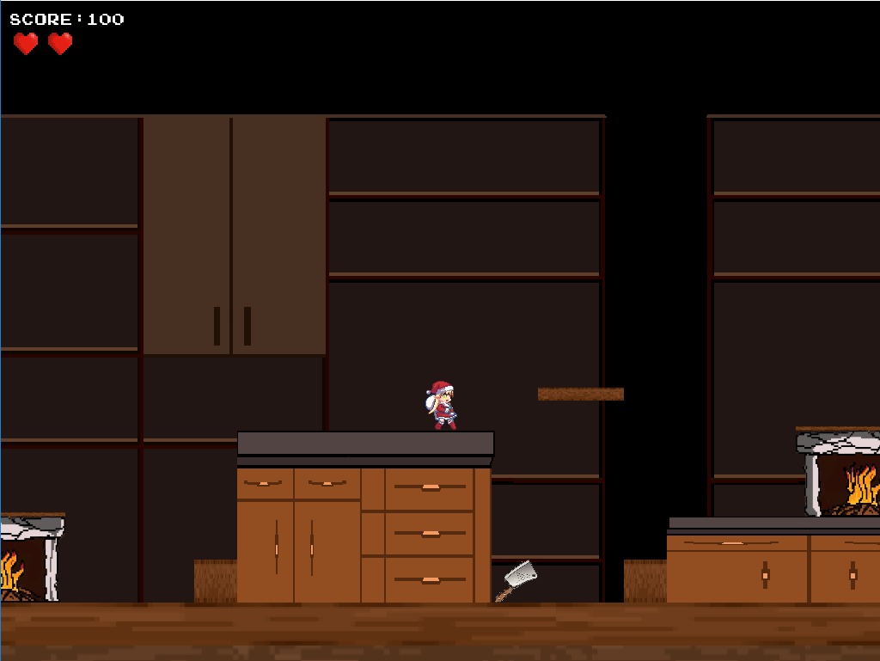
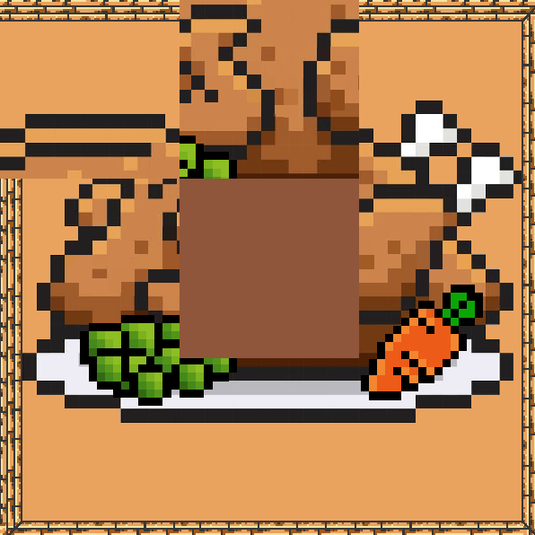
User Testing Methodology
(4)
TESTERS: 2nd Year SCC Students.
TESTS CONDUCTED:
1. Platforms Only
Puzzles Only
Full Game Run-through
To test the logical progression and difficulty scaling simply following the platforming sections of the game
To test the difficulty and sense of satisfaction or frustration from each puzzle.
To test the logical progression, difficulty and enjoyment from playing the game from start to finish.
METHOD: Speak-aloud demos with an observer.

Slide 10
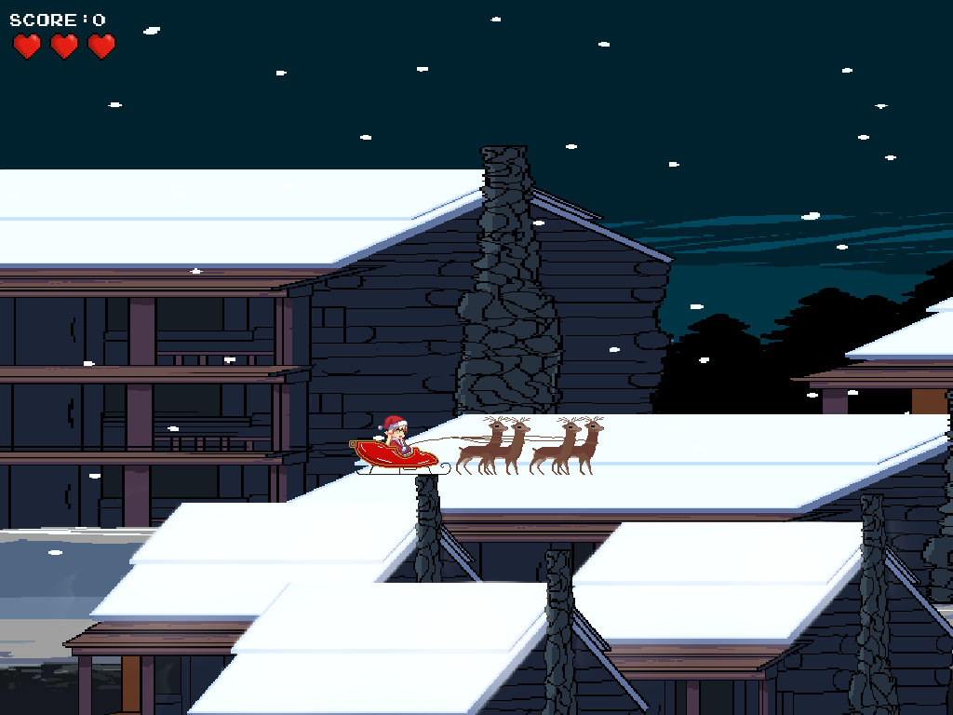
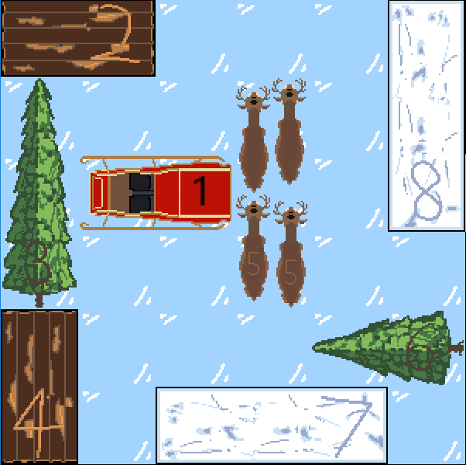
User Testing Feedback (i)
(4)
TEST 1: PLATFORMS:
Our intention: For difficulty to scale linearly upwards for each sequential level.
Our findings: Participants found level 1 more difficult than level 2.
Action Taken: Increased the number of fall locations and obstacles in level 2.
TEST 2: PUZZLES:
Our intention: For each puzzle to be unique and challenging in its own way, but not to cause frustration.
Our findings: Participants found the tile puzzle to be too complex, taking upwards of 10 minutes to solve.
Action Taken: Reduced the tile size of the tile puzzle from 4x4 to 3x3.

Slide 11
User Testing Feedback (ii)
(4)
TEST 3: FULL RUN-THROUGH:
Our intention: For the overall experience to be both enjoyable and challenging for the player.
Our findings: Participants felt a disconnect between their character and the aim of the game.
QUOTE: “Why is this elf fixing the house?”
Action Taken: Added the character to the house background in the main menu to create a mental link.
NOTE: Test 3 was completed after the changes made following Tests 1 and 2.

Slide 12
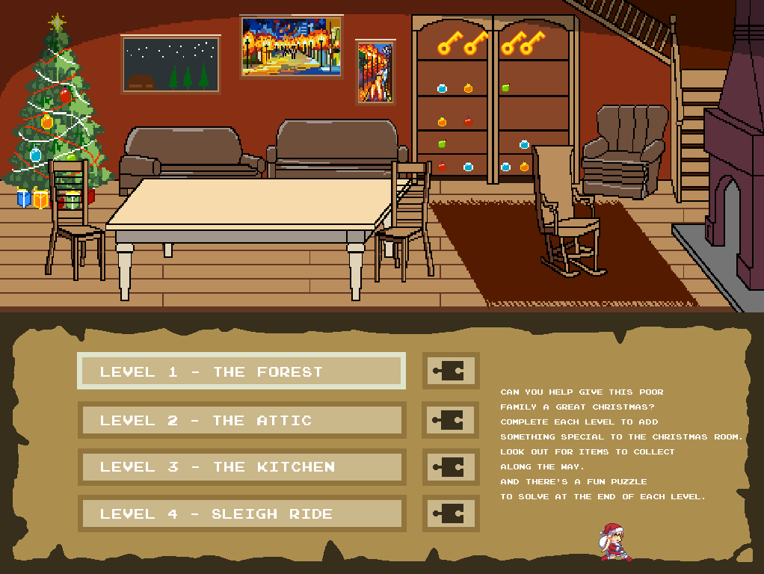
Project Evaluation
(5)
Difficulties and how we coped
Did we enjoy it? yes, but Jaejoon’s reaction very discouraging
Everyone worked well together – lots of communication; weekly workshops very helpful
What did we learn? Skills/strengths developed
Felt bad that Leo spent so much time generating graphics and didn’t get to code

