Slide 1


D2 : Final Presentation
A 3

Slide 2
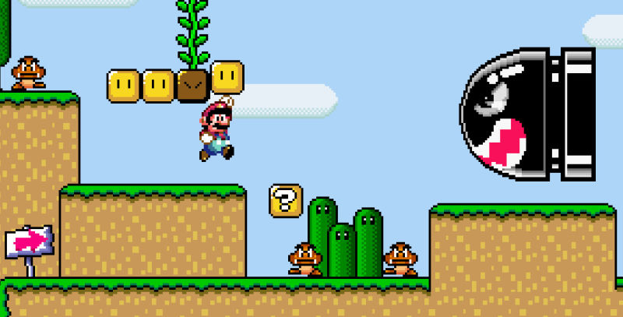
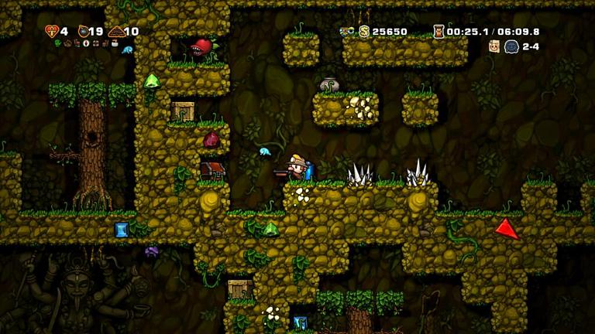
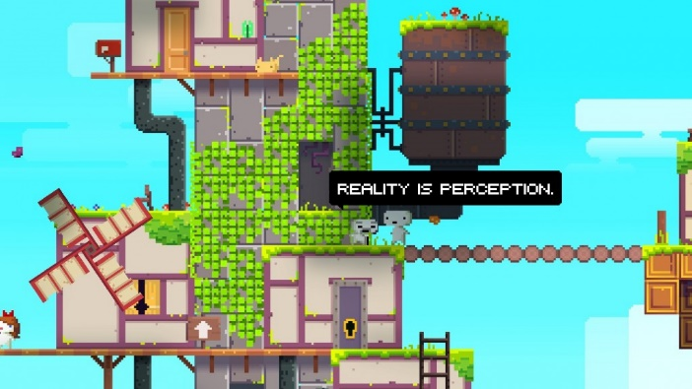
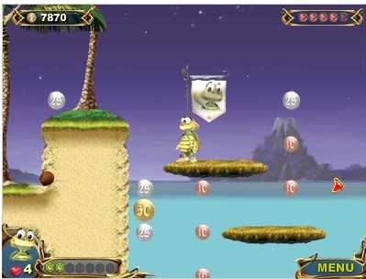
Planning and Ideas
(1)
Notes:
These are some games we researched before deciding what to do.
We agreed we would like to do a platform game, with a puzzle at the end of each platform level.
We decided that we wanted a game for all the family to play.
We decided we wanted a non-combative game with puzzle and challenges to overcome, and items to collect.

Slide 3
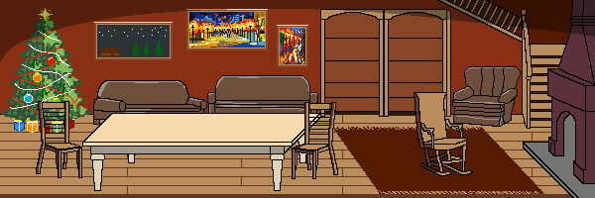
Description
(1)
STYLE: 2D Platforming & Puzzle Game
AUDIENCE: Family / Children (ages 7+)
THEME: Christmas
ROLES:
Team Lead & Puzzle Developer: Ben
Art Director: Leo
Game Engine & Platform Developer: Val & Alex
Level Designer: Gary
Notes:
We agreed that the game should have a Christmas theme, and that each level would gradually populate the Christmas Room, building up from a bare room to a room with all the trimmings for Christmas.
There is a simple player sprite moving through the platforms. There are no weapons or enemies, but there are hazards to avoid and items to collect. Each level has one special item, the key, that must be collected to allow the player to exit at the end of the platform.

Slide 4
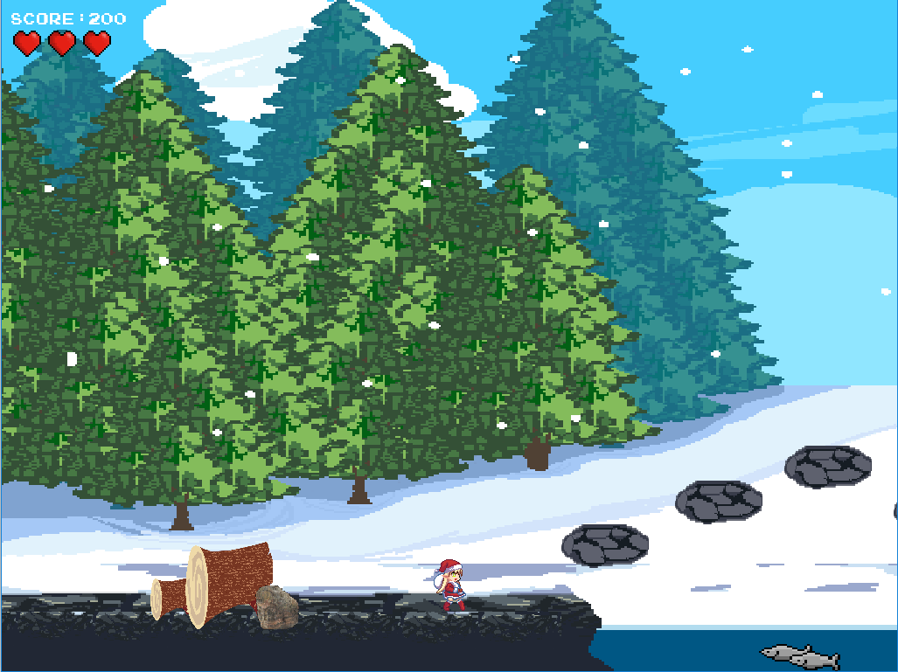
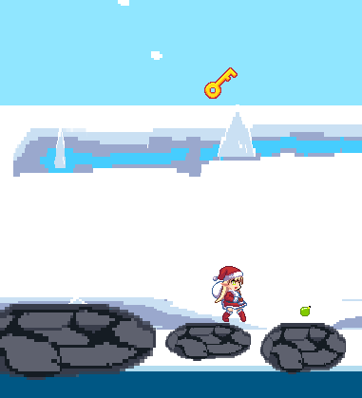
Gameplay
(2)
AIM: Beat all 4 levels to help bring Christmas to a less fortunate family.
LEVEL COMPOSITION: Each level contains the following components.
PLATFORM: A side-scrolling platforming section with challenges such as damaging obstacles and bottomless pits which reset the players progress.
PUZZLE: A different puzzle for each of the 4 levels, themed around a particular Christmas element: ‘Fir Christmas Tree’ , ‘Roast Turkey’ , ‘Decorations’ and ‘Presents’.
PROGRESS: After each level, the player is returned to the menu, where their collectables and newest Christmas element is displayed in the background.
Notes:
There are 4 levels, gradually increasing in difficulty. The level or puzzle to be played is selected from the game menu. You can only select a platform/level when you’ve completed the previous platform; you always start at the first platform.
The Christmas Room needs to be populated with 4 types of item: a tree, decorations, food, and presents. Each level of the game achieves one type aspect. The platform and puzzle are paired, and relate to the aspect being achieved.
Level 1 is in the forest. The player must cross the lake collecting baubles and the level key, without falling in the water. The puzzle is a maze, and the player must get to the end to find the Christmas tree.
Movement in the platform is via WASD or arrow keys. Moving upwards is done as a jump, and can only be done when the player is standing on something. The player is affected by gravity.
Level 2 is in the attic. The player must search the attic collecting decorations. This level introduces hazards – there are a few smoke outlets in the attic which must be avoided, and the player needs to avoid falling through the gaps in the ceiling. The player needs to do more manoeuvring to successfully cross the attic. There are “tunnels” where the player cannot jump upwards through the ceiling, as well as platforms that can be jumped up/down onto.
The player has three lives at the start of each level. Hitting a hazard, or falling off the bottom of the screen, loses a life and resets the character back to the start of that platform (although they retain any items collected so far).
If they lose all three lives, the platform game exits and they have to start that level again from the beginning.
When a platform game is successfully completed, all the items collected in that platform are displayed in the Christmas Room above the main menu.
Level 3 is in the kitchen. There are a lot more hazards here – fires and knives to be avoided. These are awkwardly placed, so that care must be taken in navigating the kitchen.
Level 4 is the Santa’s sleigh navigating the roofs. Unlike the other platforms, the sleigh moves left/right automatically, and gradually drifts downwards. The arrow keys can be used to change direction or boost movement.
In this level the sleigh must avoid the hazardous smoke coming from the chimneys. There are a lot of chimneys, making navigation surprisingly awkward because of the size and style of movement of the sleigh.

Slide 5
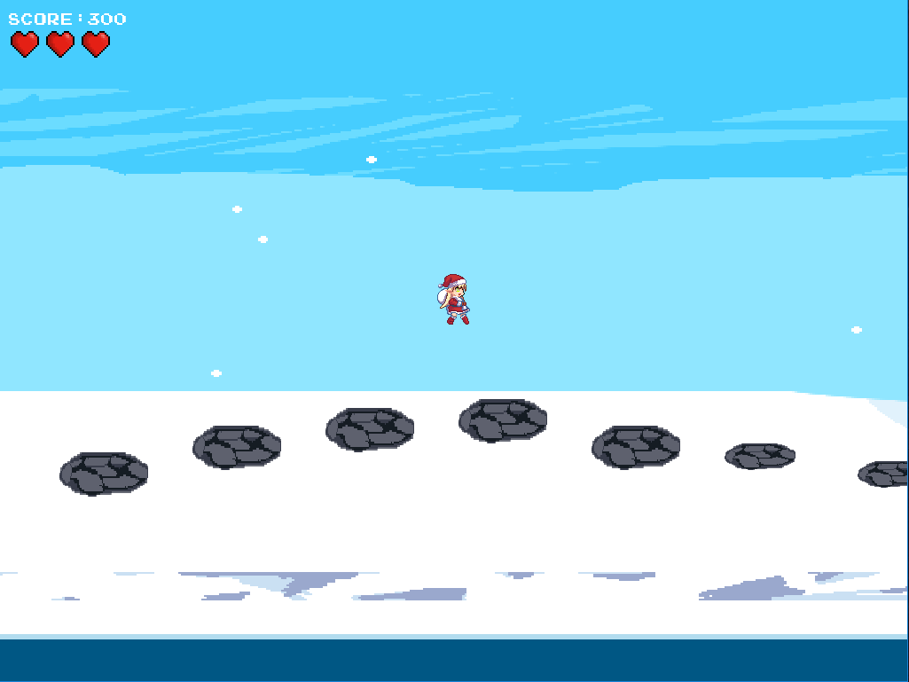


Game Rules
(2)
CONTROLS:
Menu Navigation: WSAD/Up-Down-Left-Right + Enter
Player Movement: WSAD/Up-Down-Left-Right
Puzzle Navigation: WSAD/Up-Down-Left-Right + Num-Keys
GAME DIRECTION:
The game must be played through in chronological order beginning with platform level 1 (forest), leading to a puzzle. This sequence is to be repeated for the following 3 levels.
Levels & puzzles can be replayed in order to find all the collectables.
LEVEL PROGRESSION:
In order to complete each level, the player must find the scroll, situated towards the end of the level.
However, by default the scroll is locked, and to unlock it, the player must collect the key to remove the padlock from the scroll.
Once the scroll is unlocked and found, the puzzle can be initiated, and the player can progress with the next stage of the game.

Slide 6
What Makes a Good Game?
(2)
Long term Goal: to decorate the Christmas Room
Subgoals: to complete each level, collecting items
Game starts easily, and complexity/difficulty gradually increases
Game uses standard controls and concepts. Basic guidance is given.
Levels are fairly short; losing a life restarts the level; losing 3 lives goes back to the menu
Each level has few clear rewards, which are not too difficult nor too easy to achieve
Game has interesting graphics; each level is similar and yet unique
Once completed, players can choose to redo any platform or puzzle to collect additional items

Slide 7
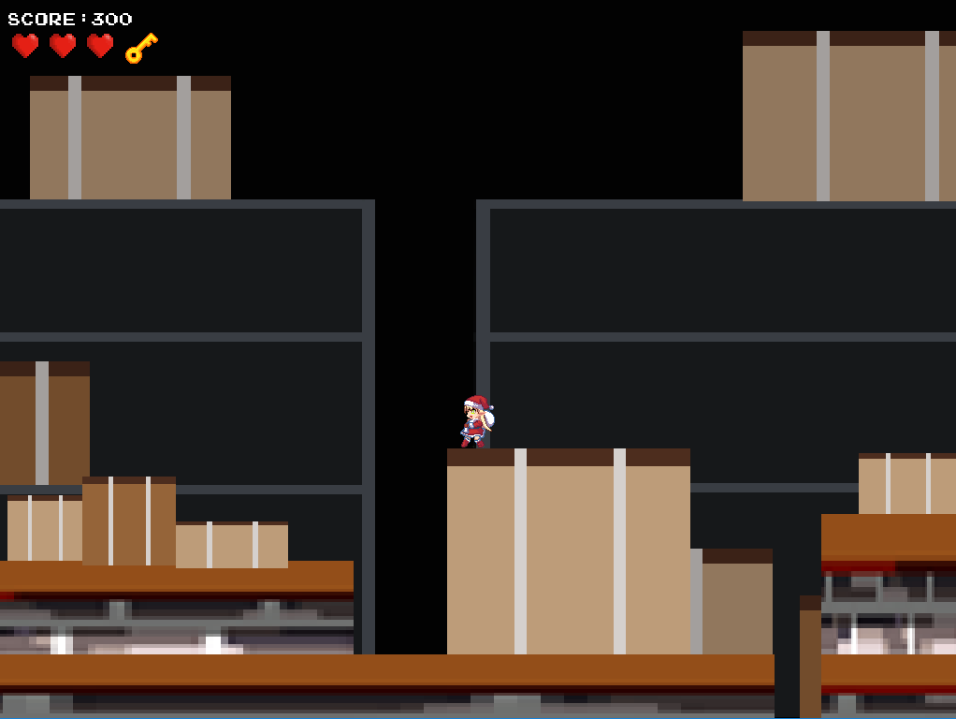
Implementation
(3)
Design Spec.
Artwork
Placeholders
Gameplay
Puzzles
Platforming
Base Tile Set
Sprites
Character Movement
Backgrounds & Platforms
Specification for each puzzle
Collision
Platform & Collectables Layout
Puzzle Tiles
Puzzle Interaction
Success Conditions
Failure and Success conditions

Slide 8
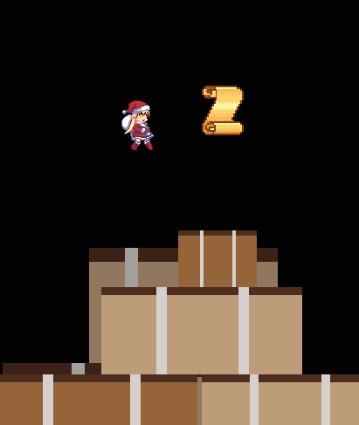
Challenges
(3)
HOW DO WE SIDESCROLL WITHOUT A CAMERA?
Give all objects in the level movement along the X axis. Keep the player centralised and move everything in accordance with the player.
HOW DO WE ENCOURAGE REPLAYABILITY?
Create persistent collectables across all levels as an additional optional measure of tracking progress. Collectables are stored and displayed in the main menu.
HOW DO WE TRANSLATE REAL LIFE PUZZLES TO NON-MOUSE DRIVEN INTERFACE?
Create a player controlled focal point. (maze, tile).
Limit scalability to bindable keys on the keyboard (traffic).

Slide 9
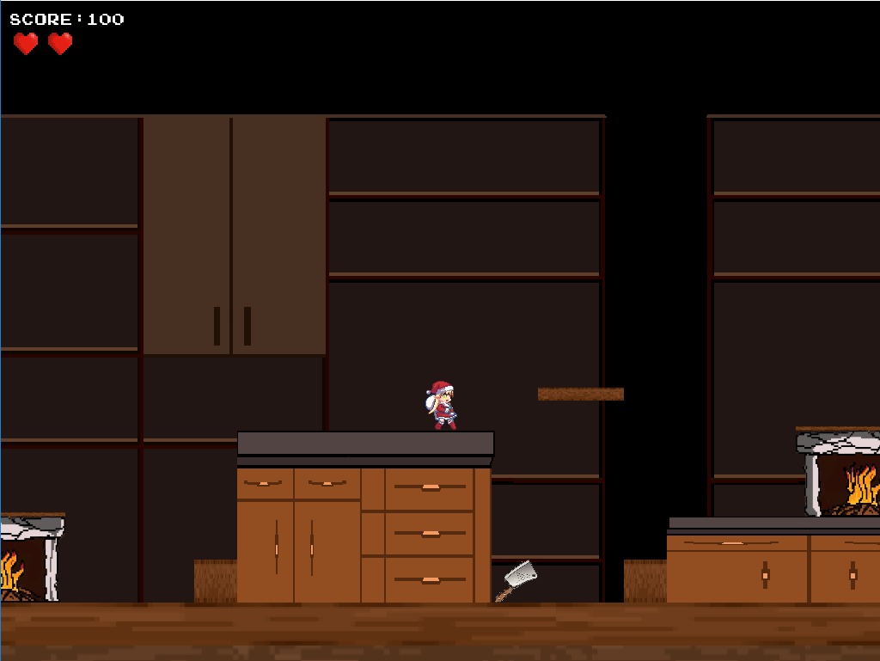
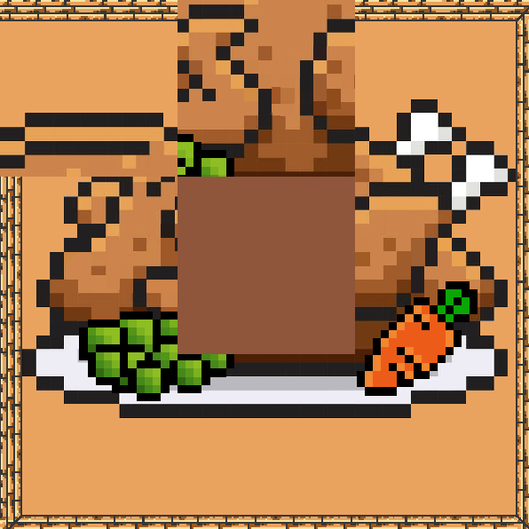
User Testing Methodology
(4)
TESTERS: 2nd Year SCC Students.
TESTS CONDUCTED:
1. Platforms Only
Puzzles Only
Full Game Run-through
To test the logical progression and difficulty scaling simply following the platforming sections of the game
To test the difficulty and sense of satisfaction or frustration from each puzzle.
To test the logical progression, difficulty and enjoyment from playing the game from start to finish.
METHOD: Speak-aloud demos with an observer.

Slide 10
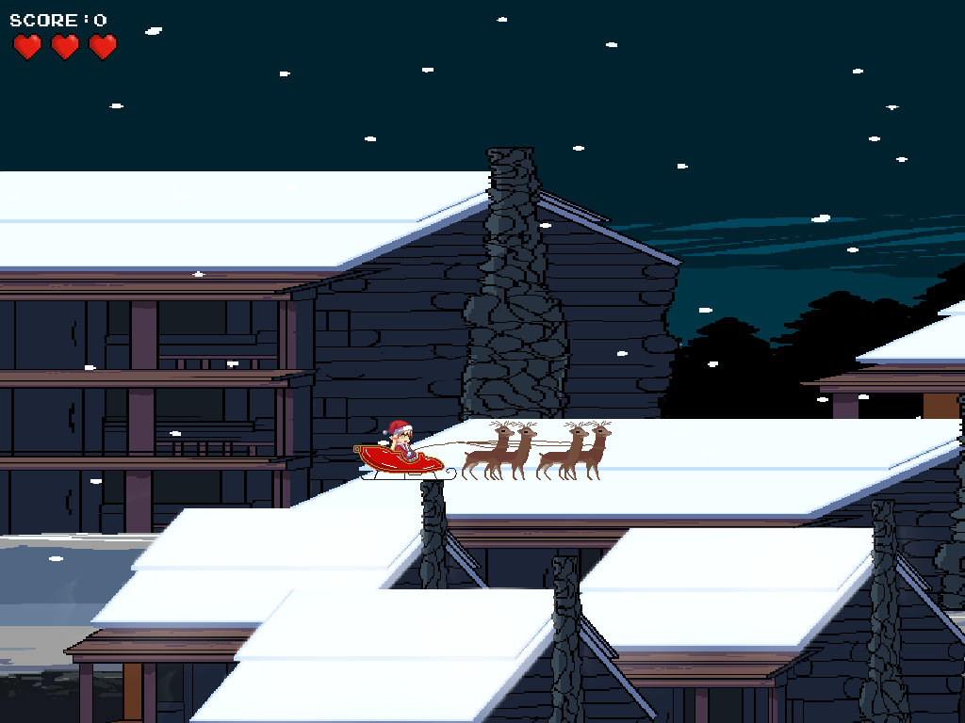
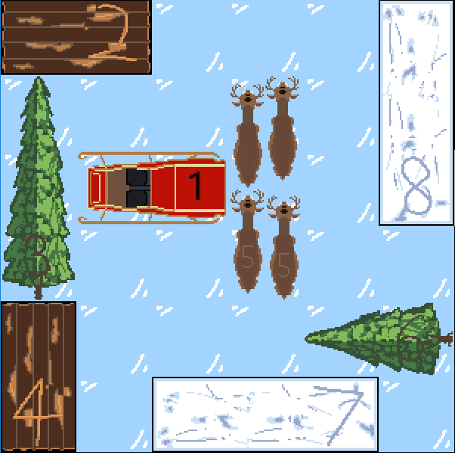
User Testing Feedback (i)
(4)
TEST 1: PLATFORMS:
Our intention: For difficulty to scale linearly upwards for each sequential level.
Our findings: Participants found level 1 more difficult than level 2.
Action Taken: Increased the number of fall locations and obstacles in level 2.
TEST 2: PUZZLES:
Our intention: For each puzzle to be unique and challenging in its own way, but not to cause frustration.
Our findings: Participants found the tile puzzle to be too complex, taking upwards of 10 minutes to solve.
Action Taken: Reduced the tile size of the tile puzzle from 4x4 to 3x3.

Slide 11
User Testing Feedback (ii)
(4)
TEST 3: FULL RUN-THROUGH:
Our intention: For the overall experience to be both enjoyable and challenging for the player.
Our findings: Participants felt a disconnect between their character and the aim of the game.
QUOTE: “Why is this elf fixing the house?”
Action Taken: Added the character to the house background in the main menu to create a mental link.
NOTE: Test 3 was completed after the changes made following Tests 1 and 2.
Notes:
More things we did:
1. While running along, player sprite should be able to move up small amounts without having to jump. In Level1, below the lake, you have to jump, and you bang your head.
Fix: amended code to allow small amounts of Y-movement as part of X-movement. (Banging head is because we can’t allow jump-up-through lake, to prevent player jumping from one side of lake to the other.)
2. Fall-through holes in attic not clearly visible due to coloration of background
Fix: moved holes to be in front of black areas of background
3. In the attic, the obstacles that you can jump on merged into the background because they were all similar colours
Fix: made foreground obstacles brighter colours
4. Jumping round to the far side of the lake in Level 1, you’re standing on snow, which isn’t allowed elsewhere
Fix: use the other lake image so that you’re standing on the lake edge.
5. In kitchen you can jump up past most shelves, but the lowest one you bang your head.
Fix: change lowest shelf to be jump-up-able, like the others.
6. Have the game play in a single window, rather than one for the menu, one for the platform, and one for the puzzle
Fix: changed to use a single window.
7. Sprite continues to move when window has lost focus
Fix: pause when window loses focus, and un-pause when focus regained
8. Jump down in kitchen, falls past fireplace when it ought to land on top
Changed shelving arrangement so this does not occur
9. Add an Ooops on loss of life and death
Added music, including Ooops sound
10. Not clear when you’ve reached the end game state
Fix: updated game instructions to show that game complete
11. Did not notice collectibles in Christmas Room, nor other Christmas Room updates
Fix: 1. Add title above shelving to identify that the collectibles will be shown there
Things we did not do:
1. Curvy shapes have rectangular hit boxes which looks odd
Nothing we can do at this late stage in the game.
2. Maze puzzle moves too quickly in response to keyboard keys
3. Need instructions for how to drive menu (Enter key, not mouse clicks)
4. Didn’t notice the new items added to the main room above the menu. Maybe it could be animated when newly added? Maybe you could show the item when you complete the puzzle?
5. Not clear why you should collect the baubles, or what the points are for.
6. The room on the menu screen does not look right – some of it is 3D and some 2D. The bookshelf looks like a door – it would be better with a bit of shading below each shelf. The joints in the floor are not angled like the front of the fireplace. Make the inside of the fireplace not the same colour as the fireplace base.

Slide 12
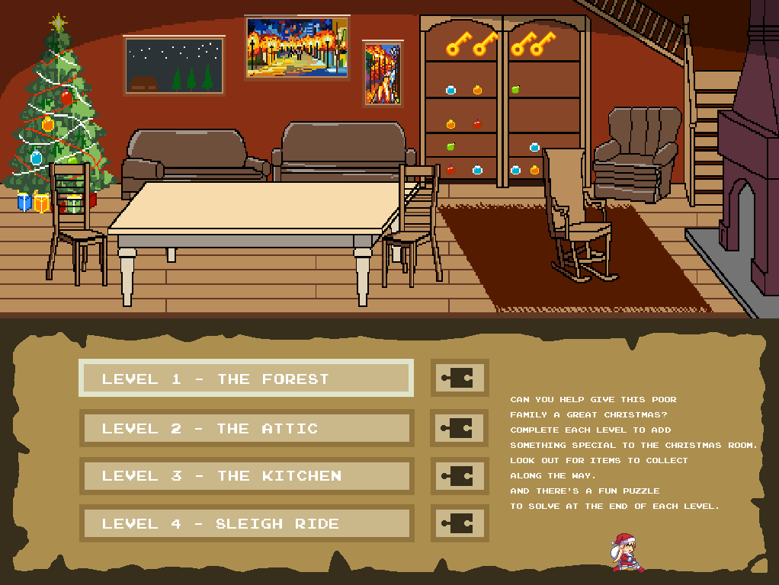
Project Evaluation - Val
(5)
Difficulties and how we coped
Did we enjoy it? yes, but Jaejoon’s reaction very discouraging
Everyone worked well together – lots of communication; weekly workshops very helpful
What did we learn? Skills/strengths developed
Felt bad that Leo spent so much time generating graphics and didn’t get to code
Developed collaborative work skills and use of git version control

Slide 13
Project Evaluation - Ben
(5)
Despite having some small scale leadership experience in the past, I thoroughly enjoyed taking the role of team leader in this longer and more in-depth assignment.
Personally, I found that I was not always able to accurately describe my mental image of a task to my teammates, and developed methods such as forming reference material, creating lists and diagrams to help others better understand my intentions.
I tried to be fair when dividing tasks between group members and always double-checked for their own opinions on the tasks they’d been assigned.
I also enjoyed the challenge of translating real-life tangible puzzles that I used to complete as a child onto a computer-orientated format.

