Slide 1


D2 : Final Presentation
A 3

Slide 2
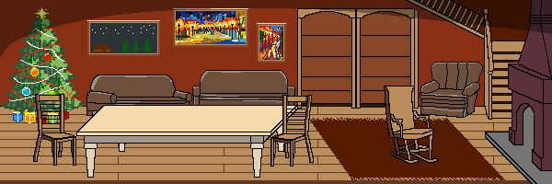
Description
(1)
STYLE: 2D Platforming & Puzzle Game
AUDIENCE: Children (ages 7+)
THEME: Christmas
ROLES:
Team Lead & Puzzle Developer: Ben
Art Director: Leo
Game Engine & Platform Developer: Val & Alex
Level Designer: Gary

Slide 3
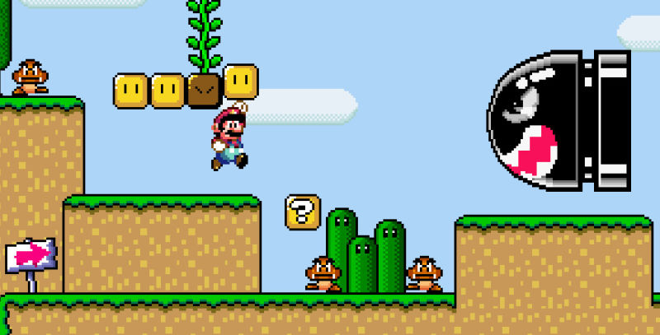
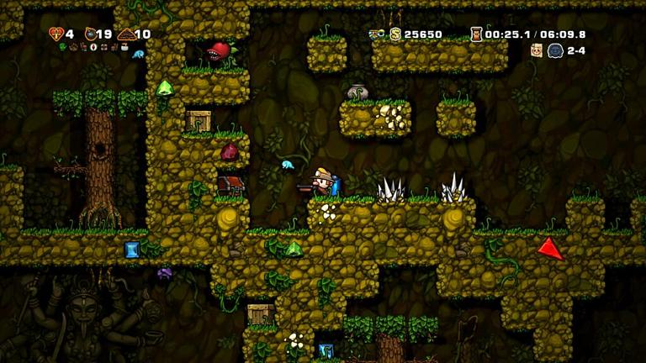
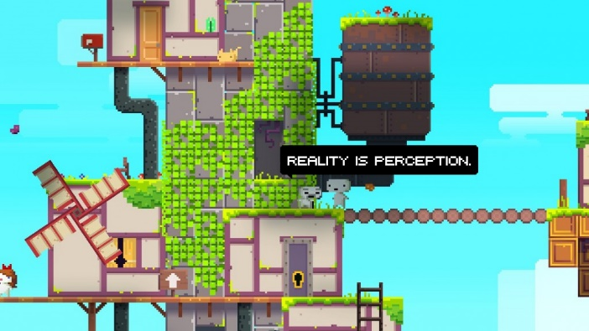
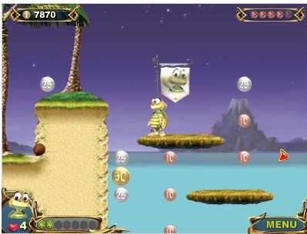
Planning and Ideas
(1)

Slide 4
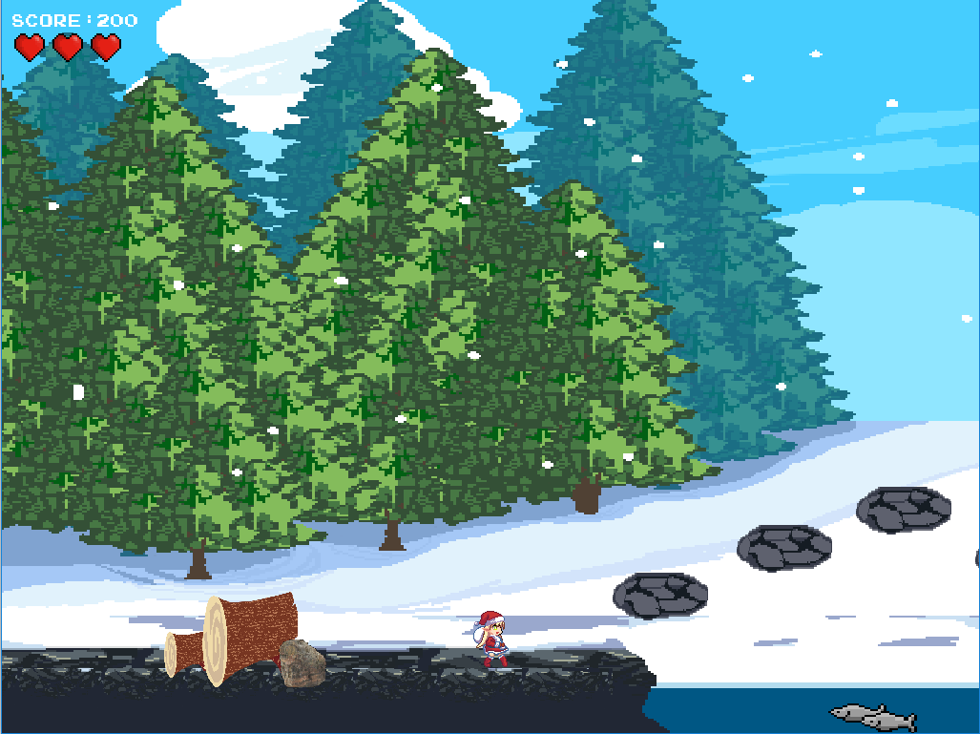
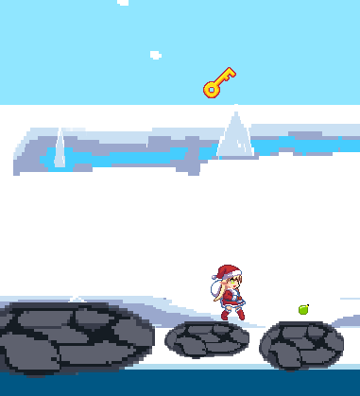
Gameplay
(2)
AIM: Beat all 4 levels to help bring Christmas to a less fortunate family.
LEVEL COMPOSITION: Each level contains the following components.
PLATFORM: A side-scrolling platforming section with challenges such as damaging obstacles and bottomless pits which reset the players progress.
PUZZLE: A different puzzle for each of the 4 levels, themed around a particular Christmas element: ‘Fir Christmas Tree’ , ‘Roast Turkey’ , ‘Decorations’ and ‘Presents’.
PROGRESS: After each level, the player is returned to the menu, where their collectables and newest Christmas element is displayed in the background.

Slide 5
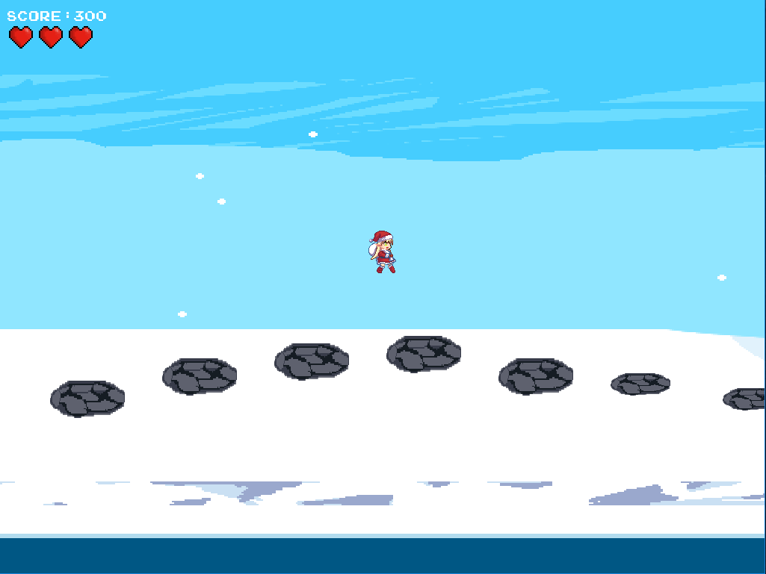


Game Rules
(2)
CONTROLS:
Menu Navigation: WSAD/Up-Down-Left-Right + Enter
Player Movement: WSAD/Up-Down-Left-Right
Puzzle Navigation: WSAD/Up-Down-Left-Right + Num-Keys

Slide 6
Implementation
(3)

Slide 7
Challenges
(3)

Slide 8
User Testing
(4)

Slide 9
Results
(4)

Slide 10
Project Evaluation
(5)

