Slide 1
Requirements for this Presentation (with % marks) (delete this slide when we’re finished)
We have 15 mins - that’s a maximum of 15 slides:
1 title slide
2 slides describing overall project (5%)
4 slides on gameplay (30%)
3 slides describing levels
1 slide referring to game design principles
2-3 slides on implementation challenges (30%)
3 slides on user testing/evaluation (20%)
3-2 slides on reflective evaluation (15%)
Notes:
Val: I’ve changed the font used in this presentation, because I found the previous one difficult to read. Calibri is very sharp and clear.

Slide 2







D2 Presentation
The Christmas Game
Group A3
Alex Carolan, Matty Conway, Gary Fung, Leo Lam, Ben Kendall, Val Williams

Slide 3
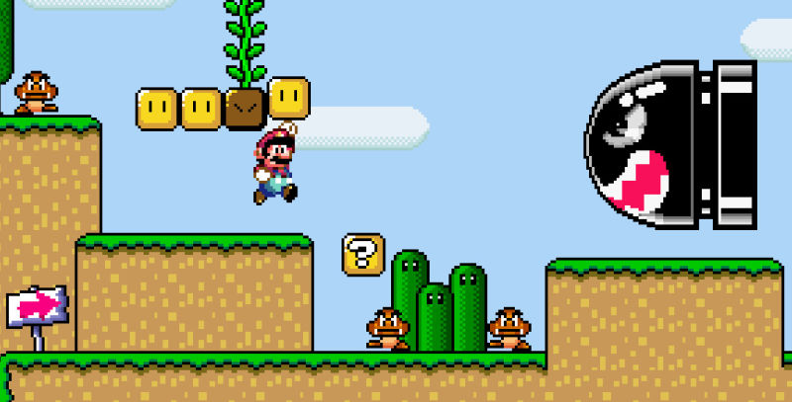
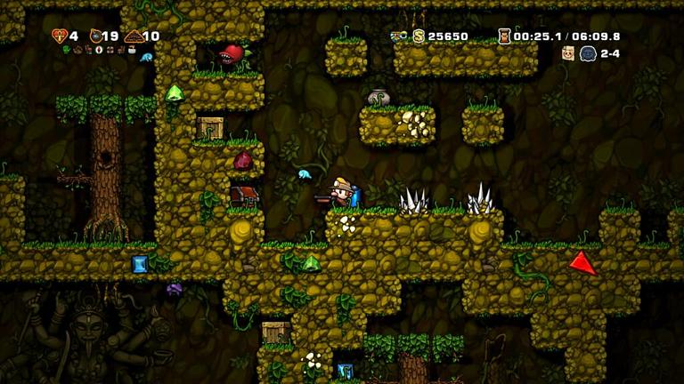
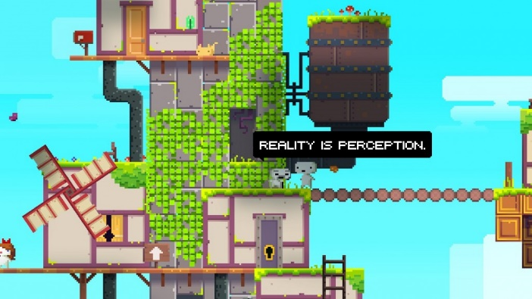
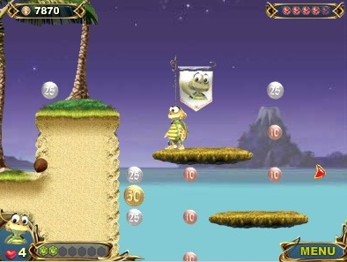
Planning and Ideas (1)
Super Mario Bros
Spelunky
Fez
Turtle Odyssey
Notes:
These are some games we researched before deciding what to do.
We agreed we would like to do a platform game, with a puzzle at the end of each platform level.
We decided that we wanted a game for all the family to play.
We decided we wanted a non-combative game with puzzles and challenges to overcome, and items to collect.

Slide 4
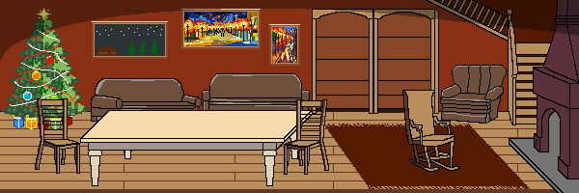
Description of Project & Management (1)
Style: 2D Platforming & Puzzle Game
Audience: Family / Children (ages 7+)
Theme: Christmas
Roles: Team Lead & Puzzle Developer: Ben
Art Director: Leo
Game Engine & Platform Developer: Val & Alex
Level Designer: Gary
Group Working: Code in github, documents in cloud
Lots of discussion (updates and queries) using Facebook Messenger
4hr lab sessions discuss progress, agree approach and share out tasks. Also “pair programming”
Notes:
We agreed that the game should have a Christmas theme, and that each level would gradually populate the Christmas Room, building up from a bare room to a room with all the trimmings for Christmas.
Leo was very keen to develop the graphics, and produced a suggestion sprite which we were very happy with.
Gary developed the ideas for the platform levels and how they would be laid out.
Ben came up with most of the ideas for the puzzles, and then coded these.
Val developed the platforming, developing movement and touching code using ideas from our first Java Swing games (balls bouncing inside a window, rebounding off each other, and with effects of gravity).
Alex set up the document and github areas, and the facebook group, and then did supporting code such as the main menu, lives and animation.
Code was always kept up to date in github – generally people were working on different areas, so there were rarely any clashes.
The weekly lab sessions were well attended and very useful. We often spent 4hrs there reviewing what we’d achieved, what we should do next, who and how to do the next steps, and targets for getting things done. Some weeks we also did group programming sessions which were very productive. This is how we got started with the development at the start of Term2.

Slide 5
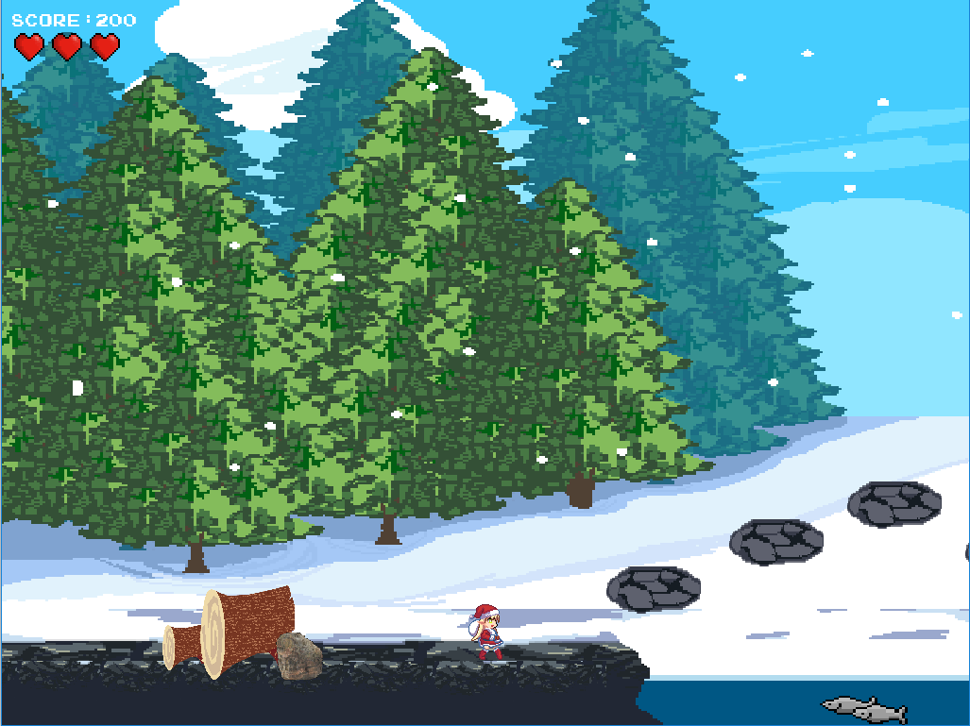
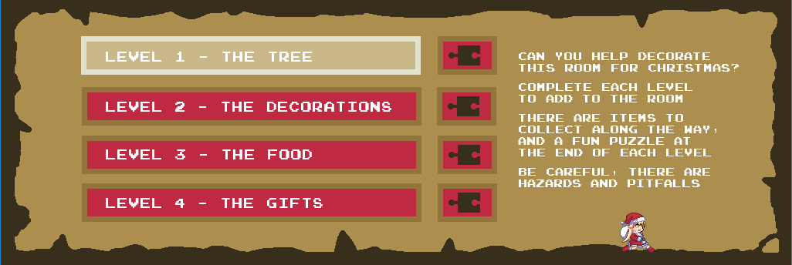
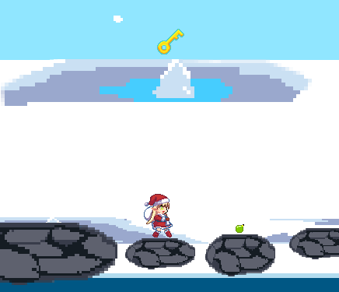
Gameplay (2)
Aim: Complete 4 levels to decorate the Christmas Room. Each level is themed around a particular aspect of Christmas : ‘Christmas Tree’ , ‘Decorations’, ‘Roast Turkey’ and ‘Presents’. Completing a level adds the themed item(s) to the room.
Level Composition: Each level contains:
Platform: A side-scrolling platforming section with challenges such as hazards and bottomless pits which reset the player’s progress. The player must collect the key to be able to complete the platform. There are also extra items to collect along the way.
Puzzle: A different puzzle for each level.
Navigation: WASD or arrow keys to move through menu, platform and puzzles
Enter to select platform/puzzle from menu
Number keys also used to select items in puzzle 4
Notes:
There are 4 levels, gradually increasing in difficulty. The level or puzzle to be played is selected from the game menu. You can only select a platform/level when you’ve completed the previous platform; you always start at the first platform.
The Christmas Room needs to be populated with 4 types of item: a tree, decorations, food, and presents. Each level of the game achieves one type of aspect. The platform and puzzle are paired, and relate to the aspect being achieved.
There is a simple player sprite moving through the platforms. There are no weapons or enemies, but there are hazards to avoid and items to collect. Each level has one special item, the key, that must be collected to allow the player to exit at the end of the platform.
Level 1 is in the forest. The player must cross the lake collecting baubles and the key, without falling in the water. The puzzle at the end of this platform is a maze, and the player must get to the end to find the Christmas tree.
Movement in the platform is via WASD or arrow keys. Moving upwards is done as a jump, and can only be done when the player is standing on something. The player is affected by gravity.
Level 2 is in the attic. The player must search the attic collecting decorations. This level introduces hazards – there are a few smoke outlets in the attic which must be avoided, and the player needs to avoid falling through the gaps in the ceiling. The player needs to do more manoeuvring to successfully cross the attic. There are “tunnels” where the player cannot jump upwards through the ceiling, as well as platforms that can be jumped up/down onto.
The player has three lives at the start of each level. Hitting a hazard, or falling off the bottom of the screen, loses a life and resets the character back to the start of that platform (although they retain any items collected so far).
If they lose all three lives, the platform game exits and they have to start that level again from the beginning.
When a platform game is successfully completed, all the items collected in that platform are displayed in the Christmas Room above the main menu.
Level 3 is in the kitchen. There are a lot more hazards here – fires and knives to be avoided. These are awkwardly placed, so that care must be taken in navigating the kitchen.
Level 4 is the Santa’s sleigh navigating the roofs. Unlike the other platforms, the sleigh moves left/right automatically, and gradually drifts downwards. The arrow keys can be used to change direction or boost movement.
In this level the sleigh must avoid the hazardous smoke coming from the chimneys. There are a lot of chimneys, making navigation surprisingly awkward because of the size and style of movement of the sleigh.

Slide 6
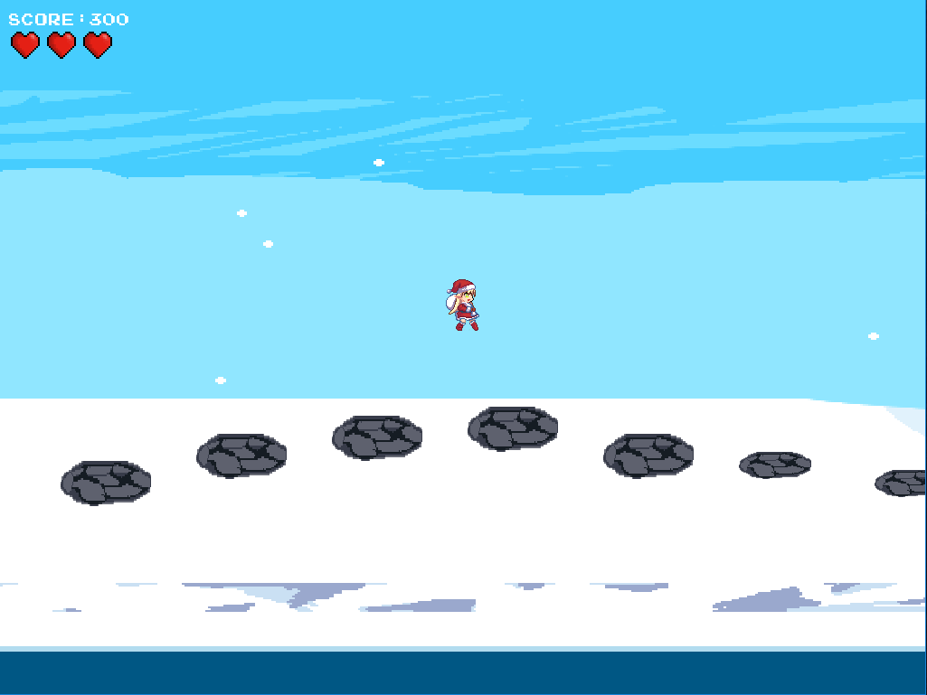
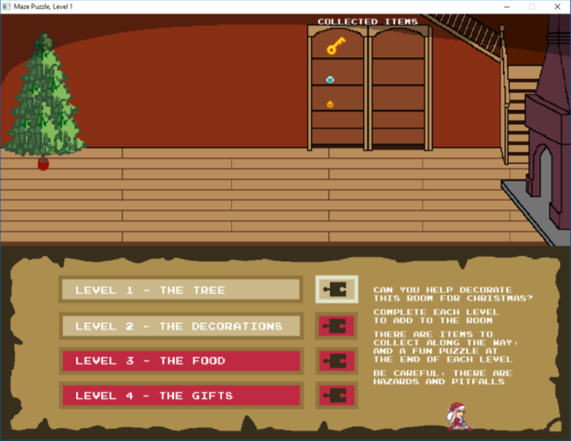
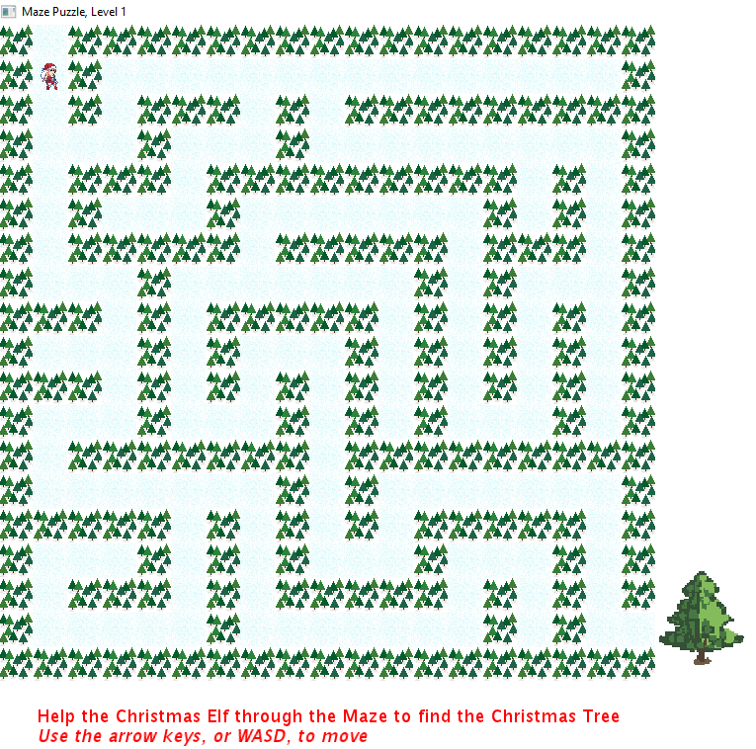
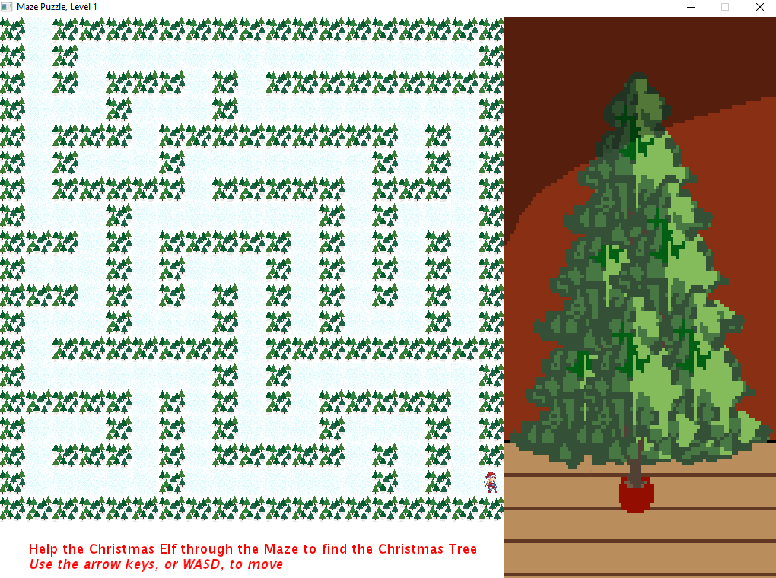
Gameplay (2)
Level Progression: To complete each level, the player must find the scroll near the end of the level.
To unlock the scroll, the player must collect the key. Reaching the unlocked scroll moves the player on to the related puzzle.
Puzzle Completion: Completion of each puzzle shows the item(s) added to the Christmas Room for that level.
Notes:
PROGRESS: After each level, the player is returned to the menu, where they can see the newly decorated Christmas Room and the items they have collected.

Slide 7
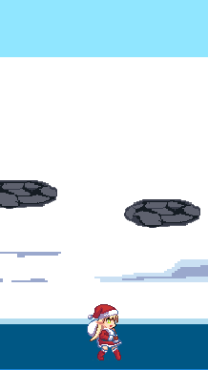
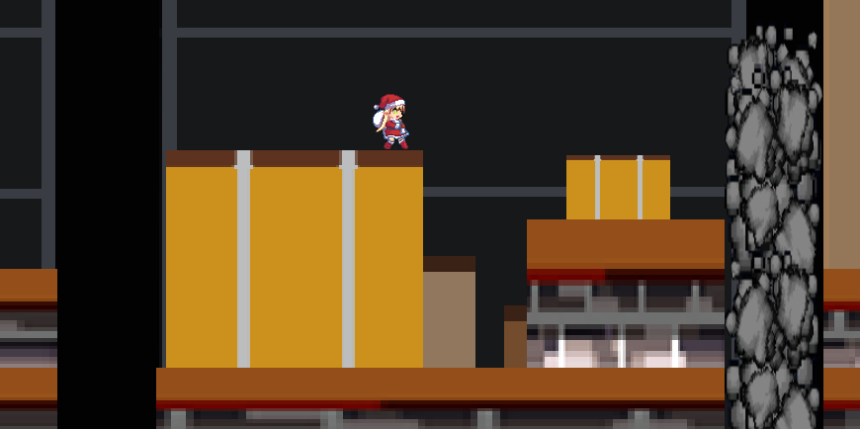
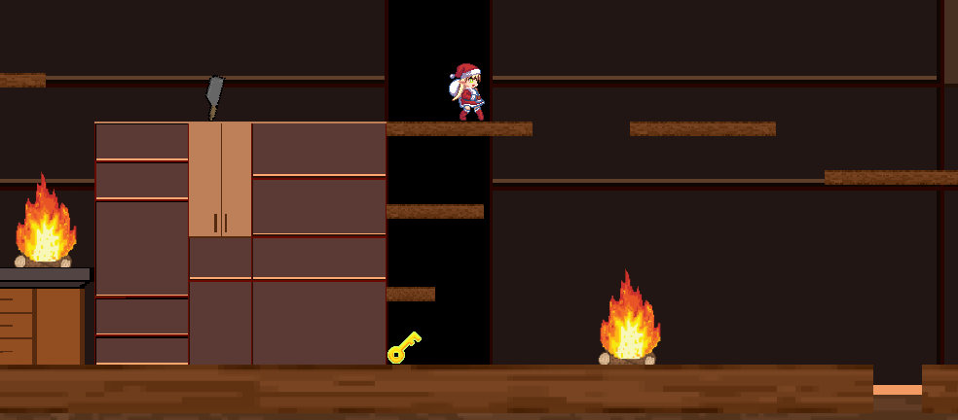
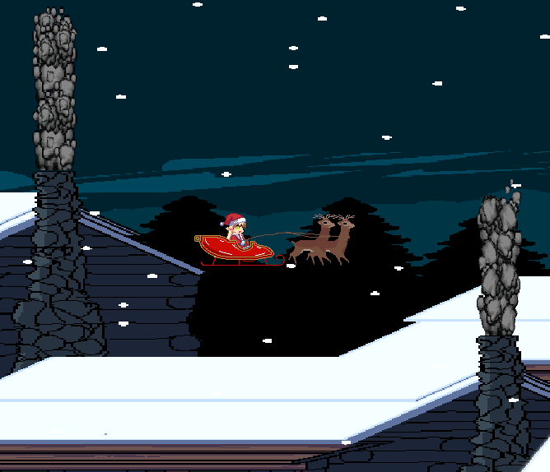
Gameplay – Increasing Difficulty (2)
Level 1 falling in the water
Level 2 smoke hazards and pitfalls
Level 3 movement around fire and knife hazards and pitfall
Level 1 Forest: Cross frozen lake, jumping between stepping stones without falling into the water.
Level 2 Attic: Manoeuvre around tops of walls without falling down gaps. Avoid the smoke that vents through the attic. Level introduces on/off hazards and running under platforms.
Level 3 Kitchen: Run round the various workspaces avoiding the flashing knives and the fires that flare up, and without falling in the pit of hot oil. Manoeuvring to collect items is challenging; timing is crucial.
Level 4 Sleigh: Once you start the sleigh, it keeps moving forwards. You need to boost upwards to counter gravity. The challenge here is to avoid the smoke from the many chimneys without being able to stop.
Level 4 flying around chimney smoke
Notes:
Level 1 is in the forest. The player must cross the lake collecting baubles and the key, without falling in the water. This introduces the style of movement using WASD (or arrow keys and space), how platforms are navigated and the pitfalls. Moving upwards is done as a jump, and can only be done when the player is standing on something. The player is affected by gravity.
Level 2 is in the attic. The player must search the attic collecting decorations. This level introduces hazards – there are a few smoke outlets in the attic which must be avoided, and the player needs to avoid falling through the gaps in the ceiling. The player needs to do more manoeuvring to successfully cross the attic. There are “tunnels” where the player cannot jump upwards through the ceiling, as well as platforms that can be jumped up/down onto.
The player has three lives at the start of each level. Hitting a hazard, or falling off the bottom of the screen, loses a life and resets the character back to the start of that platform (although they retain any items collected so far).
If they lose all three lives, the platform game exits and they have to start that level again from the beginning.
Level 3 is in the kitchen. There are a lot more hazards here – fires and knives to be avoided. These are awkwardly placed, so that great care must be taken in navigating the kitchen.
Level 4 is Santa’s sleigh navigating roofs. Unlike the other platforms, the sleigh moves left/right automatically, and gradually drifts downwards. The arrow keys can be used to change direction or boost movement.
In this level the sleigh must avoid the hazardous smoke coming from the chimneys. There are a lot of chimneys, making navigation surprisingly awkward because of the size and style of movement of the sleigh.

Slide 8
What Makes a Good Game? (2)
Long term Goal: to decorate Christmas Room
Subgoals: to complete each level, collecting items; collected items are shown on menu screen
Game starts easily, and complexity/difficulty gradually increases (manoeuvring to items, avoiding pitfalls and hazards)
Game uses standard controls and concepts. Basic guidance is given.
Levels are fairly short; losing a life restarts the level; losing 3 lives goes back to the menu
Each level has a few clear rewards, which are not too easy nor too difficult to achieve
Game has interesting graphics; each level is similar and yet unique
Completed puzzle shows what was achieved this level, which is then shown on menu screen
Once completed, players can choose to redo any platform or puzzle to collect additional items
Notes:
Redo this slide to make it more obvious what we’re are judging against
What makes a Good Game?
Playing games is about making decisions that have a real impact on the game
Playing a good game is about control / freedom for the player to explore / do things their own way
A game needs a goal. Long games need subgoals
Goals should progressively get harder to reach, starting by letting player get used to how to play, but not being too difficult
Failure can put off a player; players should not feel they have made a disastrous mistake they could have avoided
Bad decisions should not be penalised too harshly; losing the game should be the result of a Serious error; interesting decisions make the game more interesting
Good games have surprises all the way to the end; new features should be added gradually, matching the player’s ability
Rewards should not be too big nor too small – people are picky, but also greedy

Slide 9
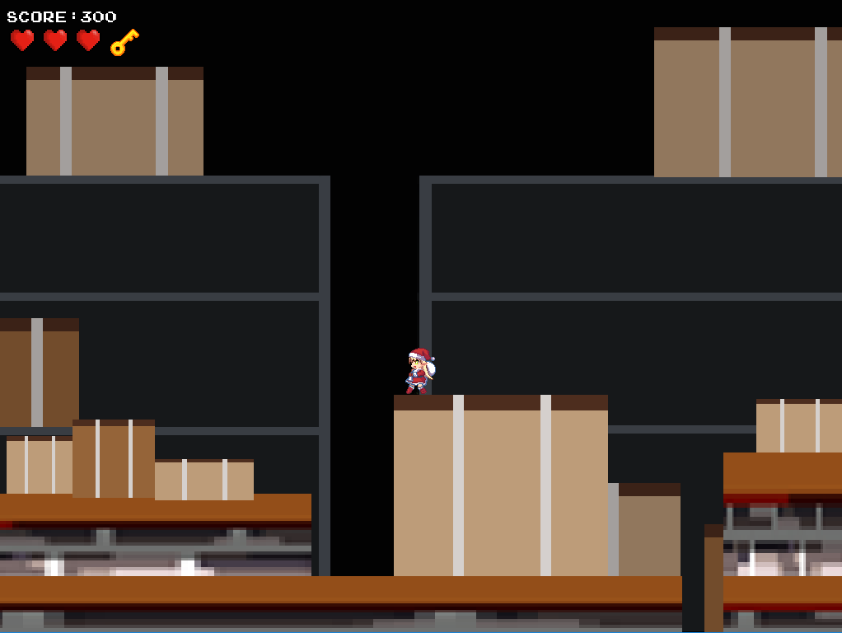
Implementation (3)
Design Spec.
Artwork
Gameplay
Placeholders
Puzzles
Platforming
Base Tile Set
Character Movement
Sprites
Specification for each puzzle
Backgrounds & Platforms
Collision & Hazards
Puzzle Interaction
Layout of Platforms & Items
Puzzle Tiles
Success Conditions
Failure and Success conditions
Notes:
I don’t like this slide. It takes up space and says very little.

Slide 10
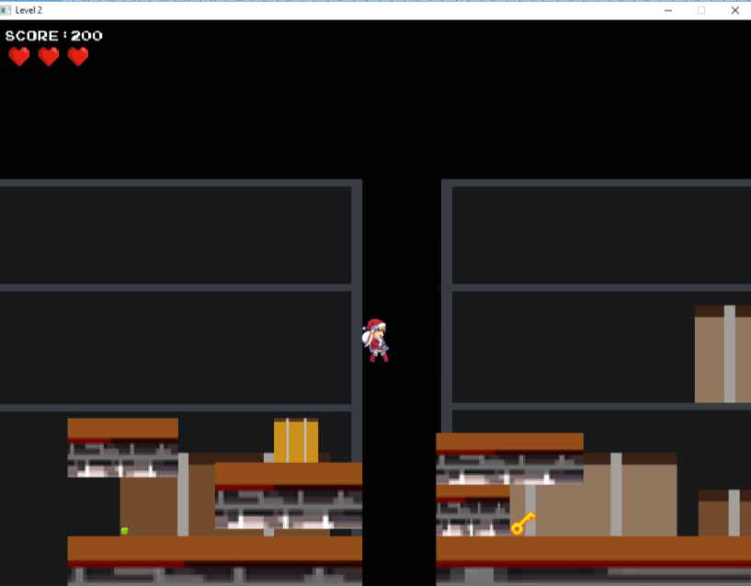
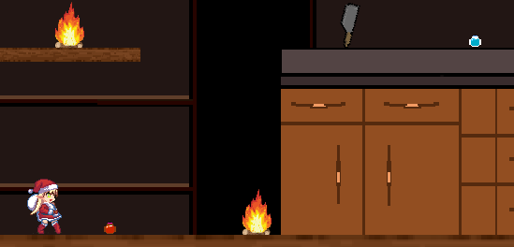
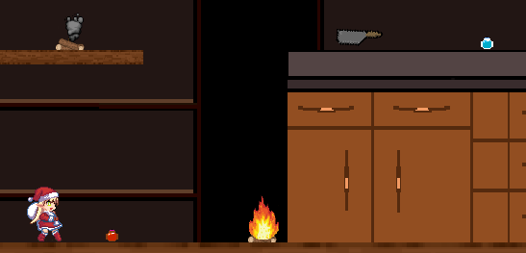
Implementation Challenges (3)
How to sidescroll without a camera?
Keep the player horizontally central and move everything else in relation to the player.
How to encourage replayability?
Create persistent collectibles across all levels as an additional optional measure of tracking progress. Display collectibles from each level in the main menu.
How to translate real life (physical) puzzle games to computer with a non-mouse driven interface?
Create a player controlled focal point (maze, tile)
Limit scalability to bindable keys on the keyboard (traffic).
How to create moving hazards?
Animate hazard using a timed thread, so that hazard causes harm only when displayed in hazardous position. Scroll through images to animate
Notes:
Do we want to add anything about ‘touching’? This was what everyone said they were pleased with when Jaejoon asked.

Slide 11
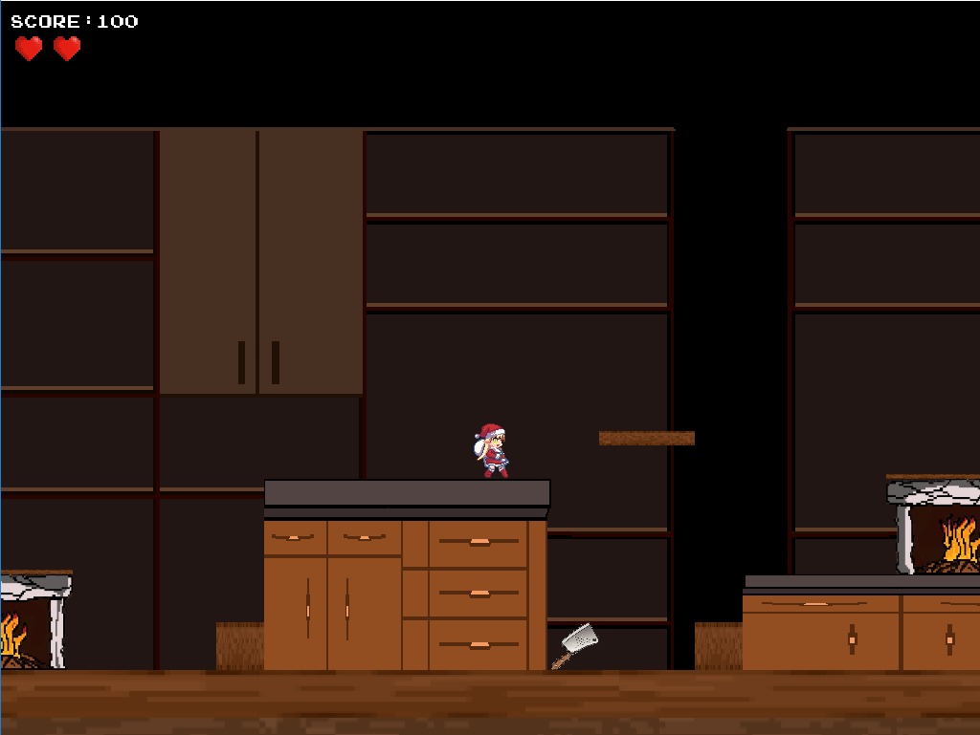
Design Changes (3)
Moveable Objects: During development, we added functionality incrementally. We thought it more important to resolve problems identified during testing rather than include moveable objects. We did not have time to do both, adding moveable objects is not straightforward, and the game works perfectly well without them.
Hazard Invincibility: We originally expected that a hazard would cause damage with some visible notification (e.g. flashing), and the player would have a short period of invincibility to get out of danger. However, it was easier and more consistent to implement hazards the same as falling down through a pit, i.e. by moving the player back to the start of the platform (or back to the main menu if they’ve used all their lives).
Sleigh Movement: We expected to control the height of the sleigh using the space bar. We had also expected to make the sprite jump using the space bar. The space bar does function in this way. However, vertical movement is also achieved using W (or Up arrow).
Timing and Player Score: We expected to track the playing time per level; this was never implemented. We did not fully think through how to handle scores. The game tracks scores within a platform level, but this adds nothing over tracking items collected (100 points per item). This aspect is not fully implemented.

Slide 12
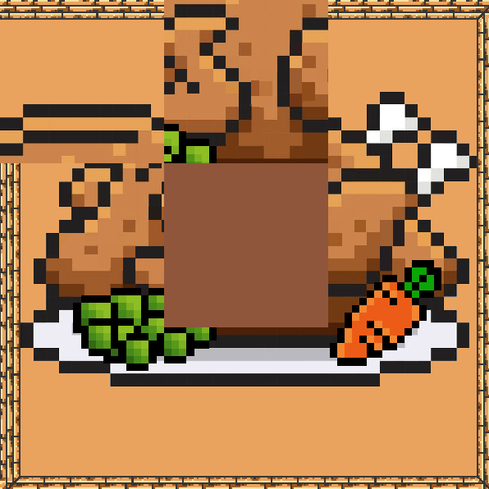
User Testing Methodology (4)
TESTERS: 2nd Year SCC Students, plus friends and family
TESTS CONDUCTED:
1. Platforms Only
To test the logical progression and difficulty scaling by simply following the platforming sections of the game
2. Puzzles Only
To test the difficulty and sense of satisfaction or frustration from each puzzle
Full Game Run-through
To test the logical progression, difficulty and enjoyment from playing the game from start to finish
METHOD: Speak-aloud demos with an observer, plus testers playing the game independently

Slide 13
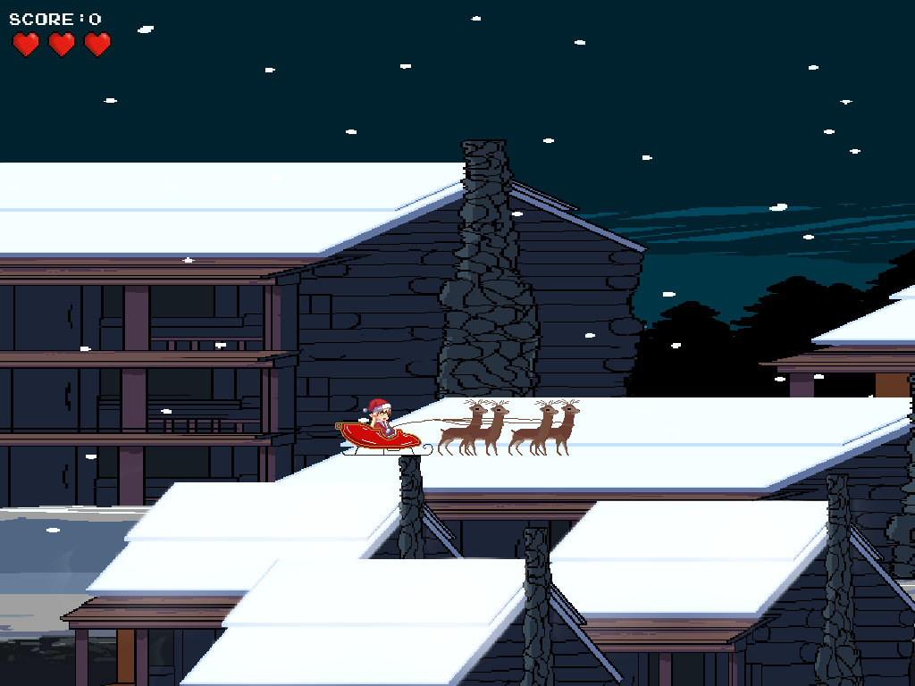
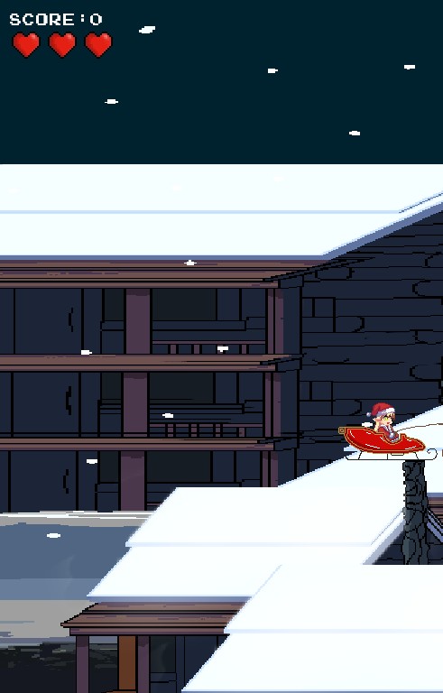
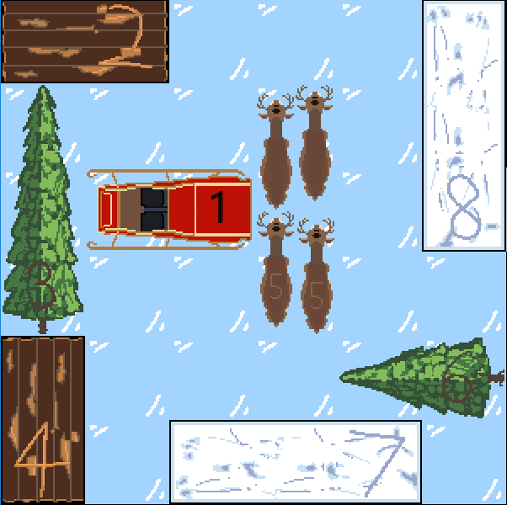
User Testing Feedback (i) (4)
TEST AREA 1: PLATFORMS:
Intention: Difficulty to scale linearly upwards for each sequential level.
Findings: Participants found level 1 more difficult than level 2.
Action Taken: Increased pitfalls and obstacles in level 2.
TEST AREA 2: PUZZLES:
Intention: Each puzzle to be unique and challenging in its own way, but not to cause frustration.
Findings: Participants found the tile puzzle to be too complex, taking upwards of 10 minutes to solve.
Action Taken: Reduced tile puzzle from 4x4 to 3x3.
TEST AREA 3: FULL RUN-THROUGH:
Intention: Experience to be both enjoyable and challenging
Findings: Participants felt a disconnect between their character and the aim of the game
QUOTE: “Why is this elf fixing the house?”
Action Taken: Added the character to the background in the main menu to create a mental link.
NOTE: Test 3 was completed after the changes made following Tests 1 and 2.

Slide 14
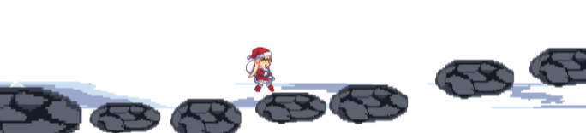
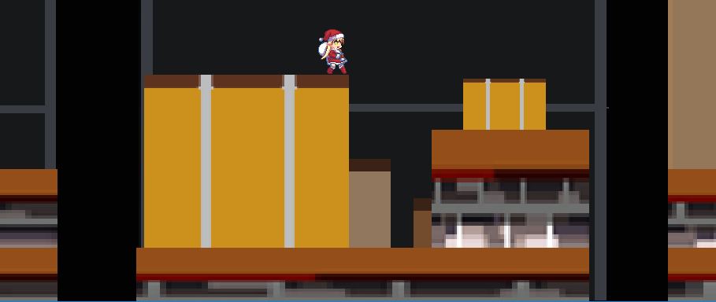
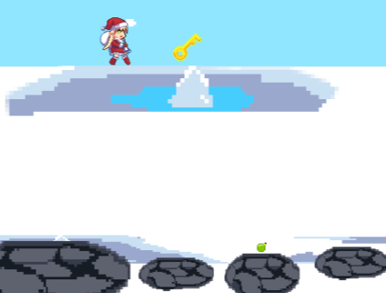
User Testing Feedback (ii) (4)
1: Player should be able to move up small amounts without having to jump, e.g. below lake
Fix: amended code to allow small amounts of Y-movement as part of X-movement
2: Pitfalls in attic are not clearly visible due to coloration of background
Fix: moved pitfalls to be in front of black areas of background
3. In the attic, the obstacles you can jump on merge into the background because they are all similar colours
Fix: made foreground obstacles brighter colours
4: When you jump round to the far side of the lake in Level 1, you’re standing on snow, which isn’t allowed elsewhere
Fix: use other lake image so that you’re standing on the lake edge
5. In kitchen you can jump up past most shelves, but the lowest one you bang your head
Fix: change lowest shelf to be jump-up-able, like the others
6. Have the game play in a single window, rather than separate windows for menu, platform and puzzle
Fix: change to use single window

Slide 15
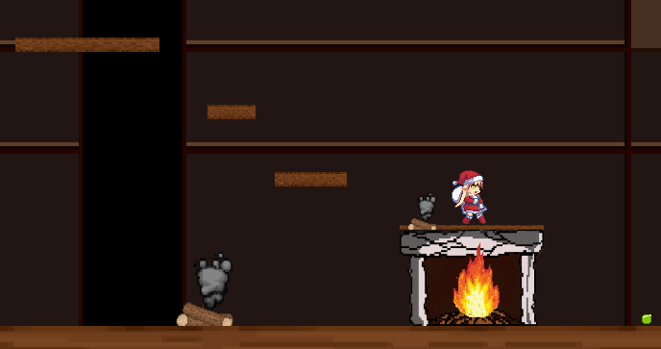
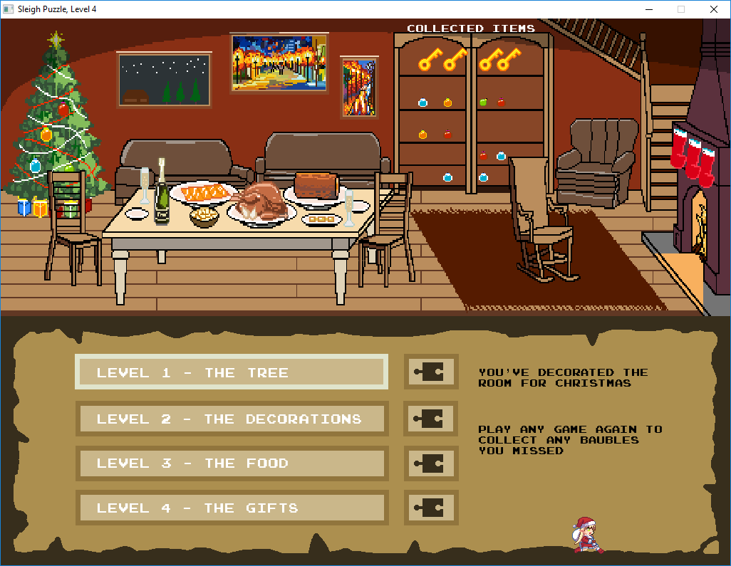
User Testing Feedback (iii) (4)
7: Sprite continues to move when window has lost focus
Fix: pause when window loses focus, and un-pause when focus regained
8: Jump down in kitchen falls past fireplace when it ought to land on top
Fix: change shelving arrangement so this does not occur
9: Add an Oops sound on loss of life, and death
Fix: Add music, including Oops sound
10: Not clear when you’ve reached the end game state
Fix: update instructions in main menu to show that game complete
11: Did not notice collected items in Christmas Room, nor other Christmas Room updates
Fix: Add text above shelving that collected items will be shown there
Show new aspect of Christmas Room beside completed puzzle before going back to main menu (shown earlier)
Notes:
Things we did not do:
1. Curvy shapes have rectangular hit boxes which looks odd
Nothing we can do at this late stage in the game.
2. Maze puzzle moves too quickly in response to keyboard keys
3. Need instructions for how to drive menu (Enter key, not mouse clicks)
4. Not clear why you should collect the baubles, or what the points are for.
5. The room on the menu screen does not look right – some of it is 3D and some 2D. The bookshelf looks like a door – it would be better with a bit of shading below each shelf. The joints in the floor are not angled like the front of the fireplace. Make the inside of the fireplace not the same colour as the fireplace base.
6. Need a proper start menu to introduce the storyline to players and to access settings of the game, which is not implemented (which should be able to adjust volume and player outfit)
7. Things that are included in the first term design report but not implemented (moving obstacles, high score table, incrementing timer, etc)

Slide 16
User Feedback – Questionnaire (i) (4)
 | Strongly Disagree | Disagree | Neutral | Agree | Strongly Agree
The game was fun to play |  |  | ✓ | ✓✓
It felt festive (good for Christmas) |  |  |  |  | ✓✓✓
The game flowed smoothly |  |  | ✓✓ | ✓
I was happy with the length of time to complete the game |  |  |  | ✓✓ | ✓
I found it easy to move the player where I wanted |  |  |  | ✓✓ | ✓
I found the design attractive (characters, backgrounds, puzzles) |  |  | ✓ | ✓ | ✓
The game flowed well between platforms and puzzles |  |  | ✓✓ | ✓
I thought the idea of the Christmas room integrated well with the game |  |  | ✓ | ✓✓
Based on feedback from three testers, and before we did all the fixes arising from their observations
Notes:
This questionnaire was from three testers, and was before we did all the fixes

Slide 17
User Feedback – Questionnaire (ii) (4)
 | Strongly Disagree | Disagree | Neutral | Agree | Strongly Agree
The game was fun to play |  |  |  | ✓✓✓
It felt festive (good for Christmas) |  |  |  |  | ✓✓✓
The game flowed smoothly |  |  | ✓ | ✓✓
I was happy with the length of time to complete the game |  |  |  | ✓✓ | ✓
I found it easy to move the player where I wanted |  |  |  | ✓✓ | ✓
I found the design attractive (characters, backgrounds, puzzles) |  |  | ✓ | ✓ | ✓
The game flowed well between platforms and puzzles |  |  | ✓ | ✓✓
I thought the idea of the Christmas room integrated well with the game |  |  |  | ✓✓ | ✓
Based on feedback from same three testers, after we did fixes arising from their observations
Notes:
This questionnaire was from the previous testers, and was after we did all the fixes.
The testers were not told what fixes had been applied; they were simply asked to re-test the game and submit new feedback.
Their feedback was:
“A lot better. There are still irritating bits, but it is improved, and looks nice. I found it easy to move the player where I wanted - Mostly very good, though the elf maze still moves many steps unless I jab at the keyboard to only move one. The gameplay is more connected to the storyline after noticing the elf is fixing the house for Christmas. ”

Slide 18
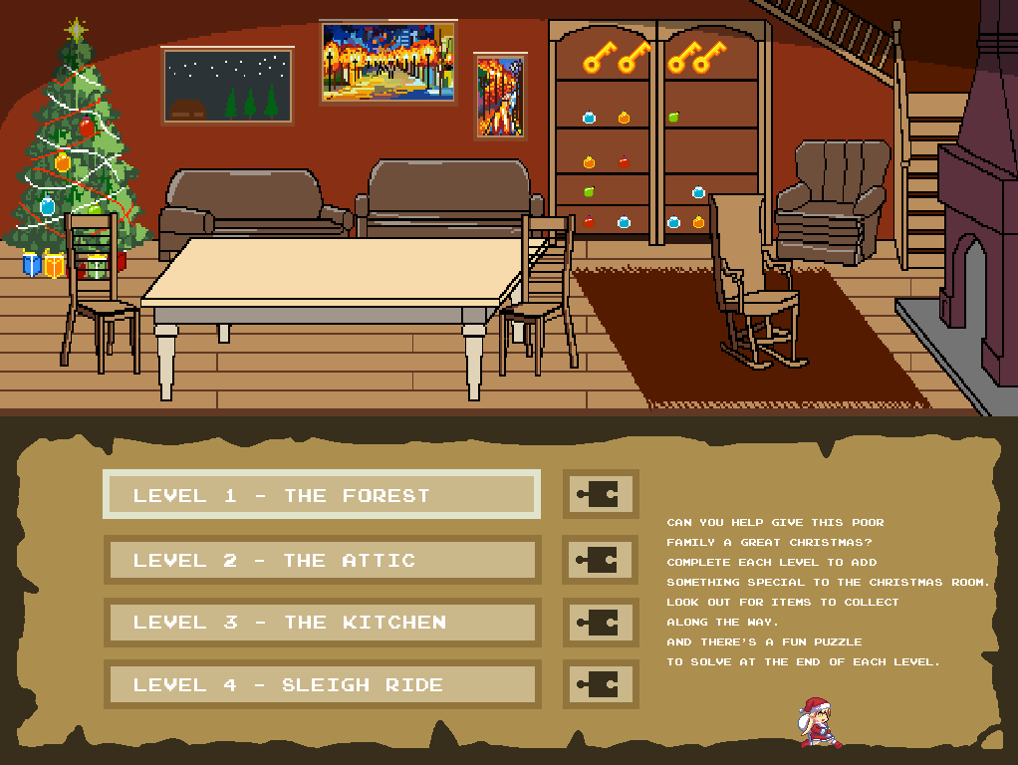
Project Evaluation - Val (5)
Everyone worked well together – frequent, useful messaging; weekly workshops achieved a lot and were enjoyable
Felt bad that Leo spent so much time generating graphics and didn’t get to code
Developed collaborative work skills and use of git version control

Slide 19
Project Evaluation - Ben (5)
Despite having some small scale leadership experience in the past, I thoroughly enjoyed taking the role of team leader in this longer and more in-depth assignment.
Personally, I found that I was not always able to accurately describe my mental image of a task to my teammates, and developed methods such as forming reference material, creating lists and diagrams to help others better understand my intentions.
I tried to be fair when dividing tasks between group members and always double-checked for their own opinions on the tasks they’d been assigned.
I also enjoyed the challenge of translating real-life tangible puzzles that I used to complete as a child onto a computer-orientated format.

