Slide 1

Moltres Agent
AI Team Onboarding
Answers with citations over an approved corpus
Hackathon demo | Powered by Cast & Crew
Notes:
Open here. Then the problem (0:00-0:40), the solution (0:40-1:20) and the approach (1:20-2:00).

Slide 2



New hires don't know where to look
Confluence
Jira
Repositories
Design pages, QA strategy, the access process
Tickets and the initiatives each team works on
READMEs, design documents and code
What do I request?
What do I read?
Who owns what?
They end up depending on senior people,
and every new hire repeats the same questions.
Notes:
When someone joins a team, the knowledge they need is scattered: Confluence, Jira, repositories. They don't know what to request, what to read, or who owns what. They end up depending on senior people, and every new hire repeats the same questions.

Slide 3
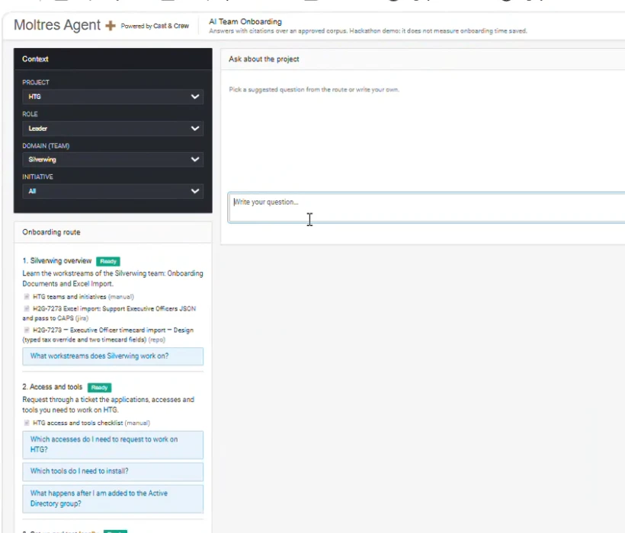



Pick your context, follow a four-step route
Project | Role | Team | Initiative
1
Overview
What the team and its initiatives work on
2
Accesses and tools
What to request through a ticket
3
Local setup
Clone, configure and run the project
4
Questions for your area
Suggested questions, or write your own
The web app: selectors and route
Every answer cites its sources
Says "not covered" instead of guessing
Ask in Spanish or English
Notes:
Moltres Agent is an onboarding assistant. You pick a project, your role (Developer, QA or Leader), a team and an initiative, and you get a four-step onboarding route: overview, accesses and tools, local setup, and questions for your area. Then you can ask in Spanish or English. Every answer cites its sources, and when the documentation doesn't cover a question, it says so instead of guessing.

Slide 4





From documents to cited answers
Corpus
Search
Re-rank
Answer
Check
Approved Markdown with source and version
Haiku rewrites the query; keyword index (BM25)
Haiku keeps the best passages
Sonnet writes it with citations
Backend rejects citations that were not retrieved
Read-only: it cannot run commands or change any system
AWS Bedrock, a .NET API and an Angular front end
Time saved is not claimed: it would be measured in a pilot
Notes:
We turn the documents into a Markdown corpus with metadata. For each question, one Claude model rewrites the query and re-ranks the candidates from a keyword index, and a second one writes the answer with citations. The backend rejects any citation that wasn't actually retrieved. It's read-only: it can't run commands or change any system. It runs on AWS Bedrock, a .NET API and an Angular front end. Don't claim time saved. Say: we'd measure that in a pilot with new hires.

