Slide 1
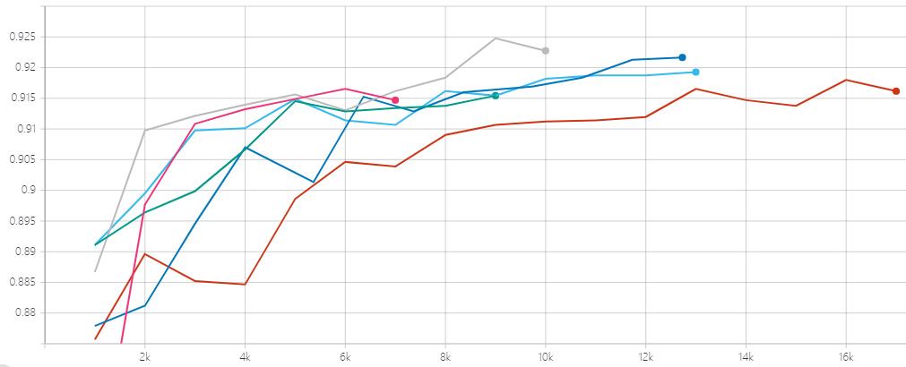
b40_e3
b32_e3
b40_e4
b24_e3
b32_e4
b24_e4
Accuracy
Steps

Slide 2
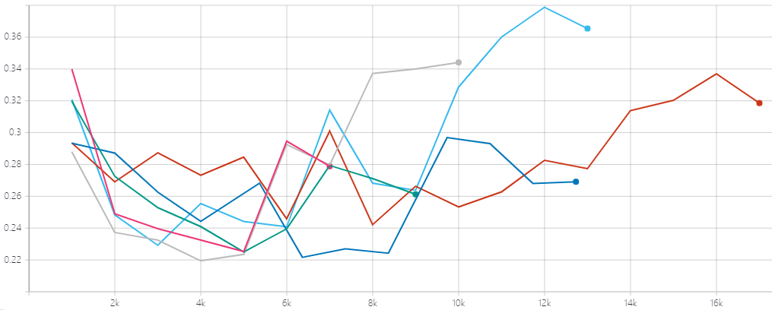
b40_e3
b32_e3
b40_e4
b24_e3
b32_e4
b24_e4
Loss
Steps

Slide 3
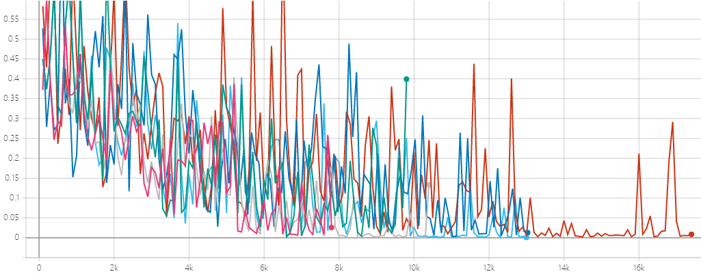
b40_e3
b32_e3
b40_e4
b24_e3
b32_e4
b24_e4
Loss
Steps

