Slide 1
Eclipse Arrowhead Onboarding scenarios
04.03.2021
Online, Austria
Mario Zsilak

Slide 2

Onboarding procedure – simplified drawing
Untrusted
Thing
1
Onboarding procedure has logical layers of security
Arrowhead services refuse connection of untrusted (i.e. not authenticated) things
Outer (orange) layer allows connection from any source
Middle (yellow) layer allows connection from onboarding and device certificates
Inner (green) layer allows connection from Arrowhead valid certificates
Onboarding controller, Device Registry, and System Registry each contact the CA to create a “better” certificate for the untrusted thing
2
Onboarding Controller
4
Device Registry
3
6
System Registry
5
CA
Service Registry
7

Slide 3
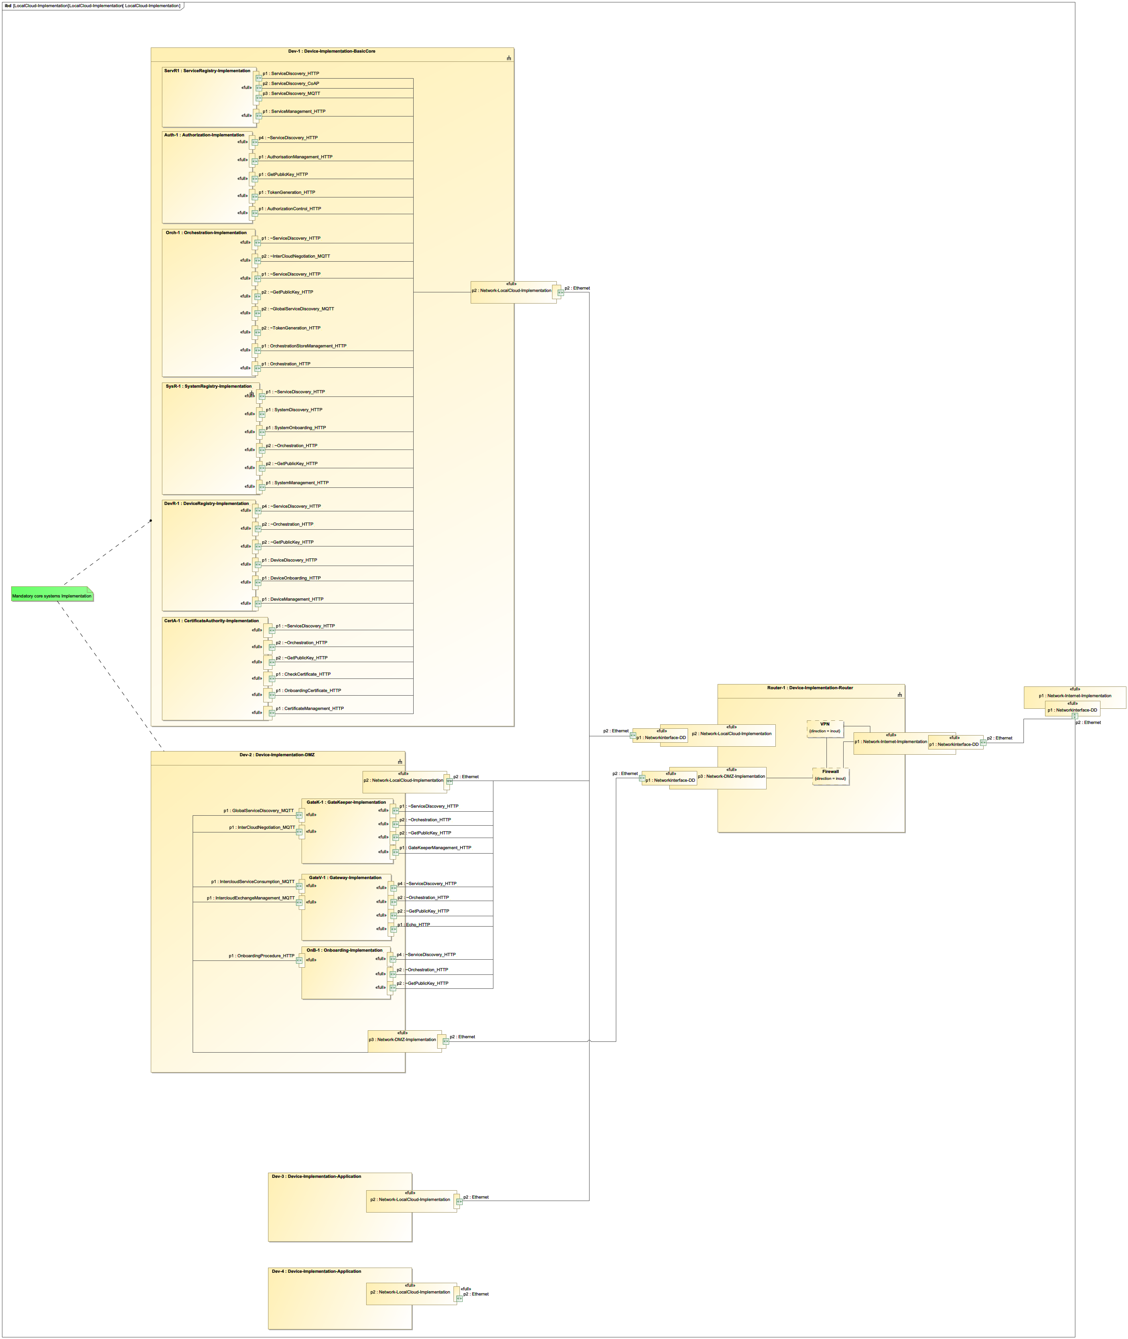

Local cloud implementation – simplified drawing
Internal Network
Router / Firewall
DMZ Network
Onboarding Controller
Trusted
Thing
Untrusted
Thing

Slide 4
1. Trusted and untrusted things connect to internal network
Trusted things, i.e. systems with valid Arrowhead certificate, may use systems and services of the local cloud
Untrusted things need to contact the onboarding controller and perform the onboarding procedure to become trusted
Untrusted things cannot use any other system or service because they lack authentication
Trusted things may become untrusted when, for example, their certificate expiries
Onboarding Controller contains an interface which accepts connections from untrusted things
Internal Network
Onboarding Controller
Trusted
Thing
Untrusted
Thing
Router / Firewall
DMZ Network

Slide 5
2a. Trusted things connect to internal network, untrusted things connect to DMZ network
Trusted things, i.e. systems with valid Arrowhead certificate, may use systems and services of the local cloud
Untrusted things need to contact the onboarding controller and perform the onboarding procedure to become trusted
Newly trusted (onboarding) things may (physically) get disconnected from the DMZ and moved to the internal network
Trusted things may become untrusted when, for example, their certificate expiries
Newly untrusted (offboarding, expired) things must be disconnected physically from the internal network
Isolated Network
Internal Network
Untrusted
Thing
Trusted
Thing
2
Router / Firewall
DMZ Network
1
Onboarding Controller

Slide 6
2b. Trusted things connect to internal network, untrusted things connect to DMZ network
Trusted things, i.e. systems with valid Arrowhead certificate, may use systems and services of the local cloud
Untrusted things need to contact the onboarding controller and perform the onboarding procedure to become trusted
Newly trusted (onboarding) things may use their AH certificate to VPN into the internal cloud
Newly untrusted (offboarding, expired) things must be disconnected …
physically from the internal network
virtually from the VPN
Isolated Network
Internal Network
Untrusted
Thing
Trusted
Thing
2
VPN / Routing
Router / Firewall
DMZ Network
1
Onboarding Controller

Slide 7
3a. Remote things connect to local cloud
Untrusted
Thing
Untrusted things need to contact the onboarding controller and perform the onboarding procedure to become trusted
Newly trusted (onboarding) things may use their AH certificate to VPN into the local cloud
Newly untrusted (offboarding, expired) things must be disconnected …
physically from the internal network
virtually from the VPN
Basically the same as 2b. but connections may come from the outside
Internal Network
2
1
Trusted
Thing
VPN / Routing
Router / Firewall
DMZ Network
Onboarding Controller

Slide 8
3b. Remote things connect to site-to-site VPN
Trusted Remote Network
Site-to-site VPN between a local internal network and a trusted remote network
Basically, the same as 1. but the internal network has virtual private networks
Trusted things, either local or remote, may use systems and services of the local cloud
Untrusted things, either local or remote, need to contact the onboarding controller and perform the onboarding procedure to become trusted
Untrusted things cannot use any other system or service because they lack authentication
…
Trusted
Thing
Untrusted
Thing
VPN
1
3
Internal Network
Onboarding Controller
2
4
VPN / Routing
Router / Firewall
DMZ Network

Slide 9
Thank you !
Mario Zsilak
mario.zsilak@forschung-burgenland.at

