Slide 1
Plant Description Engine (PDE)
Overview and demo
AH biweekly, 2021-05-25

Slide 2
Plant Description, first objective
PDE - High level motivation
To support making plans for multi-vendor integration
Ready-made AH systems are delivered by vendors independently (unknowingly of each other)
Integrator uses such systems as Lego-blocks and constructs the ”glue” for interconnectivity and operation
Late binding through orchestration will connect adequate systems at runtime, according to the plan of the plant description
To monitor that a plant runs according to plan, e.g.,
There are producers offering intended services
Only expected services exist

Slide 3
Plant Description, first objective
What is a plant description, a k a plan?
An abstract description on which systems the plant shall contain and how they shall be connected as consumers and producers
The description need not contain any instance specific information, instead meta-data about each system is used to match service producers to consumers
The active plan is used to populate the Orchestrator with store rules so that consumers requesting producers with matching meta-data will connect according to plan.

Slide 4
Plant Description, first objective
Sub-plans and alternative plans
A plan can be extended with delta plans
No need to change the base plans
Also, the PDE can be configured with several variants of plans
Where one is active (plan A).
And others are alternative plant (plan B, plan C, etc).
The active plant description is instantly populated to the orchestrator
Plans may be changed during operation
Having plans is optional, if no plant description is active the orchestrator does not contain any store rules populated by the PDE.

Slide 5
Plant Description, first objective
Monitoring
The PDE checks presence of systems specified in the active plan
If a system is not present it raises an alarm.
If it detects that an unknown system has registered a service in the service registry it also raises an alarm.
For a consumer system to be monitored by the PDE the system should produce the Monitorable service and register it in the service registry.

Slide 6
Now demo follows!

Slide 7
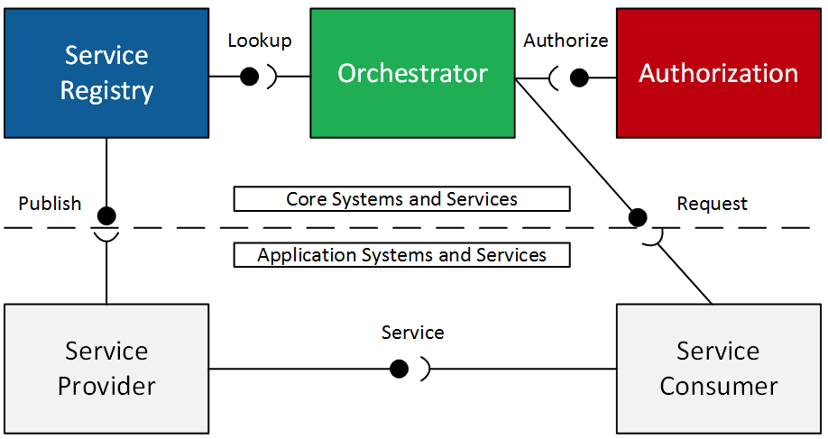
Plant Description Engine in Arrowhead
Mgmt interfaces
XML / JSON representation of Plant
Dashboard
PDE monitor
PDE mgmt
Database
PDE Interacts with Arrowhead core components
For monitoring
For orchestration
Optional heartbeat (if registry/orchestrator is insufficient)

Slide 8
Links
PDE overview
https://github.com/eclipse-arrowhead/core-java-spring/tree/pde#plant-description-engine
SOSD
https://github.com/eclipse-arrowhead/core-java-spring/blob/pde/documentation/plant-description-engine/plant-description-engine-sosd.md

