Slide 1

Arrowhead Tools WP5 / WP8 UC1
Automated Formal Verification: Integrating analysis tools with Eclipse using the Arrowhead Framework
Jan Fiedor VeriFIT research group

Slide 2
Motivation
Users often encounter two issues when using analysis tools:
They cannot run the analysis from the IDE where they have the code
They do not have the analysis tools available on their computer
Missing integration of analysis tools:
Integrate the analysis tools into Eclipse IDE
Provide a push-button solution to run the chosen analysis
Support different types of analyses (static, dynamic, …)
When analysis tools are not available locally:
Allow remote execution of analysis tools
Handle transmission of input/output data
Support different types of tools (static, dynamic, …)

Slide 3
Integrating Analysis Tools into Eclipse
Developing an extensible Eclipse plugin for running analysis tools
Users may provide custom commands for running their tools
Users may provide custom output parsers to transform their tools’ outputs into Eclipse errors, warnings, etc.
The plugin provides information about the file(s) the analysis was invoked on to the custom commands
Different types of analyses may require different inputs
Source code file(s) for static analyses
Binary file(s) for dynamic analysis
Some analyses may be invoked only on certain types of files

Slide 4





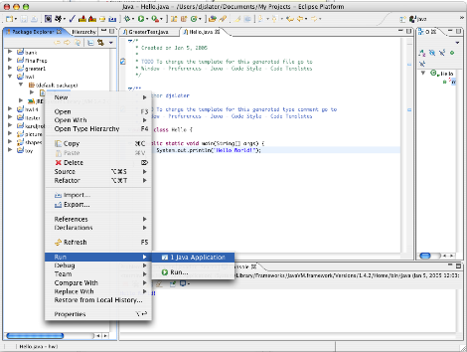

Local Tool Execution from Eclipse
Task
Executor
Plugin
Extensions
Tasks
Tool command
OSLC
Request
Parsers
Terminal
Input
OSLC
Response
Parser
Tool
Local
Command
Input
Local
Command
Output
Parser
Output
Output
with
markers

Slide 5
Offloading Analysis Tools to Remote Servers
Developing OSLC adapters for various analysis tools
Based on OSLC Automation Specification Version 2.0
OSLC adapters for the following tools are available/under development -some in AHT, some in other projects (some finished, e.g., Aquas):
ANaConDA: dynamic analysis of concurrency-related issues
Perun: dynamic analysis of performance-related issues
Facebook Infer: static analysis of source code files (prototype)
OSLC adapters for various Facebook Infer plugins in development
A compilation OSLC adapter
Provides binary file(s) compiled from the provided source code file(s)
Allows one to use source code file(s) as input(s) for analysis adapters which require binary file(s) (ANaConDA, Perun, …)

Slide 6


Remote Tool Execution from Eclipse
Task
Executor
Plugin
Extensions
Tasks
OSLC request
OSLC
Request
Parsers
Analysis
Adapter
Input
OSLC
Response
Parser
OSLC response
Tool
Local
Command
Sources
Input
Binary
Local
Command
Output
Parser
Compilation
Adapter
Output
with
markers

Slide 7
Generalizing the Analysis Adapter
The analysis adapter can use the same infrastructure as the Eclipse plugin
Custom commands can be used to run tools based on OSLC requests
Custom output parsers can be used to transform the tools’ outputs into OSLC-compliant responses
Generalization requires experience with adapters for different types of analyses (static, dynamic, for error detection, performance-related, etc.)
The goal is to create new adapters without the need to build them
New adapters are created by providing
Description how to construct the command to run the tool from the data in the OSLC request (textual configuration)
Custom commands and output parsers
Available for more complex tools, often not needed
Only command(s) and parser(s) needs to be built

Slide 8
Universal Analysis Adapter
Task
Executor
Extensions
Tasks
Tool command
OSLC
Request
Parsers
Terminal
Input
OSLC
Response
Parser
Tool
Local
Command
Input
Local
Command
Output
Parser
Output with OSLC contributions
Output
Analysis
Adapter
OSLC request
OSLC response

Slide 9
Integration with the Arrowhead Framework
Use the service registry for automatic discovery of available analyzers
Allows easy addition of new (instances of) analyzers
OSLC adapter registers itself on startup
Eclipse plugin dynamically queries the service registry to discover which OSLC adapters (analysis tools) are available
What if some analysis should be available only for specific users?
Current authorization service handles devices, not users
Should we have a separate user authentication service?
Current proposal is to use Keycloak and make it AHT-compatible
Can be integrated with LDAP and Active Directory servers
Can delegate authentication to 3rd party identity provides
Facebook, Google, etc.

Slide 10
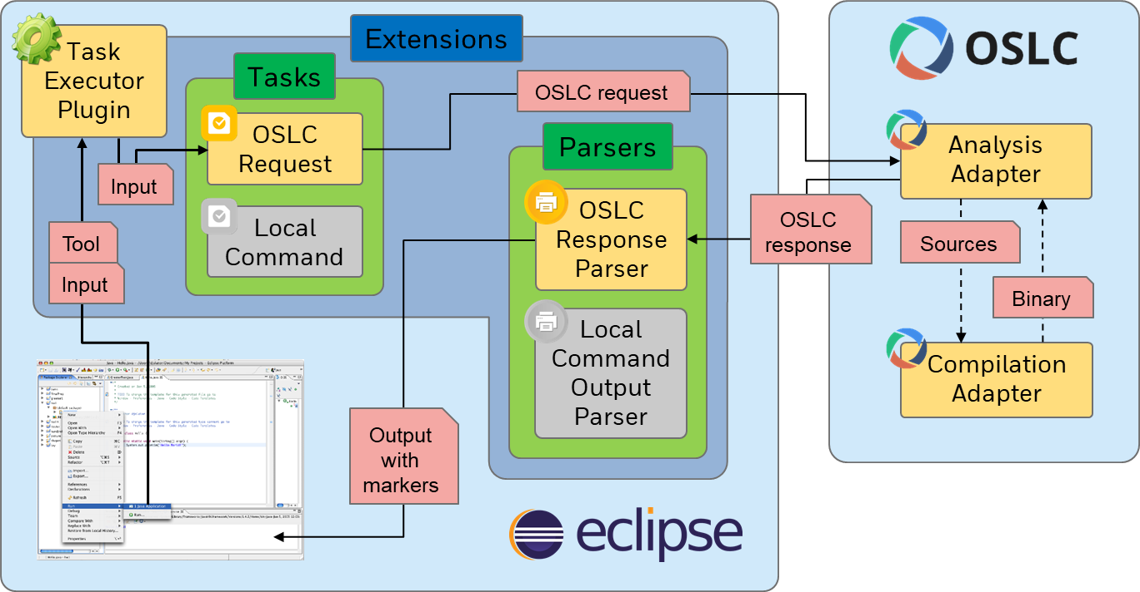
Automatic Discovery of Available Analysers
Service Registry
Authorization System
Authentication System
Adapter AHT Connector
Eclipse AHT Connector

