Slide 1
Arrowhead Core C++
Szvetlin Tanyi szvetlin@aitia.ai

Slide 2
Status
Service Registry
Register/Unregister ready
Query in development
Other core systems
Only a skeleton, not yet developed
Device Registry,
Certificate Authority
Ready

Slide 3
General information
Secure mode only (HTTPS)
DB uses MariaDB
Other DBs are usable if implemented
Memory usage: on avarage 0.1MB of memory used

Slide 4
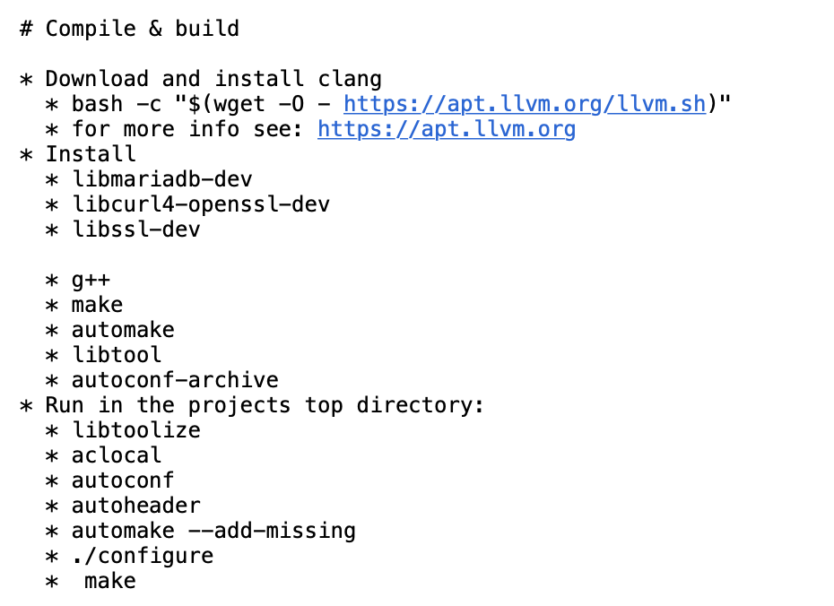
How to use
Instructions: https://github.com/arrowhead-f/core-cpp

Slide 5
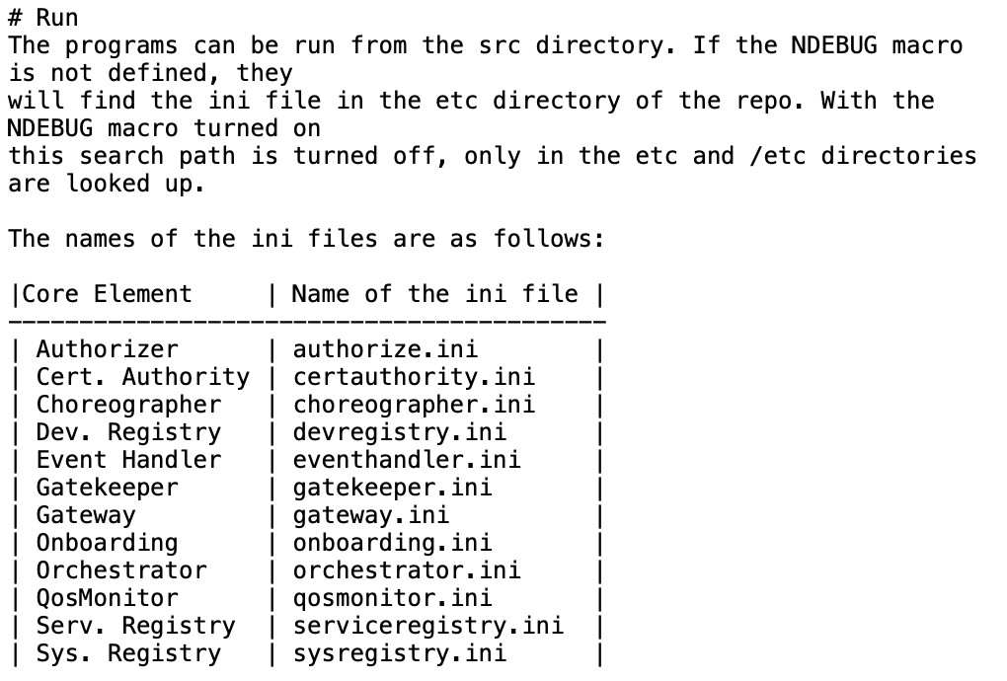
How to use

Slide 6
How to use

Slide 7
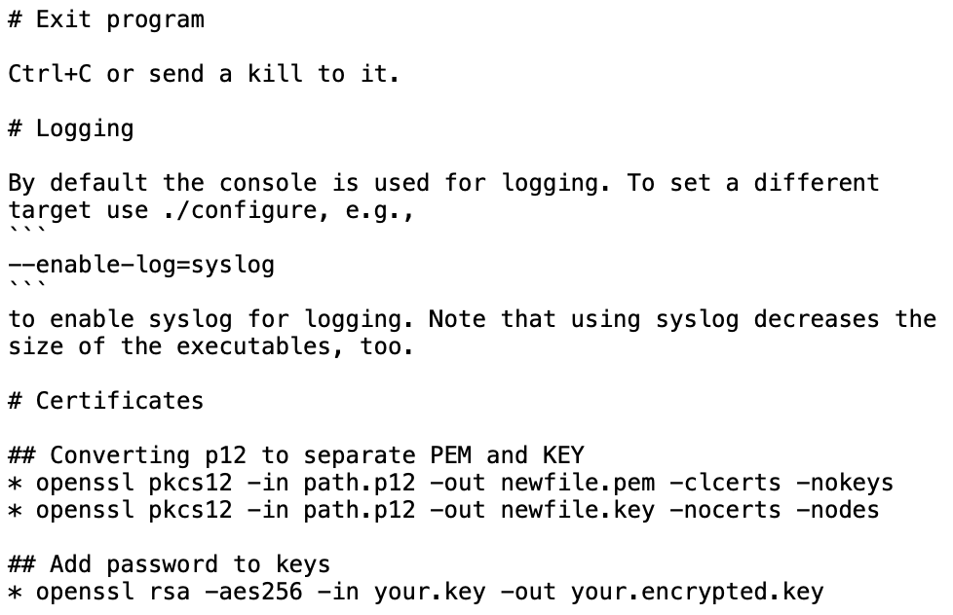
How to use

Slide 8
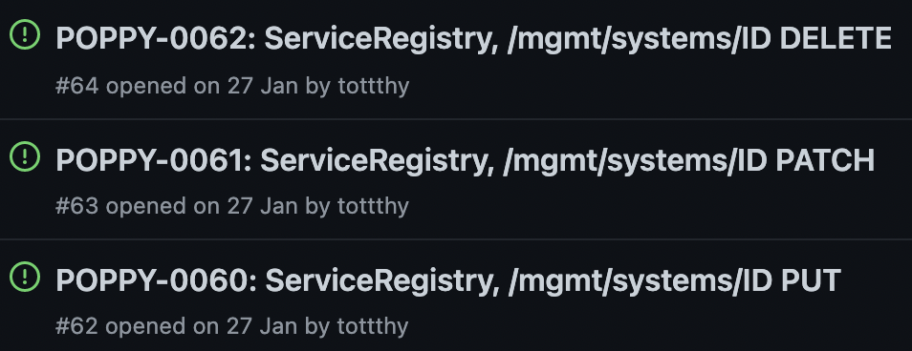
Development
Community help is needed
Pick an issue/core system, start developing it
https://github.com/arrowhead-f/core-cpp/issues
Questions, discussions: slack channel: #cpp-dev

