Slide 1
Arrowhead Framework
Open source project

Slide 2
First coordination telco
Agenda
1) Arrowhead Framework Open source project, Jerker
2) Core systems, which are they and status
3) Releases of core systems, versioning
4) Maintainers of individual core systems
5) Maintenance of Arrowhead Framework Wiki
6) ToDo list
7) Next meetings and who to invite
8) AoB

Slide 3
Next meetings and who to invite
Bi-weekly telcos?
Tuesday 15.30 - 1.5 hour max?
Leader, co-leader
Jerker, Luis,
Documentation
MoM in svn/git repository
Invites:
Core maintainer group
Arrowhead mailing list
Productive mailing list
FAR-EDGE mailing list

Slide 4
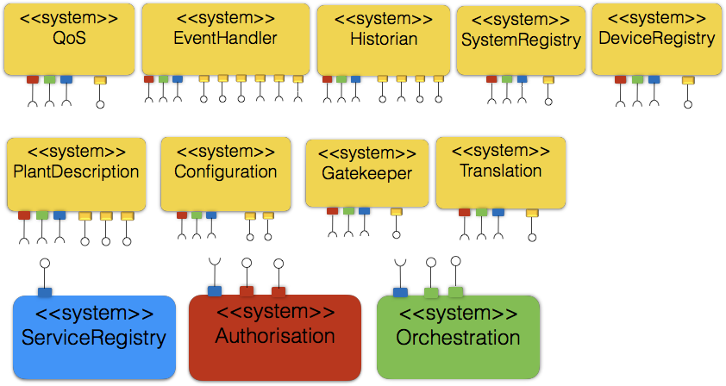
Core systems, which are they and status

Slide 5
Releases of core systems, versioning
Release approval procedure
1) Approval by core system maintainer
2) Approval by maintainer group
Release numbering: systems and services
3.2,
3.3_dev_01
3.3_pre_01
3.3_rc
3.3

Slide 6
Maintainers of individual core systems
ServiceRegistry
Authorisation
AA
AAA
Orchestration
PlantDescription
Configuration
Translation
Historian
Gatekeeper
SystemRegistry
Device registry
QoS
Eventhandler

Slide 7
ToDo action list, time plan, resource
Webinars
Forums
New core systems
Tracker
Roadmap
Upload of code and documentation
Historian
Others?
SystemRegistry
Doc and Code, LTU, Sept Oct 2017
DeviceRegistry
Doc and Code, LTU, Sept Oct 2017
Plant Description
Doc and Code,
Configuration
Doc and Code,
Maintainer of Roadmap/ToDo

Slide 8
Maintenance of Arrowhead Framework Wiki
Who
Jerker?
Administration
LTU
Site operation
LTU

