Slide 1
Arrowhead Framework
Open source project

Slide 2
Arrowhead Framework
Development coordination telco
Agenda
Updates to Arrowhead Framework wiki
System service matrix, review
Historian, status
ServiceRegistry BNearIT, AITIA and LTU versions, Differences, features, code maturity. Merge to one common code base Who will lead?
Authorisation AA: BNearIT, AITIA and LTU versions Differences, features, code maturity. Merge to one common code base. Who will lead?
Authorisation AAA co-existance with Authorisation AA
Orchestration: BNearIT, AITIA and LTU versions Differences, features, code maturity. Merge to one common code base. Who will lead?
Core system road maps, maintainers short status report.
AoB Sign up for dev mailing list

Slide 3
Updates to Arrowhead Framework wiki
Repository is now Git
Added section on Maintainers and Development coordination webex meetings
Checking links to repository
Deleting SPAM contributions
Request to maintainers
Check uploaded documents and code
Move of developments from xxx to Arrowhead Framework wiki

Slide 4
System service matrix, review
Update of System_Service_matrix.
https://forge.soa4d.org/plugins/scmgit/cgi-bin/gitweb.cgi?p=arrowhead-f/arrowhead-f.git;a=blob;f=5_Compliance/3_System+service+matrix/Core+System-Service+Matrix.xlsx;h=59670b8dcd7bcfb3791f9d768a7db6f33bb69a46;hb=HEAD

Slide 5
Mandatory core systems harmonisation and coexistence
ServiceRegistry
Autorisation AA & AAA
Orchestration
I’m aware of three implementations
BNearIT, Fredrik
AITIA, Csaba
LTU, Hasan
LTU Auth AAA, Pablo
How to proceed for harmonisation and who will lead?
How to proceed for co-existence and who will lead?

Slide 6
Core system road maps, status

Slide 7
Next meetings and who to invite
Bi-weekly telcos?
Tuesday 15.30 - 1.5 hour max?
Leader, co-leader
Jerker, Luis,
Documentation
MoM in svn/git repository
Invites:
Core maintainer group
Arrowhead mailing list
Productive mailing list
FAR-EDGE mailing list

Slide 8
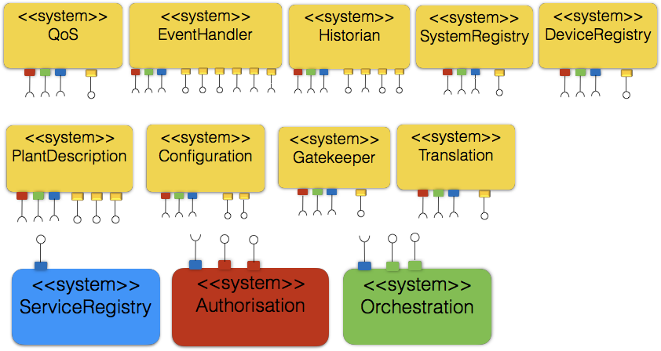
Core systems, which are they and status

Slide 9
Releases of core systems, versioning
Release approval procedure
1) Approval by core system maintainer
2) Approval by maintainer group
Release numbering: systems and services
3.2,
3.3_dev_01
3.3_pre_01
3.3_rc
3.3

Slide 10
Maintainers of individual core systems
ServiceRegistry
Authorisation
AA
AAA
Orchestration
PlantDescription
Configuration
Translation
Historian
Gatekeeper
SystemRegistry
Device registry
QoS
Eventhandler

Slide 11
ToDo action list, time plan, resource
Webinars
Forums
New core systems
Tracker
Roadmap
Upload of code and documentation
Historian
Others?
SystemRegistry
Doc and Code, LTU, Sept Oct 2017
DeviceRegistry
Doc and Code, LTU, Sept Oct 2017
Plant Description
Doc and Code,
Configuration
Doc and Code,
Maintainer of Roadmap/ToDo

Slide 12
Maintenance of Arrowhead Framework Wiki
Who
Jerker?
Administration
LTU
Site operation
LTU

