Slide 1
SINETIQ ARROWHEAD SANDBOX Ulf Slunga

Slide 2
ARROWHEAD SANDBOX: WHY? CUSTOMER NEED Replaceable core systems UP-AND-RUNNING with low effort SMALL FOOTPRINT BASED ON OPEN SOURCE or OTS-PRODUCTS WHERE POSSIBLE

Slide 3
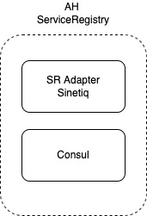
SANDBOX SERVICE REGISTRY

Slide 4
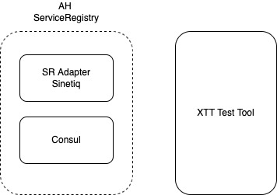
SANDBOX SERVICE REGISTRY with test tool

Slide 5
For more information karl-johan.gramner@sinetiq.se ulf.slunga@sinetiq.se

