Slide 1
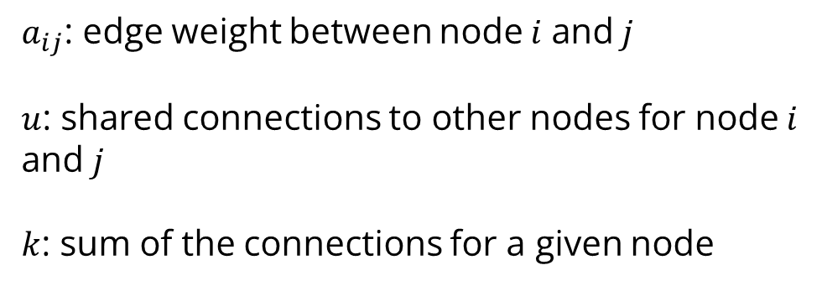
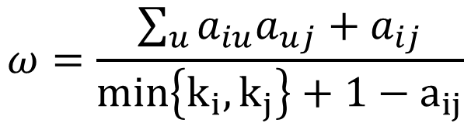
Weighted Topological Overlap
$$ω=\frac{\sum_{u}{a_{iu}a_{uj}+a_{ij}}}{min\left\{k_{i},k_{j}\right\}+1−a_{ij}}$$
$a_{ij}$: edge weight between node $i$ and $j$
$u$: shared connections to other nodes for node $i$ and $j$
$k$: sum of the connections for a given node

