Slide 1
Networking Review (Protocols)
UT CS361S – Network Security and Privacy
Spring 2021
Lecture Notes

Slide 2
What is a Protocol?
The set of rules that govern the interaction of two or more parties
In networking, it defines how two nodes communicate
When
What (including message structure)
How
Certain outcomes are guaranteed when the rules are followed

Slide 3
Overloaded Term
Actually, a protocol often refers to two separate things
FIRST, the rules/specification referred to on the previous slide
SECOND, the computer module that implements the rules

Slide 4
Common Contemporary Protocols
HTTP – HyperText Transfer Protocol
IP – Internet Protocol
SMTP – Simple Mail Transport Protocol

Slide 5
One Protocol is not Enough
There are too many rules for any one protocol to handle
Also, behavior/rules need to change for different hardware/goals
For example, consider HTTP
HTTP protocol shouldn’t need to worry about the IP protocol rules
HTTP definitely shouldn’t need to worry about Ethernet rules
And HTTP should work even after a switch from Ethernet to Wifi

Slide 6
Protocol Stacks
Object-oriented design!
Modularity
Abstraction
Information hiding
Protocols are designed in an object-oriented fashion
Protocols are combined to solve more complex problems
Each protocol should focus on one purpose/goal (High Cohesion)
Different component protocols can be swapped (Low coupling)
We call a group of protocols that work together a protocol stack
In networking, a network protocol stack or a network stack

Slide 7
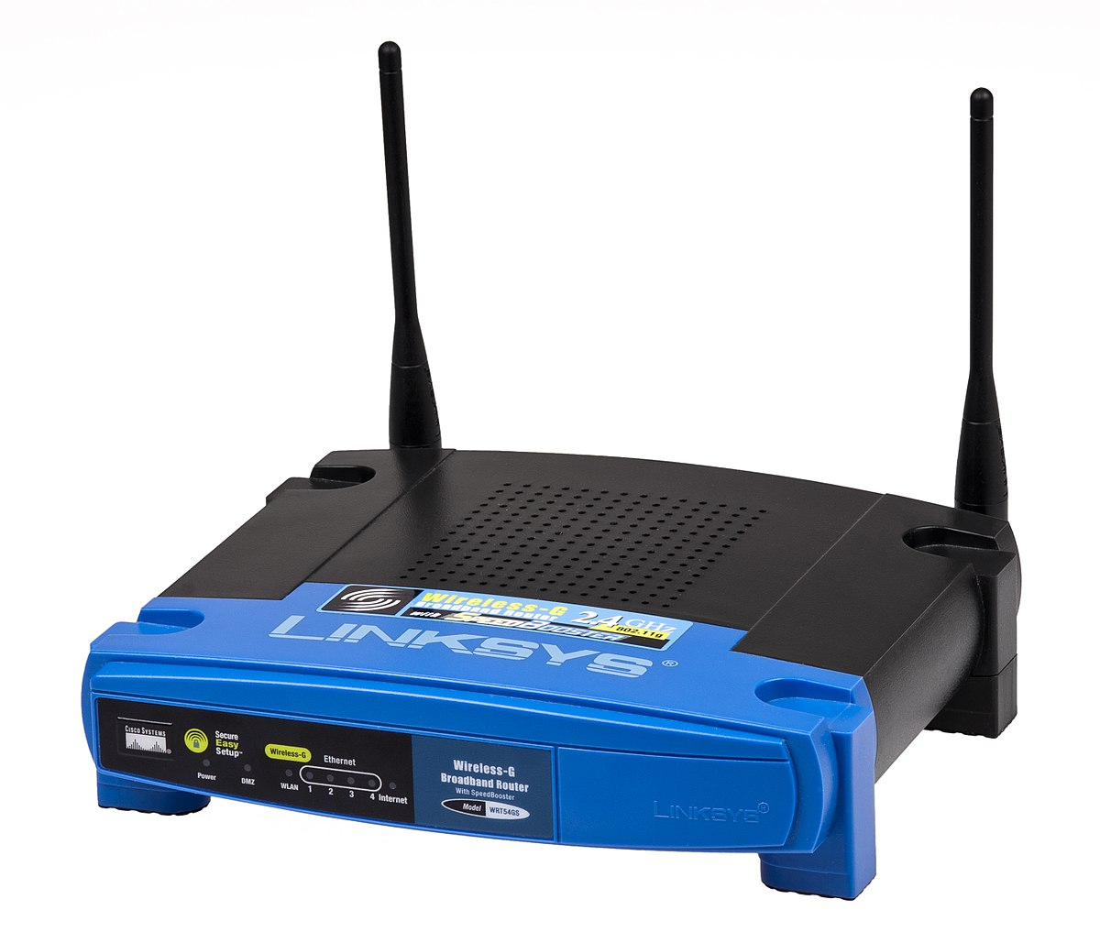

Monolithic vs Modular
HTTP Monolith Ethernet
HTTP Monolith
Wifi
HTTP
TCP
UDP
IP
Ethernet
WiFi
This Photo by Unknown Author is licensed under CC BY-SA
This Photo by Unknown Author is licensed under CC BY-SA

Slide 8
Other Problems with Monolithic
No separation of user/kernel space components
Code cannot be reused; code bloat
NxM combinations
Patching nightmare
Testing limitations
List goes on and on

Slide 9
OSI Model
Good object-oriented design is implementation independent
Conceptual guide for any given network stack implementation
It has seven layers:
7: Application
6: Presentation
5: Session
4: Transport
3: Network
2: Data Link
1: Physical

Slide 10
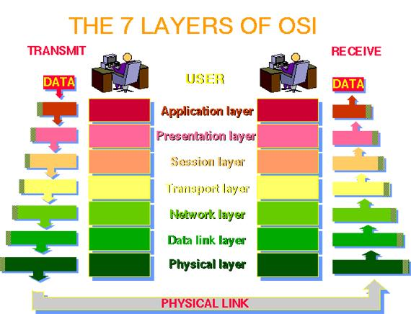

Slide 11
The OSI Model in Practice
Like most OO-designs, the abstraction often breaks down
The TCP/IP stack really only uses the following layers:
Application (Layer 7; example: HTTP)
Transport (Layer 4; TCP)
IP (Layer 3; IP)
Data Link (Layer 2; example: Ethernet)
Some breakdown in information hiding, abstractions, etc
NOTE: It’s common to just refer to a layer by it’s number (e.g., a layer-4 protocol)

Slide 12
TCP/IP Stack
For our purposes, we will focus on TCP/IP and TCP/IP-like stacks
The TCP and IP layers are fixed for layers 3 and 4 (hourglass)
But layers 7 and 2 vary widely
Millions of networked applications work over TCP/IP at layer 7
Many layer 2 protocols such as WiFi, Ethernet
Networked applications work over WiFi or Ethernet without any change
Sometimes called a MAC protocol (Media Access Protocol)
TCP/IP work over a walkie-talkie with an appropriate MAC protocol

Slide 13
How does Data Move in a Stack?
To send, data is inserted (pushed) at the top-most protocol
The receiving protocol
Processes the data, potentially splitting, recoding, etc
Derives one or more chunks of output data
Metadata added to each chunk (usually a header)
Each chunk, along with the meta-data is a “packet”
The packet is inserted (pushed) down to the next layer
On the receiving side, the process is reversed, starting at bottom

Slide 14
TCP/IP Stack Send Example
HTTP Request
TCP
TCP
HTTP Request
IP
IP
TCP
HTTP Request
MAC
MAC
IP
TCP
HTTP Request

Slide 15
Division of Labor in TCP/IP
At the MAC layer, protocol connects 2 endpoints. Typically:
Has its own addressing scheme (MAC address)
Controls who talks when
Provides error detection and error correction
IP (Internetwork Protocol)
Connects many different networks of different media types
Global addressing scheme
TCP
Reliable, in-order delivery (Session)
Multiplexing

Slide 16
Interoperability
No one company writes all TCP modules
Protocol specifications are approved by the IETF
You can find the specifications in RFC’s (Request For Comments)
RFC 793 was the first specification of TCP (1981)
If an implementation follows the spec, it will be interoperable

Slide 17
RFC 793 (TCP) Overview
Data broken into “segments” in section 2.2
Network layers in section 2.5 (a little different from our usage)
Section 2.6 lays out critical goal: Reliability
Data is delivered reliably (i.e., delivery is assured)
Data is delivered in-order
How? Sequence numbers and acknowledgements on segments
Section 2.7 identifies another goal: Multiplexing
Different flows get different ports
Section 2.8 indicates that this is a stream based protocol

Slide 18
