Slide 1
TLS, Certs, Kerberos
CS 361S
Fall 2020
Seth James Nielson

Slide 2
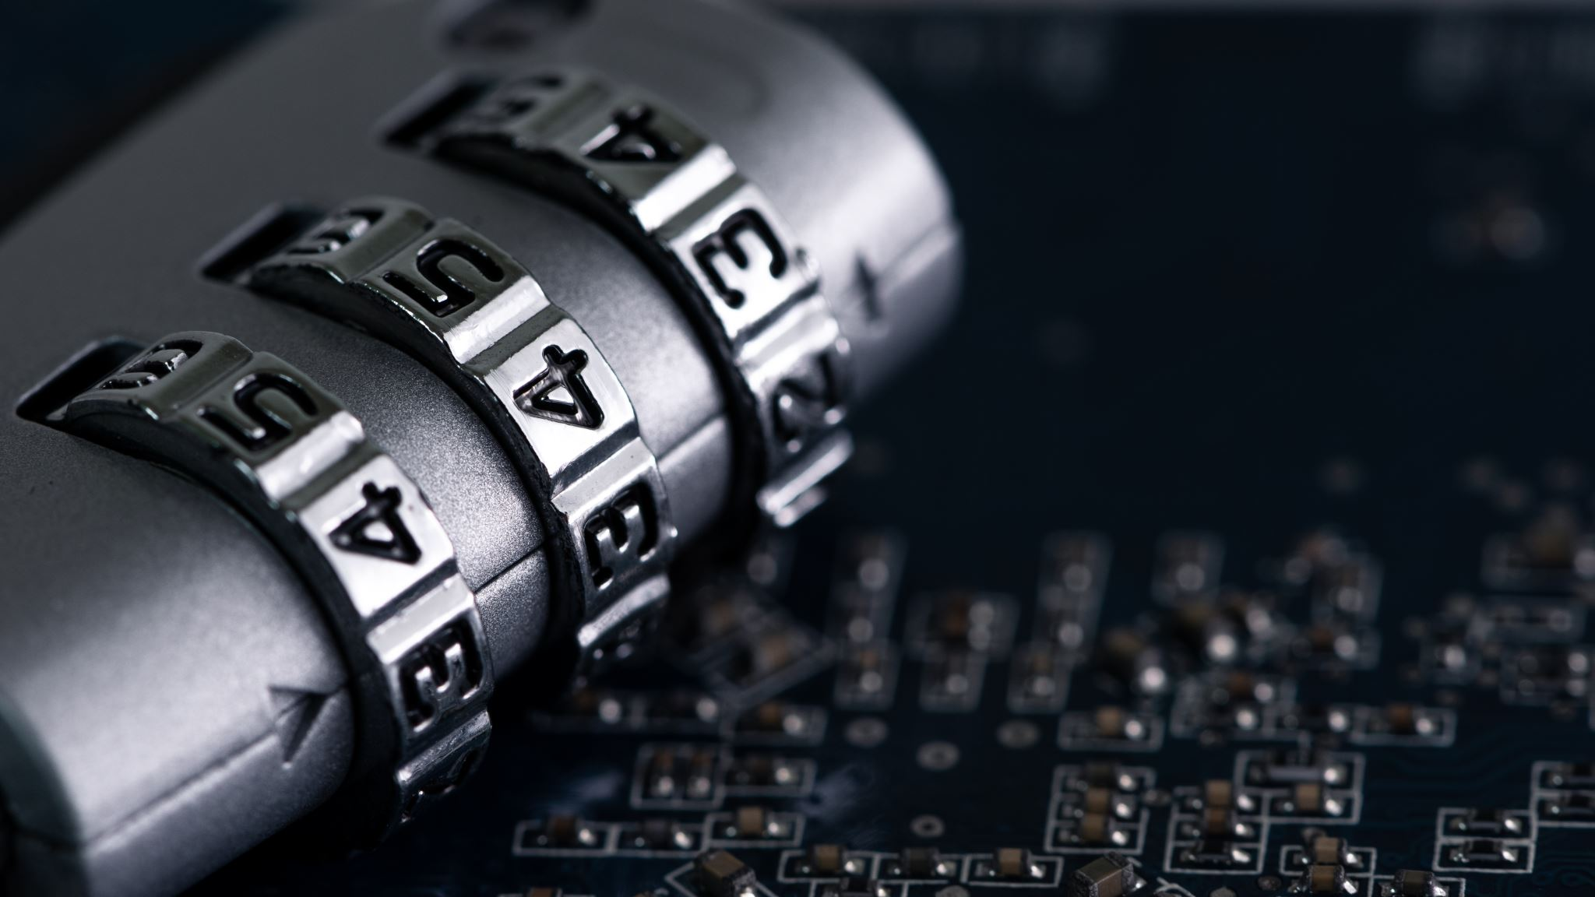
TLS Visibility
TLS is designed to provide END-TO-END “security”
MITM should NOT be able to read/modify/forge data
TLS Visibility “breaks” this for “authorized” purposes

Slide 3
b"\x12\x0e\x7f6(g\xda\x86_\xe7\xf4\xcb\xe8\x92\xddJ\x17\xb0\x04'\xa0\xb0\xb8\x9b\xed\x84\x91O&W3'"
b"\x12\x0e\x7f6(g\xda\x86_\xe7\xf4\xcb\xe8\x92\xddJ\x17\xb0\x04'\xa0\xb0\xb8\x9b\xed\x84\x91O&W3'"
MITM
WEB BROWSER
WEB SERVER
TLS VISIBILITY
DECRYPT: GET / HTTP/1.1
DECRYPT: HTTP/1.1 200 OK

Slide 4
TLS 1.2 Handshake
Goal
Agree on a cipher suite for encryption, authentication, etc.
Goal
Identify the server (and optionally the client)
Goal
Create session keys for bi-directional communication

Slide 5
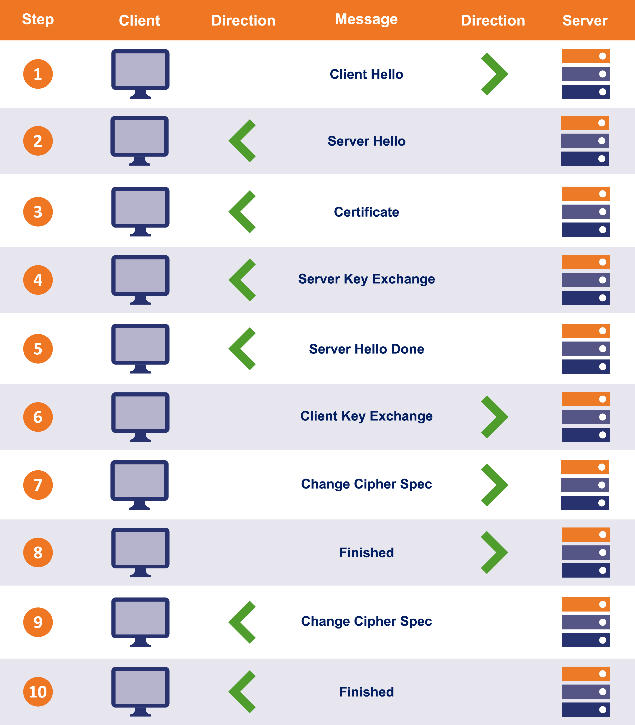
TLS 1.2 Handshake Review

Slide 6
End-to-End Handshake Visualization #2
Client Hellio
WEB BROWSER
Server Hello, Cert, KeyShare, HelloDone
WEB SERVER
KeyShare, Change Cipher Spec, {DONE}
Change Cipher Spec, {DONE}

Slide 7
Authentication
Client Hellio
WEB BROWSER
Server Hello, CERT, KeyShare, HelloDone
WEB SERVER
KeyShare, Change Cipher Spec, {DONE}
Change Cipher Spec, {DONE}
The “Certificate” message includes ONE OR MORE certificates.

Slide 8
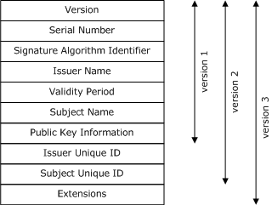
What is a Certificate?
TLS specification (RFC) doesn’t specify cert or cert verification
The most common is X 509

Slide 9
Certificate Verification
CERTIFICATE
-----------------------------
Subject CN: amazon.com
Not Valid Before: 2001
Not Valid After: 2030
Issued By: amazon CA
Signature Blob: <sig>
WEB BROWSER
Verify “amazon.com” is the URL
Verify the validity period
(Other Verification)
Who issued the cert?

Slide 10


Public Key Private Key
Name: yourbank
Issuer: godaddy
**signature**
PUBLIC KEY
PRIVATE KEY

Slide 11
Certificate Chains
Subject CN: amazon CA
…
Issued By: GlobalSign
Signature Blob: <sig>
The certificate for the Host may be signed by an INTERMEDIATE Certificate Authority
Because the web browser probably doesn’t have this intermediate cert, the TLS handshake includes both certificates.
Subject CN: amazon.com
…
Issued By: amazon CA
Signature Blob: <sig>

Slide 12
Proving Identity
Who are you?
CERT
I’m yourbank
In TLS, the “nonce” is just wrapped up with the other data, such as the client hello, which is all included in the final hash in the finished message.
VERIFY CERT:
- sbj = yourbank?
- chain trusted?
Ok, prove it (nonce)
{nonce}private_key
PUBLIC KEY
PRIVATE KEY

Slide 13
Root CA Certificates
Certificate chains MUST have a ROOT
A Root Certificate is SELF SIGNED
Browsers trust a set of root certificates AXIOMATICALLY
Certificate chains must have a trust chain to one of these roots.

Slide 14
Trusting Diffie Hellman
Recall that DH keys are EPHEMERAL
The Server’s cert includes a long-term public key
The Server’s DH key is signed by this key pair
IF the client trusts the cert, THEN it can validate the DH key

Slide 15
TLS Bulk Transport
Both Client and Server derive keys
Encryption keys AND MAC keys
MAC’s ensure continuous authentication

Slide 16
When a TLS message is Received:
The sender is “proved” by the MAC
The MAC is “proved” via MAC key derived from DH
Server’s DH key “proved” authentic by cert signature
Certificate “proved” authentic by chain to trusted root

Slide 17
It All Depends on the Cert
IF a browser trusts MY certificate to be Amazon’s certificate
THEN the browser will trust my DH public key
IF the browser trusts my DH public key
THEN the browser will derive the same MAC key I do
IF the browser derives the same MAC key I do
THEN the browser will believe my messages are from Amazon

Slide 18
Certificate Revocation
How do you revoke a certificate?
Difficult: so long as the cert is properly signed, it is believed
You can publish certificate revocation lists:
Uses just serial number
So make sure your serial numbers are actually unique!
But, until the new CRL is received, bad cert still usable

Slide 19
Online Certificate Status Protocol (OCSP)
Certificates were designed to be used offline
However, modern security constraints often necessitate OCSP
Client can ask a server (‘OCSP Responder’) about a cert
Server can respond “Good”, “Revoked”, “Unknown”
Response is signed; however, vulnerable to replay attacks!
An extension permits nonces, but often not used for efficiency
Also, potential privacy losss
But, more efficient and timely than CRL

Slide 20
Other Alternatives to TruST?
Sadly, there is no known way to create trust out of thin air
In almost every case, there must be a trust basis:
Out-of-band communication (e.g., in real life)
Evolutionary trust over time with long-term identifiers
Third parties, including CA’s, authentication/reputation servers
Crowds, such as distributed ledger

Slide 21
TLS Visibility
Typically, a browser/client MUST have a new root CA installed
This root CA is a self-signed certificate from the Visibility appliance
The appliance can now generate ANY cert and the browser believes it!
We will discuss the huge security concerns in a later lecture

Slide 22
TLS Visibility Handshake Visualization
Client Hellio
Client Hellio
Server Hello, FAKE CERT, KeyShare, HelloDone
TLS Visibility
Server Hello, Cert, KeyShare, HelloDone
WEB SERVER
WEB BROWSER
KeyShare, Change Cipher Spec, {DONE}
KeyShare, Change Cipher Spec, {DONE}
Change Cipher Spec, {DONE}
Change Cipher Spec, {DONE}

Slide 23
Kerberos
Kerberos vs TLS
Kerberos uses trusted authentication server
Must be online.
Mutual authentication, confidentiality
Basic components:
Authentication Server
Key Distribution Server (KDS)
Ticket Granting Service
Service Server
If compromised, entire system compromised

Slide 24
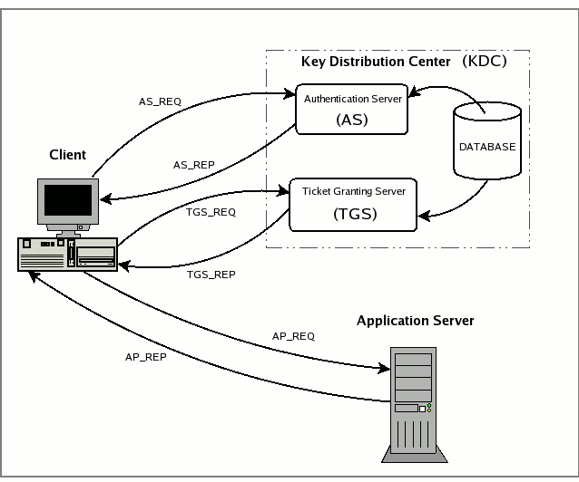
Kerberos communication

Slide 25
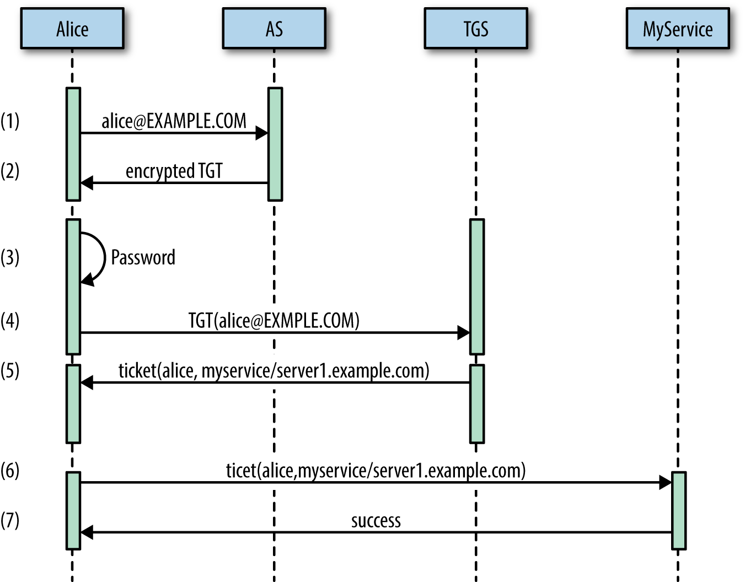
Kerberos Protocol

Slide 26
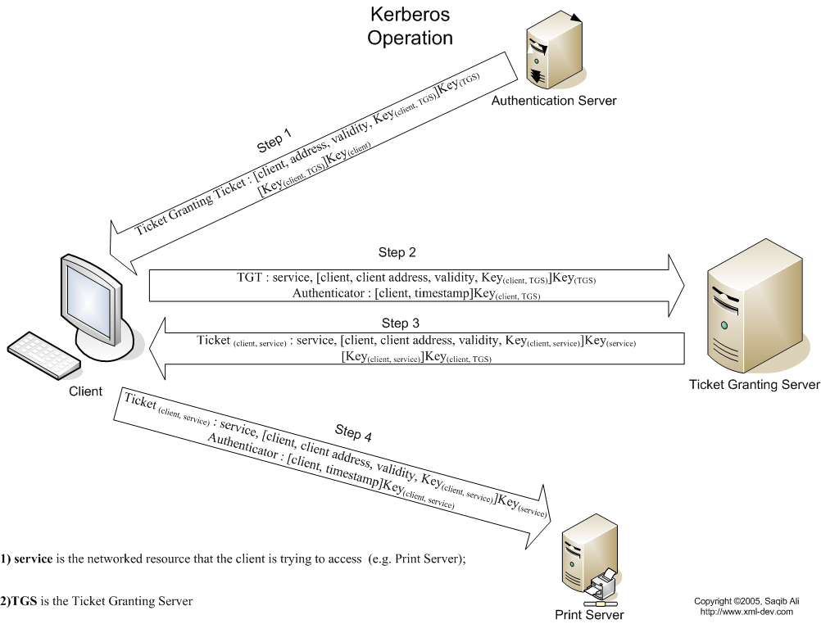
Kerberos Protocol x2

Slide 27
Protocol Principles
Note that the user’s key never goes over the wire
Note that pre-encrypted messages can be sent.
AS sends a message to A that only TGT can decrypt
Thus, TGT knows that the message sent by A MUST come from AS
How scalable is this system?

