Slide 1
IDS IPS Honeypots
CS361S
Fall 2020
Lecture Notes

Slide 2
What’s The Commonality?
Cryptography
Access Controls
Firewalls
Filtering Inputs/Escaping Outputs

Slide 3
Ideal Computer Security
SECURITY TECH
Unauthorized Activities
ATTACKER

Slide 4
Security in Practice
Attackers do, in fact, get past security
Some security technology dedicated to:
Recognizing intrusion
Eliminating the intruder
Mitigating the damage
These steps are independent

Slide 5
Intrusion Detection System
Primarily focused on DETECTION
Goal is SPEED! resources
Can protect networks, systems, and other resources

Slide 6
Why does it Matter?
Prevent additional/worse damage
Identify holes in security
Forensic analysis of what was stolen/lost
Legal responsibilities

Slide 7
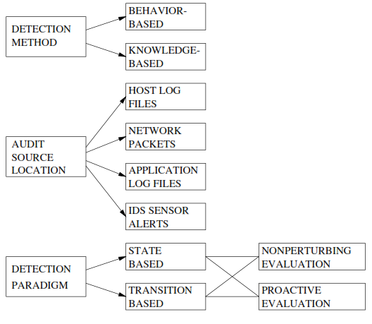
Taxonomy
(Anomaly Detection)
(Signature Detection)
Source: H. Debar, An Introduction to Intrusion-Detection System, IBM Research, Zurich Research Lab

Slide 8
Conceptual Approach
Observable System Events
Audit Systems
Audit Records
Audit Processing
Activity Data
Security Event Detection
Security Events
Decision System

Slide 9
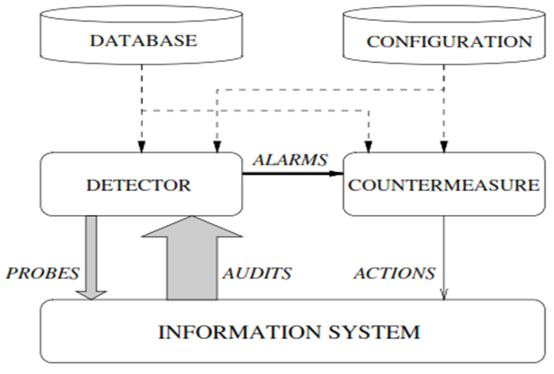
Very simple intrusion-detection system
Source: H. Debar, An Introduction to Intrusion-Detection System, IBM Research, Zurich Research Lab

Slide 10
Signature Approach
Library of attack patterns
Can be pattern of any information
Network packet data
Host access
Even Host syscall logs
Like with antivirus signatures, can’t block new attacks

Slide 11
Anomaly Detection
Identify “normal” activity
Trackable activity is just about anything
File access
User activity
Even CPU activity!
Look for “abnormal” activity
Can use heuristic rules
Can use machine learning

Slide 12
Anomaly Problems
Always struggles with False Positives!
How often does your behavior change?
Major events like COVID completely redo the norm
Mistakes, errors, etc cause “anomalies”

Slide 13
Common IDS Types
NIDS – Network IDS
For example, identifying DDOS attacks
Scan packets, looks for bad network operations
Can be realtime or offline
HIDS – Host-based IDS
Monitor for unusual or unauthorized host activity
Aggregate multiple hosts to a central system
Host can basically become a network sensor

Slide 14
Protocol Analysis
At either host or network, decode the protocol
Low levels are easy! Only a few protocols
Application layer is hard! Need a decoder for each app!
Application layer also requires TLS decryption
Can use the data for signatures or anomalies

Slide 15
Audit Data
Even systems with real-time detection still create logs
Audit trails can be processed offline to look for intrusions
Audit data can be generated for the network or hosts
Audit data can be aggregated from many sensors

Slide 16
Alerts
Most IDS works by alerting a security officer
What gets alerted and how is configurable
Problem #1: Alerts from multiple systems
Problem #2: Tuning (too many, too few)

Slide 17
SIEM
Security Information and Event Management
Real-time analysis of alerts from multiple systems/sensors
Log and audit data normalization/aggregation
Composite alerting
Dashboards
Compliance

Slide 18
IPS
Intrusion Prevention System
IDS + reaction
IPS can change firewall rules in response to an attack
Some IPS can actively close an attack network connection
False positives are an even bigger problem.

Slide 19
Data Loss Prevention(DLP)
DLP targets malicious or accidental exfiltration
DLP has two general components
Data preprocessing and host scanning
Network tracking of outbound data
The first step is for finding confidential/PII
The second step partially requires the first
Almost always requires TLS visibility/interception

Slide 20
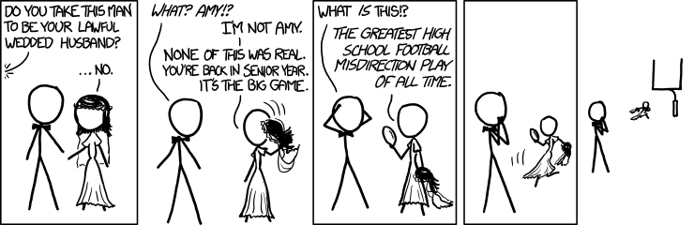
Deception
https://xkcd.com/1100

Slide 21
Honeypots
Honeypots are any fake resource
Fake systems, fake documents, fake networks, etc
One purpose is tracking exfiltrated information
But more commonly used to detect intruders

Slide 22
Beyond Honeypots
Many honeypot deployments are ad hoc
Recently, better development in deception theory/practice
Better designed comprehensive honeypot system
Fake network nodes
Fake hosts
Fake users/email/docs
Detect attacker, waste attacker time, etc

