Slide 1
Network Security and Privacy
UT CS361S
Spring 2021
Lecture Notes

Slide 2

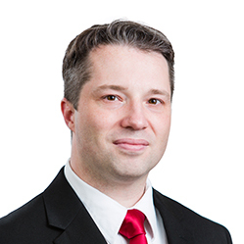



About the Instructor

Slide 3
What about You?
Why did you take this course?
What is your programming background like?
What has been your favorite course so far? Why?
What is your learning style?
What is your favorite teaching style?

Slide 4
The 5 Orders of Ignorance
0th Order: Known Knowns
1st Order: Known Unknowns
2nd Order: Unknown Unknowns
3rd Order: Unknown methods for discovering unknown unknowns
4th Order: Unknown methods for exploring the orders of ignorance
(Adapted from Phillip Armour, “The Five Orders of Ignorance”)

Slide 5
The 5 Orders of Ignorance
0th Order: Known Knowns
1st Order: Known Unknowns
2nd Order: Unknown Unknowns
3rd Order: Unknown methods for discovering unknown unknowns
4th Order: Unknown methods for exploring the orders of ignorance
(Adapted from Phillip Armour, “The Five Orders of Ignorance”)
SKILL
EDUCATION

Slide 6
A Few Introductory Notes
This course is still a little new for me
I’m still developing the materials
Please feel free to make suggestions or raise concerns

Slide 7
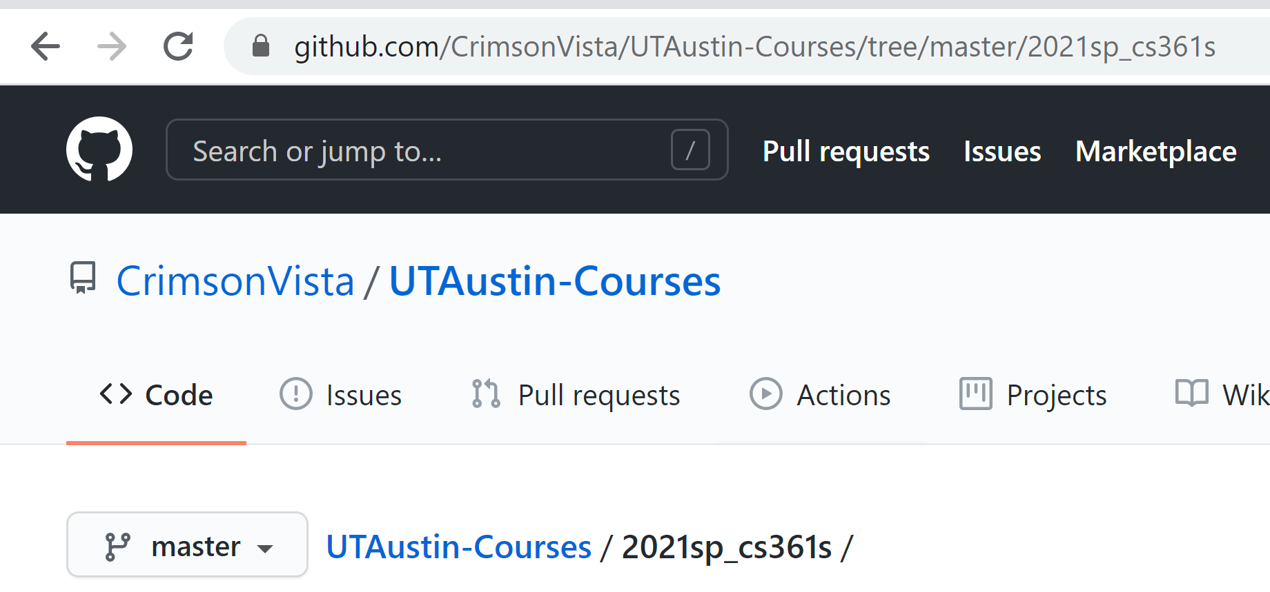
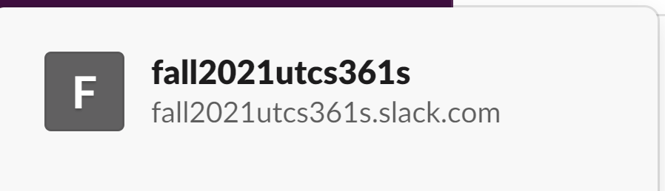
Two Resources

Slide 8
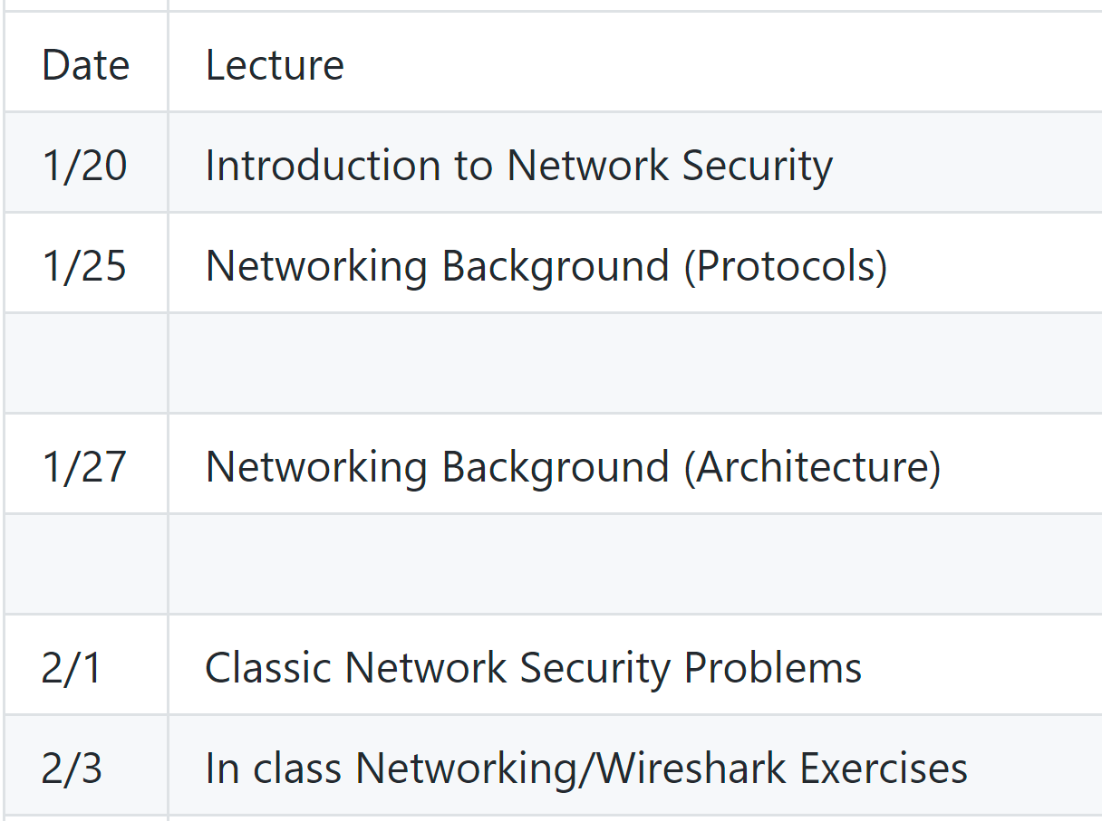
Schedule Part 1 Network Background

Slide 9
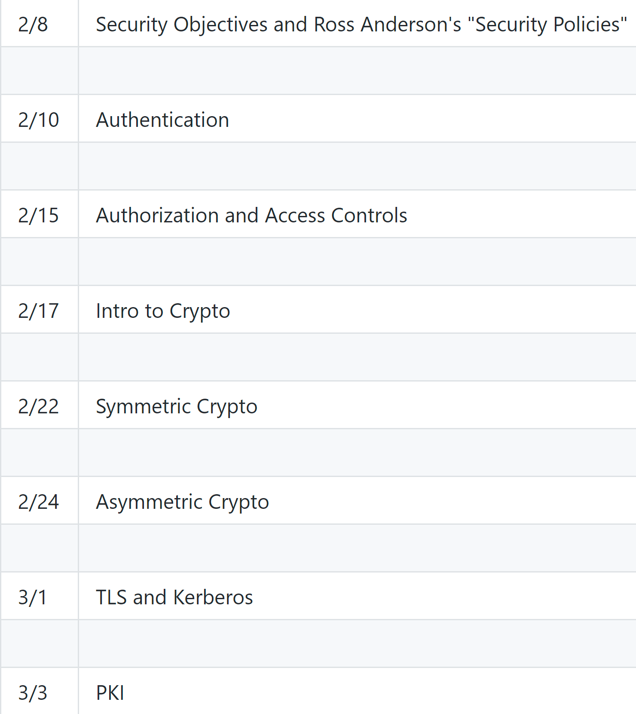
Schedule Part 2 Security Foundation

Slide 10
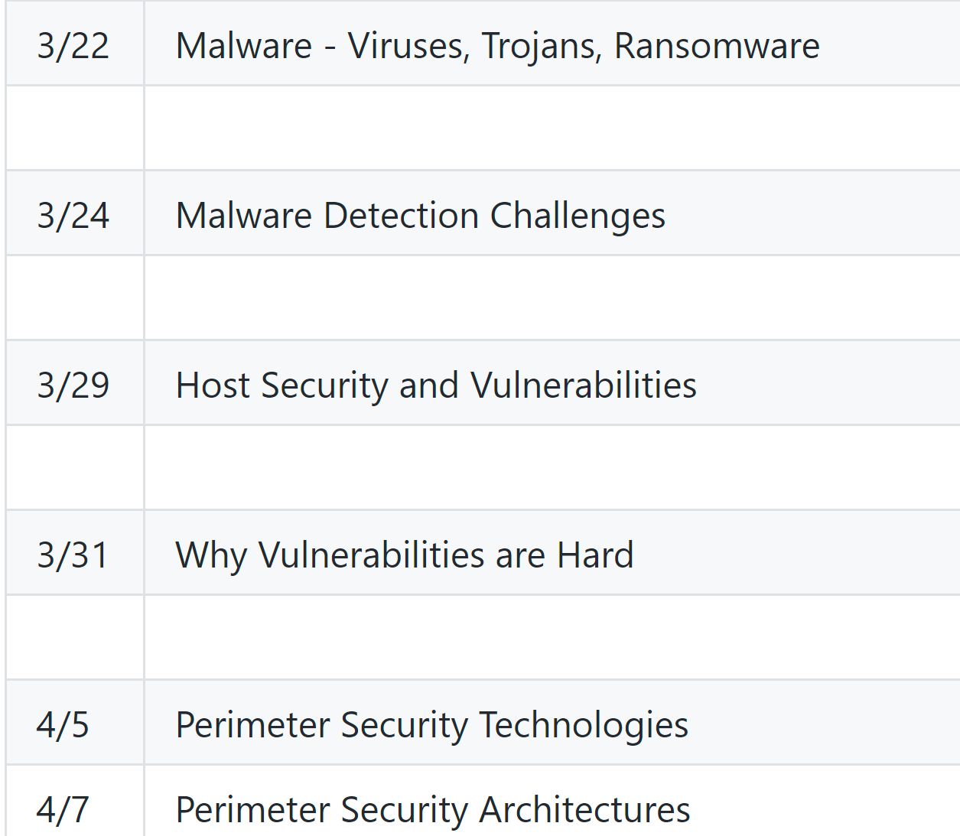
Schedule Part 3 Hosts and LANs

Slide 11
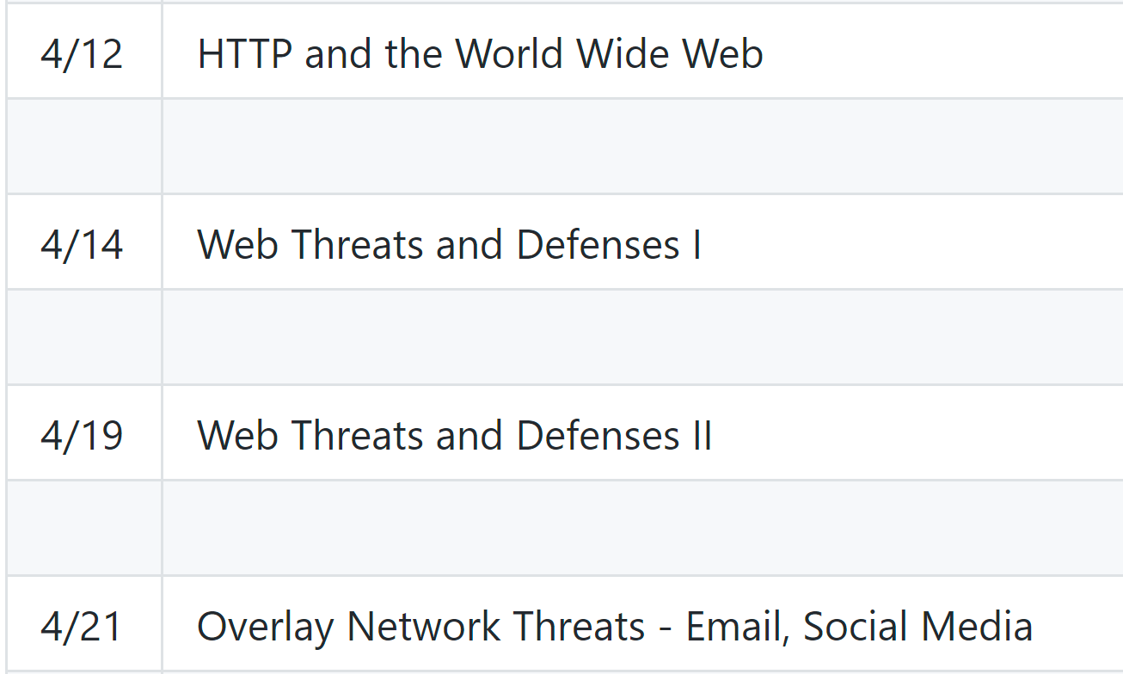
Schedule Part 4 The Wider Internet

Slide 12
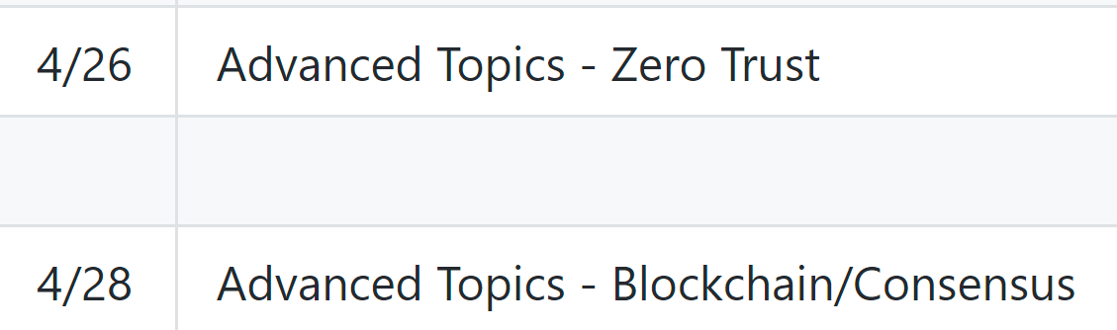
Schedule Part 5 Advanced Topics

Slide 13
Class Discussions
I hate slides and I hate “lectures”
I only use them because I haven’t found something better
Please read before class, come prepared to discuss
You will be assigned to discuss out-of-class as well

Slide 14
Grading
60% labs
10% participation
30% Exams
2 Midterms
No Final
15% each

Slide 15
Readings
I’ve tried a bunch of books. I hate them all
All free materials available online
Ross Anderson’s “Security Engineering”
This IS a great book
Second edition is free online

Slide 16
Reading Policies
Read before class for class discussion
Each week, in groups, discuss previous week’s reading
Discuss via text-based system and submit transcript

Slide 17
Labwork
Lab 1 – In class networking. Almost a freebie
Lab 2 – Authentication/Authorization
Lab 3 – TLS
Lab 4 – Return Oriented Programming
Lab 5 – Web-based CTF exercises

Slide 18
Labwork Policies
PASS/FAIL – Not worth it to do part
Code alone, debug in assigned groups
10% off per day late
Any one lab can be redone for no penalty

Slide 19
Exams
Essay based thought questions
Open book, open note
I hate memorization/regurgitation
Usually involve a hypothetical

Slide 20
Exam Sample Question
Every one complains about passwords and that they need to be replaced. Although every now and then someone comes up with a new replacement but they never seem to get much traction, so the search continues. Regardless of whatever new technology comes along to replace passwords, there are certain fundamental problems that will have to be solved. Write an essay explaining what kinds of evaluations YOU would do for a password-replacement technology.
Do not speculate about how this imaginary technology works, just imagine it to be some kind of “black box” authentication mechanism. Instead, focus your essay on the psychological, technical, and perhaps even mathematical problems that you would require it to solve or address before you believed it to be a “good” replacement. Because this is hypothetical, you can address this from a number of different angles. Your score for this essay will be based on how well you understand user authentication including principles related to “something you know”, “something you have”, and “something you are.” You may also get score for applying Anderson’s concepts on user psychology and security engineering.

Slide 21
Grading
Standard Scale
Last semester, average was about 91%
This semester, targeting 87%

Slide 22
Past Student Comment - #1
While the course material covered was interesting, I felt that we skimmed over many advanced concepts. Too much of the course was focused on obvious security considerations rather than the backing theory. The professor seemed to not always have a great grasp over the concepts, which made some explanations hard to grasp. Despite this, the professor made himself available a great deal to the class, and he was an enthusiastic lecturer. I think this course would be great with just a few tweaks.

Slide 23
Past Student Comment - #2
Use Canvas. If more than half of your students aren't understanding something, it's probably not their fault. Your lectures weren't very structured and it was hard to follow what you were talking about a lot of the time. See: The Curse of Knowledge.Lastly, use Canvas.

Slide 24
Past Student Comment - #3
Streamline your assignments. Also, stop talking about Hitler so much. People might get the wrong idea.

Slide 25
Past Student Comment - #4
I almost dropped the course because the first two labs were incredibly difficult for me and I wouldn't even know where to begin. Especially for the first lab. I've never cried because of a lab, but lab 1 made me cry due to the amount of frustration I had. The lectures were more theory based, so when it came to actually practicing this I didn't know where to begin, and the instructions were not very helpful and assumed a lot of prior knowledge…

Slide 26
Constructive Criticism
Please let me know when you don’t understand something
Please let me know when you think I don’t understand
Please let me know when I offend you
Please be specific

Slide 27
Early Criticism
I would prefer criticism *before* the class reviews
It gives me a chance to improve before being evaluated
You may send anonymous emails if you need anonymity

Slide 28
Evaluation Policy
Evaluation will now be mandatory and in-class
Proof of submission required
Factored into participation grade (3%)
Reminder: comments are part of my permanent record

