Slide 1
Asymmetric Cryptography
UT CS361S
Fall 2020
Lecture Notes

Slide 2
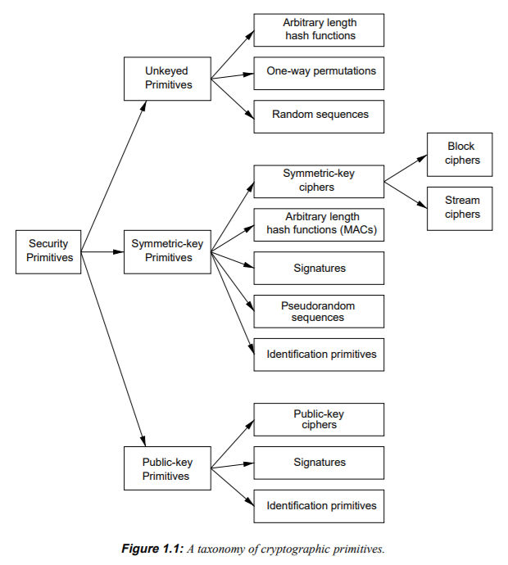
Technology Review

Slide 3
Asymmetric Cryptography
Keys come in pairs
Public key can be shared
Private key MUST be kept secret

Slide 4
Uses of Asymmetric Crypto
Unlike symmetric, what you can DO with asymmetric depends greatly on the algorithm
RSA – encryption (crypto dropbox), signatures
ECDSA/DSA – signatures
Diffie Hellman – key agreement

Slide 5
RSA Encryption
Encrypt SHORT MESSAGES with public key, decrypt with private key
Encrypted Communication between A and B
A and B have each other’s public key
A encrypts a message for B under B’s public key
B responds by sending A a response under A’s public key
Works fine but…
It is very slow (asymmetric encryption/decryption is expensive)
Used almost exclusively for Key Transfer (sending a symmetric session key)

Slide 6


RSA Encrypt Visualization
Bob, here’s my public key, K
{some secret}K
Decrypt with K⁻¹

Slide 7
RSA Signatures
RSA encrypts with the PRIVATE KEY for a signature
Step 1: Publisher produces a message M
Step 2: Publisher takes the hash of M h(M)
Step 3: Publisher encrypts the hash with the private key {h(M)}_{k} -1
Step 4: Publisher transmits Message M and {h(M)}_{k} -1 as the signature
Step 5: A verifier decrypts h(M) with Publisher’s public key
Step 6. A verifier computes their own hash of M h’(M)
Step 7: A verifier determines the signature is valid if h’(M) = h(M)

Slide 8
RSA Signature
Bob, here’s my public key, K
M, {h(M)}K⁻¹
Decrypt h(M) with K
h(M) ?= h’(M)

Slide 9
Key Exchange
Asymmetric crypto is not good for “bulk data” encryption
RSA can only encrypt small messages SLOWLY.
Other asymmetric algorithms CANT ENCRYPT AT ALL
So, asymmetric is used to authenticate KEY EXCHANGE
There are two forms:
Key Transfer
Key Agreement

Slide 10
Key Transfer
Requires asymmetric encryption (e.g., RSA)
Create a session key
Send session key encrypted with public key
Only party poessing the private key can decrypt it
(Automatically authenticated)

Slide 11
RSA Key Transport
Bob, here’s my public key, K
{session key sk}K
Decrypt with K⁻¹
{Message 1}sk
{Message 2}sk

Slide 12
RSA Weaknesses
Insecure when NO PADDING IS USED
Encryption padding schemes
PKCS 1.5 (BROKEN!)
OAEP
Signature padding schemes
PKCS 1.5 (BROKEN!)
PSS
Even though there are non-broken versions, RSA is being phased out
Also, key transfer does not have “forward secrecy”

Slide 13
Catastrophic Loss of RSA Key
Assume A and B want to communicate, E is eavesdropping
A and B use RSA key transfer to exchange session keys
E records thousands of sessions between A and B
After 5 years, A disposes her computer and buys a new one
E steals her computer from the junkyard, finds the private key
ALL PREVIOUSLY RECORDED MESSAGES ARE EXPOSED!

Slide 14
Diffie Hellman Key Exchange
The math version has to do with commutative properties.
Using modulo computations over p which is a prime with certain properties:
A → B : g^{RA} (mod p)
B → A : g^{RB} (mod p)
A → B : {M}g^{RARB}
A and B are the DH private keys
Can’t be extracted from g^{RA} (mod p)
But, because commutative, can be combined by either side into g^{RARB}
In short, to create a key, exchange DH public keys + parameters

Slide 15
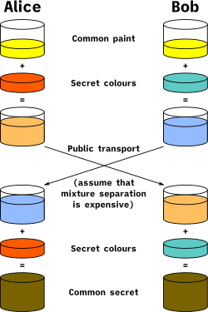
Wikipedia Visualization

Slide 16
DHE and Forward Secrecy
Diffie Hellman Ephemeral (DHE)
New Private Key used for EACH KEY AGREEMENT (session)
RSA key is used to SIGN the DH private key
DHE private key never stored outside of RAM
Now if E steals A’s computer, no messages exposed
Compromising a single key exposes only that session
This is “Forward Secrecy”

Slide 17
No DHE Authentication
Next class: how to prove authenticity of a public key
But, spoiler alert!, it HAS to be a long-term key
So, with DHE, you can create keys on the fly (“out of thin air”)
BUT, you have no idea who they’re coming from!!!

Slide 18
Two Asymmetric Steps
You caught that there were TWO asymmetric steps for DHE?
First, the DHE is used for key generation
Second, RSA is used to sign (authenticate) the DH public key
There are two asymmetric steps, algorithms, and public keys

Slide 19
Why not RSA Ephemeral?
Why not have a long-term RSA key for signing
And an ephemeral RSA key for each key transfer?
You could create a new RSA key pair each session, just like DH
The problem is that RSA is slow; DH keys are quickly generated

Slide 20
Other Asymmetric Algorithms
DSA – Just used for signing
ECDH – Elliptic Curve Diffie Hellman (just like DH)
ECDSA – Elliptic Curve DSA (just like DSA)
RSA, DH, DSA, ECDH, ECDSA are the most common I’ve seen

Slide 21
TLS 1.2 Handshake
Goal
Agree on a cipher suite for encryption, authentication, etc.
Goal
Identify the server (and optionally the client)
Goal
Create session keys for bi-directional communication

Slide 22
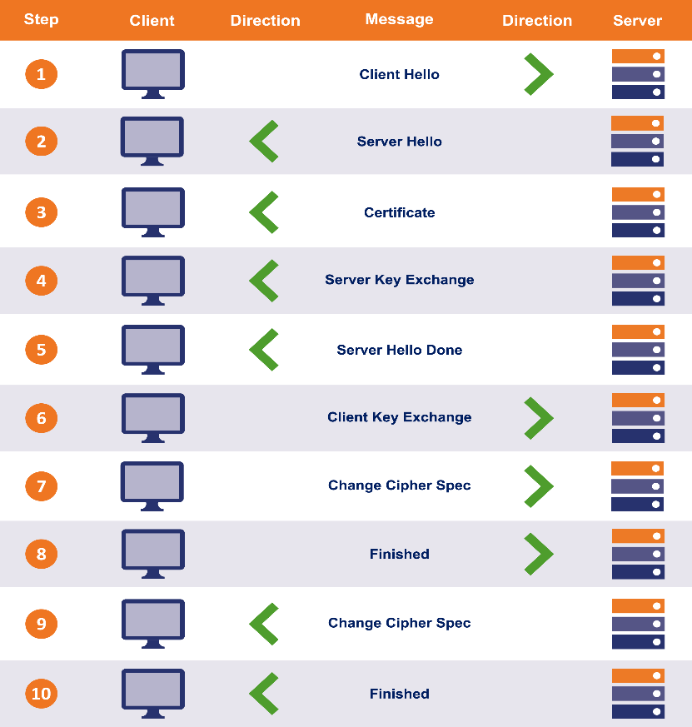
Handshake Visualization

Slide 23
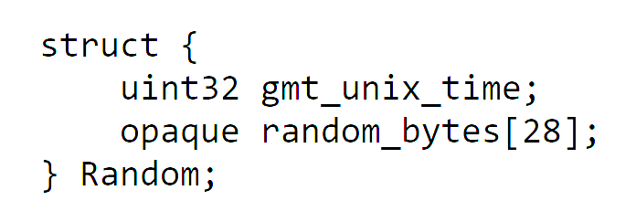
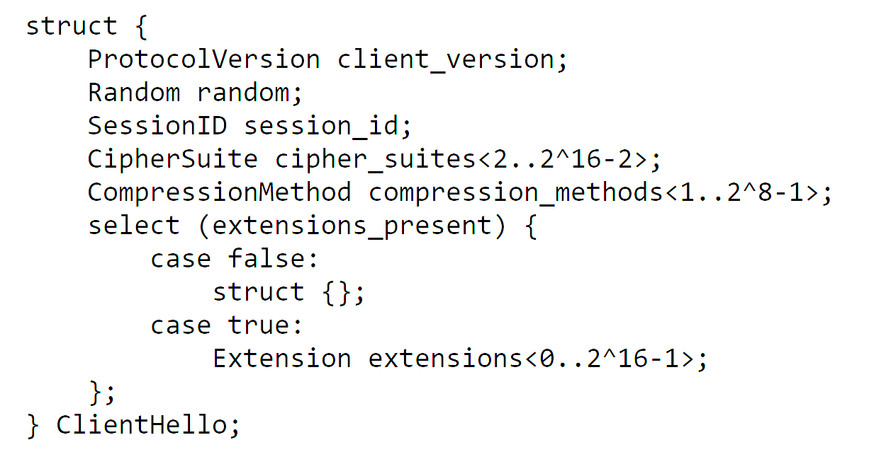
Client Hello
client_version: 0x303 for TLS 1.2
random: prevents “replay” attacks
cipher_suites: see next slide

Slide 24
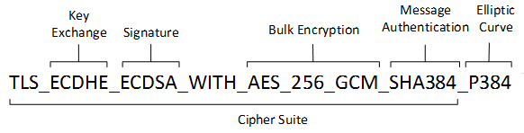
Cipher Suites
TLS_ECDHE_ECDSA_WITH_AES_128_GCM_SHA256
TLS_ECDHE_ECDSA_WITH_AES_256_GCM_SHA384
TLS_ECDHE_ECDSA_WITH_AES_128_CBC_SHA256
TLS_ECDHE_ECDSA_WITH_AES_256_CBC_SHA384
TLS_ECDHE_ECDSA_WITH_AES_128_CBC_SHA256
TLS_ECDHE_ECDSA_WITH_AES_256_CBC_SHA384
TLS_ECDHE_RSA_WITH_AES_128_GCM_SHA256
TLS_ECDHE_RSA_WITH_AES_256_GCM_SHA384
TLS_ECDHE_RSA_WITH_AES_128_CBC_SHA256
TLS_ECDHE_RSA_WITH_AES_256_CBC_SHA384
TLS_ECDHE_RSA_WITH_AES_128_CBC_SHA256
TLS_ECDHE_RSA_WITH_AES_256_CBC_SHA384
TLS_DHE_RSA_WITH_AES_128_GCM_SHA256
TLS_DHE_RSA_WITH_AES_256_GCM_SHA384
TLS_DHE_RSA_WITH_AES_128_CBC_SHA
… (there are MANY more!)

Slide 25
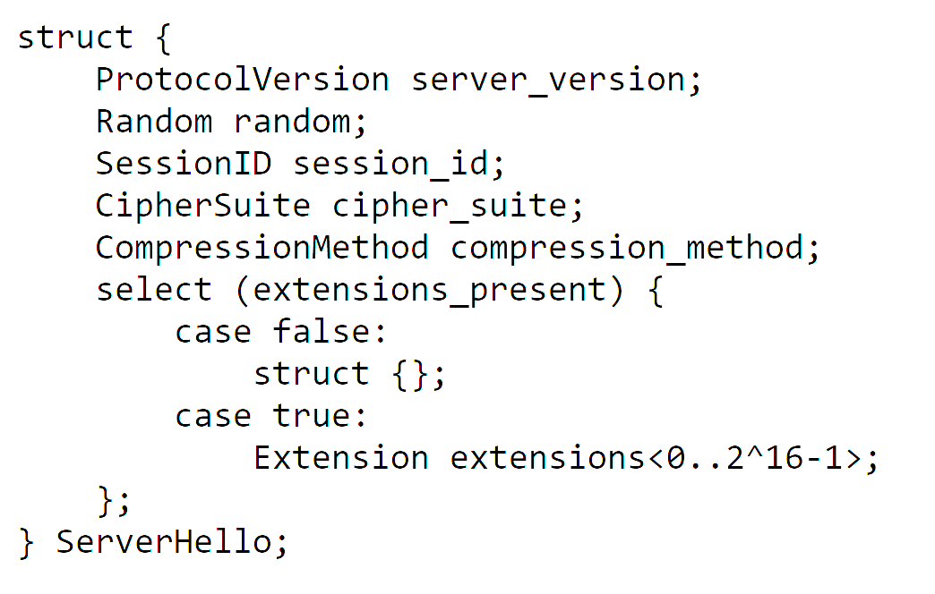
Server Hello
Note that the client offers a list of cipher suites and the server picks one

Slide 26
Certificate
We’ll talk about this more next time
Really needs its own lesson
Short Version:
Usually an X509 certificate
Identifies the server’s name (e.g., “www.amazon.com”)
Includes a public key such as an RSA public key
The public key must be compatible with the ciphersuite

Slide 27
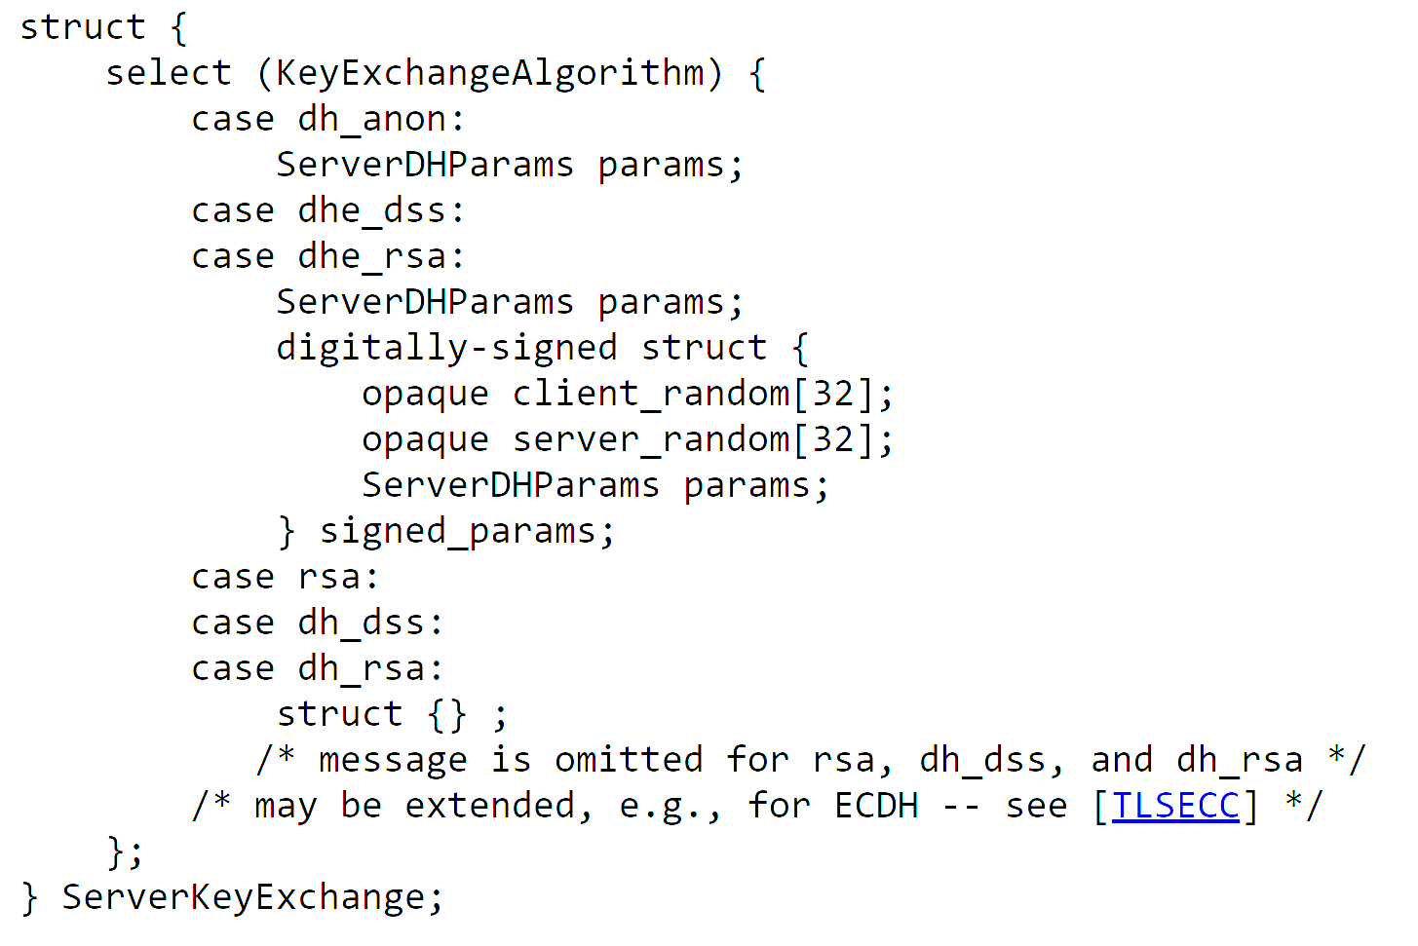
Server Key Exchange
If RSA key transport is used, this message is not sent
If DHE key agreement is used, this message sends the DHE public key
Notice the signature…

Slide 28
Server Hello Done
Server Hello Done carries no extra information
Marks the end of the Hello part

Slide 29
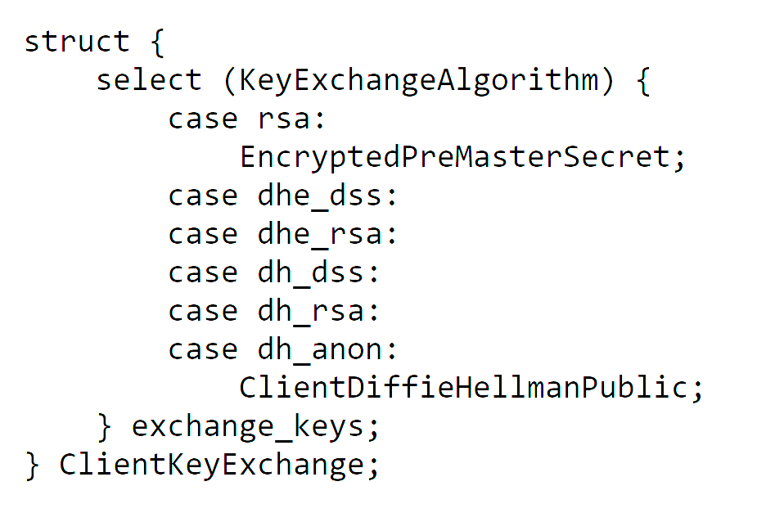
Client Key Exchange
If RSA key transport, sends a “pre master secret” encrypted under the server’s RSA public key from the server’s certificate
But, for DHE key agreement, sends DHE public key. “pre master secret” computed

Slide 30
Deriving Keys
For bi-directional communication, EACH SIDE needs its own keys
Step 1: Compute a master secret from a pre-master secret
Step 2: Compute a key expansion on the master secret
Step 3: Split up the key expansion block into the session keys

Slide 31
Generating the Key Block
DHE
PRF(pms, “master secret”,
client_random, server_random)
PRF(ms, “key expansion”,
server_random, client_random)
Pre-master Secret
Master Secret
Key Block

Slide 32
Splitting Key Block into Keys
Client Write Mac Key
Server Write Mac Key
Client Write Enc Key
Server Write Enc Key
Client IV
Server IV

Slide 33
Cipher Suites and Key Deriviaton
The side of each key depends on the algorithm
Some cipher suites don’t need IV’s; some don’t need MAC’s
PLEASE NOTE: a client WRITE key is a server READ key

Slide 34
Change Cipher Spec
Sent by the client after Client Key Exchange
Indicates that all future messages will be encrypted and MAC’d

Slide 35
Client Finished
Includes a hash of all handshake messages sent so far
Excludes Change Cipher Spec, which is not a handshake message
Excludes the current message (client finished)
Hash is computed as:
PRF(master_secret, “client finished”, Hash(handshake_messages))

Slide 36
Server Change Cipher Spec
Server verifies the client’s finished message
Remember, this message is AFTER change cipher spec, so encrypted
Server sends its own change cipher spec

Slide 37
Server Finished
Server sends its own encrypted Finished message
Hash of handshake messages includes client’s finished message
PRF(master_secret, “server finished”, Hash(handshake_messages))

