Slide 1
Sandboxing and Virtualization
CS361S
Fall 2020
Lecture Notes

Slide 2
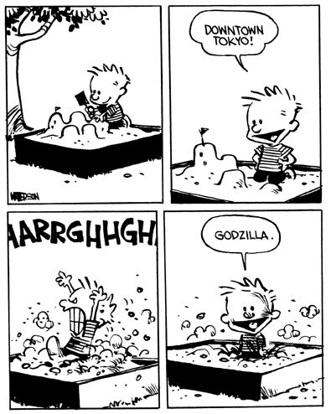
Sandboxing: the Concept
Computing Resources
Untrusted Code

Slide 3
(Copyright Use)
There is no need to request permission if you wish to use a cartoon for educational or classroom usage. Classroom use refers to public and private schools (grade K-12), home schooling (grade K-12), college dissertations, college thesis papers and other restricted college usage only. They MAY NOT be used in presentations outside of the classroom such as employee training, as handouts for non-student use or in any manner that is not a classroom setting at the K to college level. All other use will be charged a permission fee. If your use falls under the classroom use as stated above, you may use up to seven (7) cartoons per year at no costs as part of our fair use policy.
- http://syndication.andrewsmcmeel.com/licensing_permissions/educational_use

Slide 4
Code Trustworthiness
Running a program is DANGEROUS
You are allowing the author(s) to CONTROL your computer!
Large corporate vendors have incentives to behave
Commercial incentives (selling product)
Brand/company reputation
Lawsuit threats
Even then, bad code happens (e.g., Sony Rootkit)

Slide 5
Less Trustworthy Code
Until the Internet, most code written by corporate vendors
After the Internet, potential code from every website
Incentives of each author varies but includes malice
Impossible to tell if a program is good or bad (halting problem)
(Note: we should all be terrified of the Internet)

Slide 6
The Problem with Computers
Computer processors do exactly what they’re told
They have no ability to decide if they should
What if they’re told to do something harmful?
A lot of tech goes into figuring out what should be done
Operating System
Anti-virus
Device permissions

Slide 7
A Sandbox:
Concept: environment where destruction doesn’t matter
In practice: a virtualized layer between code and resources
The virtualization layer enables:
Policy Enforcement
“Sensor” (inputs to App) Translations
“Command” (outputs from App) Translations
Result: no direct access to critical resources

Slide 8
Untrusted
Application
SANDBOX
Operating System
Services
(Network, Filesystem, etc)

Slide 9
Policy Enforcement
Most common use of a Sandbox
Each incoming request and response can be inspected
Can be allowed, denied, or modified
Evaluate type, parameters, state of the system, etc
Examples:
Network Access (Deny, Same-Origin Policy)
File Access (Read Only, Write-to-Temp)
Even memory allocations

Slide 10
Sensor/Command Translations
Policy is not just about allow/deny but rewrite/modify
Command rewriting:
Rewrite command (e.g. syscall) with safer parameter
Rewrite command (e.g. syscall) to safer call with similar semantics
Sensor rewriting:
(control what the application “sees”)
Rewrite entire sensor system (e.g., virtual filesystem)

Slide 11
Untrusted
Application
Virtual Filesystem
SANDBOX
Operating System
Services
(Network, Filesystem, etc)
On-disk Filesystem

Slide 12
Mobile Code Sandboxes
Java was the first to introduce a language sandbox
Java code is virtualized by definition
All code compiles to an intermediate byte code
A Java Virtual machine executes the byte code
One VM per architecture
Permits “write once run anywhere”
Every access to a resource is mediated by the VM
VM has a security policy that determines access

Slide 13
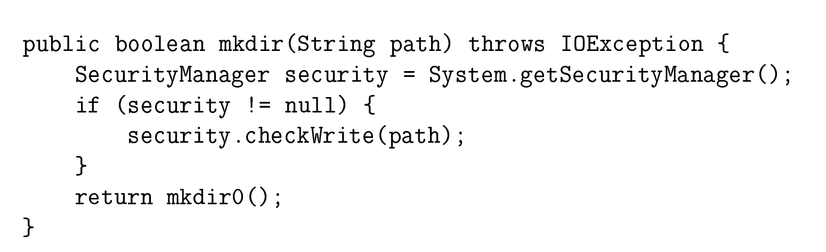
Java mkdir Example
Low-level (raw) access
Policy check/Reference Monitor

Slide 14
Java Applets
Default Java applications have almost no policy limitations
Applets, designed for web use, had extensive limitations
Network connections limited by same origin policy
Can only read/write to /tmp
etc

Slide 15
Sandbox Woes
From the very beginning, Java applets failed
To many ways to “escape” the sandbox
To many vulnerabilities in VM
“Solution” of signed code was not sufficient
Performance never justified the risks
No longer recommended, supported

Slide 16
The PyPy Sandbox
Useful for learning the sandbox concepts
Creates a limited PyPy (Python) Interpreter
No direct calls to the OS (system calls, etc)
Does not allow dynamic libraries
Enforcement process receives OS calls over a pipe
For permitted calls, performs the call and sends back result
Can modify the request and/or results

Slide 17
Controlling Process (Sandbox)
PyPy Sandbox Interpreter
Untrusted Python
Script
(optional)
Operating System
Services
(Network, Filesystem, etc)

Slide 18
Infinite Variety of Sandboxes
Different enforcement processes enforce different policies
Controlling process does not have to be Python
The PyPy project provides a default controlling process called “pypy_interact.py”
Can run a python “shell” or execute a script
Many OS subsystems completely disabled including network
Read only virtual file system
/bin – virtual bin directory with pypy and a few required directories
/tmp – temp directory that potentially maps to a real directory
NOTE: the interpreter lives in the sandbox and executes the script from virtual /tmp!

Slide 19

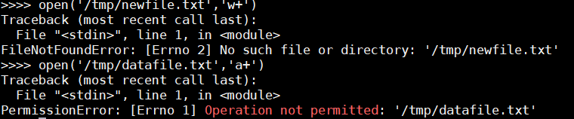

Slide 20
Running an Untrusted Script
Contents of “dangerous_script.py”
import os
print("Script Current Working Dir: {}".format(os.getcwd()))
print("Contents of root dir: {}".format(os.listdir('/')))
print("Try to delete /tmp dir with a system call.")
os.system('rm -rf /tmp')

Slide 21
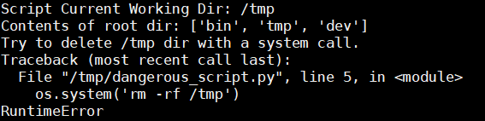

Slide 22
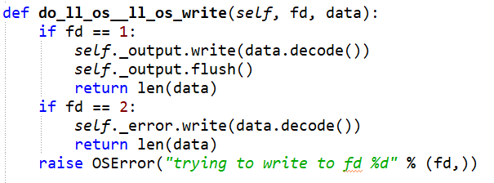
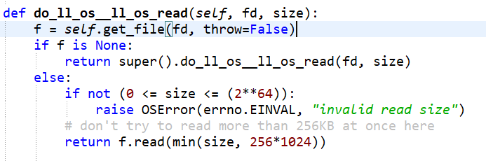
Sample Enforcement Functions

Slide 23
OS Sandboxes
Android and Apple sandbox apps for devices
Goal #1: Isolate applications from each other
Filesystem is usually per-app
Limited cross-app interactions
Goal #2: Protect applications from spying
Access permissions for hardware
Some movement toward sandboxing desktops too

Slide 24
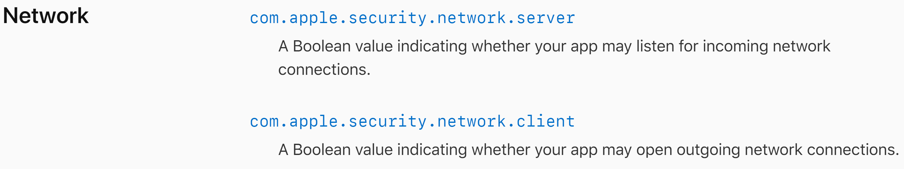
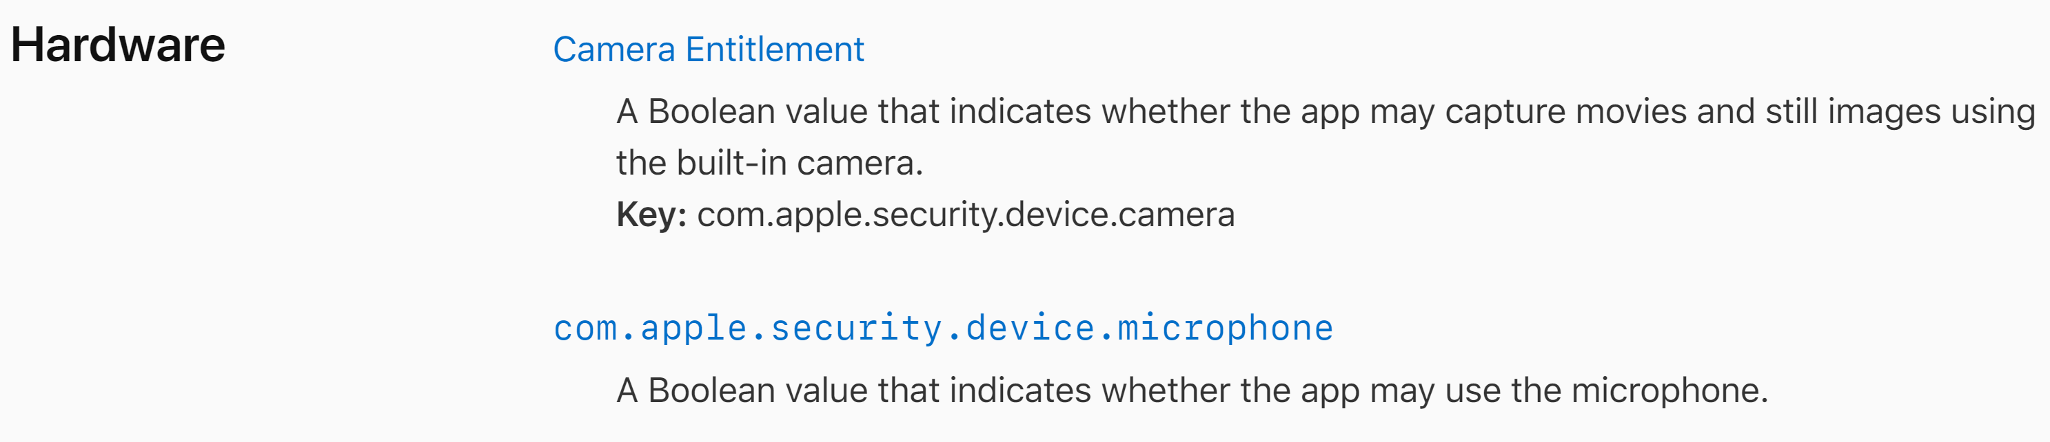
Sample Apple Permissions

Slide 25
Full Virtualization
The “ultimate” sandbox is a completely fake computer
An infected virtual system can be discarded
Checkpoints enable returning to a past state
Data backups prevent lost data
Virtual machines can be fully isolated

Slide 26
Use 1: Controlled Detonation
Firewall
INTERNET
User unknowingly requests new malware
VIRTUAL MACHINE
Firewall sends unknown data to VM. Malware is “detonated”. Bad effects observed and download is blocked.

Slide 27
Limitations
No command line parameters/user interactions
Limited time execution (e.g., 1 minute)
Bad effects must be observable within these constraints
Some malware checks for VM
VM Graphics drivers
Filesystem irregularities
Fingerprints/profiling

Slide 28
Use #2: Browsing Proxy
Physical Computer
INTERNET
VM
Browser

Slide 29
Limitations
User may copy malware from VM to physical machine
High performance costs
Many VM’s not “locked down” out of the box
May still have network access
User may configure easy file transfers

