Slide 1
Malicious Software
UT CS361S
Fall 2020
Lecture Notes

Slide 2
What is “Malicious Code”?
“Software or firmware intended to perform an unauthorized process that will have adverse impacts on the confidentiality, integrity, or availability of a system. A virus, worm, Trojan horse, or other code-based entity that infects a host. Spyware and some forms of adware are also examples of malicious code.”
NIST Special Publication 800-53, Revision 5

Slide 3
Common Malware Classes
Malware can be classified by how it spreads or generically behaves
Virus – typically has to be attached to another program (infection)
Worm – typically spreads via network vulnerabilities
Trojan Horse – typically appears benign but contains hostile operations
Malware can also be classified by its behavior
Spyware – typically designed to steal information, observe behavior, etc.
Adware – typically designed to “trap” a user into viewing certain ads
Ransomware – typically locks data unless the user pays a ransom

Slide 4
Two Primary Components
Payload – The code that performs the (harmful) action
Attack Vector/Exploit/Delivery – The code that enables the payload
May include a transmission component
May include a stealth component
May include a mechanism for bypassing security
May be as simple as an email with an attachment

Slide 5
Malware History
Much of early computer security driven by military concerns
The biggest concern was an unauthorized user or program
Other concerns developed over time
The following slides are a very brief overview/highlight

Slide 6
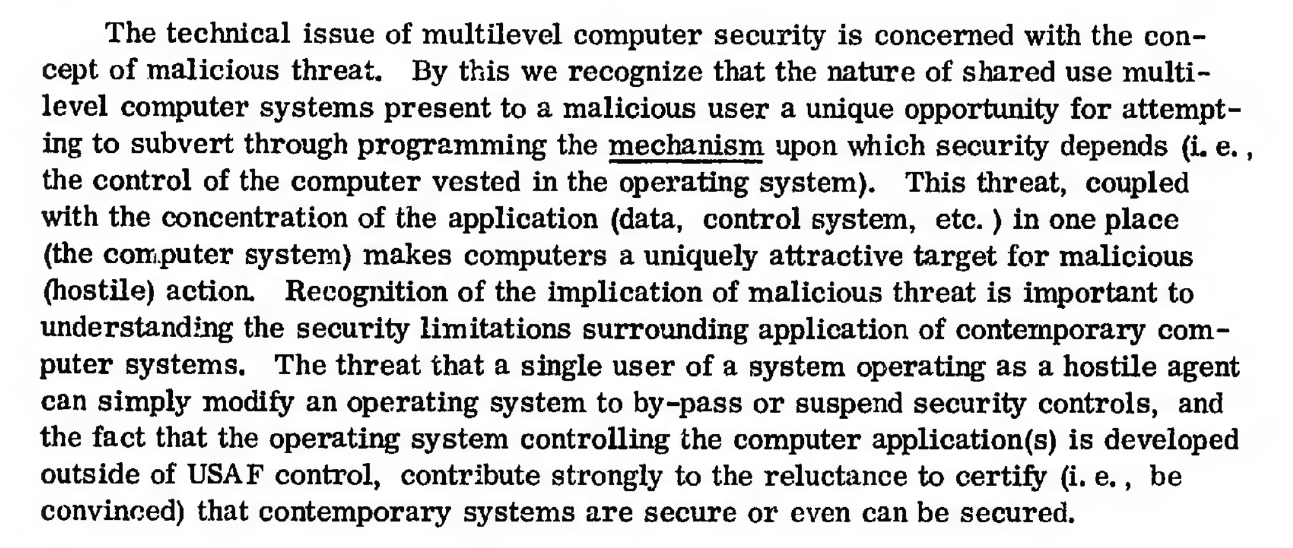
1972 Government Report:
https://apps.dtic.mil/sti/pdfs/AD0758206.pdf

Slide 7
1987: Fred Cohen’s Viruses
“Computer Viruses: Theory and Experiments” Fred Cohen, 1987
Introduced the concept of a self-replicating, evil program
The program attaches to a “good” program infecting it
When the infected program is run, the virus runs
The virus does it’s evil AND spreads itself to other programs
Concepts first proposed by Cohen in 1984

Slide 8
1988: Morris Worm
Robert Morris wrote a self-spreading piece of code (worm)
Spread using exploits in:
send mail,
Finger
rsh/rexec
Also guessed weak passwords
Copied code to new machine, compiled, and executed
Accidentally re-infected machines until machines became unusable
DOS attack brought down the Internet

Slide 9
Early DOS Viruses
PROGRAM
PROGRAM
JUMP
VIRUS

Slide 10
Impact of Early Viruses
Amazingly, most early malware DID MINIMAL DAMAGE
Often just a delivery system with a weak payload
Many viruses spread for the sake of spreading
Even the Morris worm was disruptive by accident
There were exceptions, but also plenty of hype

Slide 11
1995: Concept Macro Virus
Microsoft Word and Excel have limited scripting (“Macros”)
Concept was the first virus written completely as a macro
It was a delivery system only with no payload
But was an important proof-of-concept
Users often open documents directly from email

Slide 12
2000: I Love You
Visual Basic Script virus
Appears as email attachment:
LOVE-LETTER-FOR-YOU.txt.vbs
The .vbs often hidden on Windows
When executed:
Damaged many office files
Sent email out to email address book automatically
Spread worldwide in hours

Slide 13
2004: MyDoom
Fastest spreading mass mailer virus at the time
Slows overall internet performance by about 10%
Slows average web page load times by about 50% percent
Responsible for approximately one in ten e-mail messages.
Appears as a delivery error, mail error, etc
Includes an attachment that, if clicked on, mails out copies
Also attempted to spread via P2P vile sharing Kazaa
Opened a back door for remote control
Attempted to launch a DDOS against the SCO Group’s website

Slide 14
2005: Sony Rootkit
Sony CD’s from the 2004-2005 era installed a “Rootkit”
Rootkit, as name implies, usually installs with elevated access
Using this elevated access, it can change the OS
This bypasses usual security such as antivirus, etc
Also usually very good at being undetectable
Installed at root with an EULA that did not mention the software
In 2005, US-CERT ISSUED AN ADVISORY!!!
Texas, under Greg Abbot, was the first state to sue

Slide 15
Why is the Sony Rootkit So Bad?
In addition to violations of privacy, etc, caused:
Slowing the system, consuming resources
False alarms from antivirus
OPENED HOLES FOR ADDITIONAL MALWARE
“Stinx-E trojan”

Slide 16
2013: Cryptolocker
Modern Ransomware
(1980’s had a ransomware called CyberAIDS)
Locks up system and uses public key crypto
In addition to fiat currency, accepted BitCoin

Slide 17
2016: Mirai
Worm that finds vulnerabilities in IoT devices
Takes over the device (“Zombie”)
Corrdinates all devices with a Command and Control
Launched a powerful DDOS against “krebs on security”

Slide 18
Command and Control Concept
Uninfected Machine
Command and Control
Try to Infect Others
Infected Machine
When infected, contact C&C. Can
then receive updates, instructions, etc.

Slide 19
Zero-day Vulnerabilities
What is a ZERO DAY exploit?
It is a vulnerability to a system for which a fix/defense is not yet available
Notice this isn’t a very technical term
Could be in any form
Virus
Worm
Trojan
Typically, the context is serious vulnerability
Privilege escalation
Login bypassing

Slide 20
Simultaneously New and Old
Obviously, by definition, zero day vulnerabilities are not new
Every vulnerability starts out as a zero-day
But the CONTEXT has changed so drastically in recent years
Political shifts (Drones, “Smart Power”)
Ubiquity of Computing
Reliance on Computing
Automation
Speed of information dissemination
Broader knowledge of computing among the masses
Tools

Slide 21
Zero Days from 2005 until Now
In the last ten years, a true “market” has emerged for buying zero-day’s
December 2005 – Fearwall tried to sell an exploit on Ebay
2006 – Unnamed security firm began selling exploits to US defense firms
2006 – Unnamed security firm had Charlie Miller selling exploits to U.S.
I was there at the time but wasn’t involved
Didn’t really know what was going on
My current knowledge is from the book “Countdown to Zero Day”
2011 – “Middlemen” that broker deals
Currently, companies like VUPEN, etc

Slide 22
What are Zero-Days used for?
Defensive testing
Some companies/agencies/groups buy zero-days for advanced penetration testing
If one system is compromised, how do the others do?
Why don’t they report these?
Bug bounties
Private Black Market
Anonymous
Russian Mafia
Military

Slide 23
Militarization of Cyberspace
Why Cyberweapons are seductive
Plausible deniability
Secrecy
Potential to minimize casualties on both sides
Cost effectiveness
Political convenience
CURRENTLY, ambiguity of law and regulation

Slide 24
Risks of Cyberweapons
ONE: Everything is interconnected
TWO: Humanity is reliant on automation
THREE: Law of Unintended Consequences

Slide 25
Malware Defense Strategies
Identify and neutralize
Identify and neutralize malware before the attack
Mitigate
Mitigate malicious activity during the attack
Recover or restore
Recover or restore damaged systems after the attack

Slide 26
Identifying Malware
Primarily a classification problem
Software
?
Benign
Malicious

Slide 27
Classification Approaches
Static Analysis
Analyze the software to categorize it
Compare against known patterns (signatures)
Or determine guess how it will behave (heuristics)
Dynamic Analysis
Analyze the software’s execution
Identify behavior that violates a security policy
Or, determine guess if behavior is dangerous
Typically in a “safe” container (emulation or sandboxing)

Slide 28
Early “Anti Virus”
“Virus Bulletin” started in 1989
Still available at www.virusbulletin.com
Used to print BYTE SEQUENCES of known viruses
Virus Bulletin, January 1991

Slide 29
Virus Advancements
Antivirus scanners emerged with “libraries” of virus signatures
In response, viruses became “polymorphic”’
Each infection encrypts virus under a different key
Decryption engine decrypts virus for operations
Encryption means that each infection has unique bytes

Slide 30
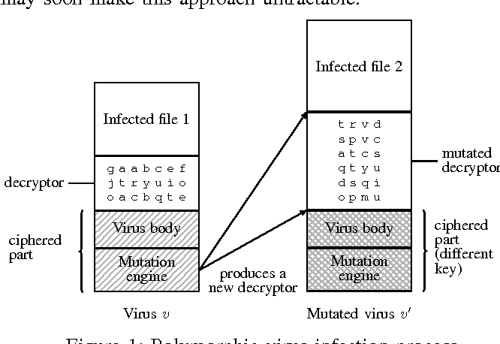
Polymorphic Virus Diagram
“Automated extraction of polymorphic virus signatures
using abstract interpretation” by Chaumette and Tabary

Slide 31
Anti-virus Arms Race
Advanced Signatures
Signature is not just a byte sequence
Each “signature” is a mini-program of detection instructions
Partial Interpreter
Virus usually takes control early
Interpret the first bytes to see if its decrypting
Decrypt and then scan
(Developed in the 1990’s)

Slide 32
Beyond Scanning
Behavior Blockers
Tries to block bad behavior
But what counts as “bad”?
Integrity Checkers
Checksum files
Detect unauthorized changes
But what is authorized?
Heuristics
Look for “telltale” signs
Minimally effective; too many false positives

Slide 33
Emulation and Sandboxing
Emulation simulates execution
Default arguments
Stubbed I/O
Simulate the “beginning” when viruses activate
Sandboxing runs the software in a virtual environment
Default arguments
Usually for a limited amount of time (e.g., 1 minute)
Observe changes to the filesystem
Problems
Non-contextual execution including arguments
Malware that detects sandboxes

Slide 34
Malware Scanning
Antivirus scanning is representative of all malware scanning
Always “behind” the enemy
Signatures can only catch “known” malware
Guesses always have FP and FN
Dynamic execution can be detected/evaded

Slide 35
Enemy: Halting Problem
Decidability is a classic computer science problem
Halting Problem:
Given: a program P and input I
Can you write a program D that determines if P halts on input I
(Halts, meaning e.g., not stuck in an infinite loop)
Over the set of all possible programs, the answer is NO
(Maybe able to determine for some, but not for all)
Alan Turing proved this in 1936!
Halting problem proven to extend to any non-trivial characteristic

Slide 36
In Other Words
There is no program that can detect all malware
Is this just theoretical?
What if we can detect 99.9999999%?
What if we can detect all the “important” threats?

Slide 37
Thoughts from 1995
In 1995, Gryaznov wrote, “Scanners of the year 2000”
He discussed Heuristics
Specifically mentioned the halting problem, but said:
Fortunately, this does not rule out a possibility of 90 or even 99 per cent reliability. And with the remaining one per cent cases we hopefully shall be able to deal with using our traditional virus signatures scanning technique.
GRYAZNOV WAS WRONG.

Slide 38
Gryaznov’s View
All Possible Viruses
Algorithmically Detectable

Slide 39
Why It Doesn’t Work
Gryaznov treats viruses as if they are created at random
Viruses are created by human beings
If an antivirus writer creates an algorithm, the adversary adjusts
The adversary moves into the space not detected by the algorithm

Slide 40
Correct View
All Possible Viruses
Virus Authors
MOVE in the
space
NEXT MONTH’S VIRUSES
THIS MONTH’S VIRUSES
Current Antivirus Algorithm

Slide 41
What about Behavior?
Behavior isn’t a program
We should be able to perfectly detect bad behavior, right?

Slide 42
“Weird Machines”
“Weird machines, exploitability, and provable unexploitability”
Written by Thomas Dullien
Explains that users interacting with a program is a program

Slide 43
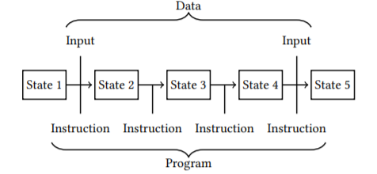
What is a Program?
*From Dullien’s Paper

Slide 44
State Machine View
View a “Program” as a state machine
Program starts in state S_0
Based on instruction, advances to state S_i

Slide 45
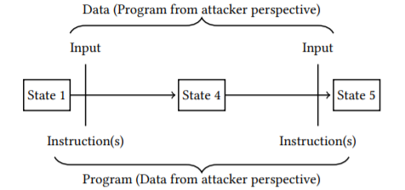
States and User Interactions
Program is in some State. Call it S_0
User interacts with the program
Program advances to state S_1

Slide 46
What is a “User”?
Do we literally mean a flesh-and-blood human?
Really, “user” is just whatever provides the input
This can, of course, just be another process
Thus, two processes interacting IS A PROGRAM
Therefore, determining if “behavior” is good is undecidable

Slide 47
One More Big Problem
Decidability is a fundamental, unsolvable problem
Another big problem is Supply Chain

Slide 48
1984: Thompson’s Reflections
“Reflections on Trusting Trust” by Ken Thompson, 1984
Demonstrated creating an evil compiler
Would compile a login program with a backdoor
BUT! ALSO COMPILED COMPILERS WITH THIS LOGIC!
“Clean” compiler source code compiled by an evil compiler is evil!
Proved that a “source code review” can’t catch all evil

