Slide 1
Intro to Cybersecurity
UT LAW 379M
Spring 2021
Lecture Notes

Slide 2

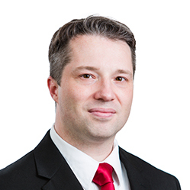



About the Instructor

Slide 3
What about You?
Why did you take this course?
What is your technology background like?
What has been your favorite course so far? Why?
What is your learning style?
What is your favorite teaching style?

Slide 4
The 5 Orders of Ignorance
0th Order: Known Knowns
1st Order: Known Unknowns
2nd Order: Unknown Unknowns
3rd Order: Unknown methods for discovering unknown unknowns
4th Order: Unknown methods for exploring the orders of ignorance
(Adapted from Phillip Armour, “The Five Orders of Ignorance”)

Slide 5
The 5 Orders of Ignorance
0th Order: Known Knowns
1st Order: Known Unknowns
2nd Order: Unknown Unknowns
3rd Order: Unknown methods for discovering unknown unknowns
4th Order: Unknown methods for exploring the orders of ignorance
(Adapted from Phillip Armour, “The Five Orders of Ignorance”)
SKILL
EDUCATION

Slide 6
A Few Introductory Notes
This course is still a little new for me
I’m still developing the materials
Please feel free to make suggestions or raise concerns

Slide 7
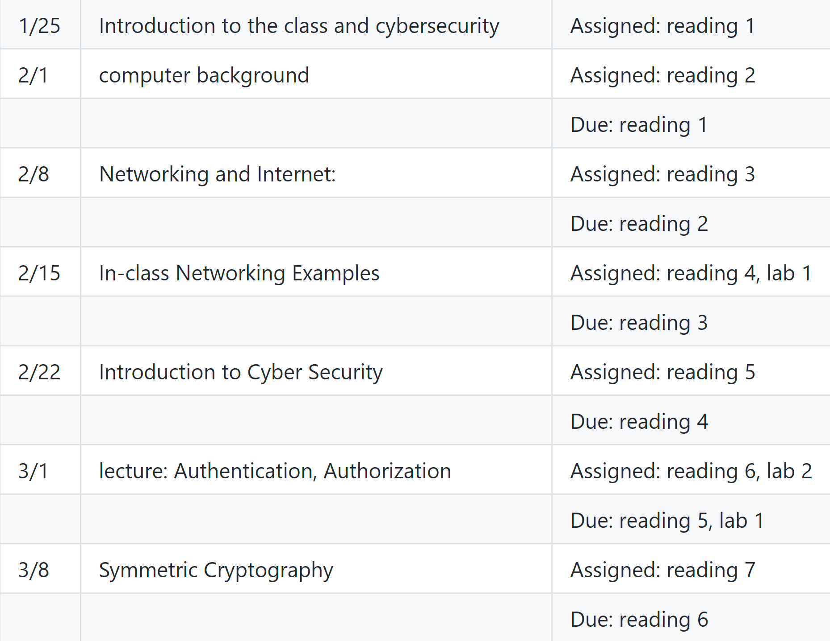
Schedule Part 1 Basics and Background

Slide 8
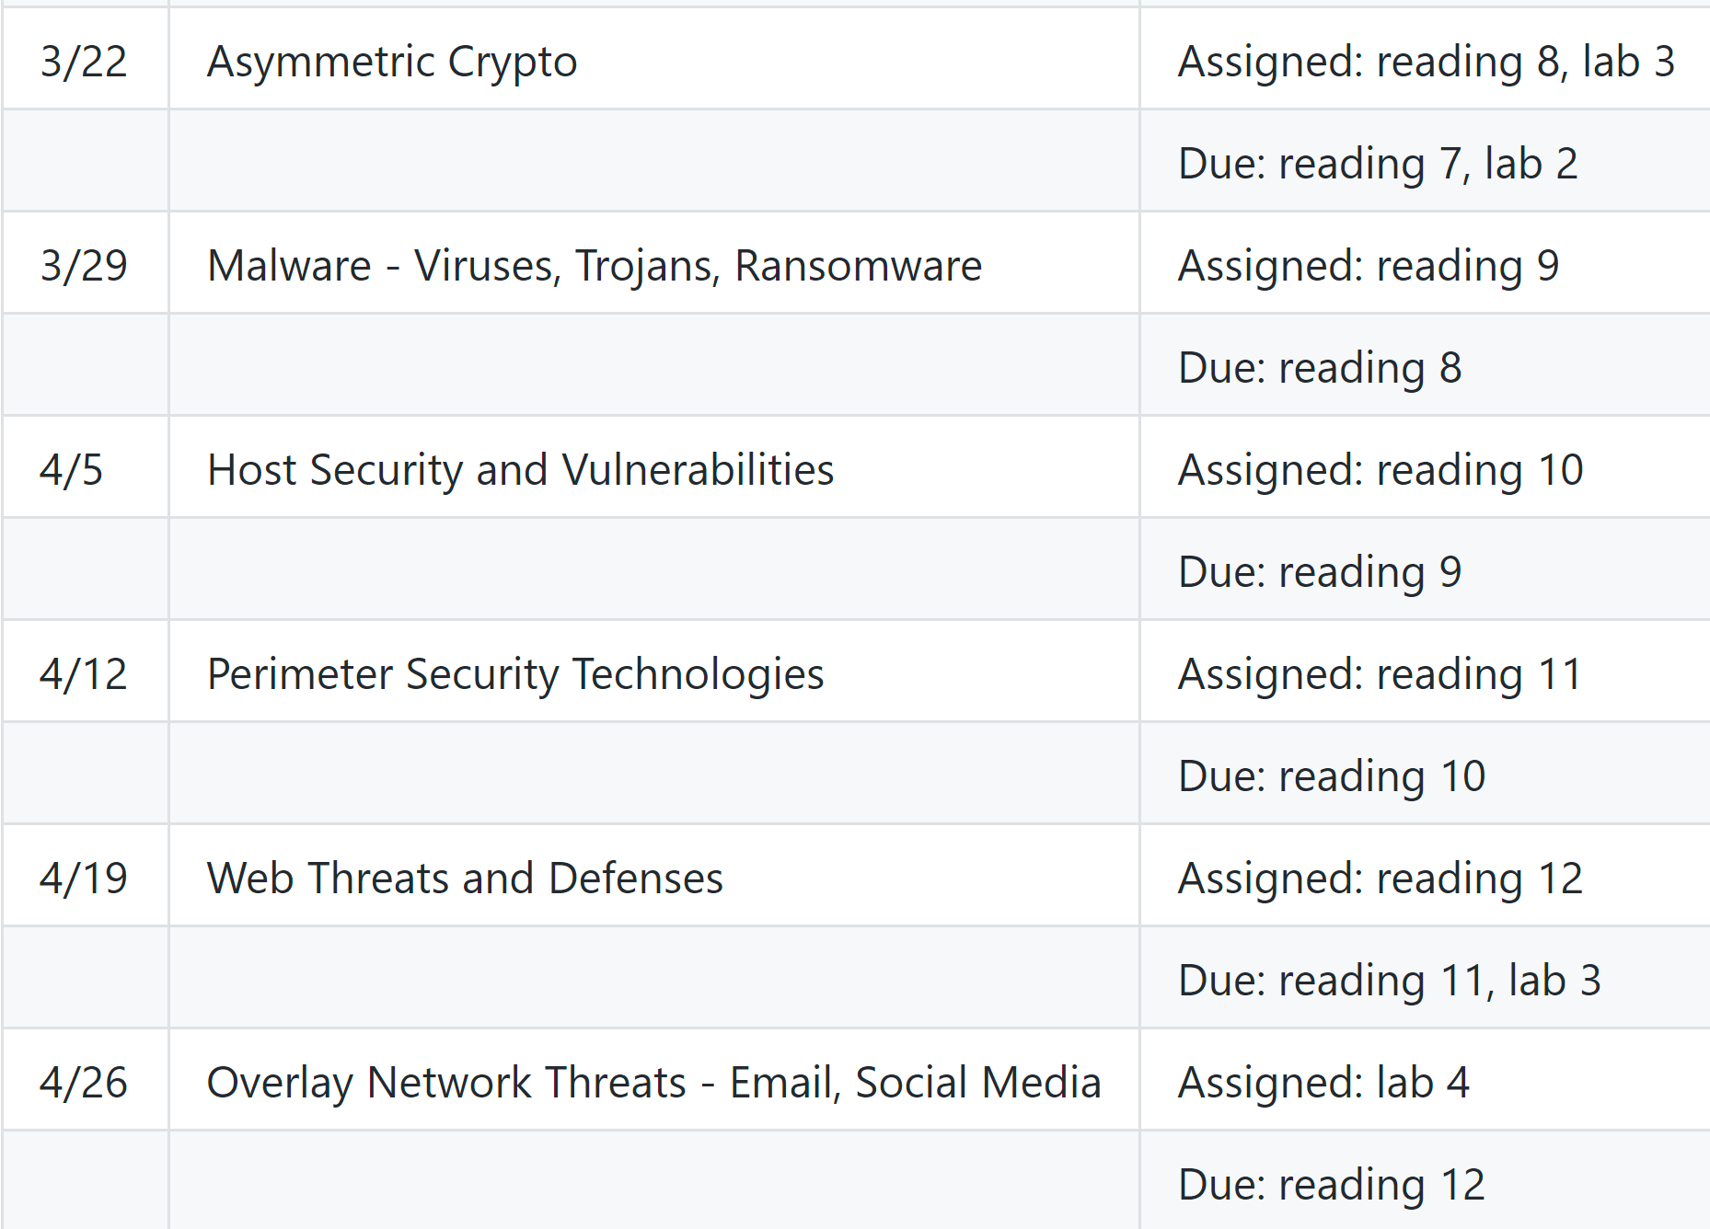
Schedule Part 2 Threats and Defences

Slide 9
Class Discussions
I hate slides and I hate “lectures”
I only use them because I haven’t found something better
Please read before class, come prepared to discuss
You will be assigned to discuss out-of-class as well

Slide 10
Grading
60% labs (15% each)
10% participation
30% Exams
1 Midterm
1 “floating” Final
15% each

Slide 11
Readings
I’ve tried a bunch of books. I hate them all
All free materials available online
Ross Anderson’s “Security Engineering”
This IS a great book
Second edition is free online

Slide 12
Reading Policies
Read before class for class discussion
Each week, in groups, discuss previous week’s reading
Discuss via text-based system and submit transcript

Slide 13
Clarification about Reading
Difference between “reading” and “reading discussion”
Syllabus says “reading due”. This just means read before class
Reading discussions are different
In your group, discuss previous week’s reading
Submit discussion transcript (may use Canvas)

Slide 14
Labwork
lab 1 - Wireshark and Browsing
lab 2 - Password Cracking
lab 3 - Certificates and Public Keys
lab 4 - Phishing Contest

Slide 15
Labwork Policies
PASS/FAIL – Not worth it to do part
You may talk to other students about the labs
But you must do your own work
I also will provide help sections as needed

Slide 16
Exams
Essay based thought questions
Open book, open note
I hate memorization/regurgitation
Usually involve a hypothetical

Slide 17
Exam Sample Question
Every one complains about passwords and that they need to be replaced. Although every now and then someone comes up with a new replacement but they never seem to get much traction, so the search continues. Regardless of whatever new technology comes along to replace passwords, there are certain fundamental problems that will have to be solved. Write an essay explaining what kinds of evaluations YOU would do for a password-replacement technology.
Do not speculate about how this imaginary technology works, just imagine it to be some kind of “black box” authentication mechanism. Instead, focus your essay on the psychological, technical, and perhaps even mathematical problems that you would require it to solve or address before you believed it to be a “good” replacement. Because this is hypothetical, you can address this from a number of different angles. Your score for this essay will be based on how well you understand user authentication including principles related to “something you know”, “something you have”, and “something you are.” You may also get score for applying Anderson’s concepts on user psychology and security engineering.

Slide 18
Grading
Standard Scale
Last semester, average was about 93%
This semester, targeting 87%

Slide 19
Introducing Cybersecurity
This is a very broad concept
Includes concepts of technology, psychology, etc etc
Where to start?
Let’s start with Ross Anderson’s “Security Engineering”

Slide 20
What is “Security Engineering”?
“[It] is about building systems to remain dependable in the face of …”
Malice
Error
Mischance.
“As a discipline, it focuses on the…”
Tools
Processes
Methods

Slide 21
The Goal
Confidentiality, Integrity, Availability (CIA Triad)
For new systems:
Design security
Implement security
Test security
For existing systems:
Adapt them for increased security
Adapt them as their environment evolves

Slide 22
“Having” Security
Everyone wants “security”. But how?
“Whoever thinks his problem can be solved using cryptography, doesn’t understand his problem and doesn’t understand cryptography.”
— Attributed by Roger Needham and Butler Lampson to Each Other

Slide 23
Key Observation
Anderson, Ch 1, p. 4

Slide 24
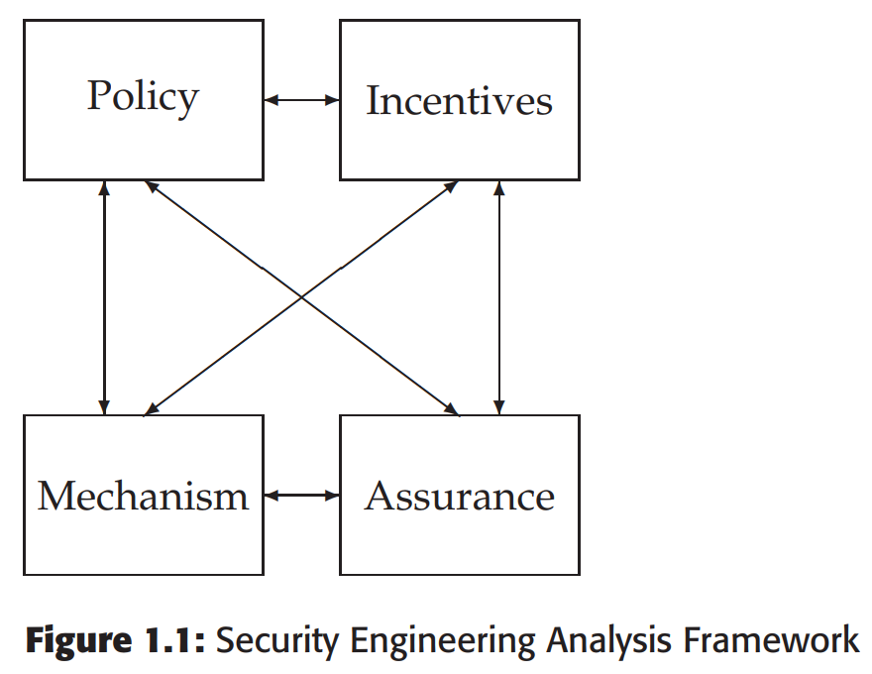
A Framework
Policy
Mechanism
Assurance
Incentives

Slide 25
Some Definitions
System – Tech + Auxiliary Tech + Staff + Users + etc.
Subject – Physical “person”
Principal – Entity in the system
Identity – Unique label attached to a unique principal
Trusted – Failure results in compromise
Trustworthy – Failure is unlikely

Slide 26
CIA (Not the Spies)
Confidentiality – Cannot be read
Integrity – Cannot be altered
Availability – Cannot be interrupted

Slide 27
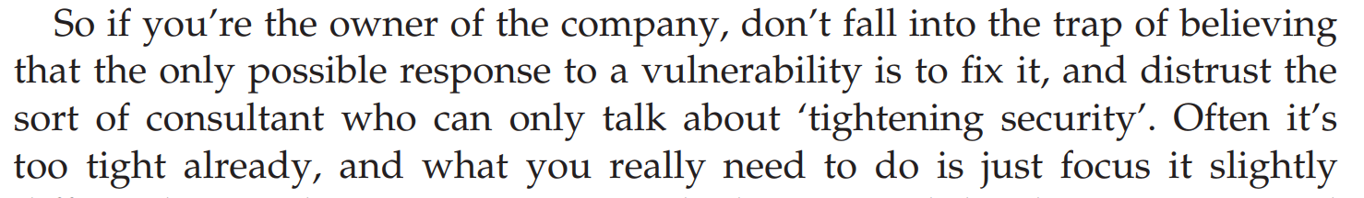

Understand This
Anderson, Ch 25, p. 816

Slide 28
Anderson’s Examples
Bank
Military
Hospital
Home

Slide 29
IAAA
Identity – Unique label for a unique principal
Authentication – Validation of the principal’s identity
Authorization – Permissions granted the prinicpal
Accountability – Metering and auditing of principal
(Message Authenticity – Integrity + Freshness)

Slide 30
Grasp the Context
SECURITY IS ABOUT CONTEXT (Repeat after me)
What does it mean when you say “system X is secure”?
Secure against whom?
Secure under what conditions?
Are we even protecting what matters?!
Take voting security
Who are the potential attackers?
How does the context change if a nation decides to be the attacker?

Slide 31
Start with Policy
“…a succinct statement of a system’s protection strategy” (Anderson ch1 p. 15)
Examples:
Each credit must be matched by an equal and opposite debit
All transactions over $1,000 must be authorized by two managers
Practice:
What are the security policies for TLS?

Slide 32
Then figure out mechanism
This is where most security people like to start
But really we only need mechanism to enforce policy
Some mechanisms aren’t even technical (e.g., legal)
MUST understand threat model

Slide 33
Assurance
Just how strong/resilient/comprehensive is the mechanism?
Requires a solid understanding of the threat model
Applications at every stage!
Design – solid security engineering principles
Implementation – coding practices, development processes
Testing – adversarial, comprehensive assessment

Slide 34
Incentives
Anderson’s example of airport security
What motivates the behavior?
What is “Security Theater?”
Everyone should learn a little game theory
Read up on Prisoner’s dilemma
Understand “mechanism design”
Anderson’s “Moral Hazard” (Chapter 25)

Slide 35
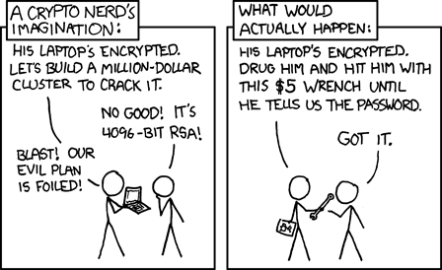
Illustrations
See http://xkcd.com/538/

Slide 36
Psychology
Much of computer security rests on psychology
Phishing, email scams, etc all depend on user psych
Security mechanisms avoided because they clash with psych

Slide 37
Understanding Human Bias
Humans are not rational
Humans are designed with a bias toward action
If we thought about everything we’d never do anything
We’re programmed to act without thinking
Examples of bias:
We’re more afraid of dying in a plane crash than a car crash

Slide 38
When Emotion Takes Over
When human logic/thinking ends, emotions take over
If we don’t know explicitly what to do, we respond emotionally
So, sometimes education has limited value
Bad guys will always learn how to exploit what the users dont know
One solution is safe defaults (FAIL SAFE/FAIL SECURE!)
“Our bank will never, ever send email”

Slide 39
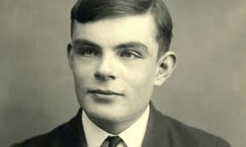
CAPTCHAs
Good case study!
Combine psychology, usability, and system design nicely
Designed around what humans do well that computers do not
“Completely Automated Public Turing Test to Tell Computers and Humans Apart”
Thanks Alan Turing!

Slide 40
Important Security Principles
Least privilege
Minimize attack surface
Defense in depth
Separation of duties and responsibilities
Crowdsourcing
Open systems
Fail Safe/Fail Secure

Slide 41
Course Goals
Understand how secure systems are constructed
Underlying concepts, such as policy and mechanism
Tools, such as cryptography
Systems, such as perimeter defense
Understand how “secure” systems are deconstructed (attacked)
Underlying concepts, such as “halting problem”
Tools, such as vulnerabilities
“Systems” such as Advanced Persistent Threats

