Slide 1
Malicious Software
UT CS361S
Fall 2020
Lecture Notes

Slide 2
What is “Malicious Code”?
“Software or firmware intended to perform an unauthorized process that will have adverse impacts on the confidentiality, integrity, or availability of a system. A virus, worm, Trojan horse, or other code-based entity that infects a host. Spyware and some forms of adware are also examples of malicious code.”
NIST Special Publication 800-53, Revision 5

Slide 3
Common Malware Classes
Malware can be classified by how it spreads or generically behaves
Virus – typically has to be attached to another program (infection)
Worm – typically spreads via network vulnerabilities
Trojan Horse – typically appears benign but contains hostile operations
Malware can also be classified by its behavior
Spyware – typically designed to steal information, observe behavior, etc.
Adware – typically designed to “trap” a user into viewing certain ads
Ransomware – typically locks data unless the user pays a ransom

Slide 4
Two Primary Components
Payload – The code that performs the (harmful) action
Attack Vector/Exploit/Delivery – The code that enables the payload
May include a transmission component
May include a stealth component
May include a mechanism for bypassing security
May be as simple as an email with an attachment

Slide 5
Malware History
Much of early computer security driven by military concerns
The biggest concern was an unauthorized user or program
Other concerns developed over time
The following slides are a very brief overview/highlight

Slide 6
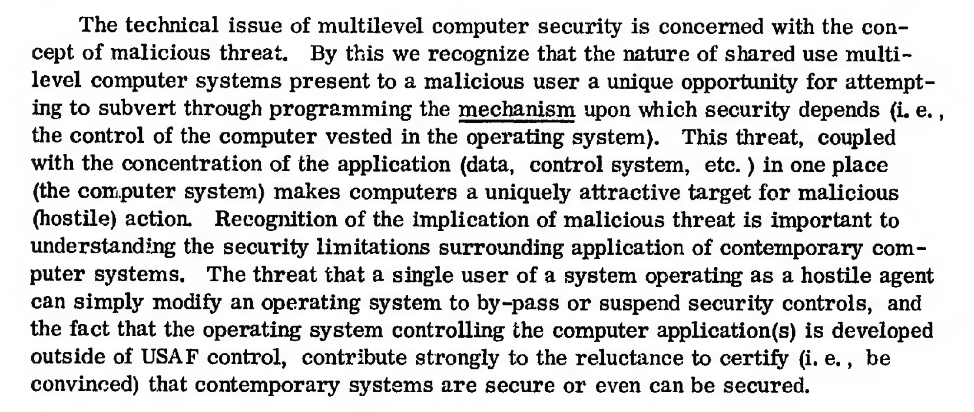
1972 Government Report:
https://apps.dtic.mil/sti/pdfs/AD0758206.pdf

Slide 7
1987: Fred Cohen’s Viruses
“Computer Viruses: Theory and Experiments” Fred Cohen, 1987
Introduced the concept of a self-replicating, evil program
The program attaches to a “good” program infecting it
When the infected program is run, the virus runs
The virus does it’s evil AND spreads itself to other programs
Concepts first proposed by Cohen in 1984

Slide 8
1988: Morris Worm
Robert Morris wrote a self-spreading piece of code (worm)
Spread using exploits in:
send mail,
Finger
rsh/rexec
Also guessed weak passwords
Copied code to new machine, compiled, and executed
Accidentally re-infected machines until machines became unusable
DOS attack brought down the Internet

Slide 9
Impact of Early Viruses
Amazingly, most early malware DID MINIMAL DAMAGE
Often just a delivery system with a weak payload
Many viruses spread for the sake of spreading
Even the Morris worm was disruptive by accident
There were exceptions, but also plenty of hype

Slide 10
1995: Concept Macro Virus
Microsoft Word and Excel have limited scripting (“Macros”)
Concept was the first virus written completely as a macro
It was a delivery system only with no payload
But was an important proof-of-concept
Users often open documents directly from email

Slide 11
2000: I Love You
Visual Basic Script virus
Appears as email attachment:
LOVE-LETTER-FOR-YOU.txt.vbs
The .vbs often hidden on Windows
When executed:
Damaged many office files
Sent email out to email address book automatically
Spread worldwide in hours

Slide 12
2004: MyDoom
Fastest spreading mass mailer virus at the time
Slows overall internet performance by about 10%
Slows average web page load times by about 50% percent
Responsible for approximately one in ten e-mail messages.
Appears as a delivery error, mail error, etc
Includes an attachment that, if clicked on, mails out copies
Also attempted to spread via P2P vile sharing Kazaa
Opened a back door for remote control
Attempted to launch a DDOS against the SCO Group’s website

Slide 13
2005: Sony Rootkit
Sony CD’s from the 2004-2005 era installed a “Rootkit”
Rootkit, as name implies, usually installs with elevated access
Using this elevated access, it can change the OS
This bypasses usual security such as antivirus, etc
Also usually very good at being undetectable
Installed at root with an EULA that did not mention the software
In 2005, US-CERT ISSUED AN ADVISORY!!!
Texas, under Greg Abbot, was the first state to sue

Slide 14
Why is the Sony Rootkit So Bad?
In addition to violations of privacy, etc, caused:
Slowing the system, consuming resources
False alarms from antivirus
OPENED HOLES FOR ADDITIONAL MALWARE
“Stinx-E trojan”

Slide 15
2013: Cryptolocker
Modern Ransomware
(1980’s had a ransomware called CyberAIDS)
Locks up system and uses public key crypto
In addition to fiat currency, accepted BitCoin

Slide 16
2016: Mirai
Worm that finds vulnerabilities in IoT devices
Takes over the device (“Zombie”)
Corrdinates all devices with a Command and Control
Launched a powerful DDOS against “krebs on security”

Slide 17
Command and Control Concept
Uninfected Machine
Command and Control
Try to Infect Others
Infected Machine
When infected, contact C&C. Can
then receive updates, instructions, etc.

Slide 18
Zero-day Vulnerabilities
What is a ZERO DAY exploit?
It is a vulnerability to a system for which a fix/defense is not yet available
Notice this isn’t a very technical term
Could be in any form
Virus
Worm
Trojan
Typically, the context is serious vulnerability
Privilege escalation
Login bypassing

Slide 19
Simultaneously New and Old
Obviously, by definition, zero day vulnerabilities are not new
Every vulnerability starts out as a zero-day
But the CONTEXT has changed so drastically in recent years
Political shifts (Drones, “Smart Power”)
Ubiquity of Computing
Reliance on Computing
Automation
Speed of information dissemination
Broader knowledge of computing among the masses
Tools

Slide 20
Zero Days from 2005 until Now
In the last ten years, a true “market” has emerged for buying zero-day’s
December 2005 – Fearwall tried to sell an exploit on Ebay
2006 – Unnamed security firm began selling exploits to US defense firms
2006 – Unnamed security firm had Charlie Miller selling exploits to U.S.
I was there at the time but wasn’t involved
Didn’t really know what was going on
My current knowledge is from the book “Countdown to Zero Day”
2011 – “Middlemen” that broker deals
Currently, companies like VUPEN, etc

Slide 21
What are Zero-Days used for?
Defensive testing
Some companies/agencies/groups buy zero-days for advanced penetration testing
If one system is compromised, how do the others do?
Why don’t they report these?
Bug bounties
Private Black Market
Anonymous
Russian Mafia
Military

Slide 22
Militarization of Cyberspace
Why Cyberweapons are seductive
Plausible deniability
Secrecy
Potential to minimize casualties on both sides
Cost effectiveness
Political convenience
CURRENTLY, ambiguity of law and regulation

Slide 23
Risks of Cyberweapons
ONE: Everything is interconnected
TWO: Humanity is reliant on automation
THREE: Law of Unintended Consequences

Slide 24
Early DOS Viruses
PROGRAM
PROGRAM
JUMP
VIRUS

Slide 25
Early “Anti Virus”
“Virus Bulletin” started in 1989
Still available at www.virusbulletin.com
Used to print BYTE SEQUENCES of known viruses
Virus Bulletin, January 1991

Slide 26
Virus Advancements
Antivirus scanners emerged with “libraries” of virus signatures
In response, viruses becamse “polymorphic”’
Each infection encrypts virus under a different key
Decryption engine decrypts virus for operations
Encryption means that each infection has unique bytes

Slide 27
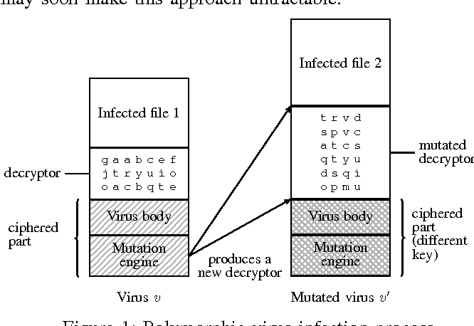
Polymorphic Virus Diagram
“Automated extraction of polymorphic virus signatures
using abstract interpretation” by Chaumette and Tabary

Slide 28
Antivirus Solution Classes
Static Analysis
Analyze the actual code of the virus
Dynamic Analysis

Slide 29
Solutions
Advanced Signatures
Signature is not just a byte sequence
Each “signature” is a mini-program of detection instructions
Partial Interpreter
Virus usually takes control early
Interpret the first bytes to see if its decrypting
Heuristics
Look for “telltale” signs
Minimally effective; too many false positives

Slide 30
Virus Delivery vs Payload
Much of the focus on Viruses is the delivery
How does it spread?
How does it bypass security?
Payload can be deleting

Slide 31
1984: Thompson’s Reflections
“Reflections on Trusting Trust” by Ken Thompson, 1984
Demonstrated creating an evil compiler
Would compile a login program with a backdoor
BUT! Compiler code is compiled by a compiler
“Clean” compiler source code compiled by an evil compiler is evil!
Proved that a “source code review” can’t catch all evil
SUPPLY CHAIN

