Slide 1
Improving Population Management through Pharmacist-Primary Care Integration: A Pilot Study
Amanda G. Kennedy, PharmD, BCPS,1 Harry Chen, MD,2 Michele Corriveau, BS Pharm,3 Charles D. MacLean, MDCM1
03.01.2024
Amy Nguyen
Follow the Money: Impact of Payment Reform and Health Policy on Pharmacy Practice

Slide 2
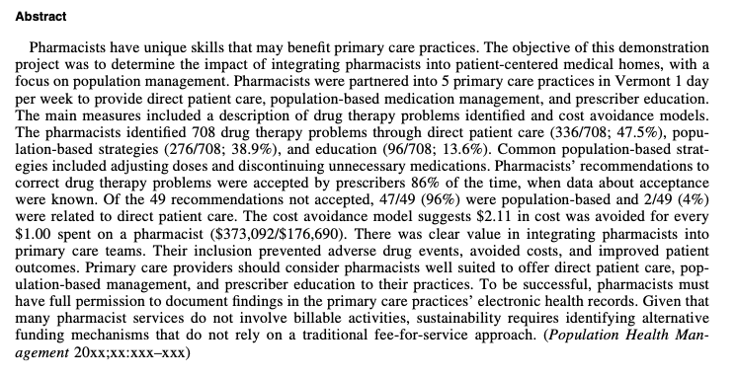
Background
75% of all primary care visits include prescribing or continuing medications
Given the association between polypharmacy and drug-related problems, there is a critical need to improve primary care prescribing.
Citation:
Amanda G. Kennedy, Harry Chen, Michele Corriveau, and Charles D. MacLean. Improving Population Management through Pharmacist-Primary Care Integration: A Pilot Study. Population Health Management. Feb 2015.23-29.http://doi.org/10.1089/pop.2014.0043

Slide 3
Background
Rationale
Evidence suggests that pharmacists in ambulatory settings reduce hospital and emergency department admissions, nonscheduled health services, number and cost of drugs, and improves prescribing.
Pharmacists have been shown to optimize patient outcomes and improve patient safety.
With innovative care and payment models (PCMHs and ACOs), there are new opportunities to integrate the unique skills of pharmacists into primary care teams.
Objective
To determine the impact of integrating pharmacists into patient-centered medical homes, with a focus on population management.

Slide 4
Methods: Study Design
Observational design with no control group
Data from January 2012 through August 2013
Approved by the Committees on Human Research at the University of Vermont

Slide 5
Methods: Population
The participants (pharmacists and primary care practices) were recruited by convenience sample to represent the typical primary care environment of Vermont.
Eligible pharmacists' inclusion criteria:
1. Vermont pharmacy license
2. Work near their physician partner practice
3. Have approval from their supervisor for the release time needed for participation.
Pharmacists were not required to have experience or specialty training in ambulatory care.

Slide 6
Methods: Setting
Primary care practices were selected to ensure diversity across demographic variables within Vermont
1. Geography (rural, urban, multiple counties)
2. Practice type (internal medicine, family medicine)
3. Practice ownership (hospital owned, Federally Qualified Health Center, private practice)
4. Progress toward or achievement of National Committee for Quality Assurance Patient-Centered Medical Home certification.
At baseline, practices did not have access to a pharmacist specific to the practice.
A physician champion was identified at each practice to assist the pharmacist with integration into the practice.

Slide 7
Methods: Study Protocol
The intervention involved partnering a pharmacist 1 day per week (0.2 full-time equivalent [FTE]) in the primary care practice
Pharmacists were required to participate in primary care using 3 strategies:
1. Direct patient care
2. Educating prescribers
3. Population-based strategies
The pharmacists met by conference call for weekly discussions throughout the project.
Pharmacist interventions were entered into:
A) Health Insurance Portability and Accountability Act-compliant Assurance software ( Medication Management Systems, Inc., Golden Valley, MN)
B) Or de-identified Microsoft Excel spreadsheets (Microsoft Corporation, Redmond, WA)

Slide 8
Methods: Endpoints
Primary Endpoints:
Description of the pharmacists’ identified drug therapy problems
Pharmacists’ recommendations
Estimated costs avoided
Secondary Endpoints:
Classification of pharmacist recommendations

Slide 9
Methods: Statistical Analysis
There were no a priori hypotheses
Analyses were conducted in Microsoft Excel 2010

Slide 10
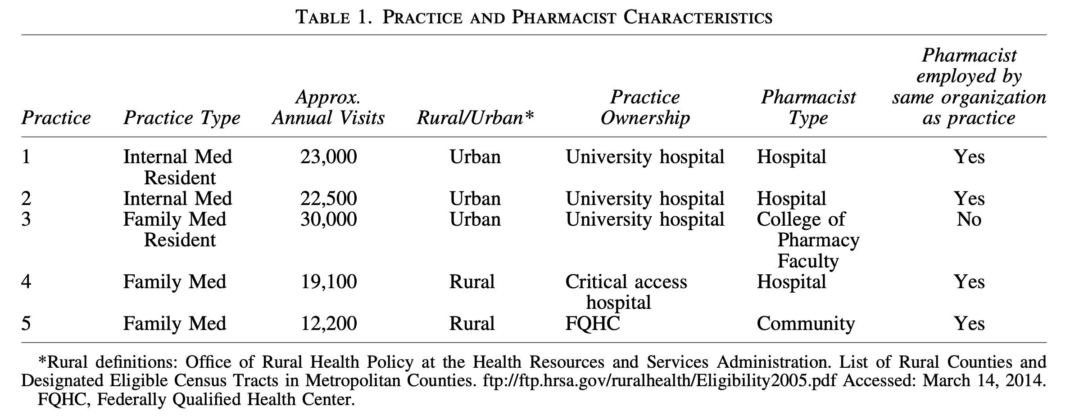
Results
Seven sites and 8 pharmacists enrolled (at 1 site 2 pharmacists shared the 0.2 FTE)
5 sites included in final analysis
Two sites were excluded because they contributed less than 6 months of data to the project
One site was excluded because it had difficulty developing the needed relationship and scope of pharmacist activities to successfully collect meaningful data.

Slide 11
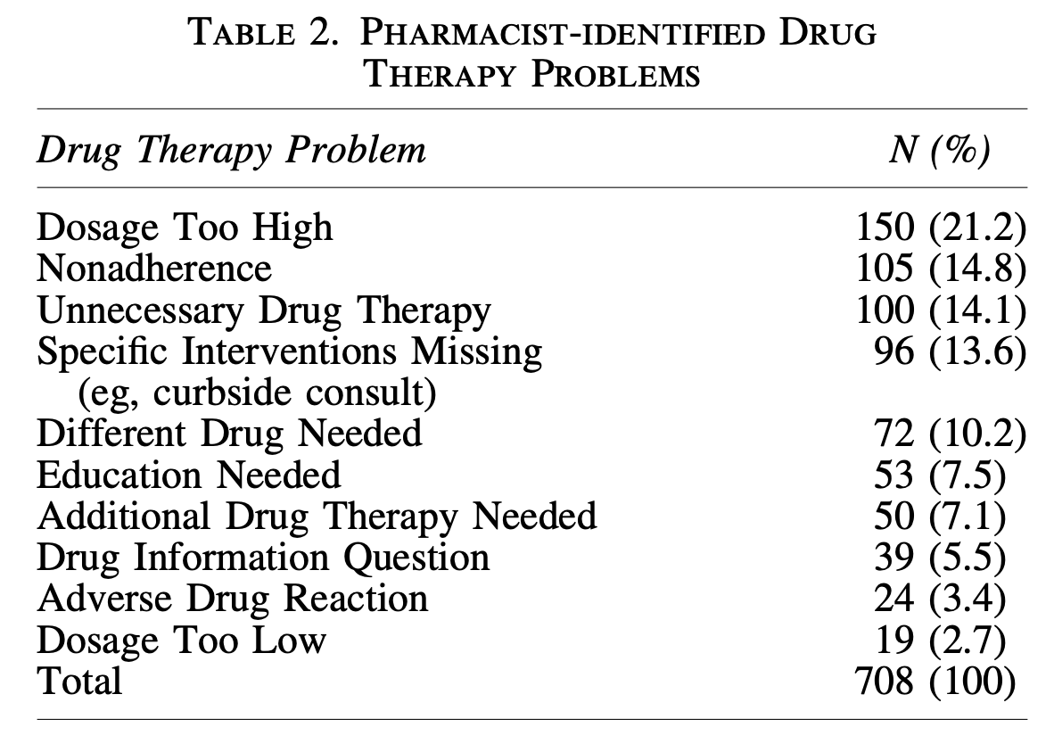
Results: Primary Outcomes
Drug therapy-related problems
The pharmacists identified 708 drug therapy problems
Pharmacists’ recommendations were accepted by prescribers 86% of the time

Slide 12
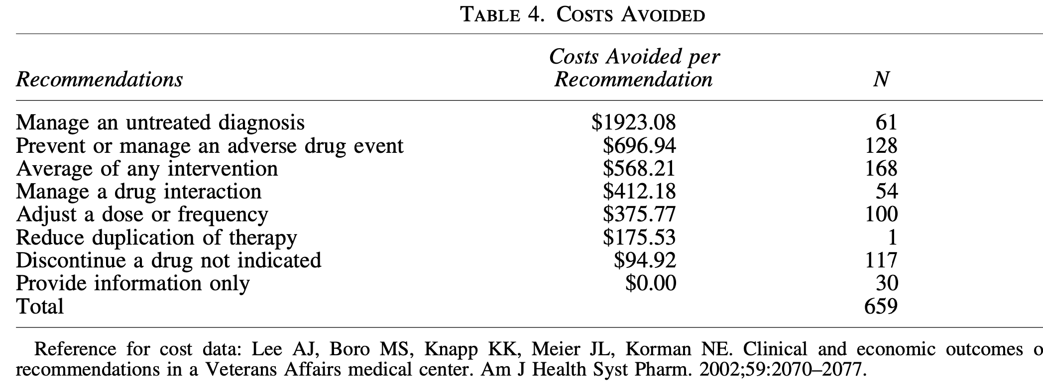
Results: Primary Outcomes
Cost avoidance
The recommendations resulted in an estimated $373,092 of avoided costs.
The results suggest that $2.11 in cost was avoided for every $1.00 spent on a pharmacist ($373,092/$176,690).

Slide 13
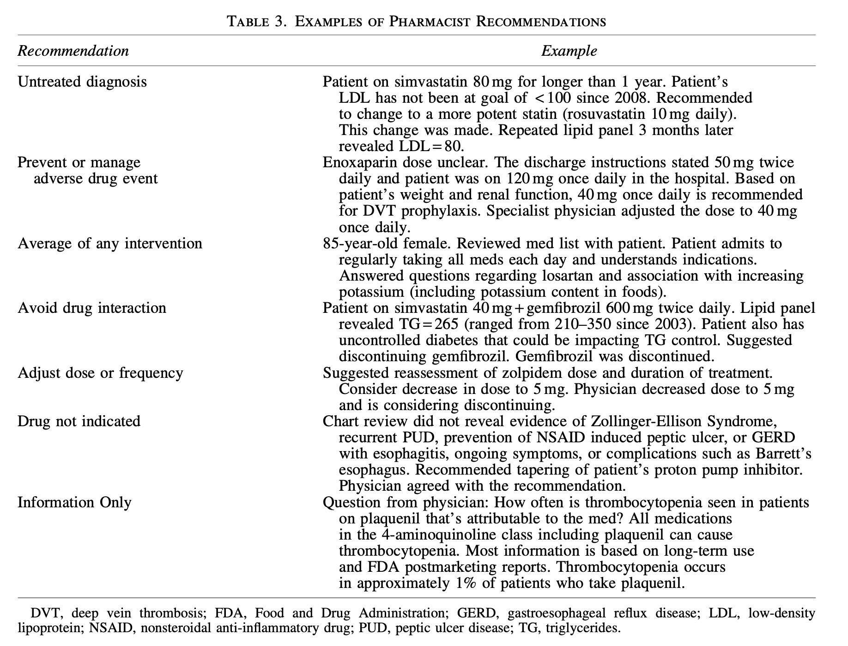
Results: Secondary Outcomes
Classification of pharmacist recommendations
The drug therapy problems were classified according to recommendations made to prescribers

Slide 14
Discussions and Conclusions
The findings of this study support the growing body of evidence confirming the value of pharmacists’ activities in primary care.
Primary care providers should consider pharmacists well suited to offer direct patient care, population-based management, and education in their practices.
Pharmacist inclusion is feasible, prevents adverse drug events, reduces costs, and improves patient outcomes.
The most successful sites included specialty-trained academic pharmacists and pharmacists employed by the same organization as the practice
Reported limitations:
Data regarding prescriber acceptance of interventions and long-term outcomes are incomplete.
Patient denominators as well as most patient characteristics are unknown because de-identifiers utilized across organizations
Only 5 practices included

Slide 15
Critique: General
Positives:
Title and abstract reflect study findings
Provides relevance for study and cites rationale based on previous studies
The principal investigator (AK) and a coauthor (CM) independently reviewed each pharmacist intervention and assigned the codes and categories. Discrepancies were resolved through discussion among the coauthors.
Negatives
Abstract only mentions 2 out of the 3 main measures (excludes pharmacists’ recommendations)

Slide 16
Critique: Study Design
Positives:
Pharmacist inclusion criteria clear
Negatives
Convenience sample is not representative of the larger population leading to potential biases in the results
Study protocol vague
Pharmacists’ efforts varied by location and left to the discretion of the pharmacist and physician champion in each practice
Secondary endpoints not well defined
Primary care practice inclusion/exclusion criteria not clear

Slide 17
Critique: Results/Discussion
Positives
Recognized limitations of their study
All results were clearly reported in tables
Utilized other studies to support their findings
Negatives
Interpretation of study findings not clear
Gaps in data - Missing acceptance data for 350 out of 708 pharmacist recommendations
Total number of patients encountered unknown

