Slide 1
Winter Term Progress Report – Alex Hoffer
CS462
Group: Stat Champs
Project: Machine Learn Your Way to March Madness Glory

Slide 2
Term overview
Fulfillment of responsibility #1
Fulfillment of responsibility #2
Revision of documents for OneNote hosting
Writing progress report
Writing these slides
Voice-over demonstration (this presentation)
Team captain responsibilities
Uploading documents to OneNote
Registering our team for Spring Expo

Slide 3
Responsibility #1: Description
In abstract:
Hosting of web page, development of basic Graphical User Interface (GUI) for project to help users navigate through page
This bolded sentence was how my first responsibility was described in our Technology Review document, drafted in Fall Term
Specifically:
Host website on my public_html branch of the ENGR server
Produce HTML: Title of page, Links to other parts of page at top of page using divs, lists, sections, etc. The sections of our page that I created include Home, Instructions, Module, Purpose, and About. The modification of such sections are found in my Responsibility #2. The basic structure of our web page.

Slide 4
Responsibility #1: Description (continued)
Produce CSS: Customize the html to look nice for users to improve usability of module. Without clean, readable interface, module may not make sense for Biochemistry/Biophysics students.
Produce JavaScript: Allow for changes to occur within browser without re-loading the page. To refer to the HTML portion- ability to click on a link in the home menu and have the page automatically scroll down to that section without requiring the page to refresh. This improves page usability by providing an intuitive way to navigate through the site and reduces the load on the server by requiring fewer page refreshes.

Slide 5
Responsibility #1: Technologies Used
HTML – used to communicate between server and user, divide page into sections such as Home, Instructions, Module, Purpose, and About to improve both usability (user will not be overwhelmed by a massive amount of information) and code readability/maintainability (easier to read and modify code when the entire web page is split into logical chunks that are properly commented).
CSS – used to make the page look nice. Without CSS, HTML looks quite ugly, which reduces usability of the GUI. Creation of tags in HTML allows for aesthetic modification of page components using separate CSS files that are loaded into the HTML file which generates the page.
JavaScript – used to make the page more interesting and appealing to interact with. For example, while HTML allowed for the division of the page into smaller components, JavaScript allowed for the navigation between such smaller components without reloading the page.

Slide 6

Responsibility #1: Screenshot of Main Page

Slide 7
Responsibility #1: Demonstration
Of course, a screenshot of the main page of our web site is just one part of Responsibility #1, and to see the JavaScript that Responsibility #1 encompasses, I will load up the page for a demonstration:
http://web.engr.oregonstate.edu/~hoffera/CapstoneProject/MachineLearnYourWayToMarchMadnessGlory.html

Slide 8
Responsibility #2: Description
In abstract:
Presentation of Instructions on how to use the module (before the module itself is presented), presentation of Module, Purpose, and About pages.
The bolded part of the previous bullet point is how my Responsibility #2 was described in our Technology Review from Fall Term.
Specifically:
Using the foundational GUI developed in Responsibility #1, develop the sub-components found on the main page, including the Instructions, Module, Purpose, and About components.
Use CSS and JavaScript to make each of these subcomponents look nice to enhance usability. For example, a button that navigates to other subcomponents that changes color when the mouse hovers over it.

Slide 9
Responsibility #2: Description (continued)
Write the content for each page. For Instructions, the details on how to operate the module. The Module subcomponent consists of a link to the Machine Learning module developed by Chongxian. The Purpose subcomponent includes a description of why the module was developed (i.e. Dr. Victor Hsu’s intentions in commissioning us to work on this project) and contains a button that leads to the “About the Developers” subcomponent. The “About the Developers” subcomponent includes our names, our class information, and a button with a picture of mail to indicate e-mail that links the user to my email in case they wish to contact us about the project.

Slide 10
Responsibility #2: Technologies Used
Essentially a repeat of Responsibility #1’s Technologies Used page. CSS and JavaScript were primarily used here, with JavaScript allowing for us to move from one subcomponent to the next with ease and CSS providing a nice design to the subcomponents.

Slide 11
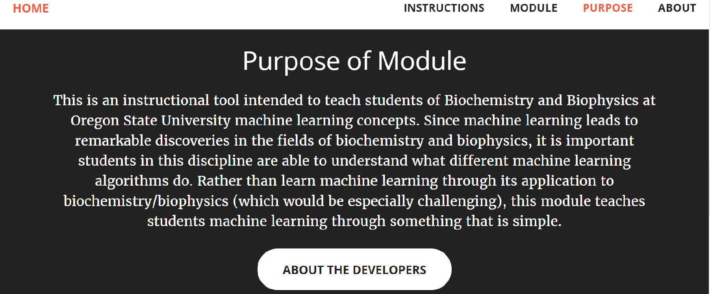
Responsibility #2: Screenshot, Purpose Page

Slide 12
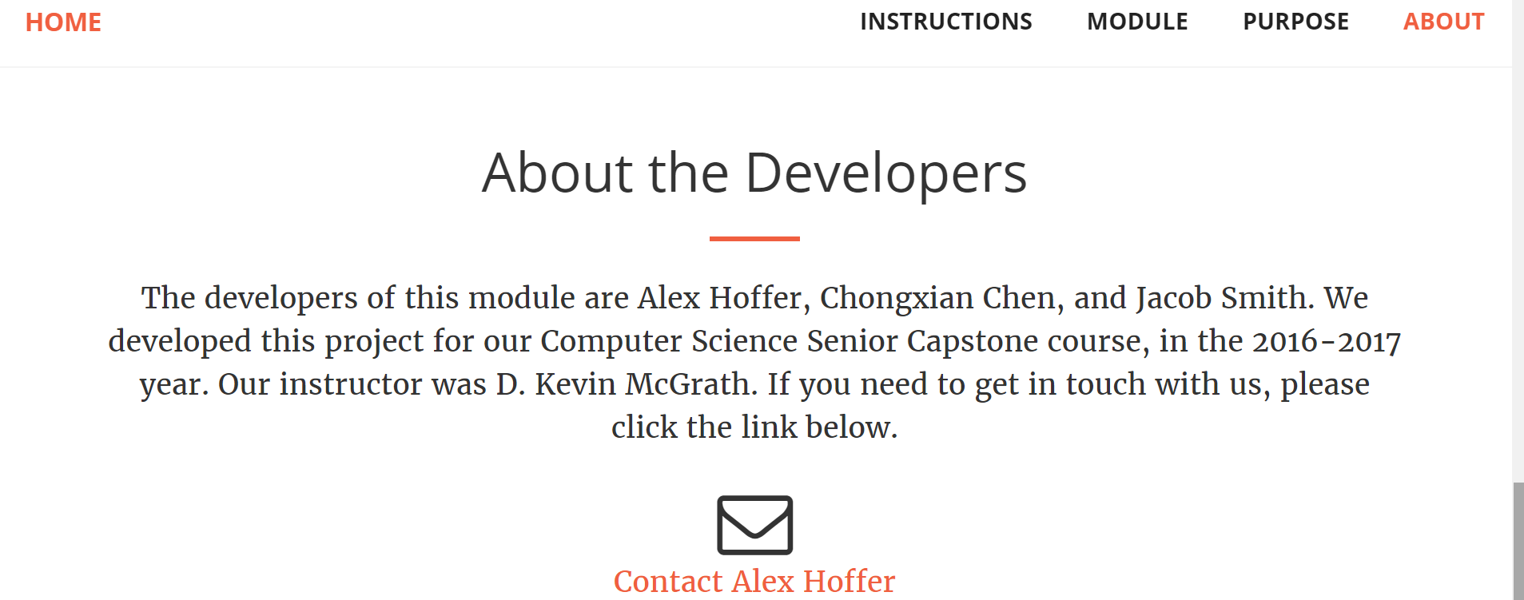
Responsibility #2: Screenshot, About Page

Slide 13
Responsibility #2: Demonstration
http://web.engr.oregonstate.edu/~hoffera/CapstoneProject/MachineLearnYourWayToMarchMadnessGlory.html

Slide 14
Responsibility #3
My third responsibility was to format the data into a bracket structure.
This ended up being more convenient for Jake and Chongxian to do as they generated the machine learned model.
Can be seen complete on the module.

Slide 15
What Alex needs to do to complete this project + course
All responsibilities done
Revise poster that I submitted
Polish code – browser compatibility, fix certain positioning issues, perhaps change some of the GUI around
Present poster at Spring Expo

Slide 16
Jake Term overview
Fulfillment of responsibility #1
Fulfillment of responsibility #2
Helping George with machine learning code
Script to generate bracket
Writing progress report
Writing these slides
Voice-over demonstration (this presentation)

Slide 17
Jake’s Responsibility #1
Getting the data:
For getting the data I actually didn’t use any of the statistics websites I mentioned in the tech review. I ended up finding the data on a website called Kaggle.com, it is a data science website with a wide variety of stats.
This website only had data leading up to this season so I had to manually pull most of the data for this season and any additional stat metrics I or George wanted to have.

Slide 18
Responsibility #1
For getting this years data I started out writing a python script to grab the stats for me from ESPN. But I kept having issues with stats counted twice and sometimes it would pull the woman's team data instead of the men's.
I ended up pulling most the data from this year by hand and am still adding the games stats from the march madness tourney as the games are played.

Slide 19
Responsibility #2
Storing the data:
For storing the data I originally planned on using phpmyadmin but it turns out we could not run our python scripts on the OSU servers so we are now hosting the data in AWS
This was actually a lot easier then phpmyadmin and has a lot more flexibility. The downside is that on the free version of AWS it takes awhile to run the python scripts because its running through so much data.

Slide 20
Other work
I helped George write and come up with the machine learning script by giving him examples and helping him come up with strategies on what stats to weigh more heavily.
I found a handy python script that generated our bracket for us by feeding it the teams, seeds, and picture of the bracket.

Slide 21
Possible Improvements
I was planning on adding games stats as they are played to see if they would accurately predict the next round of games based on the last round and season data.
I also wanted to try and see what combination of weights on stats would have given me the correct outcome of the whole tournament. In other words what did I need to change for it to produce a perfect bracket.
I would also like to get the runtime of the scripts down to below a minute because as of now they take a little over two minutes to run and output the results.

Slide 22
What Jake needs to do to complete this project + course
All responsibilities done
Revise poster that Alex submitted
Polish code – scripts and stats
Present poster at Spring Expo

Slide 23
Chongxian’s Winter Term Overview
Fulfillment of responsibility #6
Fulfillment of responsibility #7
Fulfillment of responsibility #8
Keep Track of Weekly Progress
Writing progress report
Writing slides
Voice-over demonstration (this presentation)

Slide 24
Responsibility #6 and #8: Description
In abstract:
Explore SciKit-Learn library in python
Explore Machine Learning methods for our project
Predict result using data and generate output
Specifically:
Learn Supervised Learning method for our project
Separate data into training sets and testing sets
Write codes in Python to fit and predict results
Produce outputs with confidence of match results as a CSV file

Slide 25
Responsibility #6 and #8: Technologies Used
Python – I wrote the code in python primarily because Python is a popular and powerful language to use.
SciKit-Learn Libray – Scikit-learn library is a Python based machine learning library. It is open-sourced and easy to learn and use. The website provides rich documentations and examples. Besides SciKit-Learn has a large community supporting its development. There are also many machine learning projects I can learn from in GitHub that uses SciKit-Learn
Machine Learning – In order to understand machine learning better, I also study the Stanford Machine Learning online class by Professor Andrew Ng.

Slide 26
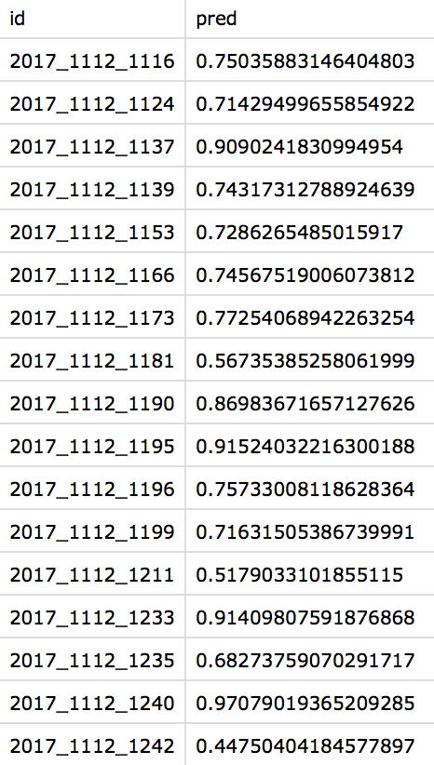
Responsibility #6 and #8: Screenshot of Output
The output file has two attributes. The first one has the season, team one ID, team two ID separated by an underscore. The second attribute indicate the chances the first team winning over the second team predict by our machine learning model.

Slide 27
Responsibility #7: Description
In abstract: Allow the user to choose different stats they want to considered in the prediction and generate an output.
Technology used:
Python
Python Pandas Library
PHP
Python Command Line tools
Set up cloud environment and use pip to install packages.

Slide 28
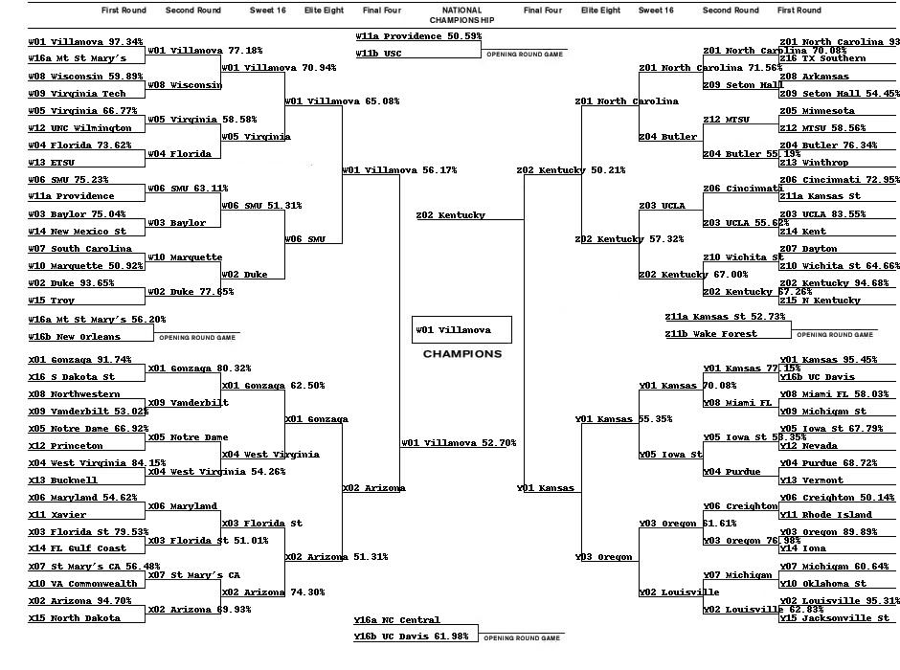
Responsibility #7: Screenshot of Output
After generating our csv files, we used a bracket generator to generate a picture as our final result. Looks like this prediction predicts Villanova to be the champion!

Slide 29
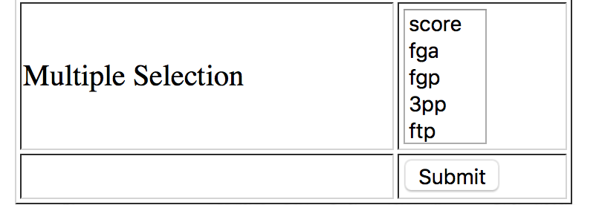
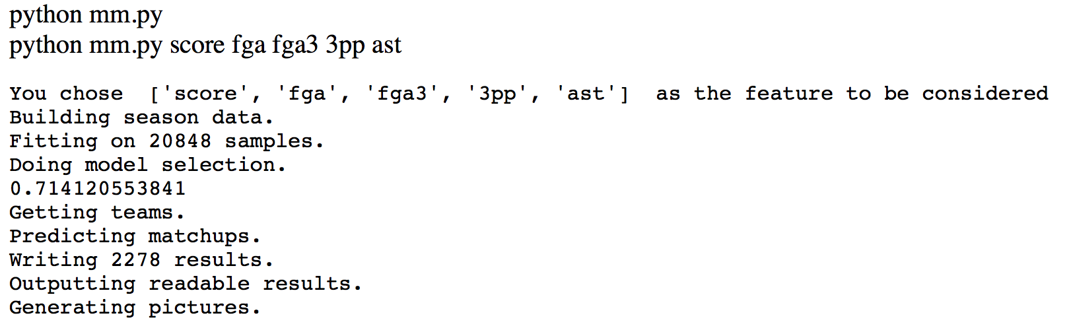
Responsibility #7: Screenshot of Output
Here is a webpage I wrote that allow the user to choose stats and generate corresponding outputs.

Slide 30
What Chongxian needs to do to complete this project + course
All responsibilities done
Revise poster that Alex submitted
Polish code – scripts and stats, maybe adding allow the users to choose year of stats they want to consider
Present poster at Spring Expo

