Slide 1
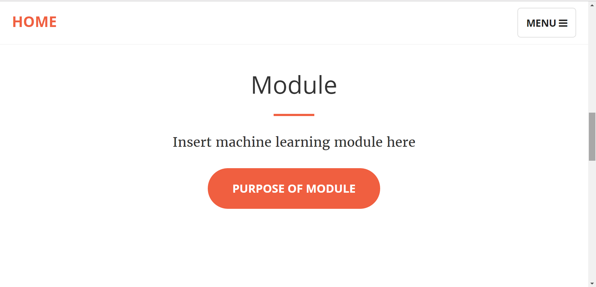
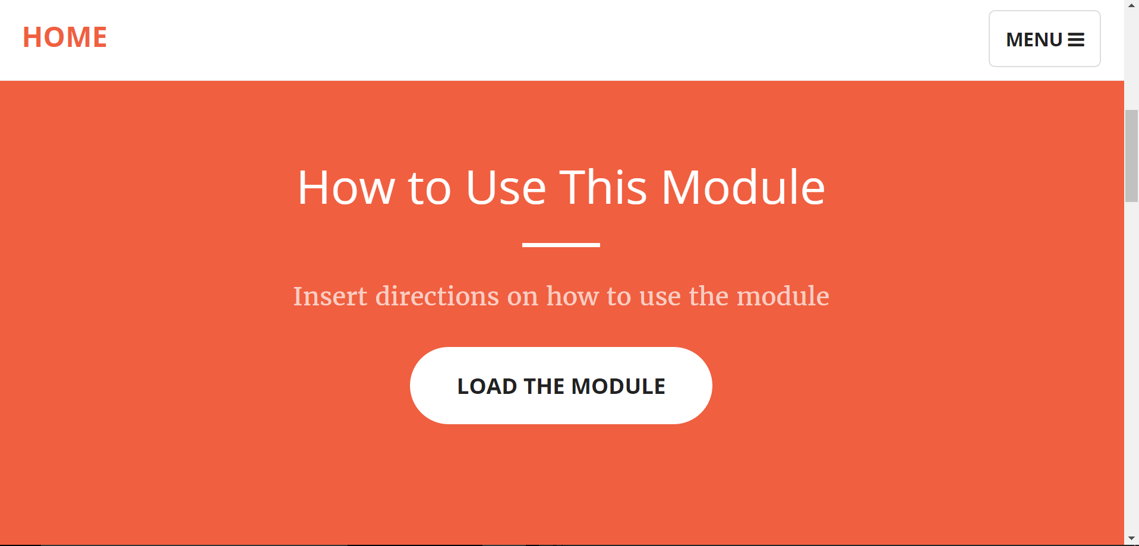
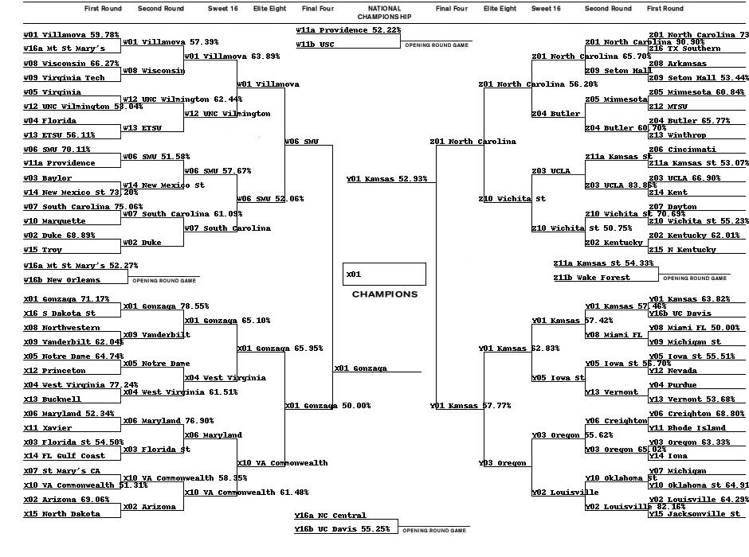

Machine Learn Your Way to March Madness Glory!
Introduction/Background
CONCLUSION
IMPORTANCE OF MACHINE LEARNING TO BIOCHEMISTRY AND BIOPHYSICS
Biochemistry and biophysics are two ﬁelds that are ripe with many exciting breakthroughs. Machine learning, a type of artificial intelligence where computer programs adapt to new data, is used by biochemists and biophysicists to do things like generate new strands of DNA. Our client, a professor in the department of Biochemistry and Biophysics at OSU, recognized there was a need for his budding scientists to understand machine learning so they could be better prepared for their careers.
A NEED FOR A MACHINE LEARNING INSTRUCTIONAL TOOL
Our client noticed that the Biochemistry and Biophysics curriculum at OSU did not encourage undergraduate students to learn machine learning. Even if machine learning classes were to become a cornerstone of their coursework, the content would be difﬁcult for people without a Computer Science background. To make matters worse, teaching machine learning to these students through its application to biochemistry and biophysics is particularly challenging, since machine learned models of DNA can be hard to interpret.
WHAT WE WERE COMMISSIONED TO DO
We were enlisted to produce an online instructional module where these students could grasp machine learning fundamentals in a fun and clear manner. Our client wanted us to develop this module so that students could generate machine learned NCAA March Madness brackets. Since a fundamental aspect of learning machine learning is recognizing how the inclusion or exclusion of data influences resulting models, this module would satisfy the need by producing models (brackets) that were distinguishable from each other based on the college basketball statistics a user chose to train their model on. In addition to this clarity, the module would also be fun to use, because rather than focus machine learning on biochemistry and biophysics, it would instead concentrate on men’s college basketball.
Teaching Biochemists and Biophysicists Machine Learning
AGGREGATE/SELECT STATISTICS
Jacob gathered college basketball statistics from 1985 to the current season from the website Kaggle.com in the CSV file format. Since the regular season didn’t conclude until March, Jacob manually updated the database to reflect the current standings frequently until the final game was played. Then added stats from the tournament for future algorithms and analysis.
FEED STATISTICS TO MACHINE LEARNER
Using Python SciKit-Learn library, Chongxian read the CSV files into Numpy arraies. By using a basketball ELO rating system, the supervised machine learning model is able to fit on the statistics and predict new matches. A CSV file of the match results between two teams with probability is generated as a result.
GENERATE BRACKET OF RESULTS
The prediction CSV file generated from the machine learning model was then transferred into bracket form by Jake using a python script.
MAKE OUR MODULE MORE EDUCATIONAL
By modifying the python script, we allow the users to choose stats in basketball matches they think are important to generate their own prediction. They are also able to choose different machine learning estimators like Linear Regression and SVM Polynomial. The bracket results effectively present how the users choice affects the machine learning prediction.
Fig. 4: Module page that hosts the machine learning module.
Fig. 2: Instructional page that informs users on how to use the machine learning module.
FEATURES PROVIDED BY MODULE:
A Graphical User Interface (GUI) including a home page, an instructions page, an about the developers page, and a statement of purpose.
The ability to select from a set of college basketball statistics.
A machine learned bracket that corresponds to the specific statistics the user requested the model to be trained on.
As of mid-March 2017, we can conclude that the project is incomplete. The machine learning module has only been partially implemented bhad a number of different y Chongxian. This has effects: the user is not able to generate predictions, and as such, the other developers have not been able to work on converting the generated models into brackets. Once the final pieces are put into place by Chongxian, Jake can work on pretty printing the bracket, which Alex will help with. Future machine learning modules similar to this one will want to have a better way for users to select college basketball statistics. Additionally, the developers of such modules may wish to have prior machine learning experience, a more proper mode of communication, and a more rigid implementation schedule in order to allow for time at the end to polish each component of the module separately.
PROJECT INFORMATION
Class: CS Senior Capstone, 2016-2017
Developers:
Alex Hoffer (hoffera@oregonstate.edu)
Jacob Smith (smitjaco@oregonstate.edu)
Chongxian Chen (chencho@oregonstate.edu)
Client: Dr. Victor Hsu, Oregon State University, Department of Biochemistry and Biophysics
PROJECT DESCRIPTION
To implement the module, we needed to complete the following five steps:
Develop a Graphical User Interface (GUI)
Aggregate/select college basketball statistics
Feed statistics to machine learner
Train a model
Generate bracket of model
The following headings are technical descriptions of the five steps:
GUI
Alex used HTML, CSS, and JavaScript to produce the GUI for our web page. HTML was used to split the page into logical sections such as Home (found in Figure 1), Instructions (found in Figure 2), Module (found in Figure 4), Purpose, and About (found in Figure 3). We utilized CSS to make these sections look clean and usable. Finally, JavaScript was used to enhance the user experience by making the page interactive, such as turning certain buttons different colors upon clicking in order to notify the user of the action they had just performed.
Fig. 3: The March Madness bracket predicted by SVM RBF
Fig. 1: Home page. The “Menu” button allows the user to navigate through the website.
Notes:
If tri-fold mounting at SMS – make sure no text or image is in-between the two vertical guide lines; this space will be cut away. To view the vertical guide lines: Select “View” from the main menu, select “Guides” from the pull down menu, and lastly select “Static Guides”.

