Slide 1
Spring Term Progress Report
CS463
Group: Stat Champs
Project: Machine Learn Your Way to March Madness Glory

Slide 2
Brief recap of project purpose and goals
Background: Machine learning is used by Biochemistry/Biophysics.
Purpose: Our client, Dr. Victor Hsu, is a professor in the Biochemistry and Biophysics department at OSU who recognized that his students should understand machine learning in order to prepare them for their careers.
No opportunity for them to learn it, hard to learn it from its application to BC/BP.
Goal: Produce an online module where BC/BP students could learn machine learning.
Idea: User chooses machine learning algorithm and college basketball statistics to train a model on, can observe how differences in statistics and algorithm choice influence a March Madness bracket that is generated.

Slide 3
Where Alex Is On the Project
All of Alex’s requirements fulfilled as of last term
Still could make generated brackets look nicer, but changes won’t be in the product presented at Expo

Slide 4
Problems Alex Encountered
JavaScript difficulties. Solution: tutorials, bootstrapping
Cross-compatibility among browsers (action item)
Group issue: Oregon State server does not support embedded Python, looked to AWS as solution

Slide 5
Example of a cool piece of code
<div class=”col−lg−4 text−center”> 2 <i class=”fa fa−envelope−o fa−3x sr−contact”></i> 3 <p><a href=”mailto : hoffera@oregonstate .edu”>Contact Alex Hoffer</a></p> 4 </div>
HTML code that utilizes CSS and JavaScript to show a “Mail” button that the user clicks on to send me an email if the user has a question about the project. A picture of this in action is on the next slide.

Slide 6
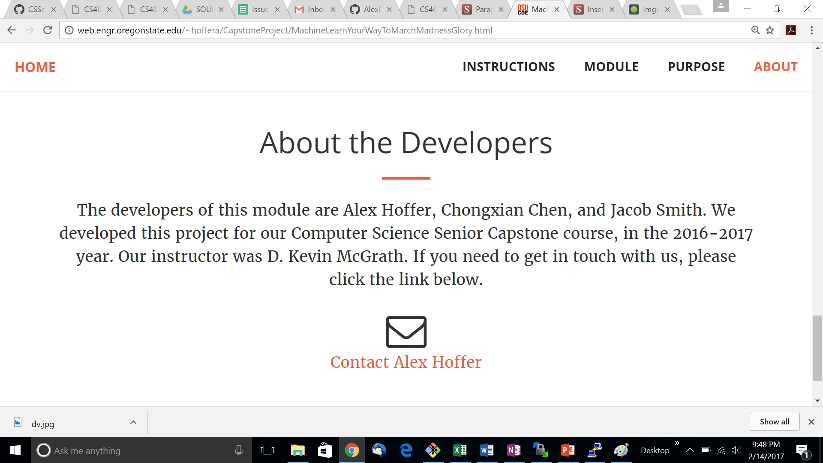
Sample screenshot: “About the Developers” page.

Slide 7
Walkthrough of code of Alex’s requirements

Slide 8
Expo Pitch
Materials we will have
Background
Purpose
How it works
Results

Slide 9
Project demonstration

