Slide 1
Winter Term Progress Report – Alex Hoffer
CS462
Group: Stat Champs
Project: Machine Learn Your Way to March Madness Glory

Slide 2
Chongxian’s Term overview as of Week 6
Fulfillment of responsibility #6
Fulfillment of responsibility #8
Keep Track of Weekly Progress
Writing progress report
Writing slides
Voice-over demonstration (this presentation)

Slide 3
Responsibility #1: Description
In abstract:
Explore SciKit-Learn library in python
Explore Machine Learning methods for our project
Predict result using data and generate output
Specifically:
Learn Supervised Learning method for our project
Separate data into training sets and testing sets
Write codes in Python to fit and predict results
Produce outputs with confidence of match results as a CSV file

Slide 4
Responsibility #1: Technologies Used
Python – I wrote the code in python primarily because Python is a popular and powerful language to use.
SciKit-Learn Libray – Scikit-learn library is a Python based machine learning library. It is open-sourced and easy to learn and use. The website provides rich documentations and examples. Besides SciKit-Learn has a large community supporting its development. There are also many machine learning projects I can learn from in GitHub that uses SciKit-Learn
Machine Learning – In order to understand machine learning better, I also study the Stanford Machine Learning online class by Professor Andrew Ng.

Slide 5
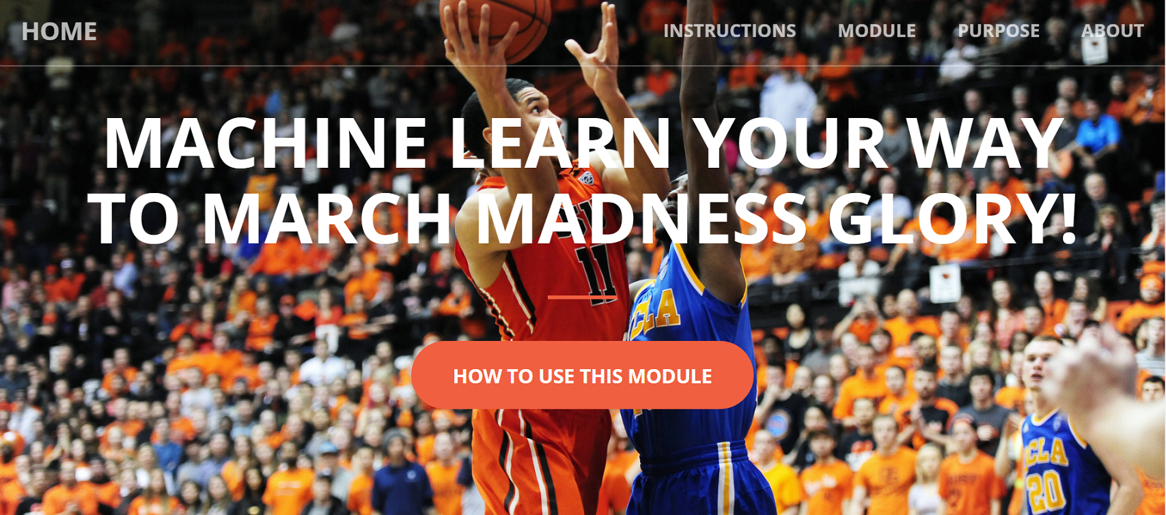
Responsibility #1: Screenshot of Main Page

Slide 6
Responsibility #1: Demonstration
Of course, a screenshot of the main page of our web site is just one part of Responsibility #1, and to see the JavaScript that Responsibility #1 encompasses, I will load up the page for a demonstration:
http://web.engr.oregonstate.edu/~hoffera/CapstoneProject/MachineLearnYourWayToMarchMadnessGlory.html

Slide 7
Responsibility #2: Description
In abstract:
Presentation of Instructions on how to use the module (before the module itself is presented), presentation of Module, Purpose, and About pages.
The bolded part of the previous bullet point is how my Responsibility #2 was described in our Technology Review from Fall Term.
Specifically:
Using the foundational GUI developed in Responsibility #1, develop the sub-components found on the main page, including the Instructions, Module, Purpose, and About components.
Use CSS and JavaScript to make each of these subcomponents look nice to enhance usability. For example, a button that navigates to other subcomponents that changes color when the mouse hovers over it.

Slide 8
Responsibility #2: Description (continued)
Write the content for each page. For Instructions, the subcomponent is there, but since the module itself hasn’t been developed fully yet (this is encompassed by Chongxian and Jake’s responsibilities), I don’t know what the instructions are. This will likely be the final thing added to our project. The Module subcomponent will consist simply of the Machine Learning module. The Purpose subcomponent includes a description of why the module was developed (i.e. Dr. Victor Hsu’s intentions in commissioning us to work on this project) and contains a button that leads to the “About the Developers” subcomponent. The “About the Developers” subcomponent includes our names, our class information, and a button with a picture of mail to indicate e-mail that links the user to my email in case they wish to contact us about the project.

Slide 9
Responsibility #2: Technologies Used
Essentially a repeat of Responsibility #1’s Technologies Used page. CSS and JavaScript were primarily used here, with JavaScript allowing for us to move from one subcomponent to the next with ease and CSS providing a nice design to the subcomponents.

Slide 10
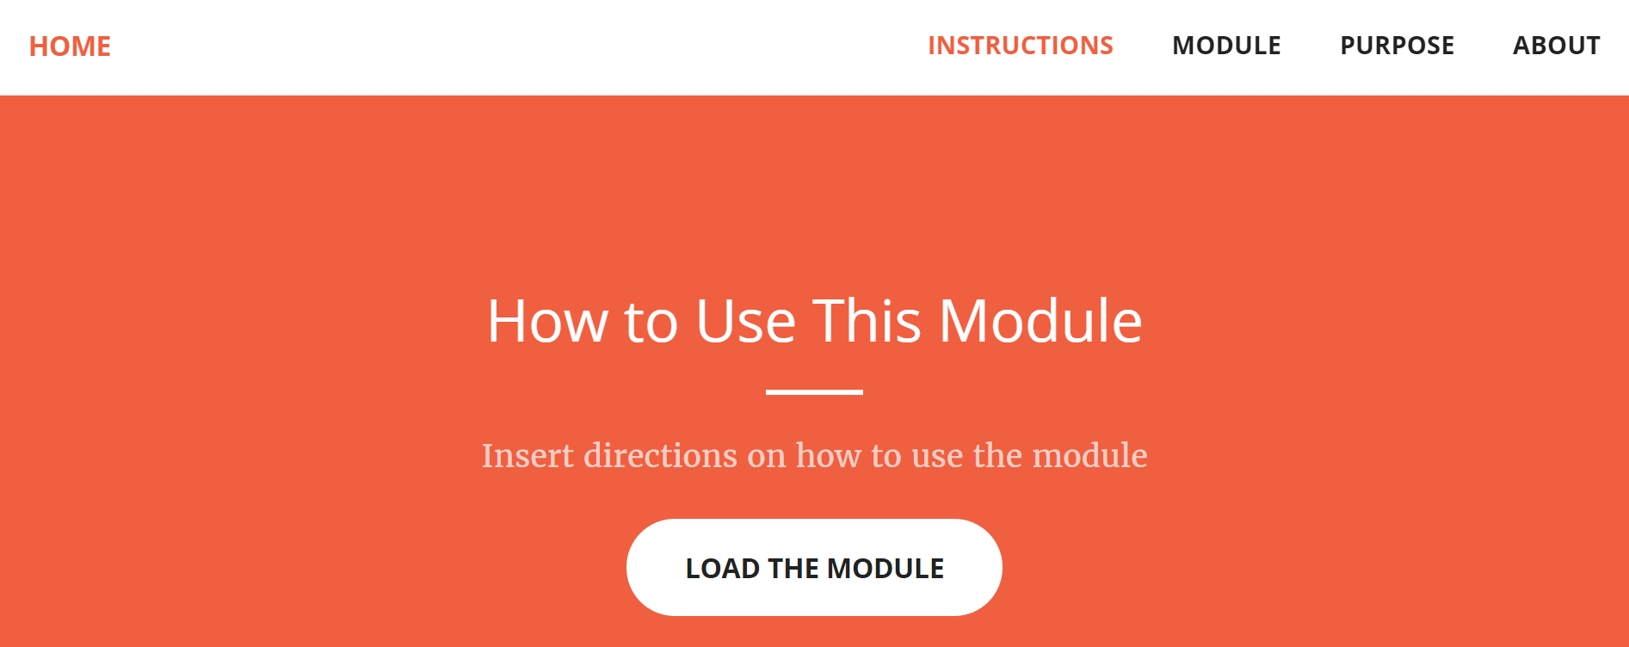
Responsibility #2: Screenshot, Instructions Page

Slide 11
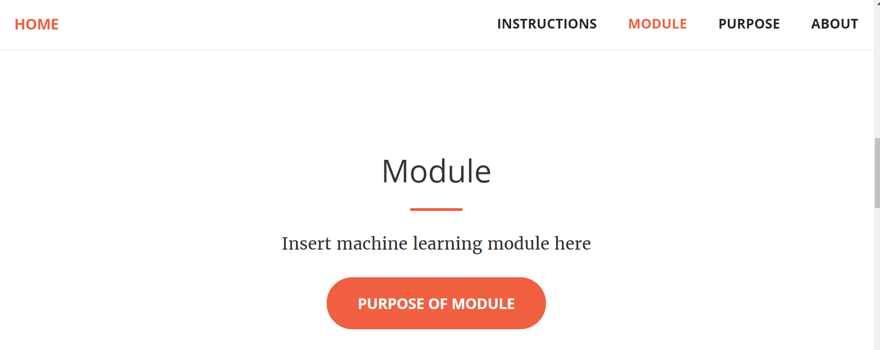
Responsibility #2: Screenshot, Module Page

Slide 12
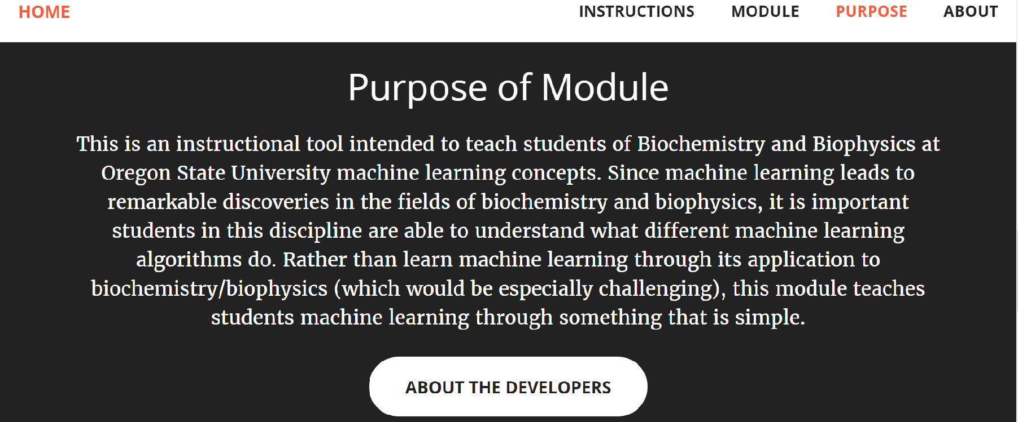
Responsibility #2: Screenshot, Purpose Page

Slide 13
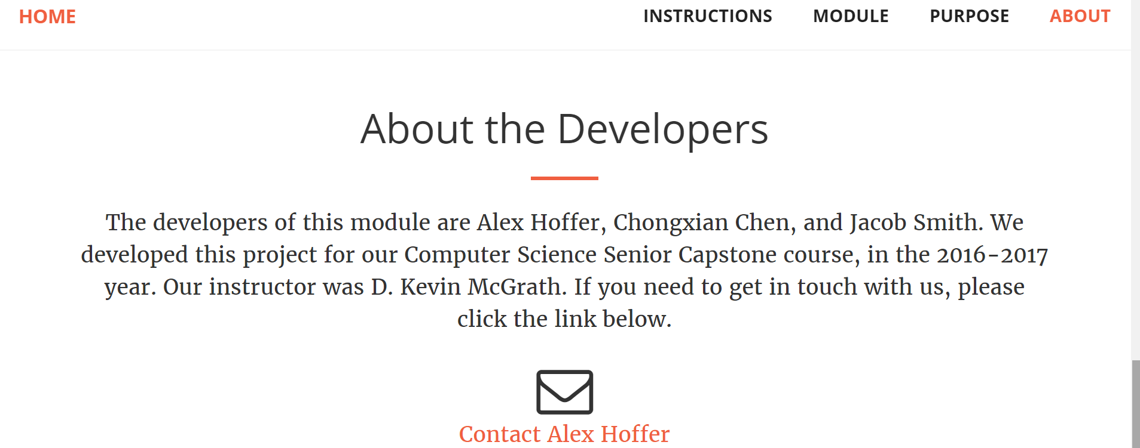
Responsibility #2: Screenshot, About Page

Slide 14
Responsibility #2: Demonstration
The screenshots of this Responsibility do it a lot of justice, but we can do a quick demonstration of what the subcomponents look like and how we get from one to the other using the buttons.
http://web.engr.oregonstate.edu/~hoffera/CapstoneProject/MachineLearnYourWayToMarchMadnessGlory.html

Slide 15
End of Winter Term and Abroad: What Alex needs to do to complete this project + course
Fulfill responsibility #3
Description of responsibility #3: Given a machine learned bracket of Chongxian’s creation, format it to look nice
Help develop poster
Present poster at Spring Expo

Slide 16
Responsibility #4
Getting the data:
For getting the data I actually didn’t use any of the statistics websites I mentioned in the tech review. I ended up finding the data on a website called Kaggle.com, it is a data science website with a wide variety of stats.
This website only had data leading up to this season so I had to manually pull most of the data for this season and any additional stat metrics I or George wanted to have.

Slide 17
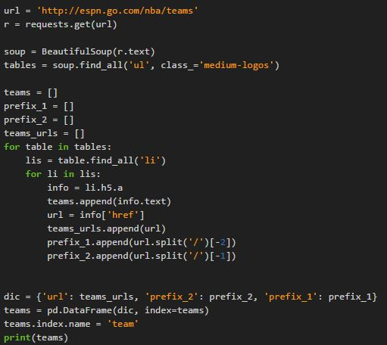
Responsibility #4
For getting this years data I started out writing a python script to grab the stats for me, here is a screen shot of part of it.
This part of the script just gets the teams and the url of where the data is. This is testing it on NBA data cause there are less teams.

Slide 18
Responsibility #5
Storing the data:
For this I am still planning on using phpmyadmin to store the data and attach it to the website.
I have not started adding the data to the database yet, all the data is just in excel or CSV files as of now. But it wont tale long to add the data because its already in a compatible format for transfer.
The database is mainly for the website module so it will most likely be done before the beta release.

